Slide 1
Johnson County Public Health
Naloxone vending machines and Opioid Settlement Funds
ISAC Webinar 2026

Slide 2
Background
Johnson County is receiving funds from the national opioid litigation settlements
To date, the County has received approximately $2.5 million, with an estimated total of just over $6 million by 2038
Payments began in 2022 and will continue annually through 2038
Funds are restricted to opioid-related expenditures under settlement agreements
Settlement funds represent both an opportunity to stabilize existing services and invest in new strategies

Slide 3
Settlement Framework
At least 75% of funds must support
Core Strategies (Schedule A)
  MAT, naloxone, recovery services, warm handoffs, prevention
Up to 25% may support
Other Approved Uses (Schedule B)
  Planning, data collection, training, harm reduction, research
Up to 2.5% of expenses may be used for administration, but must be tied to opioid-related activities
Funds must be used for opioid-related expenses only
Not permitted for general County overhead or unrelated expenses

Slide 4
About our Program: Naloxone Vending Machines
Public health harm reduction initiative providing free, low barrier access to health and safety supplies
Multiple locations to reduce barriers and increase equitable access
Johnson County HHS Building
Iowa City Deadwood
Coralville Public Library
North Liberty Library
VA, Community Family Resource, & Integrated Testing Services (ITS) partnership
Gun locks, sexual health supplies, ‘prescription drug destroyer’
Ongoing tracking of utilization and communication with partner sites
More information available at: www.jocorecovery.org

Slide 5
Expenses
Costs:
Vending machines and distribution boxes: $29,419.00
Decals & brochures: $1,159.90
Naloxone: $28,512.00
Total spent: $59,090.00

Slide 6
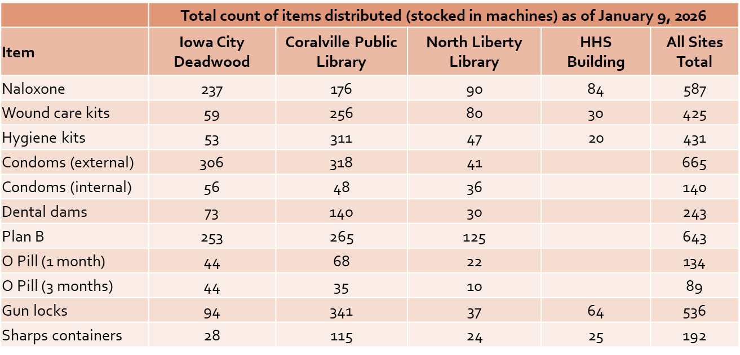
Results
4085 total items stocked/distributed through vending machines since installation (August 2025 – January 2026)

Slide 7
Public Health Next Steps
Continue tracking utilization by product and location
Assess restocking frequency and supply needs
Anticipated cost of $93,312 in settlement funds to maintain naloxone supply through FY27 (roughly $7,700 monthly)
Launch a survey with QR code sticker on the machine to elicit community feedback and consider changes to the items currently stocked

Slide 8
Johnson County Next Steps
January 2026 – provided update to the Board of Supervisors and tentatively requested $125,000.00 to continue purchase of naloxone and determine additional vending machine
April 2026 – Johnson County Board of Supervisors voted unanimously to sign the “Six Remnant Defendants” opioid settlement agreement
April – May – Johnson County Grants team released application for FY27 funding - https://johnsoncountyiowa.gov/opioid-community-grants
July 2026 – continue vending machine project and identification of next location

Slide 9
Recommendations to the Board of Supervisors
These recommendations were provided to the Board of Supervisors January 2026 to guide spending:
Offset Existing Costs (50%)
Continue support for core services already funded by the County
e.g., Guidelink, ambulance, CFR
Enhancing & Expanding Existing Programs (30%)
Build upon existing services with expanded access and additional supports
Consider an RFP process to bring in proposals from JC departments & community partners
New Initiatives (20%)
Reserve funds for emerging needs and innovative projects
Possible focus areas: education, prevention, pilot programs

Slide 10
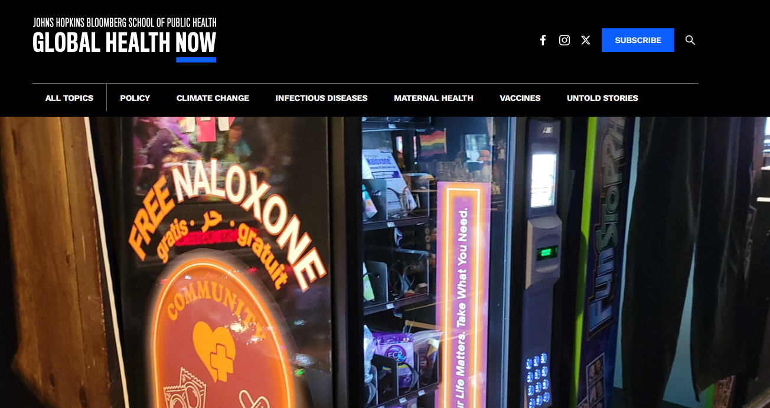
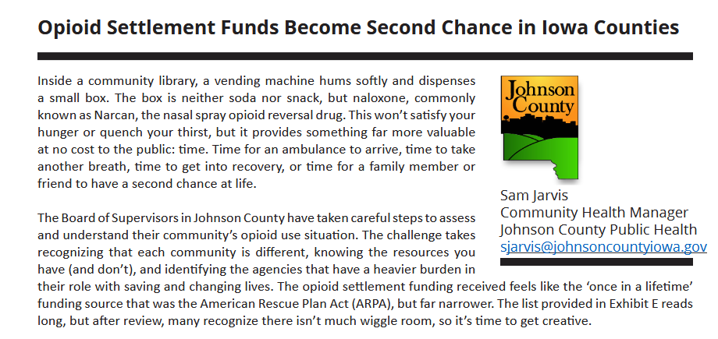
In Case You Missed It
https://www.iowacounties.org/wp-content/uploads/2026/03/IA-CTY_March-2026_PDF.pdf
https://globalhealthnow.org/2025-12/dispensing-free-chances-life-public-health-vending-machines-are-more-novelty

Slide 11
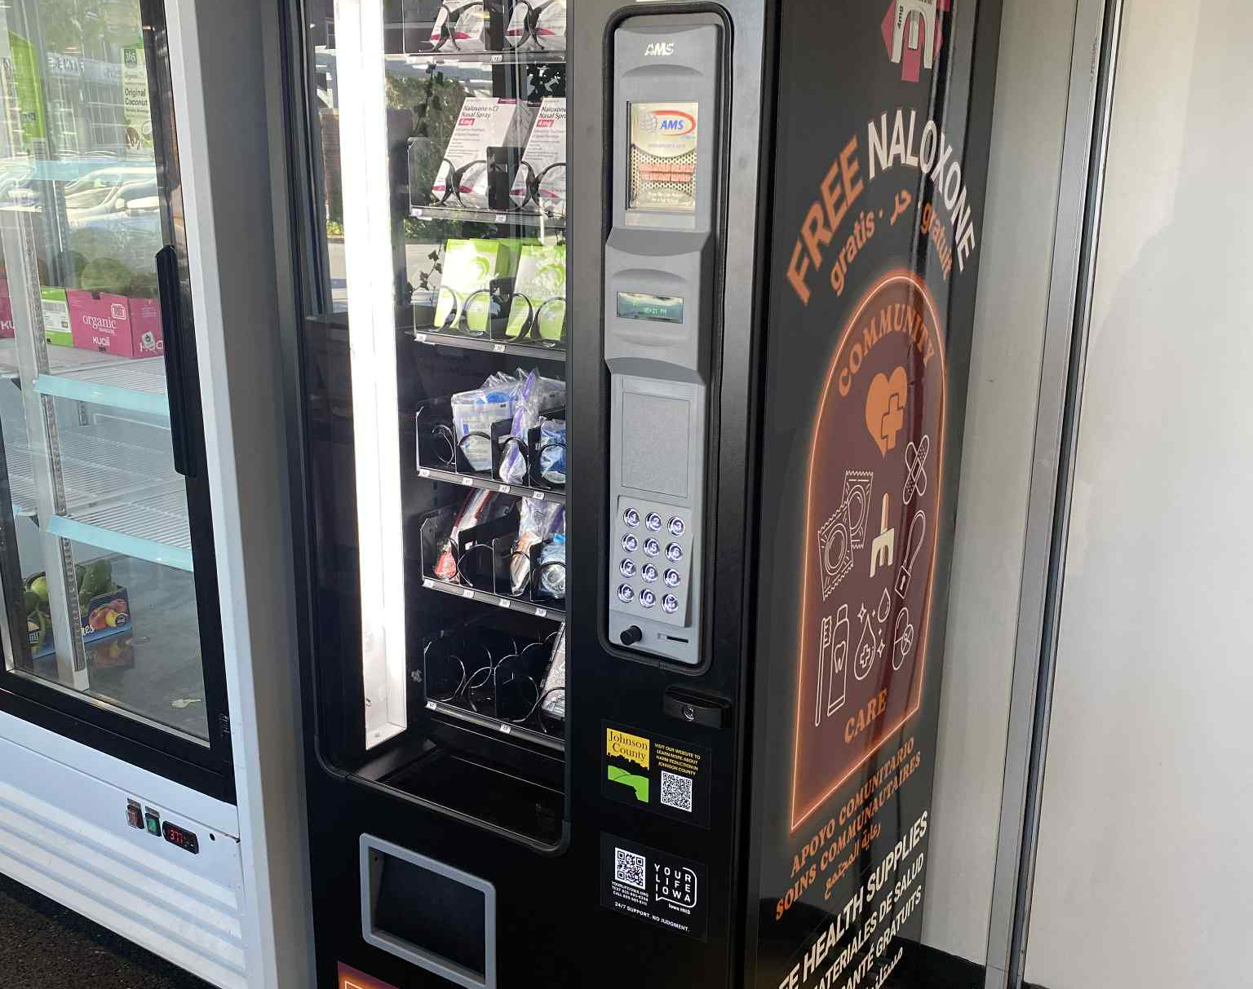
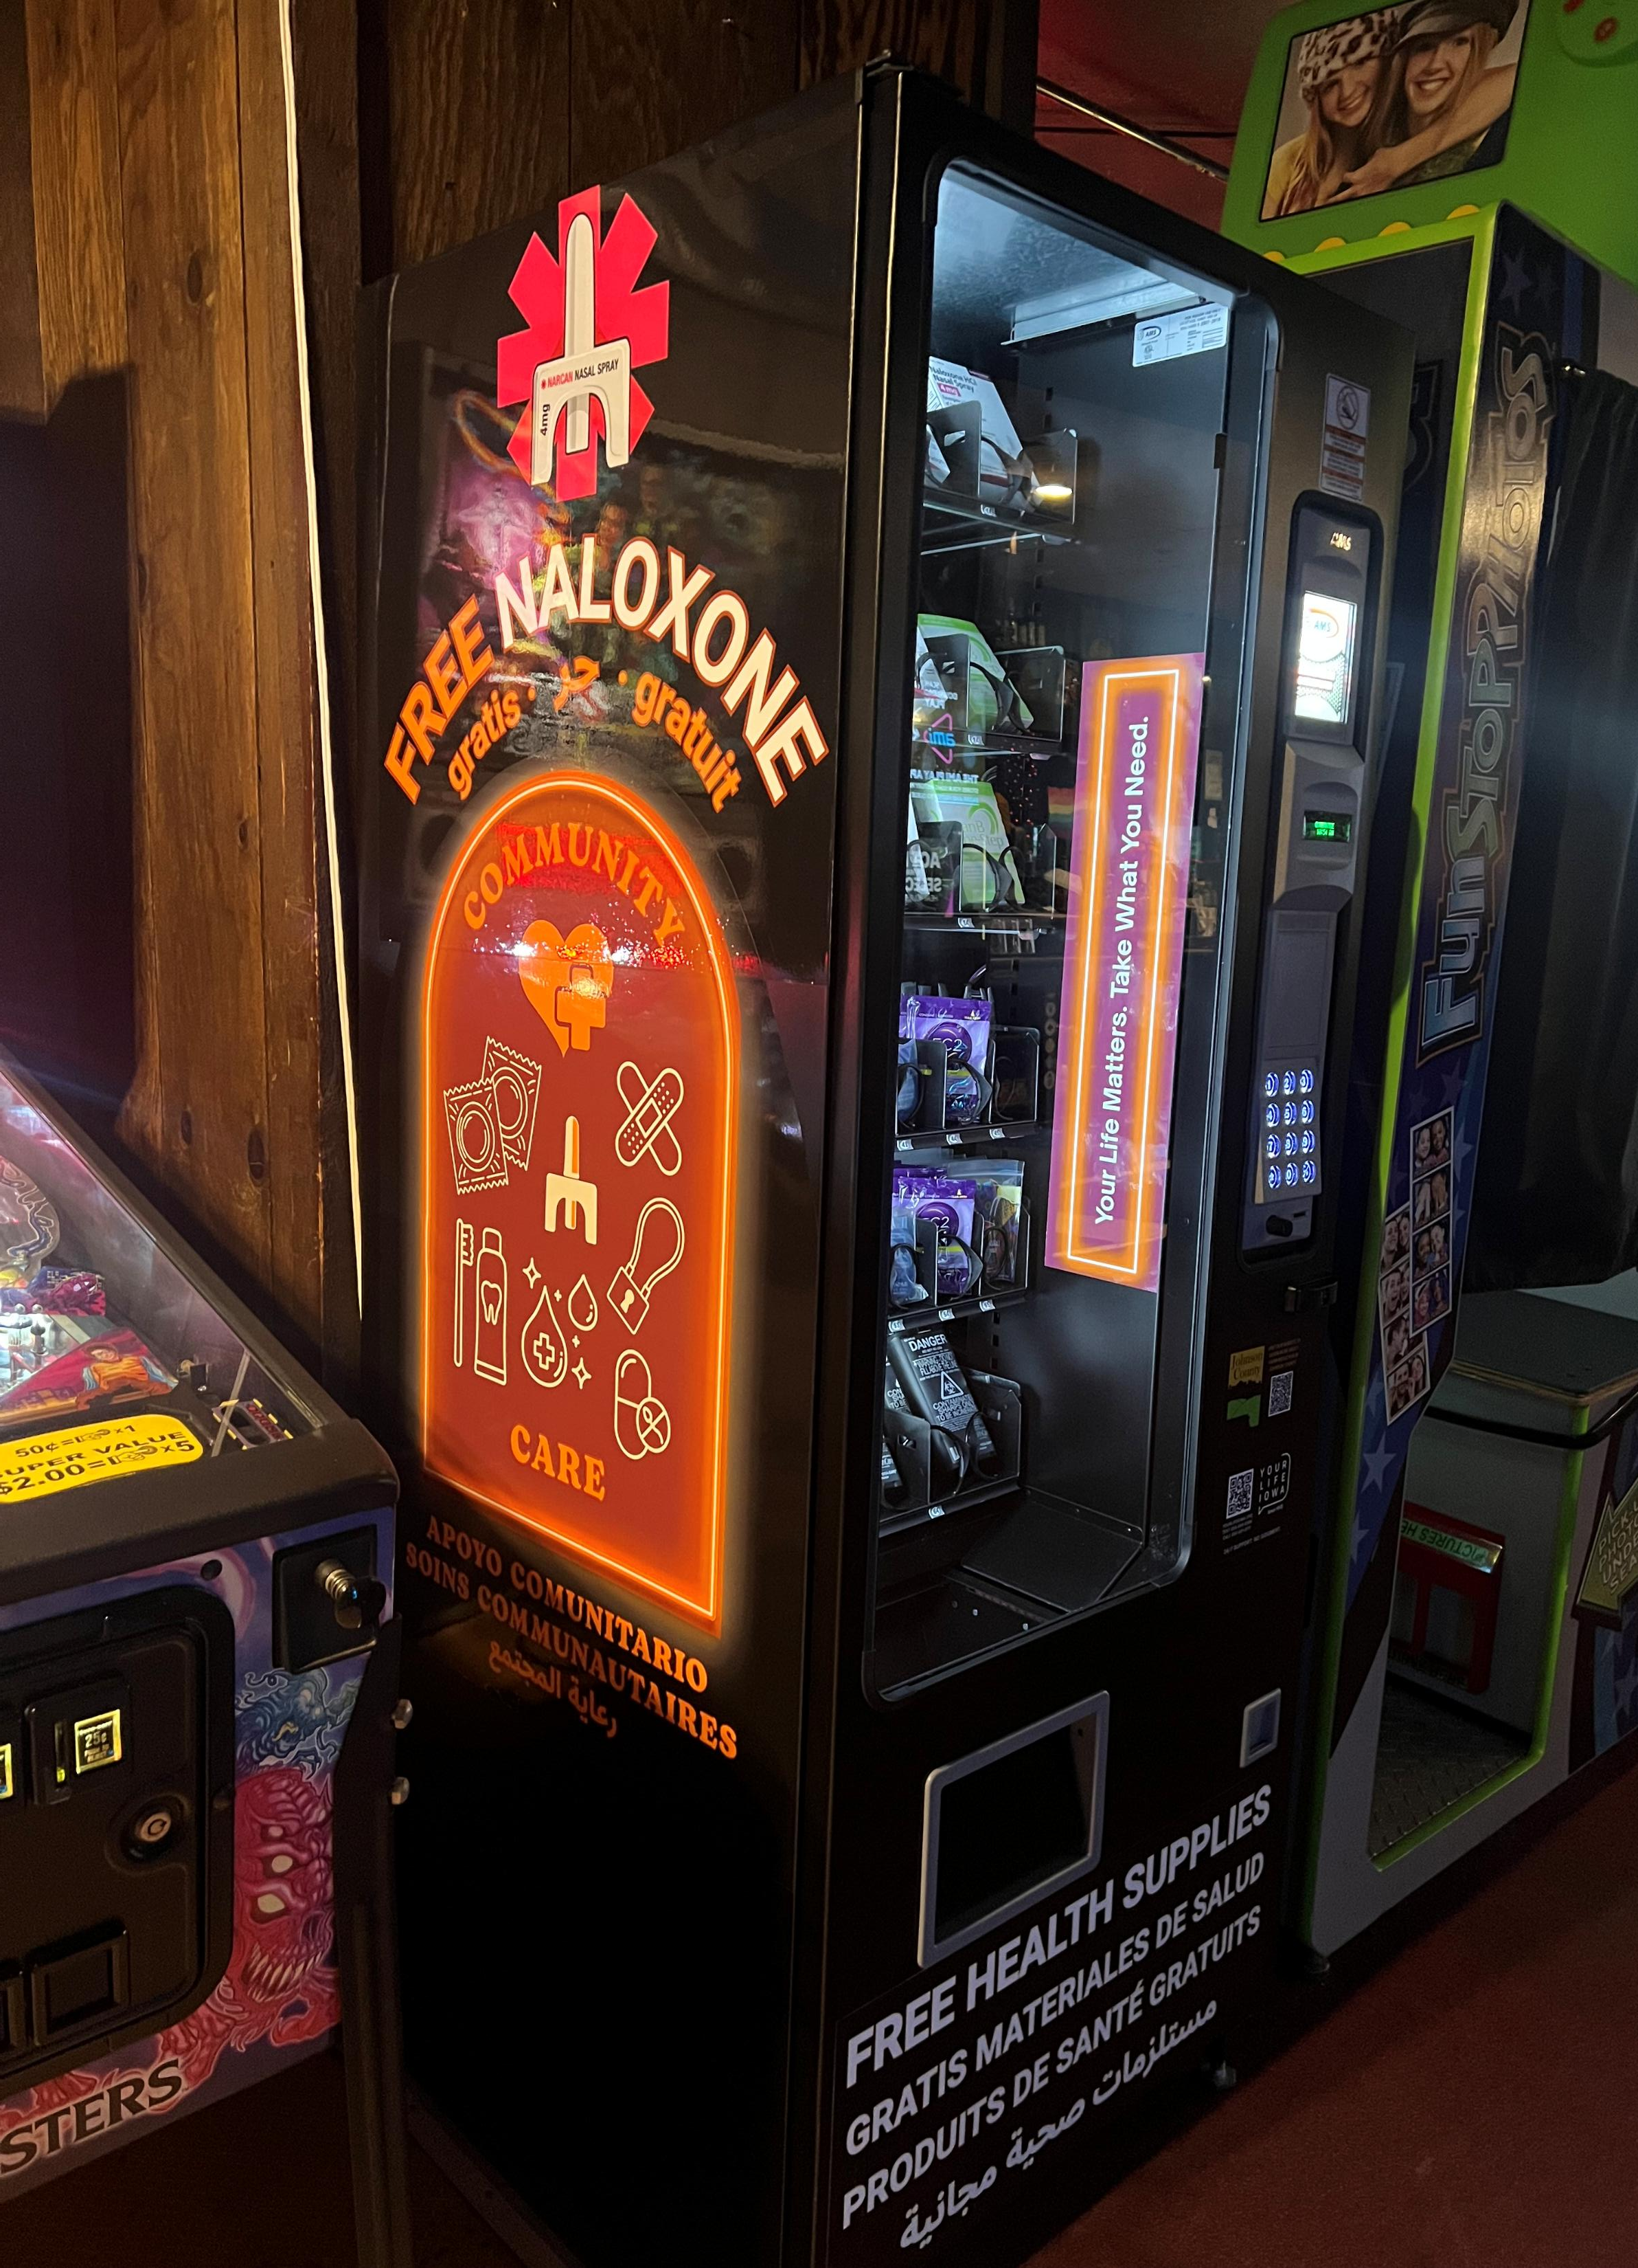
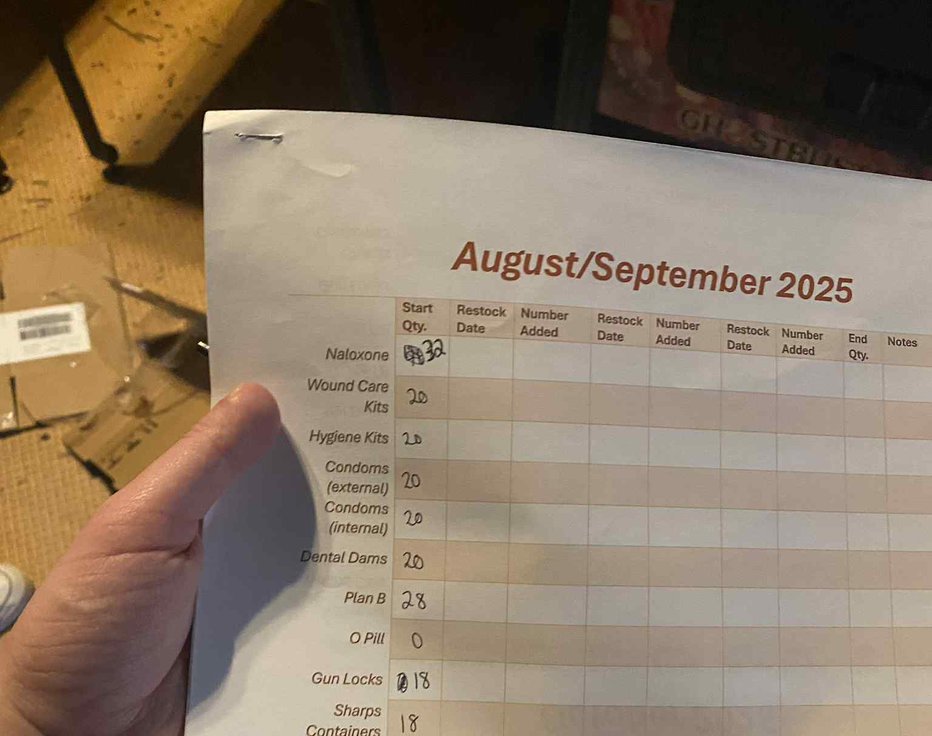
Vending Machine Installation
Four (4) sites across Johnson County
Tracking logs

Slide 12
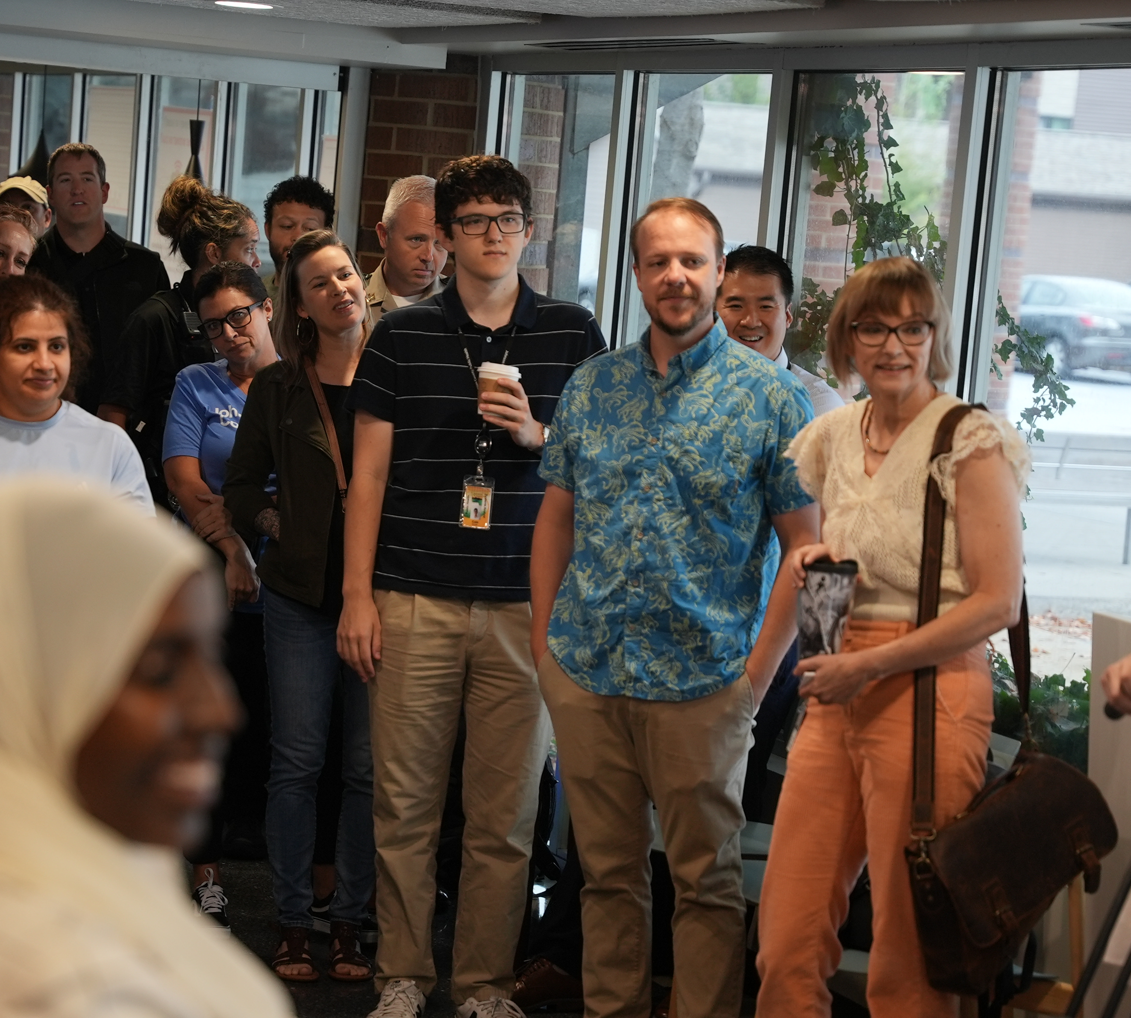
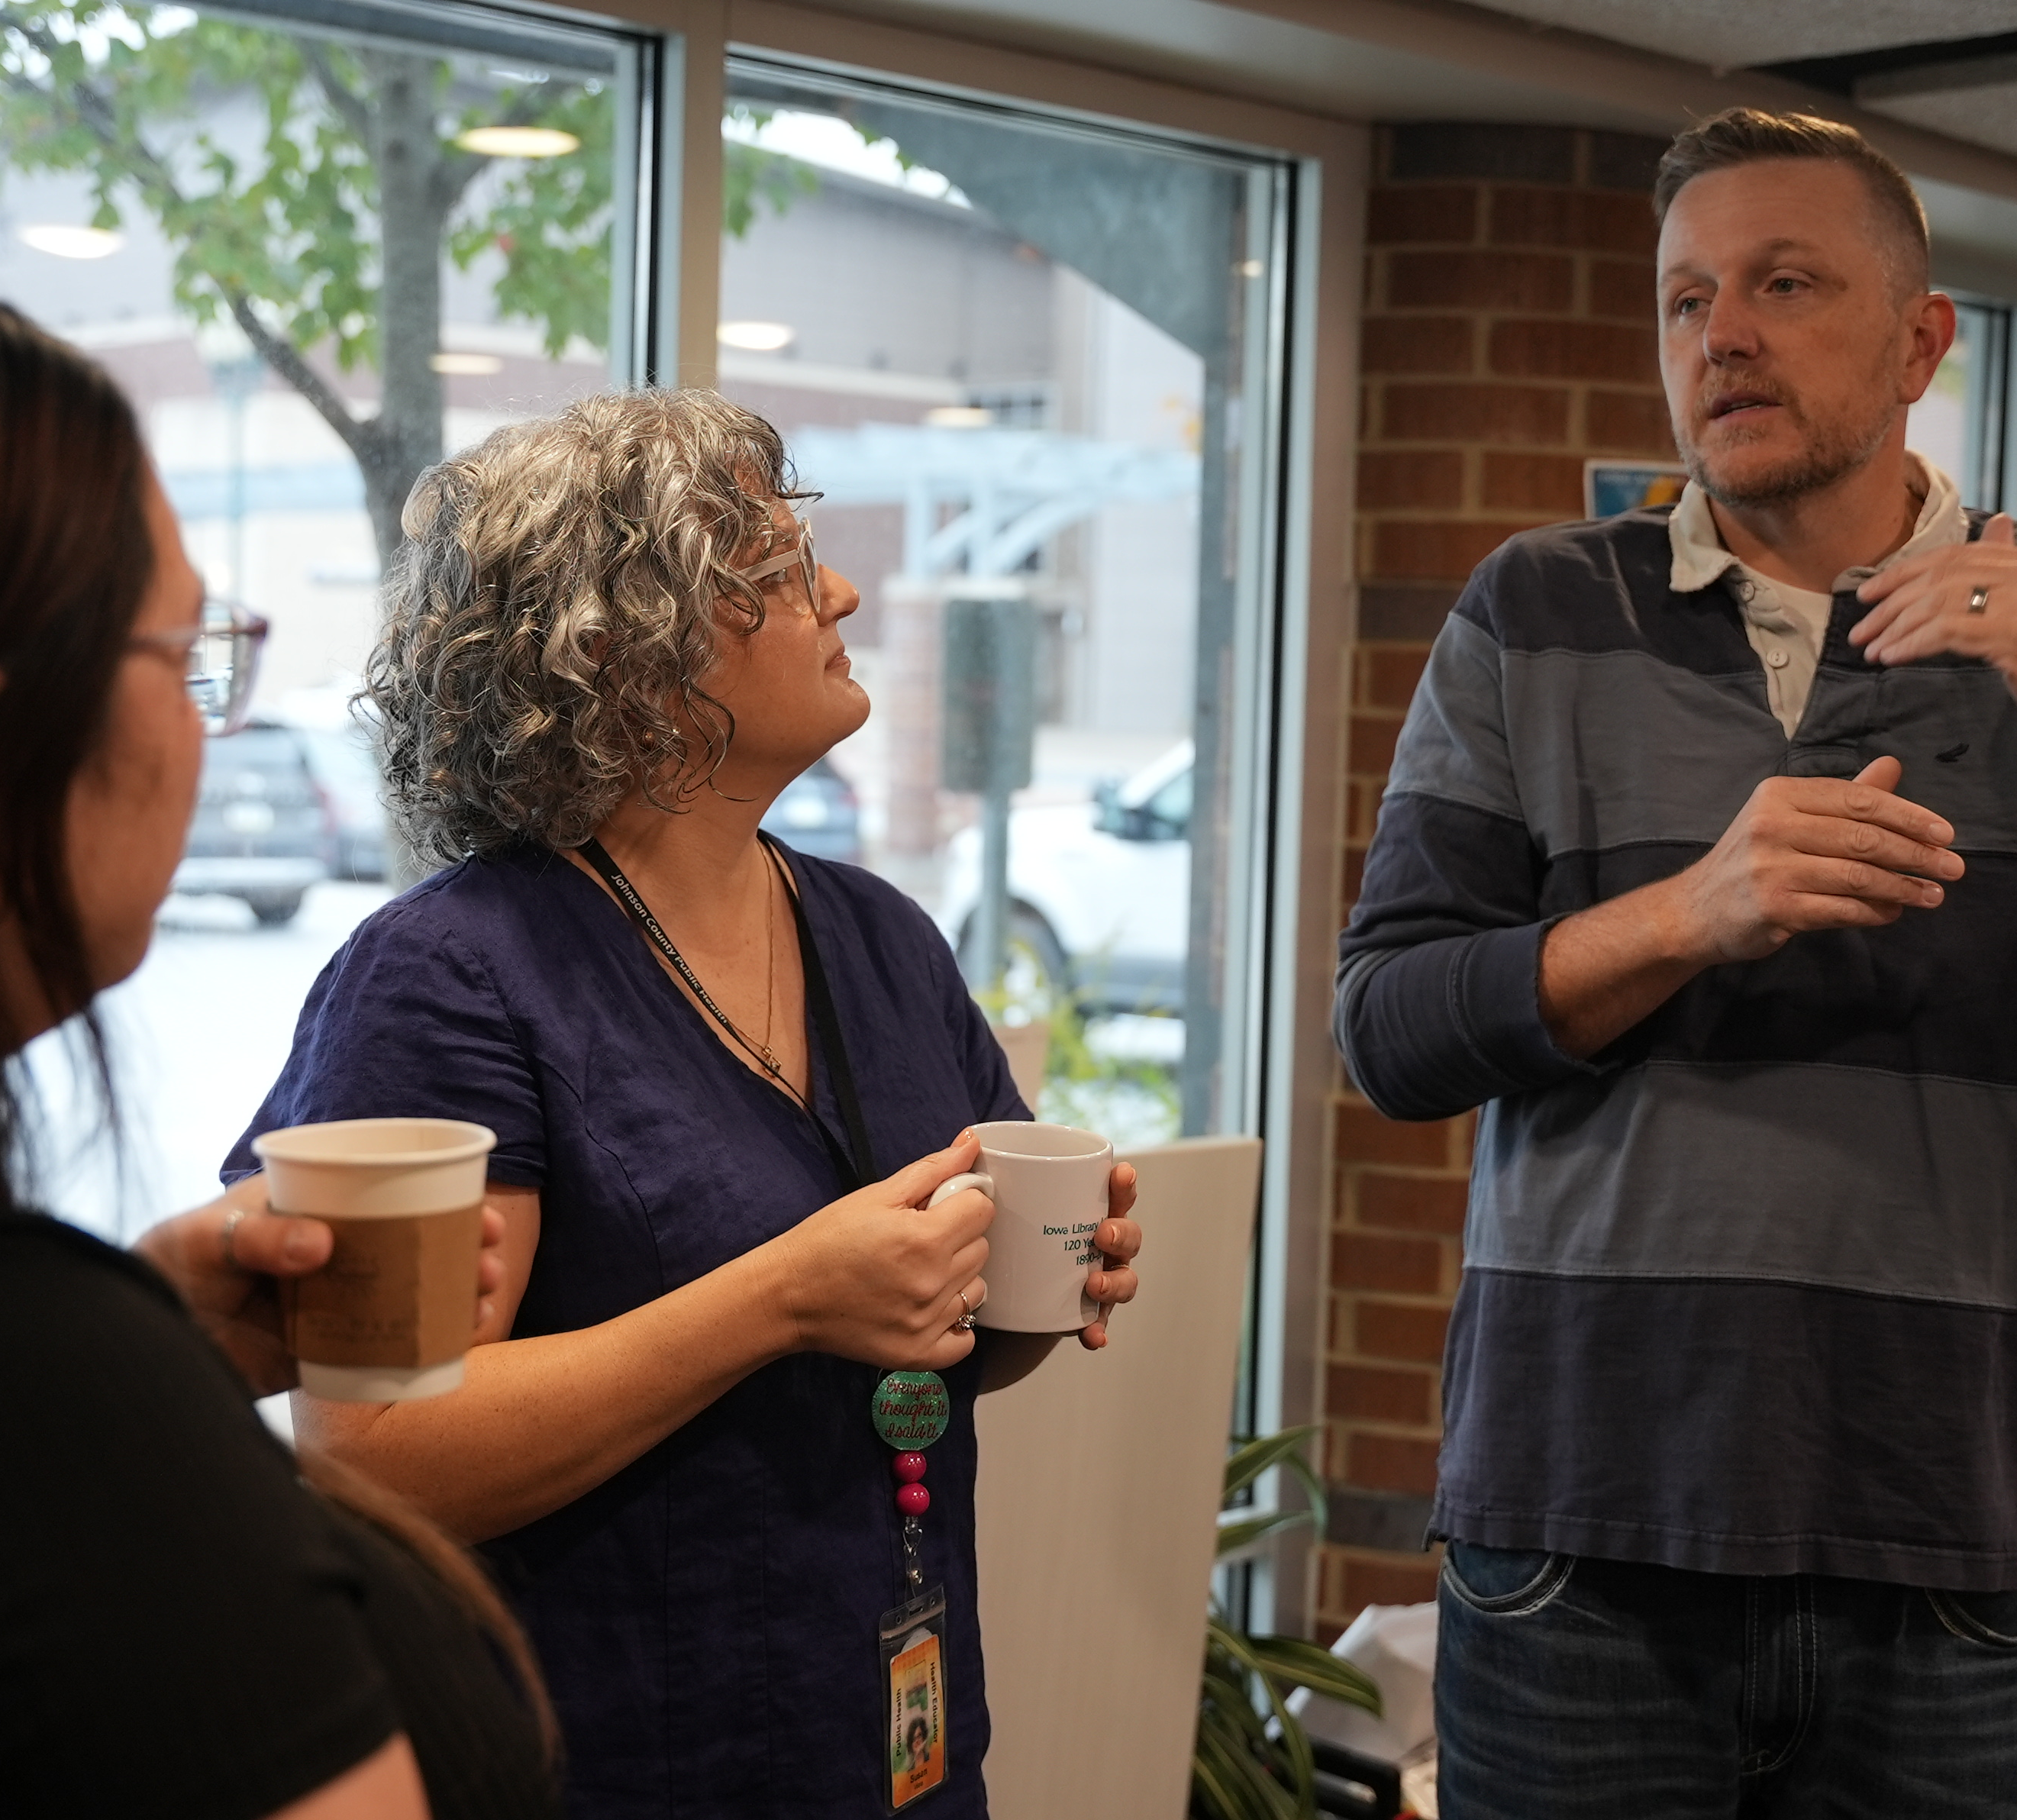
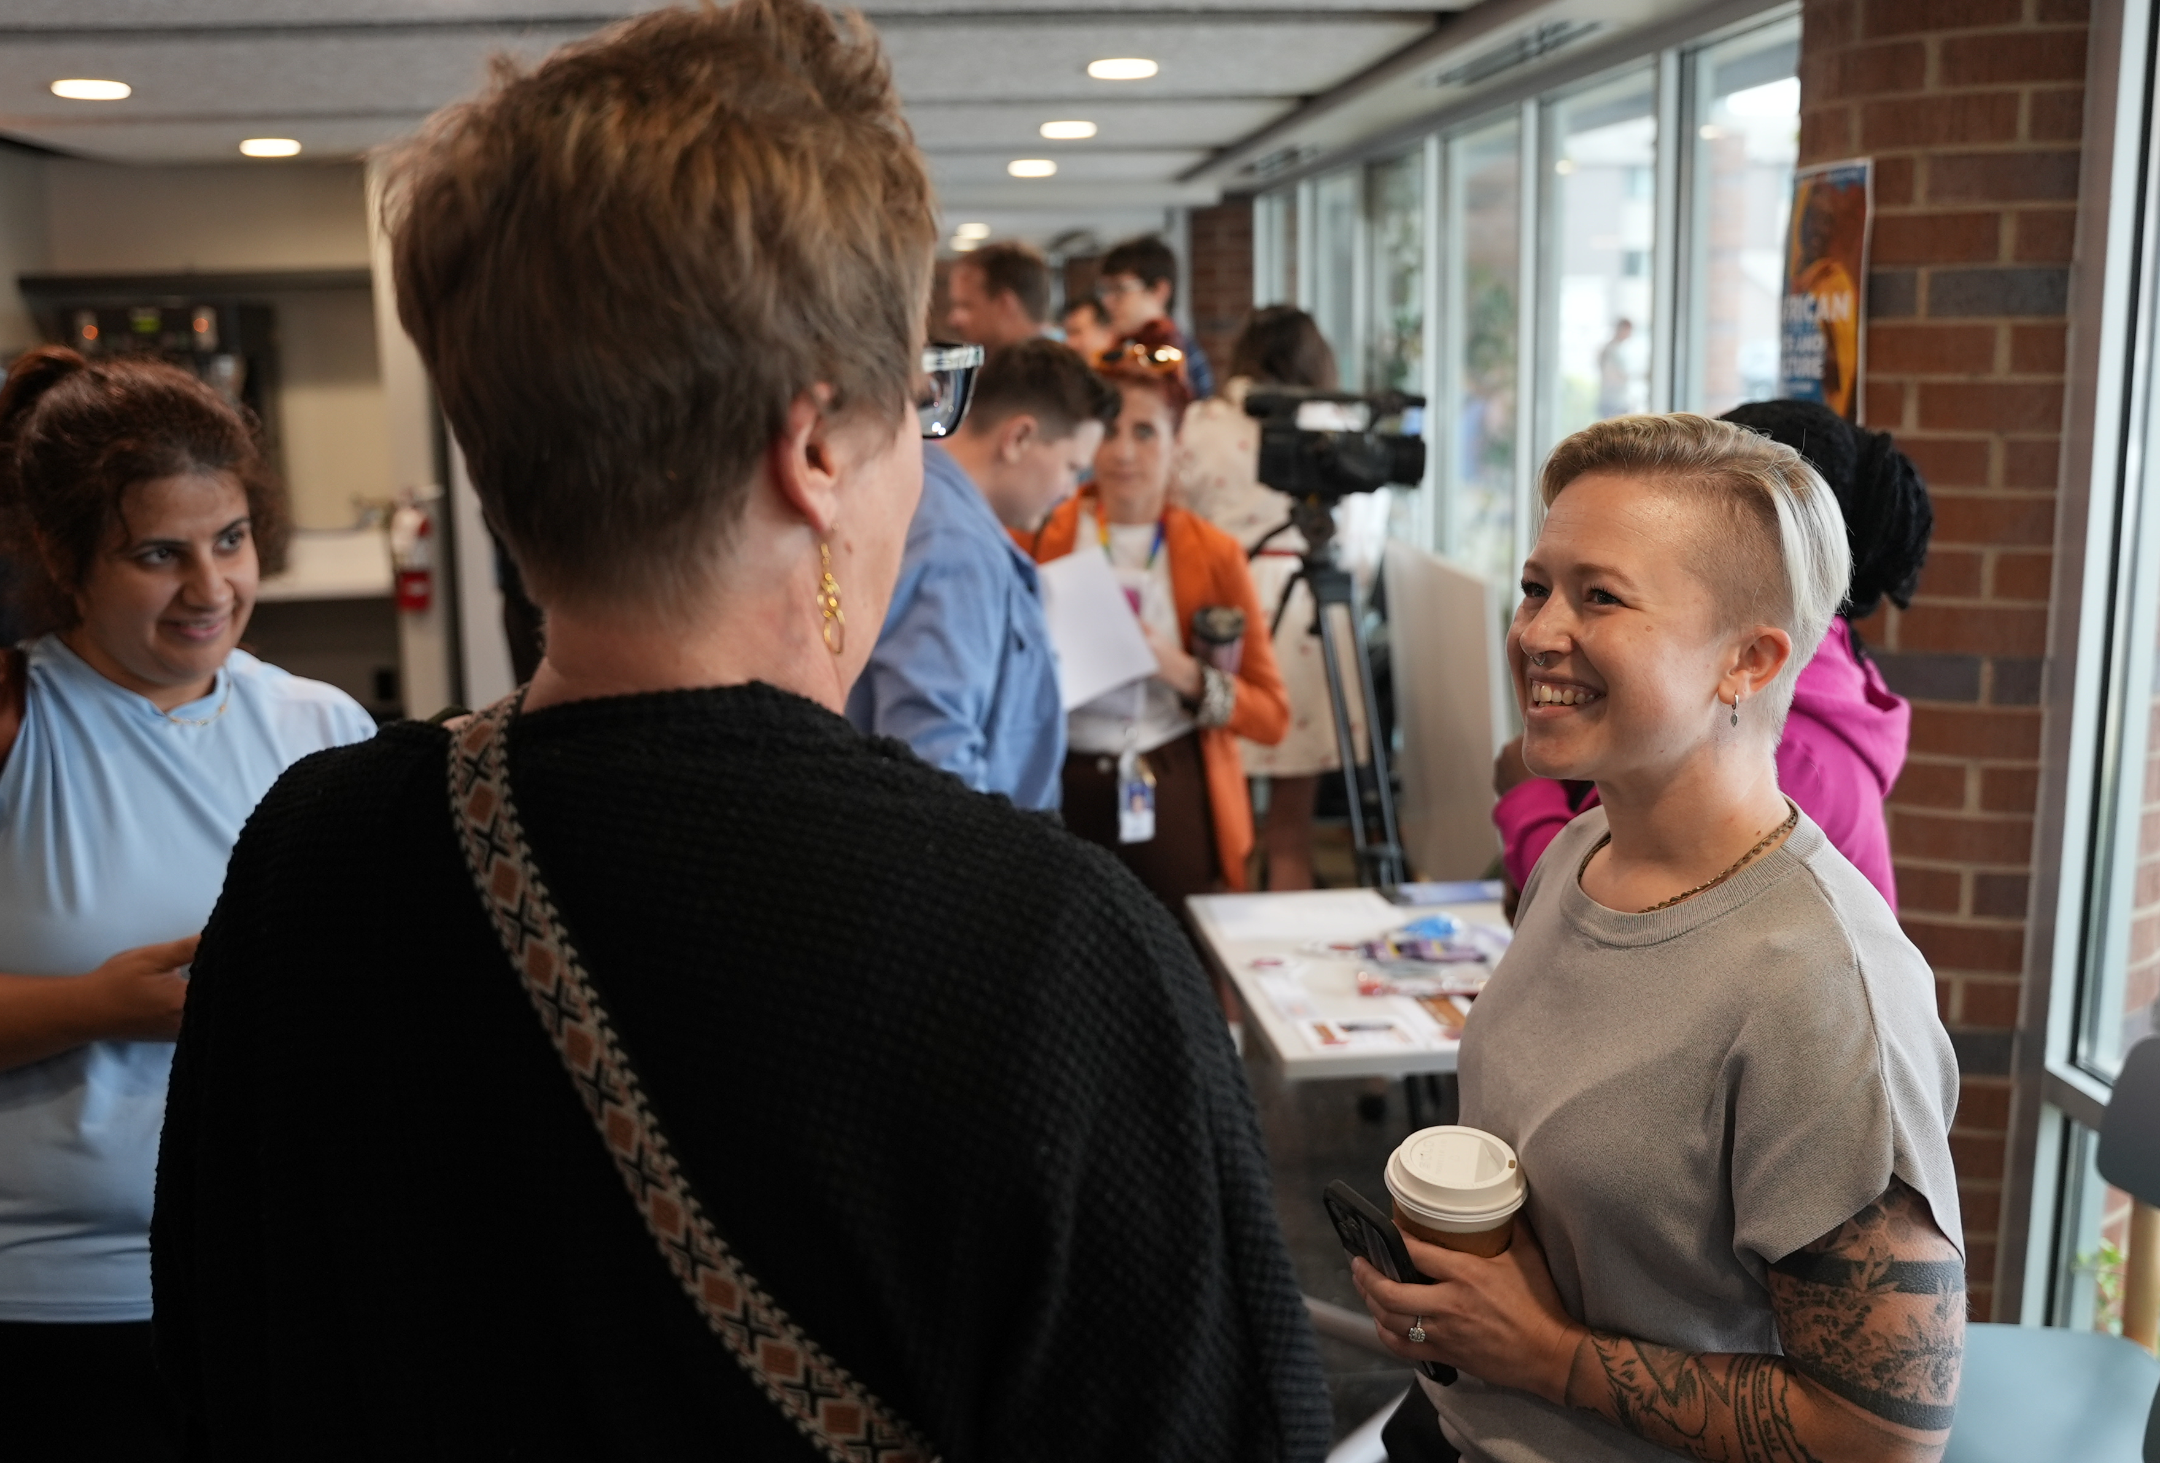
Kick Off Event
Bring on the ‘fanfare’!
Community partners, agencies, and medical providers
Reduce stigma and highlight the work

