Slide 1
Ethics for Public Officials
Iowa Ethics and Campaign Disclosure Board
An Independent Agency of the Executive Branch
Erika Eckley, Executive Director and Legal Counsel

Slide 2
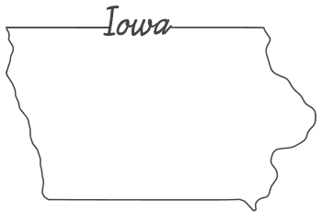

ABOUT US
Established in 1973, reorganized in 1993
6 Board members, appointed by the governor (confirmed by the state Senate) to serve staggered 6-year terms
  The Board must be balanced by political party and gender.*
  The Board meets in person 3-4 times per year as needed and virtually.
The Board employs an executive director, deputy director, exectuive secretary, and 4 auditors.

Slide 3
OUR MISSION
The mission of the Iowa Ethics and Campaign Disclosure Board is to promote the public’s trust and confidence in government by ensuring the integrity of political campaigns, the ethical standards for officials and employees of the executive branch of state government, and the lawful conduct of executive branch lobbyists.
The Board enforces the statutes and rules under its jurisdiction, guided by the principles of fairness and consistency. This enforcement should not discourage individuals from being involved in the political process or state government. At all times the Board will seek to educate those individuals and entities that come under its jurisdiction concerning the requirements of Iowa law and will continue to embrace technological changes to better serve the public.
In order to accomplish its Mission, the Board will enforce the provisions of the “Campaign Disclosure Act” in Iowa Code chapter 68A, the “Government Ethics and Lobbying Act” in Iowa Code Chapter 68B, the reporting of gifts and bequests received by agencies under Iowa Code section 8.7, and the Boards administrative rules in Chapter 351 of the Iowa Administrative Code.

Slide 4
OUR JURISDICTION
Campaign Disclosure
Gov. Ethics & Lobbying
Gifts/Bequests
Iowa Code ch. 68A
Campaign finance laws for candidates and other organizations engaging in advocacy
Iowa Code ch. 68B
Ethics standards for executive branch of state government
Lawful conduct of executive branch lobbyists
Iowa Code § 8.7
Reporting of gifts and bequests to the state
Notes:
The Board enforces the statutes and rules under its jurisdiction, guided by the principles of fairness and consistency. This enforcement should not discourage individuals from being involved in the political process or state government. At all times the Board will seek to educate those individuals and entities that come under its jurisdiction concerning the requirements of Iowa law and will continue to embrace technological changes to better serve the public.
In order to accomplish its Mission, the Board will enforce the provisions of the "Campaign Disclosure Act" in Iowa Code chapter 68A, the "Government Ethics and Lobbying Act" in Iowa Code chapter 68B, the reporting of gifts and bequests received by agencies under Iowa Code section 8.7, and the Board's administrative rules in Chapter 351 of the Iowa Administrative Code.

Slide 5
OUR ACTIVITIES
Providing legal information and offering guidance
      We receive inquiries from the general public and campaigns.
      Staff can offer assistance to ensure compliance.
Investigating complaints and providing eventual enforcement
Drafting advisory opinions for clarity
Auditing campaign finance reports
Auditing ethics reports (including dual-compensation, gifts, personal financial disclosures, etc.)
Educating organizations throughout the state on ethics/campaign laws and updates
Notes:
Iowa Admin. Code r. 351—9.4(68B)

Slide 6
FORMAL COMPLAINT ORDER OF OPERATIONS
Complaint
Investigation
Board Action
A person may submit a complaint or the Board may initiate a complaint on its own.
Staff reviews available information and may subpoena before making recommendation to Board.
Dismissal
Contested Case
  Discipline
Administrative
  Reprimand
  Civil penalty
Notes:
We will reverse the agency's factual findings only if they are not supported by substantial evidence when the record is viewed as a whole. Coffey v. Mid Seven Transp. Co., 831 N.W.2d 81, 89 (Iowa 2013). "Evidence is substantial if a reasonable mind would find it adequate to reach the same conclusion." 2800 Corp. v. Fernandez, 528 N.W.2d 124, 126 (Iowa 1995). "`Substantial evidence' need not be a preponderance, but a mere scintilla will not suffice." Elliot v. Iowa Dep't of Transp., 377 N.W.2d 250, 256 (Iowa Ct. App. 1985).

Slide 7
BOARD ACTION: INFORMAL RESOLUTIONS
Administrative resolution
  The Board may order remedial action (e.g., newspaper ad for lack of attribution statement)
  A letter of reprimand
Admonishment
Civil penalty for violation
  Not to exceed $500
  Penalties apply for late disclosure filings, but may be
  ordered for other situations
Settlement
  Before or after contested case proceeding started
Notes:
Iowa Admin. Code r. 351—9.4(68B)

Slide 8

GOVERNMENT ETHICS
Iowa Code Chapter 68B

Slide 9
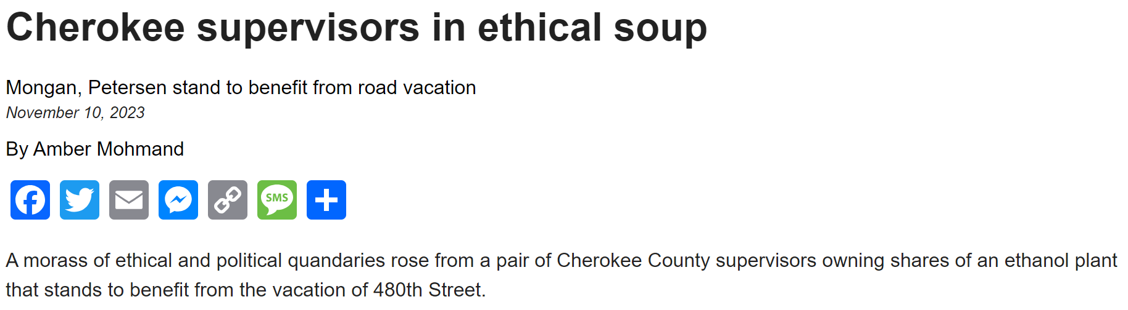
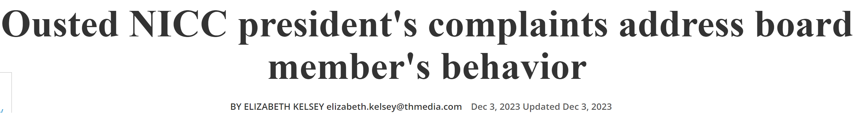
ENFORCEMENT AT THE LOCAL LEVEL
Local governments are not within 68B jurisdiction, but staff can offer advice.
Allegations of ethics violations are filed with the appropriate county attorney.
The Board often publishes advisory opinions to provide clarity (on our website starting in 2000).
The Board can also enter enforcement agreements with political subdivisions.
Notes:
§ 68B.24A

Slide 10
68B: CONFLICTS OF INTEREST
A conflict between public obligations and private interests of a public official.
68B covers both actual and potential conflicts.
Violations are serious misdemeanors.
Prohibited conflicts include:
  1. Outside employment
  Using public time, facilities, equipment, and supplies
  Using badge, uniform, business card, etc.
2. Receiving money in exchange for performing public work duties
3. Employment in an area under the regulatory control of the public employment position
Notes:
a situation that can undermine a person due to self interest and public interest.
68B.2A
The trust issue applies to potential conflicts of interest as much as actual

Slide 11
CONFLICTS OF INTEREST: REMEDIES
Using public time/resources for an advantage or benefit not available to members of the public:
      No Remedy- STOP IMMEDIATELY
Compensation from an outside source for performing an official act:
No Remedy- STOP IMMEDIATELY
Notes:
a situation that can undermine a person due to self interest and public interest.
68B.2A
The trust issue applies to potential conflicts of interest as much as actual

Slide 12
CONFLICTS OF INTEREST: REMEDIES
Involvement in outside employment/activities that is subject to control by the government body
Remedy #1: STOP IMMEDIATELY
Remedy #2: Publicly disclose the conflict and refrain from taking any official action that would affect the outside employment/activity:
          Any vote
          Granting license/permit
          Determining the facts/law in a contested case
          Conducting any inspection
          Providing any other official service/thing that is not available generally to members
          of the public in order to further the interests of the outside employment/activity
Notes:
a situation that can undermine a person due to self interest and public interest.
68B.2A
The trust issue applies to potential conflicts of interest as much as actual

Slide 13
“Statutory conflict-of interest provisions reveal legislative intent to engender public confidence in the operation of government. The principle underlying this policy is that a government employee or official cannot serve two masters at the same time, and public interest should not be entrusted to an official with interests in conflict with the public interest.”
T & K Roofing Co. v. Iowa Dep’t of Educ., 593 N.W.2d 159, 163 (Iowa 1999) (intental citations omitted).
Notes:
68B.2A
First two are the clear problems. There’s no gray area. That’s prohibited.

Slide 14
EXAMPLE 1
The Board of Supervisors plans to vote on an urban renewal plan. Supervisor Bob works for a company that owns real estate in the area subject to the renewal plan. Should Bob vote on the plan?
No, he has a conflict of interest
Yes, this does not cause a conflict of interest because there’s no direct financial interest
Yes, if he discloses the potential conflict of interest

Slide 15
EXAMPLE 1
Answer: A
No. He cannot participate due to the conflict of interest.
Wilson v. Iowa City, 165 N.W.2d 813, 823 (Iowa 1969)
Official action would create financial benefit not available generally to members of the public in order to further the interests of the outside employment/activity
Bob should disclose the conflict of interest and avoid participating in any discussion on the subject at the meeting or with any of the council members. If he has any questions, he should reach out to the city’s attorney or the Ethics Board for advice.

Slide 16
EXAMPLE 2
Fire Inspector Fred works for the City Fire Department. Fred wants to invest in rental properties. The buildings he plans to rent out all require inspections to make sure they comply with the city’s fire code. May Fred proceed with his side rental business?
No, because inspecting his own properties presents a conflict of interest.
No, because he works for the City.
Yes, because he needs a side hustle.
Yes, as long as he has no involvement in inspections of his own properties.

Slide 17
EXAMPLE 2
Answer: D
There would clearly be a conflict of interest because ownership of the rental properties would be in an area under the regulatory control of the public employment position. He can address the conflict of interest by ensuring other inspectors conduct the inspections. He must also ensure he does use his position as an employee to impact the outcome of the inspections.

Slide 18
STATE REGULATORY AGENCIES
An official or employee of a regulatory agency may not sell or lease any goods, real estate, or services to anyone subject to the regulatory authority of the agency
Except with consent of the agency; the employee must request consent in writing, explaining how this sale will not create a conflict.
Some of these approvals are posted on the Ethics Board Web Reporting System
Example: Farmers who also work for the Department of Agriculture
  Part-time farmer/part-time employee of the Department
  of Agriculture wants to sell grain to a company regulated
  by the Department.
  If there is no conflict, the agency can consent to this
  Key: Disclosure and public elimination of appearance of
  conflict.
Notes:
Note applicable to city and county employees, but demonstrates the principle
It’s better if you can publicly dispel any appearance of a conflict.

Slide 19
Foreign Agents
Services Against the State
Public Bidding
State employees shall not engage in any outside employment or activity that requires the person to register under the federal Foreign Agents Registration Act of 1938.
No state employee may receive compensation to render services against the interest of the state.
State employees may not make sales to the state except after public notice and competitive bidding.

Slide 20
CITY CONTRACTING & LOCAL RULES
Local rules may be more stringent than Iowa Code.
Iowa Code § 362.5 prohibits city officers from having a direct or indirect interest in a city contract.
  Basic rule: A city official cannot do business with the city.
Some exceptions:
  Contracts entered into through an open competitive bid process
  Contracts for less than $6,000 in a fiscal year

Slide 21
EXAMPLE 3
The city needs groundskeeping work on city property. Members of the city council suggest soliciting bids from companies in the area. The mayor thinks that is far too much hassle and hires her son. The mayor honestly believes her son will do a good job. Does this violate the law?
No.
Yes
Maybe. It depends.

Slide 22
EXAMPLE 3
Answer: C.
This is not a violation of Iowa Code § 68B.3, which applies to state employees and requires a bid for services if $2,000 or more.
Regardless, it may create an appearance of impropriety and will likely generate complaints.
The local government may have a prohibition on nepotism. Depending on the size of the contract, the city may also require a bid.

Slide 23
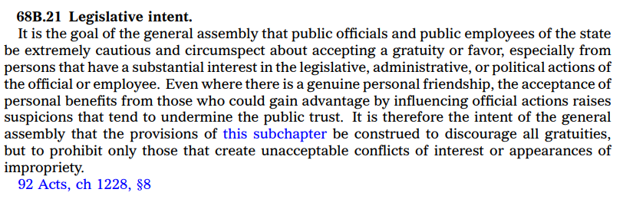
GIFT LAW
BASELINE: A public official, public employee, or that person’s immediate family member may not, directly or indirectly, receive any gift or series of gifts from a restricted donor. A restricted donor shall not, directly or indirectly, offer or make a gift to a public official/employee or candidate.
Importance of the section’s preamble/legislative intent
Notes:
68B.22

Slide 24
RESTRICTED DONOR DEFINITION
“Restricted donor” means someone who is giving a gift and:
Does business or is seeking to do business with a government office
      **And is offering a gift to an employee of that office
Has a substantial financial interest in the performance or nonperformance of a public official’s duty
  **More so than the public generally or an industry generally
Has a matter pending before a regulatory agency
**And is offering a gift to an employee with authority over that matter
Is a lobbyist in the donee’s jurisdiction

Slide 25
ALLOWABLE GIFTS (Exceptions)
Relevant informational materials
Gifts from relatives (who are not agents of restricted donors)
Items available to the general public
Items available to all members of an organization the donee is a member of
Food/lodging for participating in a panel or speaking engagement
Plaques/recognition awards
Items at conferences/seminars of organizations primarily for state or local government officials or employees
Funeral flowers
Wedding or anniversary gifts
Food/lodging for trips to attract new business to the state
Gifts from a foreign national as part of a ceremonial presentation/custom
Notes:
68B.22

Slide 26

HONORARIA NOT ALLOWED
“Honorarium” means anything of value that is accepted or given as consideration for an appearance, speech, or article.
Exceptions (similar to gift rules)
  Limited to cost of food/lodging to participate in a panel or speaking engagement.
  Nonmonetary and donated within 30 days to a public body or charity.
  The payment is related to private business expertise and not related to the public employee’s status as a public employee.

Slide 27
DONATING GIFTS
You can donate a prohibited non-monetary gift within 30 days to:
A public body
Department of Administrative Services
A bona fide educational or charitable organization

Slide 28
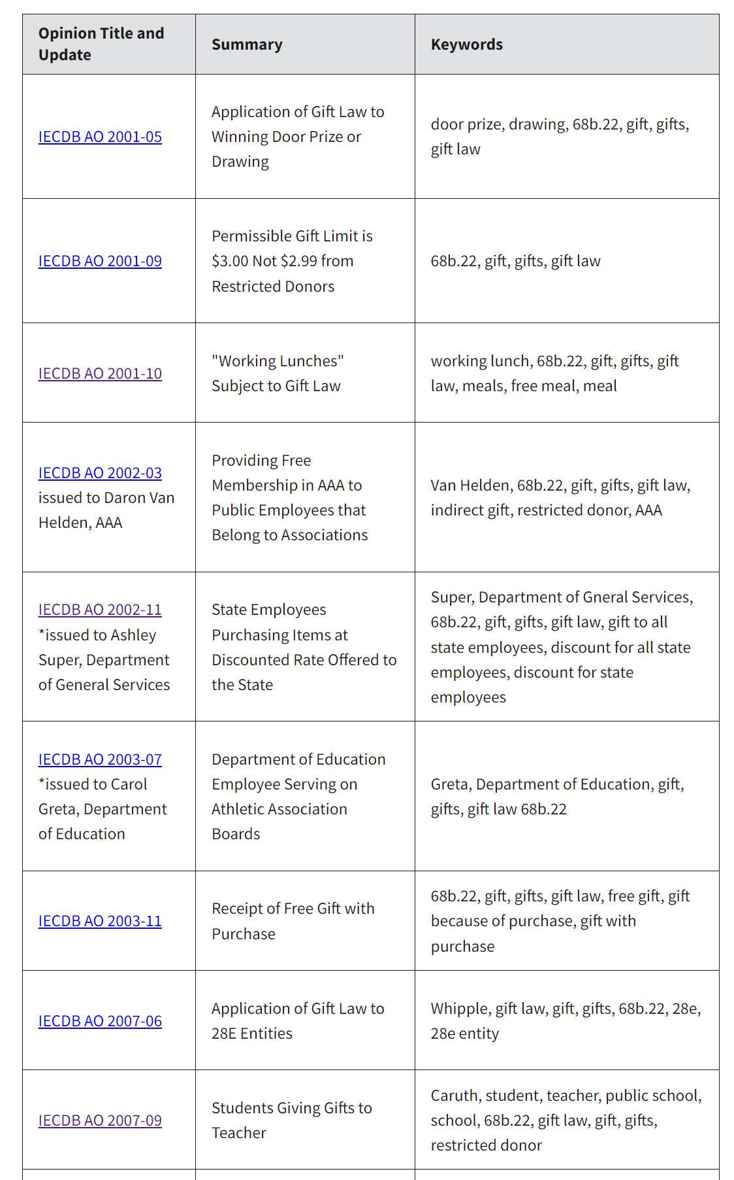
A restricted donor gave me a gift! Now what?
Is it worth $3 or less?
It’s worth $3.01
YES!
  No 68B violation has occurred.
  A public employee may accept a nonmonetary gift, if it is donated within 30 days to a public body or an educational or charitable organization (501(c)(3)).
Notes:
IECDB AO 2001-09
Iowa Code section 68B.22(4)"i" permits the receipt of "items with a value of three dollars or less that are received from any one donor during one calendar day". Thus, a gift from a restricted donor of $3.00 may be accepted without violating the statute.

Slide 29
EXAMPLE 4
A.T. & Love provides landline and mobile telephone services to individuals and organizations. It has recently begun offering free iPhones to city employees who sign up for new personal cell phone lines and agree to listen to a presentation about the benefits of selecting A.T. & Love to provide services for their offices. A.T. & Love does not currently have any contract with the city. The city is not currently soliciting bids for new telephone service providers, but plans to in the future. Is A.T. & Love a restricted donor?
Yes, it stands to gain financial benefit from future sales to the city.
Yes, it is a company.
No, it is not a vendor or a current bidder for a contract with the city.
No, A.T. & Love is only providing phones for employees’
personal use.

Slide 30
EXAMPLE 4
Answer: A.
Not every company is a restricted donor. The determination is made on the specific facts. In this case, AT & Love is seeking to influence to capture the contract in the future. The city has a possible bidding in the future for the services and the presentation to employees is geared toward benefits of selecting for the office.

Slide 31
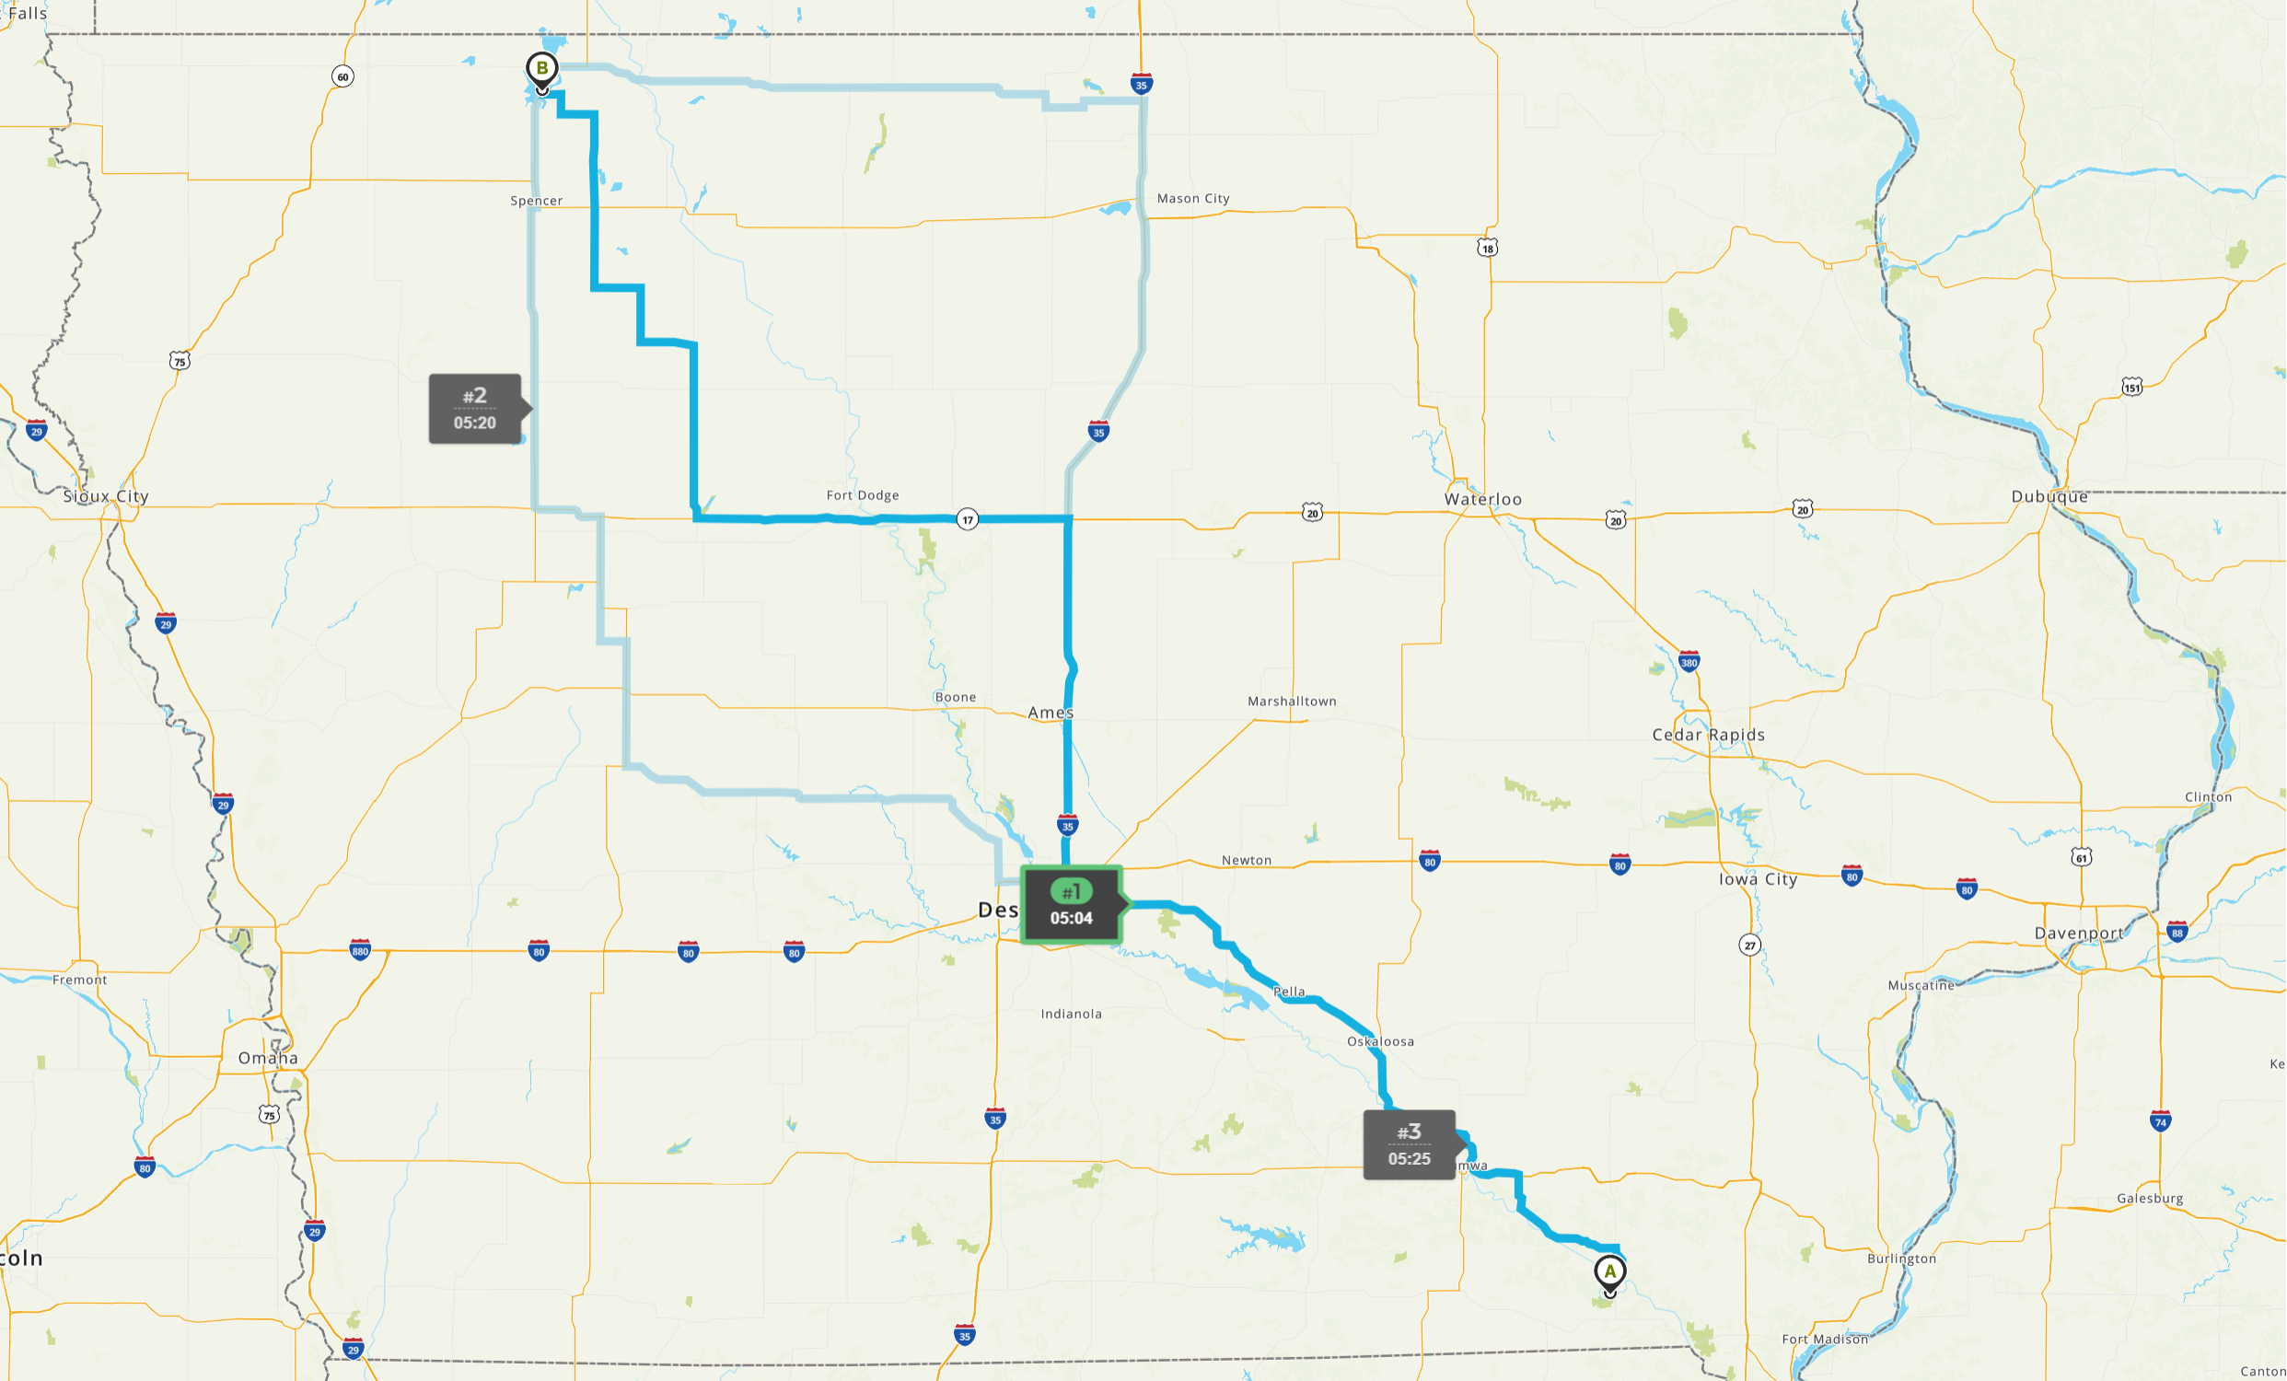
EXAMPLE 5
Selena works as the Director of Public Works for the City of Keosauqua. Selena receives a a beautiful horse statue (retail value $19.95) from Dan, a family friend. Dan knows Selena loves horses and it would look great in her office at City Hall. Dan is a registered lobbyist for the Okoboji Tourism Association. May Selena accept the gift?
Yes. Dan is a friend.
Yes. Dan is not a restricted donor.
No, because Dan is a lobbyist.
No, because Dan gave it to her to place
in her office at City Hall.
OKOBOJI
KEOSAQUA

Slide 32
EXAMPLE 5
Answer: B.
Dan is a lobbyist, but he is not a restricted donor as to Selena, because his lobbying on behalf of Okoboji Tourism would not come into any conflict with Selena’s area of authority. Friends can be restricted donors depending on the circumstances.

Slide 33
EXAMPLE 6
Public Official Paul runs into Carl Carlson Jr., owner of Carlson Contractors. Carl asks Paul to put in a good word him when reviewing bids for the new school construction project. Carl then hands Paul a fat stack of cash. The next day, Paul feels weird about this interaction. He informs his supervisor. He immediately donates all the money to Save the Florida Manatees, a 501(c)(3) non-profit organization. Has Paul violated the gift law?
No, because Carl is not a restricted donor.
No, because Paul donated the money to a 501(c)(3).
Yes, because Paul donated the money to a charity outside of Iowa.
Yes, because Paul accepted a monetary gift from a restricted donor.

Slide 34
EXAMPLE 6
Answer: D.
Carl Carlson Jr., is a restricted donor. His company Carlson Contractors is seeking to win the bid for a new school construction project. Paul’s acceptance of a cash gift violates the gift law. Paul cannot donate the cash to a charity to address the issue. Only non-monetary gifts may be donated after receipt.

Slide 35
EXAMPLE 7:
THE COMMON “IOWA NICE” SCENARIO
Martha is a resident of Anywhere County, she loves to bake cookies and deliver them to various places across the County. Today she has dropped off a batch of her prize-winning chocolate chip cookies at the Board of Supervisors’ offices. Supervisor Johnson cannot resist chocolate chip cookies.
Can Supervisor Johnson and her staff accept appreciation cookies from Martha?
What if Martha is employed by a company that will be bidding on the maintenance contract for the county community center?
What if Martha owns a bakery and is passing out $5 coupons to everyone in the County?

Slide 36
EXAMPLE 8
A vendor is in regular contact with a local government employee in charge of purchasing his goods. The vendor gives the employee tickets to a local minor league baseball game because he knew the employee is a big fan. Does this violate the gift law?
No, the employee has a relationship with the vendor, so it is permissible.
No, the vendor is not a restricted donor.
Yes, the vendor is a restricted donor.

Slide 37
EXAMPLE 8
Answer: C.
The vendor is a restricted donor because she does business with the local government. While the tickets were not provided specifically to induce a sale at that time, it is prohibited. Intent doesn’t matter. State v. Knowles, 602 N.W.2d 800 (Iowa 1999).

Slide 38

CAMPAIGN DISCLOSURE
Iowa Code Chapter 68A

Slide 39
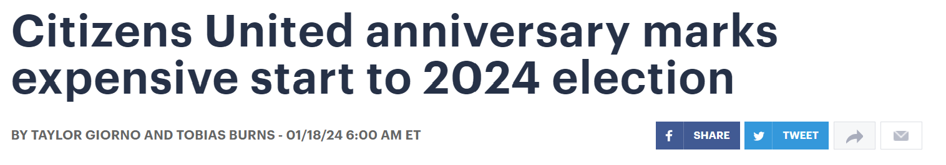
CAMPAIGN FINANCE BASICS
Candidate Committees: must establish if he/she accepts contributions, makes expenditures, or incurs debt in excess of $1,000 in a calendar year.
Statements of Organization and regular reporting
Campaign funds may only be used for permitted purposes.

Slide 40
PUBLIC RESOURCES FOR POLITICAL PURPOSES BAN: 68A.505
The state and the governing body of a county, city, or other political subdivision of the state shall not expend or permit the expenditure of public moneys for political purposes, including expressly advocating the passage or defeat of a ballot issue.
Public employees may express their opinions, but cannot use public resources to promote that opinion (i.e. school districts advocating for or against a ballot issue).
Notes:
68A.505

Slide 41
ADDITIONAL PROHIBITED USES OF
PUBLIC RESOURCES
Soliciting votes, contributions or other campaigning, including polling.
Using a publicly owned motor vehicle to transport political materials.
Placing campaign signs on a publicly owned motor vehicle.
Traveling to campaign-related events in a publicly owned motor vehicle.
Using public resources to produce and distribute communications that expressly advocate for or against candidates.
Placing campaign materials on public property, including a public right-of-way.
EX: A bookmark bearing the state seal could be distributed on public property, but a bookmark that identified a candidate for office could not.
Notes:
Iowa Admin. Code r. 351—5.1(68A)

Slide 42
USE OF TITLE OR INIDICIA OF OFFICE
Board Advisory Opinions, IAC Chp. 351 offer clarification:
Podium that bears the official seal of the public entity to make campaign announcements cannot be used.
Uniforms do not continue to cost a public entity, so wearing them while campaigning is allowed.
Identifying yourself by job title: no cost to a public entity, so allowed.
Events on public property where more than one candidate is invited are allowed (e.g., a debate).

Slide 43
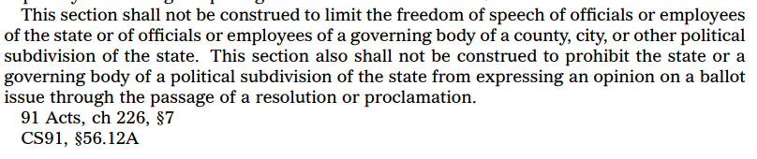
PUBLIC EMPLOYEE FREE SPEECH
Notes:
From wearing uniform/indicia of official work while campaigning to wearing indicia of campaign while working
Government officials and employees may be as politically active as they desire; they just
may not use government resources for their political activities

Slide 44
EXAMPLE 8
County employee Chris decides to run for public office. He forms a committee and files regular reports with the Ethics Board. He continues to work while campaigning. On his breaks from work, he steps out into the hallway and makes campaign calls on his personal cell phone. Has Chris violated ethics rules?
No, because he did not use any government resources.
Yes, because he made campaign calls on government property.
Yes, Chris cannot be a candidate while he holds his government position.
No, because he filed the proper paperwork.

Slide 45
EXAMPLE 8
Answer: A.
There is likely not a violation because Chris is using his personal cell phone and not doing it while on work time. A much better practice would be to leave government property entirely when switching to campaign activity.

Slide 46
EXAMPLE 9
Elected Official Max decides that a mailer would be a great way to inform local citizens of government services. He decides to spend his discretionary funds on a mailer shortly before Election Day, in which he is up for re-election. He designs the mailer to feature his name and title prominently and a large photo of himself. Does Max have a problem?
Yes, he used public funds for what is essentially a campaign mailer.
No, he is simply identifying himself by title on an informational mailer.

Slide 47
EXAMPLE 9
Answer: B.
Iowa Code § 68A.405A prohibits statewide elected officials from using their funds to send mailers with their photo or to appear in ads. This does not apply to local elected officials. Further, the mailer does not expressly advocate for his candidacy, so it would not violate Iowa Code § 68A.505, the use of public funds for political purposes.
It could, however, create a conflict of interest as it creates a benefit to the Max that is not available to others and will likely generate complaints. Max should check with his county attorney about the mailing.

Slide 48
EXAMPLE 10
Elected official Liz is up for re-election. As part of her duties, she maintains the department’s Facebook page. She creates posts with information on departmental services for citizens. She also posts about her campaign to the department’s Facebook page, advocating for her re-election. Has Liz violated ethics rules?
No, because Facebook does not cost anything.
Yes, if she failed to include a “paid for by” statement in her campaign posts.
Yes, because she is using department resources.
No, as long as she posts during her breaks.

Slide 49
EXAMPLE 10
Answer: C.
She is using a public resource she has access to solely due to her position. The post are expressly advocate for her re-election, so they are in violation of Iowa Code § 68A.505.

Slide 50
EXAMPLE 11
James is a full-time government employee at a state DNR facility that includes greenhouses on the property. James also grows orchids in his spare time and is part of a gardening club that meets regularly. The DNR facility frequently rents out its space, including the greenhouses, to groups in the area for a nominal fee. James’ gardening club needs a place to meet this month, so he reserves a greenhouse with his manager but does not pay. Is this an ethical violation?
No, the fee is so nominal that it won’t matter to DNR.
No, but James should encourage members to donate to a nonprofit separately.
Yes, because James used his public position for personal benefit.

Slide 51
EXAMPLE 11
Answer: C.
James can rent any space, including in his office, that is available to the public to rent for a fee. But he (or his group) must pay for the rental as anyone else would.

Slide 52
EXAMPLE 12
Steve, your boss, brings a petition to work opposing a controversial ballot measure. After spending the morning gathering signatures, he reaches your desk. He asks you to sign the petition, arguing that county workers will lose their retirement benefits if the measure passes. Can Steve do this?
Yes, Steve is the director of the department where you work, so he makes the rules.
No, Steve is using public resources to advance his political position.
Yes, Steve has First Amendment rights.

Slide 53
EXAMPLE 12
Answer: B.
Government resources cannot be used to expressly advocate for or against a ballot issue. Circulating a petition without advocacy is not allowed if the opposing position is not given the same opportunity, per § 68B.2A.

Slide 54
EXAMPLE 13
Supervisor Fred is running for re-election. You are the supervisor of a county department. Fred has come to one of your employees and demanded they post his campaign materials on the bulletin board used for employee announcements. What should you do?
Post the campaign materials because Fred controls your budget.
Post the campaign materials and hope nobody says anything because you don’t want to upset Fred.
Refuse to post the campaign materials because it would be using government resources for a political purpose.

Slide 55
EXAMPLE 13
Answer: C.
Unless there is a specific policy that allows for any person to post materials on the bulletin board (which would include political materials from all sides), the campaign materials should not be posted on a publicly owned bulletin board. You may want to consider ensuring there is a policy in place to assist employees to prevent them from being put in a situation like this.

Slide 56

CAMPAIGN SIGNS
WHERE CAN THEY BE PLACED? | WHERE NOT PERMITTED?
Residential property (including leased property) Agricultural land owned by individuals or a family farm operation Property used as campaign HQ leased by the candidate/committee PROHIBITED CONTRIBUTORS: Insurance Company, Savings Association, Bank, Credit Union, or Corporation (for-profit and non-profit) | Public property (including right-of-way areas) Property owned, leased, or occupied by a prohibited contributor On property without the permission of the owner/lessee On the premises of or within 300 feet of*: Polling place on election day Absentee voting site Satellite absentee voting sites *Except on private property

Slide 57
CAMPAIGN SIGNS
Can Public Official Patrick put his campaign sign in his office window? No.
What if he just stores them in his office, where they happen to be visible to people walking by? Still no.
Can he put them in the right-of-way outside the building? Probably not, unless there is a policy that everyone can put signs there.
Can he put them on his office’s designated vehicle? Nope. Exception for his personal vehicle as long as it’s not parked in close proximity to a polling place on Election Day.
Can he put them across the street, in the window of the local store Main Street, Inc.? No. Corporations are prohibited contributors and are prohibited from displaying signs on their property.
Can he put them on Free Speech Hill, the place designated by the City Council as open for all signs and expressions of free speech? Sure.

Slide 58
SUMMARY
Learn the rules and your local policies.
Use common sense.
If you don’t know what the rule is, ask before taking action!
Consider the Grandma Rule or Front Page Test.

Slide 59
QUESTIONS?
Erika Eckley
Phone: 515-423-5006
Email: erika.eckley2@iowa.gov
Check our website for
FAQs and resources:
https://ethics.iowa.gov/

