Slide 1
Carrie Johnson
Fiscal & Policy Analyst Sr.
January 15, 2026

Slide 2
County Budgeting Basics

Slide 3
Agenda
Budget Timelines and Everyone’s Role
Funds and Expenditure Classes
Property Tax Levies and Rates
Walk Through the Process

Slide 4
Budget Process and General Timelines

Slide 5
Timelines
The fall is a good time to review established spending policies and labor negotiations for tentative budget proposals
Typically, in November or December the Auditor (or Budget Director) will furnish budget worksheets to elected officials and department heads to prepare proposed revenues and expenditures for the next fiscal year.
County Compensation Board (if in place) will meet to recommend salary changes for elected officials.
County auditors certifies valuations to DOM and all levy authorities by January 1
County departments submit proposed expenditures and revenue by January 15.

Slide 6
Timelines
The board files the proposed budget with the auditor, allowing enough time for the budget to be lawfully published and certified (by January 20).
The notice of proposed tax is published and posted on applicable county social media “not less than 10 nor more than 20 days” before the hearing.
A mailing is sent to taxpayers to alert them to the proposed tax hearing, as well as their school hearing and city if applicable. (by March 15)
The hearing is held for taxpayers and residents of the county to present to the board their objections to, or arguments in favor of, the county proposed tax. (no earlier than March 20)

Slide 7
The regular notice of public hearing and proposed budget summary is published “not less than 10 nor more than 20 days” before the hearing.
The hearing is held for taxpayers and residents of the county to present to the board their objections to, or arguments in favor of, any part of the budget.
The board adopts the budget by resolution.
The board directs the auditor to properly certify and file by April 30

Slide 8
Citizens have until May 10 to file a budget protest.
County auditors certify county budget (and other local government budgets.)
DOM certifies property tax rates to county auditors by June 15.
County auditor provides tax list to county treasurer by June 30
The Board of Supervisors appropriate, by resolution, the amounts necessary for each county officer and department during the ensuing fiscal year.

Slide 9
Department of Management’s Role
DOM provides the forms (including web-based), instructions, technical assistance for all local government budgets
https://dom.iowa.gov/local-government/county-resources

Slide 10
County Department Roles
Department Estimates
By January 15 , each elective or appointive officer or board, having charge of a county office or department, shall prepare and submit to the auditor or other official designated by the board an estimate, itemized in the detail required by the board and consistent with existing county accounts, showing all of the following:
a. The proposed expenditures of the office or department for the next fiscal year.
b. An estimate of the revenues, except property taxes, to be collected for the county by the office during the next fiscal year.

Slide 11
County Auditor’s Role
By January 20, the auditor or other designated official shall compile the various office and department estimates and submit them to the board.

Slide 12
County Supervisors’ Role
Consults with any officer or department concerning the estimates and requests and may adjust the requests for any county office or department.
Prepares and files the budget with the county auditor.
Sets hearing dates.
Conducts public hearings.
Approves full budget by resolution.
Appropriates by resolution.

Slide 13
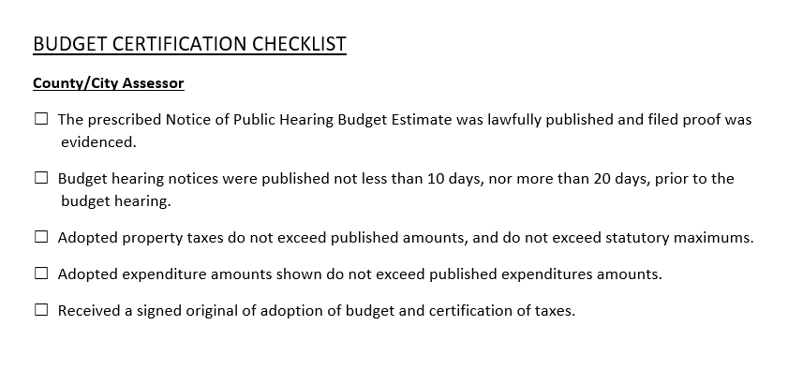
County Auditor’s Role-Certification
County auditor certifies all local budgets, including the county budget

Slide 14
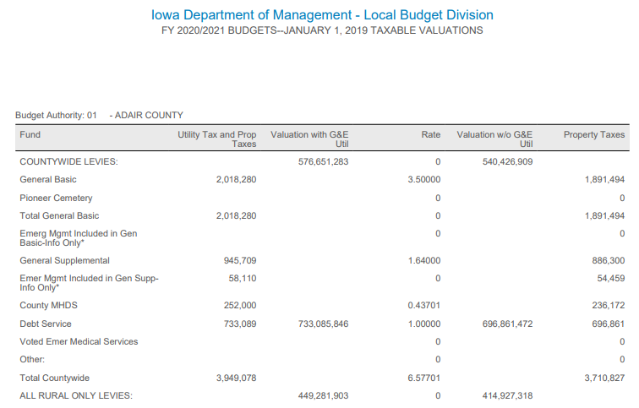
Department of Management’s Finalization
DOM certifies the final property tax levies by tax district to county auditor by June 15, as well as consolidated rates
Tax rates and amounts are within statutory limits

Slide 15
Funds and Expenditure Classification

Slide 16
Types of Funds
The accounts of the County are organized on the basis of funds, each of which is considered a separate accounting entity.
The operations of each fund are accounted for by a separate set of self-balancing accounts that comprise its assets, deferred outflows of resources, liabilities, deferred inflows of resources, fund balances, revenues, and expenditures.

Slide 17

Types of Funds
Governmental (Budgetary)
General
Special Revenue
Capital Projects
Debt Service
Permanent
Governmental Activities
(for government-wide reporting)

Slide 18

Types of Funds, cont.
Nonbudgetary
Fiduciary
Agency
Proprietary
Enterprise
Internal Service

Slide 19
Governmental Funds
GENERAL FUND - The General Fund is the chief operating fund of the County. All general tax revenues and other receipts that are not allocated by law or contractual agreement to some other fund are accounted for in this fund. From this fund are paid the general operating expenses, the fixed charges, and the capital improvement costs that are not paid from other funds.
SPECIAL REVENUE FUNDS - Account for proceeds from specific sources (other than those accounted for within capital projects funds) which are usually required by law or regulation to be accounted for in separate funds and debt service or are restricted or committed to expenditure for specific purposes. Expendable trusts should be reported here.

Slide 20
Governmental Funds
CAPITAL PROJECTS FUNDS - Optionally account for resources used in the acquisition or construction of major capital facilities and capital assets. (Even if a capital projects fund is used, not all capital acquisition need be accounted for in the fund. For example, the routine purchases of capitalizable items (e.g., police vehicles, copy equipment) are typically budgeted and reported in the general fund.)
DEBT SERVICE FUNDS - Account for the payment of interest and principal on the County's general long-term debt, except when authorized or required to be paid from other funds.

Slide 21
Governmental Funds
PERMANENT FUNDS – account for resources that are legally restricted to the extent that only the earnings, and not
principal, may be used for purposes that support the reporting of government’s programs (i.e., for the benefit of the government or its citizenry).
GOVERNMENTAL ACTIVITIES – (Government wide financial reporting). Account for balances related to governmental funds that are only reported in the government-wide statement of net position.

Slide 22
Governmental Funds-Non Budgetary
AGENCY FUNDS – Account for those assets held solely in a custodial capacity by a governmental unit as an agent for individuals, private organizations, other governmental units, and/or other funds. Also include any 28E entities for which the county is fiscal agent.
ENTERPRISE FUNDS-May be used to report any activity for which a fee is charged to external users for goods or services. Activities are required to be reported as enterprise funds if any one of the following criteria is met. Governments should apply each of these criteria in the context of the activity’s principal revenue sources.
INTERNAL SERVICE FUNDS-May be used to report any activity that provides goods or services to other funds, departments, or agencies of the primary government and its component units, or to other governments, on a cost-reimbursement basis. Internal service funds should be used only if the reporting government is the predominant participant in the activity. Otherwise, the activity should be reported as an enterprise fund.
The major use of internal service funds by Iowa county governments is for self-insurance.

Slide 23
Special Revenue Funds
Rural Basic Fund
The operating fund for county services benefiting property not within incorporated areas of the county.
Rural Services Supplemental
If the Rural Basic levy is insufficient to meet the county’s needs, the supplemental levy can be used to pay charges for:
FICA, IPERS, and unemployment premiums associated with salaries in Rural Basic
County contribution to an aviation authority

Slide 24
Special Revenue Funds
Secondary Roads Fund:
The operation fund for maintenance and repair of secondary roads, construction and maintenance of county bridges and bridges in cities having a population of 8,000 or less, and all or part cost of construction of roads which are located in cities of less than 4,000 and lead to state parks.
Revenues from federal, state, and county
Road Use Tax - Farm-to-Market – Transfers from General Basic and Rural Basic funds

Slide 25

Classification by Function
Budget summary requires reporting of expenditures by 12 expenditure classes or functions
The classes are categorized into functions
Functions are comprised of programs
Programs are composed of activities

Slide 26
Summary of Functions
Public Safety and Legal Services
Physical Health and Social Services
County Environment and Education
Roads and Transportation
Governmental Services to Residents
Administration
Nonprogram and Other Budgetary Financing Uses
Non-Function General Revenues (for Statement of Activities revenue classification)

Slide 27
Tax Rates and Levies

Slide 28
Valuations-Assessment Limitation 2025 for FY26-27
The following classes of property are subject to taxation at less than 100% of value for 2025 values payable in FY2026/2027:
Agricultural Property is to be taxed at a percentage of: 59.4401%.
Residential Property is to be taxed at a percentage of: 44.5345%.

Slide 29
Valuations-Assessment Limitation 2025 for FY26-27
The following classes of property are subject to taxation at less than 100% of value for 2025 values payable in FY2026/2027:
Commercial, Industrial and Railroad Property is to be taxed via a two-tier assessment limitation as follows:
A. 44.5345% to the value of each property unit that exceeds zero dollars ($0), but does not exceed one hundred fifty thousand dollars ($150,000).
B. 90.0000% to the value of each property unit that exceeds one hundred fifty thousand dollars ($150,000).

Slide 30
Valuations-Assessment Limitation 2025 for FY26-27
The following classes of property are subject to taxation at less than 100% of value for 2025 values payable in FY2026/2027:
Utility Property is to be taxed at a percentage of: 94.2059% to the value of utility property valued by IDR pursuant to chapter 437 98.0000% to the value of utility property valued by IDR pursuant to chapters 428 and 438

Slide 31
How Valuations Tie to Budgets
Taxable Valuation/1000 X Rate = Taxes Levied
Valuation is set by the Assessor and the Department of Revenue
Applicable Assessment limitation is applied by class of property
Rates are set by local governments to generate the desired levy (property tax dollars)

Slide 32
Property Valuation-Rollback
Tax rate is presented as dollars and cents per thousand dollars of taxable property valuation.
Taxable Valuation
1000 x Tax Rate = Property Tax Dollars (Levy)
Example:
Residential home in rural area with an actual value from the assessor of $200,000.
Apply the residential assessment limitation of 44.5345%.
Taxable value is 89,069.
89,069 1000 x 9.50000 = $846.16

Slide 33
County Property Tax Levy
331.301 General powers and limitations.
7. A county shall not levy a tax unless specifically authorized by a state statute

Slide 34
Categories of Property Tax Levies
General county services-benefitting all county residents (Basic, Supplemental)
Rural county services-benefitting those outside cities (Basic, Supplemental)
Debt service
Other taxes specifically provided by law
Examples:
Emergency Medical Services
Unified Law

Slide 35
Basic Property Tax Levies-FY27
HF 718 struck 331.426, which allows counties to exceed the General Basic and Rural Basic rates by publishing an extra notice
Allowed any existing exceeding amount included in FY24 budgets to be included in the base calculation of the maximum basic rates for FY25. This base carries forward.
Requires an election to exceed the basic levies and limits their length moving forward

Slide 36
Basic Levies-Changes from HF 718 and SF 2442
Provided a mechanism for levy rate to be reduced if non-TIF taxable growth triggers are met or exceeded
Rate each year becomes part of the calculation for the next year
Maximums will go back to 3.50/3.95 in FY29

Slide 37
Basic Rate Calculations for FY27
Reduces levy by constraining growth by 1%, 2% or 3% each year, depending on the trigger hit
Non-TIF taxable growth under 2.75%, no reduction
Non-TIF taxable growth over 2.75% but less than 4%, 1% reduction factor applied
Non-TIF taxable growth over 4% but less than 6%, 2% reduction factor applied
Non-TIF taxable growth over 6%, 3% reduction factor is applied
Budget forms will make the calculation for you once the county valuations are submitted.

Slide 38
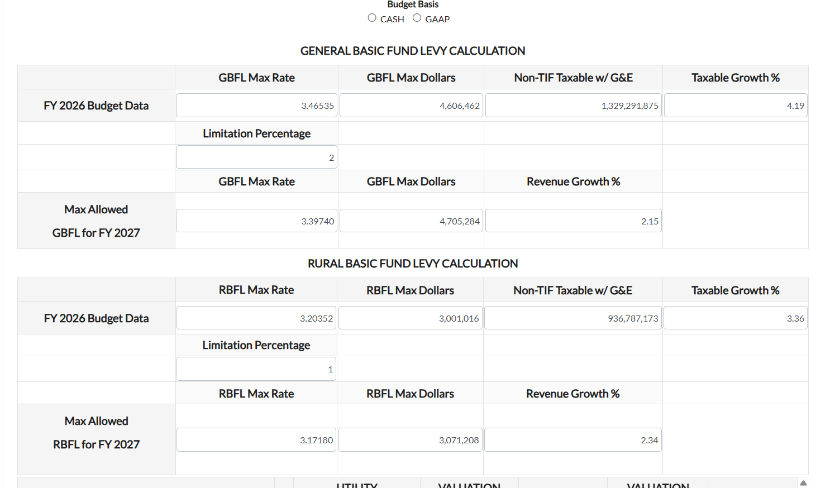

Slide 39
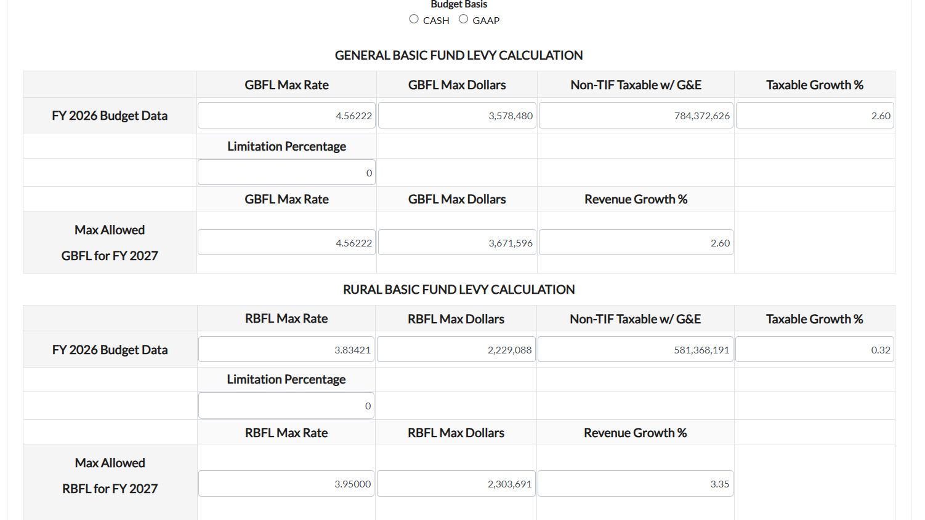

Slide 40
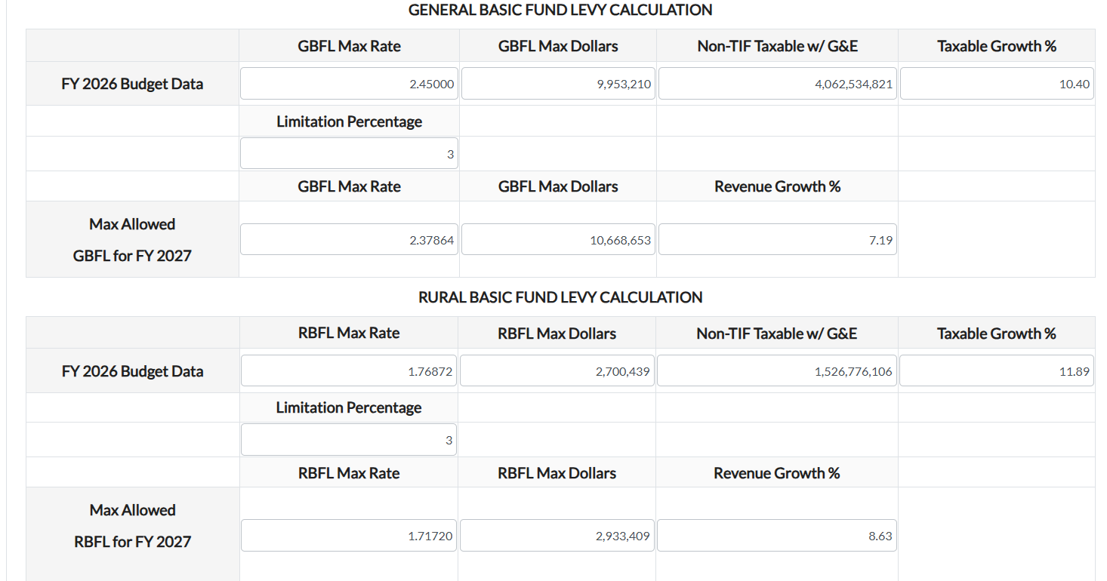

Slide 41

Supplemental Property Tax Levies
Limited in purpose, not amount
331.424 (1) for general county services
Examples include elections, FICA, IPERS, health insurance, etc.
331.424 (2) for rural county services
General or Rural Basic levy must be at county’s limit before using the applicable supplemental levy

Slide 42

Debt Service Levy
Debt Service Levy to pay
Certain judgments
Interest and Principal on General Obligation debt
Certain payments under a lease or lease purchase agreement
Lease cost of a joint city/county building

Slide 43
Cemetery Levy
Levy limit of $0.0675 per $1,000 of taxable valuation to repair and maintain cemeteries under the jurisdiction of the Board of Supervisors (includes Pioneer Cemeteries)
Levied and accounted for within General Fund
Around 20 counties use this levy

Slide 44

Emergency Services Levy
If county provides fire protection to a township under 331.385, the county shall establish an emergency services fund and may certify taxes in the township not to exceed levy limits in 359.43
Currently only applicable in Polk County

Slide 45

Unified Law Enforcement Levy
Unified law enforcement levy under Code of Iowa Chapter 28E.
The county levy is only on property outside of incorporated areas and is limited to $1.50 per thousand dollars of taxable valuation.
A vote of the people is required to establish this levy (Code of Iowa Section 28E.22).

Slide 46

Flood and Erosion Control Levy
A flood and erosion control purposes levy, to be levied only against agricultural lands valuations.
Limited to $0.06750 per thousand dollars of taxable valuation (Code of Iowa Section 161E.9).

Slide 47

Emergency Medical Services Levy
Emergency medical services levy for up to 10 or 15 years as approved at an election.
Specific process is required-see 422D

Slide 48
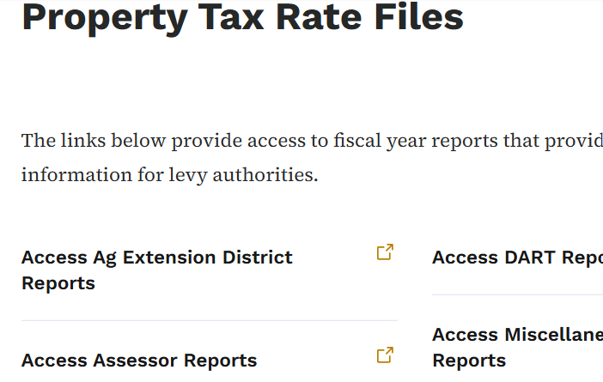
County Tax Rates:
https://dom.iowa.gov/local-government/property-tax-tax-replacement#property-tax-rate-files

Slide 49
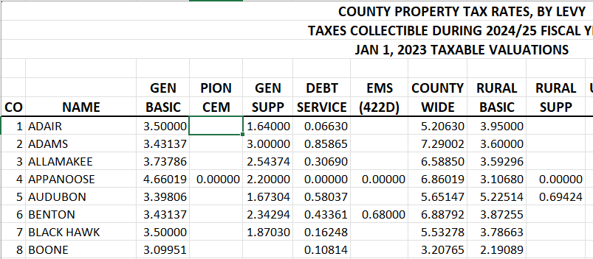

Slide 50
Business Property Tax Replacement
Business Property Tax is no long a credit but a reduction of value with a replacement. Budget like Commercial and Industrial Replacement under the 22xx revenue sources.
FY24 was the first year of replacement revenue (Two Tier Replacement) instead of the Business Property Tax credit revenue from the State.
You may want to review what was received to estimate your FY27 replacement revenue.

Slide 51
Commercial & Industrial Phase Out
DOM has estimated future C&I replacements throughout the phase out.
https://dom.iowa.gov/local-government/property-tax-tax-replacement#commercial-amp-industrial-replacement

Slide 52
Homestead and Military Exemptions
Homestead Exemption
HF 718 retains the existing homestead credit and adds a homestead exemption for individuals 65 and over. Those individuals receive a property valuation exemption of 6,500 for FY26 and beyond. There is no state replacement revenue for this exemption.
Military Exemption
HF 718 also increased the military property valuation exemption from 1,852 to 4,000 for FY25 and after. The military exemption will not be funded by the state.

Slide 53
Walk Through the Budget Process Timelines

Slide 54
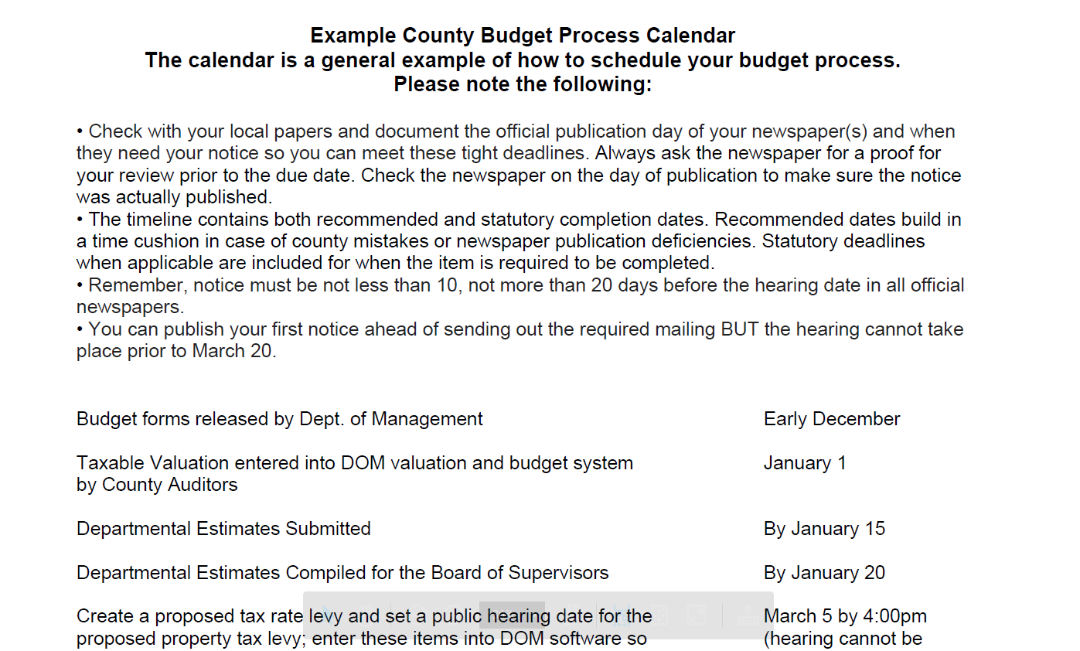

Slide 55
Important Deadline
BY MARCH 5 at 4:00 p.m.
Cities, Counties and Schools enter Proposed Property Tax Notice Hearing (1st hearing) information in DOM Online Budget System. This information is used for the Proposed Property Tax notice hearing statement mailed by County Auditors to taxpayers.
If a county (or city) fails to file all necessary information with the department of management by 4:00 p.m. on March 5, taxes levied by the county (or city) shall be limited to the prior yearns budget amount.

Slide 56
Important Deadlines
ON MARCH 15
County Auditors mail Proposed Property Tax notice statements to taxpayers in their county.
NO EARLIER THAN MARCH 20
Cities/Counties/Schools hold their 1st hearing, this one on the Proposed Property Tax levy
In addition to the mailing, notice must have been published/posted no later than 10, not more than 20 days prior to the date of hearing
BY APRIL 30
Cities/Counties/Schools hold 2nd hearing, this one is the regular hearing on the full budget
Notice must have been published/posted no later than 10, not more than 20 days prior to the date of hearing

Slide 57
Proposed Tax Levy Hearing
Requires notice be published of this public hearing in the same manner as the regular budget notice (for counties, all official newspapers)
Requires it be placed on local government’s web page and social media on a date no later than the date of publication of the notice.

Slide 58
Proposed Property Tax Levy Hearing
Requires cities, counties and schools to set a date for a hearing on their tax asking. Notice of the hearing AND a mailing to be sent by the county auditor by March 15 will be provided to taxpayers.
These will include the following information.
–Total Current Year Tax Rate and Dollars (DOM Provides)
–Proposed Budget Year Tax Rate and Dollars (local gov provides via hearing notice)
–If there is an increase, an explanation of the reasons for the increase, detailing specific purposes or programs(local gov provides via hearing notice)

Slide 59
Proposed Property Tax Levy Hearing
These will include the following information.
–An example of the tax impact on a residential and commercial property (DOM Provides)
–Percentage of current year property tax rate in relation to other levy authorities (DOM Provides)
–Time, Date and Place of hearing on this proposal (local gov provides via hearing notice). CANNOT OCCUR DURING ANOTHER MEETING
Requires notice be published of this public hearing in the same manner as the regular budget notice. Requires it be placed on local government’s web page and social media

Slide 60
Proposed Tax Levy Hearing
Public Hearing is separate from any other meeting and no other business shall be conducted at the hearing
No action required after the hearing.
The local government may decrease but NOT increase the property tax adopted in the final budget.

Slide 61
Budget Public Hearing Notice
At that point, the county proceeds with the budget process as always (set a date for public hearing, with a notice published/posted not less than 10 no more than 20 days from the hearing date.)
Requires the regular public hearing notice for the budget to include a statement regarding the process to protest a county budget-DOM has included this in the forms.
Notice of public hearing published in all county newspapers selected under Code of Iowa Chapter 349.
Must be published not less than 10 nor more than 20 days before the hearing.
Budgeted expenditures and levies may be reduced as a result of the public hearing, but may not be increased.

Slide 62
Budget Public Hearing
Your opportunity to communicate to your public the overview of the proposed budget
Budget Summary
Explains any change in the countywide levy rate
Impact to property owner taxes
Any changes which result in increased cost to the county for services
Any changes in Treasurer’s interest earnings
Overall wage and benefit changes or limits
Graphs and Charts will be helpful in explaining comparisons to prior years

Slide 63
Budget Adoption and Deadline
After the public hearing, the Board adopts the budget by resolution and the county auditor files the budget.
Budget submission deadline for counties is April 30

Slide 64
Late Budgets
Taxes levied by a county whose budget is certified after April 30 shall be limited to the prior year’s budget amount.
The penalty may be waived by the director of the DOM if the county demonstrates to the satisfaction of the director that the deadline was missed because of circumstances beyond the control of the county-SF 2442 sets specific reasons

Slide 65
Budget Extensions-Limited Reasons
DOM can waive penalty for late filed city/county budgets for only the following reasons:
(1) A newspaper failed to publish a notice of hearing as required under section 24.2A after the city/county gave the newspaper sufficient time to publish the notice.
(2) A verifiable public emergency or weather-related event which forced the cancellation of a public hearing as required under section 24.2A.
(3) An illness or unexpected vacancy of one or more board/council members caused a lack of a quorum necessary to hold a hearing as required under section 24.2A.
(4) A failure of state software or a state process caused the board to miss the required date to certify the city/county's budget.

Slide 66
Penalty Implementations
Prevents a city/county from having not property taxes in a year because of a late budget.
A city/county may collect taxes for a fiscal year for which no budget has been certified, but the county shall not distribute any funds collected for a fiscal year until the city/county certifies its budget and transmits the certified budget to the county auditor.
Taxes levied by a city/county whose budget is certified after April 30 shall be limited to the taxes levied for the previous fiscal year subject to applicable levy rate limits in this chapter. However, that amount shall not exceed the amount the county could collect based on property assessments for the fiscal year for which the county failed to certify property taxes.

Slide 67
Budget Protests
Budget Protest deadline is May 10 to accommodate later budget deadline.
Budget hearing notice must include information on protesting the budget (DOM added language to the hearing notice.)

Slide 68
Budget Protests
Protesting a local government budget is covered under Code of Iowa Section 24.27. Persons affected by the proposed budget, expenditure or tax levy, or by any item thereof, may appeal the budget by filing a petition and appeal with the county auditor of the county in which the local government is located.
Protests to county budgets require at least 100 signatures
County Auditor forwards protest document to State Appeal Board

Slide 69
Appropriations
The board must appropriate, by resolution, the amounts deemed necessary for each of the different county officers and departments during the ensuing fiscal year.
Without an appropriation, expenditures are not authorized. Appropriations need not be made in any specific level of detail.
It is unlawful for a county official to authorize an expenditure larger than the amount, which has been appropriated by the board of supervisors (Code of Iowa Section 331.437).

Slide 70
Changing Departmental Appropriations
Increases or decreases in departmental appropriations do not require a budget amendment, as long as none of the 10 major classes of expenditures are to be increased. Instead, changes in departmental appropriations may be provided by resolution at any regular meeting of the board. Obviously, any increases in departmental appropriations will have to be offset by decreases in other departmental appropriations, so individual expenditure class amounts are not exceeded.

Slide 71
Changing Departmental Appropriations
Decreases in appropriations for an office or department of more than 10 percent or $5,000, whichever is greater, are not effective until the board holds a public hearing on the proposed decrease, and publishes notice of the hearing not less than 10 nor more than 20 days prior to the hearing, in all of the county newspapers selected under Code of Iowa Chapter 349 (Code of Iowa Section 331.434(6)).

Slide 72
Budget Amendment
A budget amendment is required for any increase in the totals for any one of the major classes of expenditures listed on the adopted budget summary. The amendment must be effective before the expenditure amounts are exceeded.
Budget amendments require the same notice and hearing procedures as required for the adoption of the original budget.
Budget amendments are subject to protest. An amendment of a budget after May 31, which is properly protested but without adequate time for hearing and decision on the protest by June 30, is void.

Slide 73
Budget Amendment Online Form
The amendment form is found by logging into this same online system you use to adopt your budget and selecting “Amend” on your current year budget.
You can access instructions within the online amendment form itself.

Slide 74
ONLINE BUDGET SYSTEM

Slide 75
Budget System for FY27
Log in access should transfer from last year-let me know if someone needs access that does not have it.
If you use the tab key during data entry, it will move between the cells in which you can enter data. You can also use the arrow keys side to side and up and down.
Ending fund balances are produced by subtracting the sum of all expenditures from the sum of beginning balances and revenues.

Slide 76
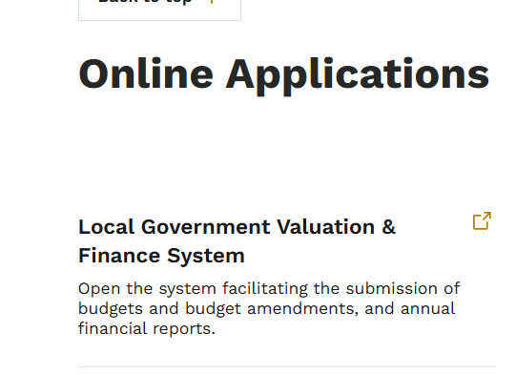
https://dom.iowa.gov/local-government/county-resources

Slide 77
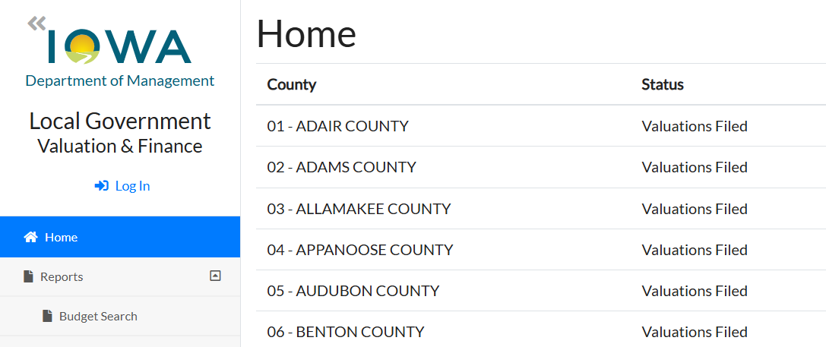

Slide 78
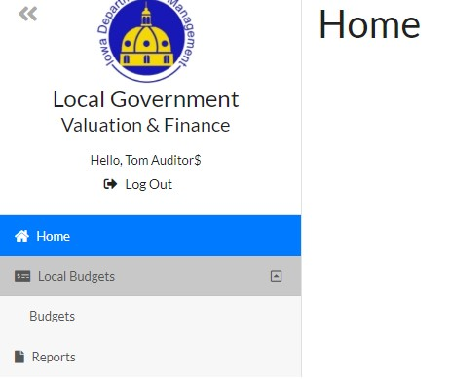
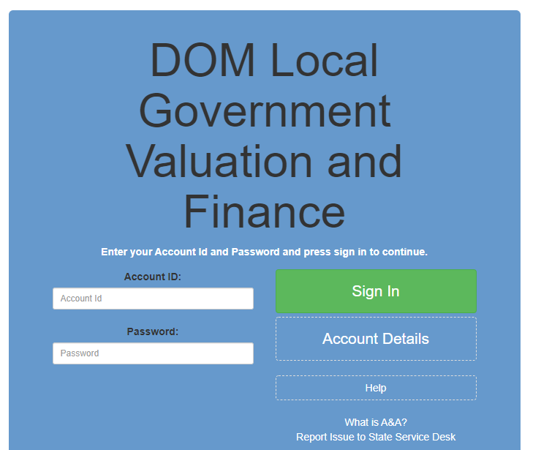
To begin your budget:
Login using your Enterprise A&A an Account ID and password.

Slide 79
Budget Screen
The new FY27 budget as well as the current year budget and other recent budgets created in the system will be displayed.
Click the “Edit” icon to enter a budget to view, enter data and print.
You can view and amend your current year budget also from this screen.

Slide 80
Budget Tabs or Pages
The pages of the budget are tabs across the top of the screen. The regular budget hearing notice is the “Budget Adoption Notice” tab. The property tax levy notice required is the “Proposed Tax Notice” tab. The budget summary is the “Budget Summary” tab. The Adopted of Budget and Certificate of Taxes tab is the “Property Tax” tab. Revenues detail is found in the “Revenues Detail” tab. Service Area Expenditures are found as “Service Area 1-0“. The Long Term Debt Schedule is found in the tab by that name.
You WOULD ONLY use exceed the Exceed Gen and Exceed Rural tab if you held an election to exceed these in FY27. If not, you can ignore that tab.

Slide 81
Proposed Tax Notice
Per statutory requirements, your first task will be to complete the Proposed Tax Notice sheet.
You will note that some data has been populated for you utilizing previously filed current year data.
Other data will pull from what you complete on the Property Tax tab, as that is where you will input your tax asking information.

Slide 82
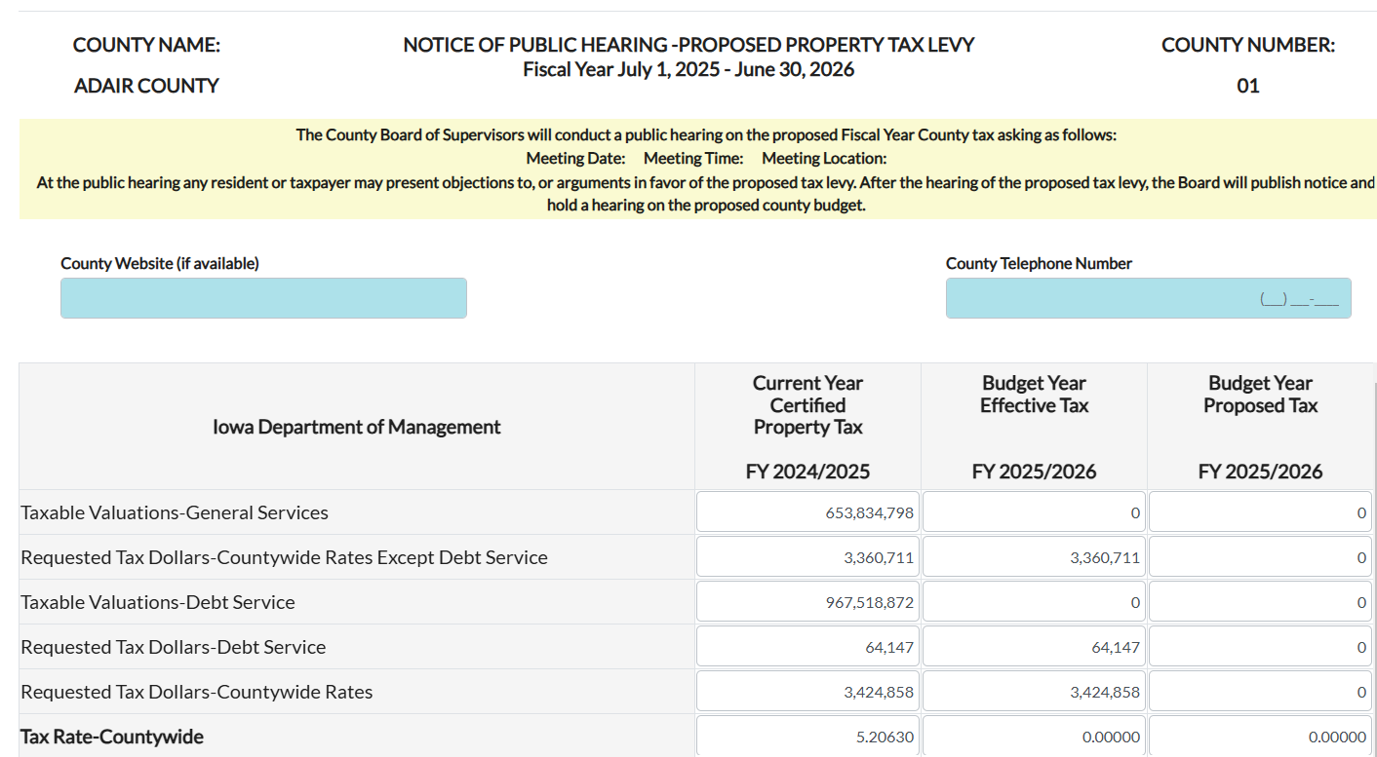
Proposed Tax Notice

Slide 83
Proposed Tax Notice
Upon completion of the Proposed Tax Notice form, you will select the button “Tax Notice Propose” at the top left.

Slide 84
Proposed Tax Notice
This will generate a hearing notice for you to publish in the paper/post on applicable online sites. You will need to enter the hearing date, time and place, these populate on the printed notice.
IN ADDITION, this provides the information needed by the county auditor to do the required mailing. Must be done by March 5 at 4:00 p.m.

Slide 85
Proposed Tax Notice
You can enter data into the supplementary pages of the budget forms at any time during the process but you MUST complete the Proposed Tax Notice process prior to proposing the entire budget for publishing.

Slide 86
Proposed Tax Notice
You cannot “Propose/Publish” the regular budget notice until the Proposed Tax Notice has been proposed. The “Propose/Publish” button will be greyed out until the Proposed Tax Notice process has been completed. Once you have “proposed” the Proposed Tax Notice, you will see the “Propose/Publish” (for the regular hearing notice) will be blue and available.

Slide 87
Valuations Populated
Once the 2025 valuations are filed in your county, the FY27 valuations figures need to complete the budget will be populated.
Until valuations are filed or if the county auditor “Unfiles” valuations, you will see the following notice on the top of your budget forms.

Slide 88

Budget Actions
Once in the budget you can “Check Errors”, “Save” and “Print” at any time.

Slide 89
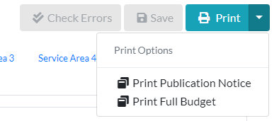
Printing and Saving Budget
You can print the full budget at any time and now can print only the Current Tab.
Upon proposing your budget for publication, you can also print only the Publication Notice.

Slide 90
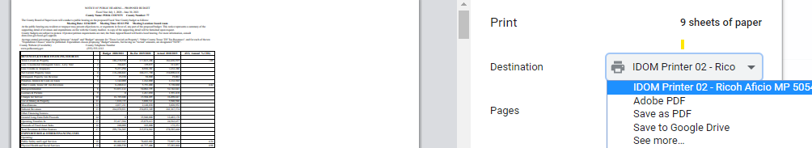
If in Google Chrome, you can select your local printer or “Save to PDF” as your destination. Thereby printing a hardcopy or choosing to save a PDF version to your machine.

Slide 91
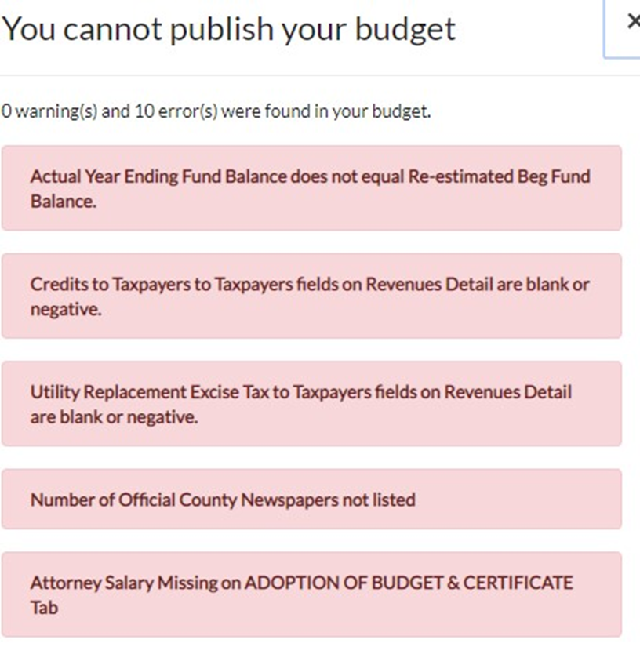
Check Errors

Slide 92
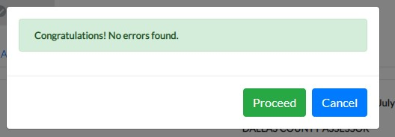
Check Errors
When error free, you can Propose/Publish your budget to obtain the budget hearing notice to publish.

Slide 93

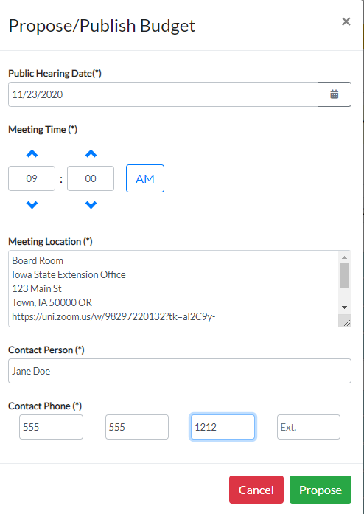
Propose/Publish Regular Budget Notice
You will get a screen to enter the date, time and place for the hearing notice for the regular budget hearing.

Slide 94
Propose/Publish Regular Budget Notice
The system will generate a notice you can print or save to your system.
You can also access the public hearing notice at any time after proposing by going to Print at the top right.

Slide 95

Adopt the Budget
Following the public hearing, the Board may make any allowable revisions (decreasing tax asking or expenditures) to the budget by Return to Draft (which just opens the budget for edits) and making changes. The budget is again “Propose/Publish” (although not published in the newspaper again-leave the original publication date the same unless republishing for some reason) and now ready to “Adopt”.

Slide 96
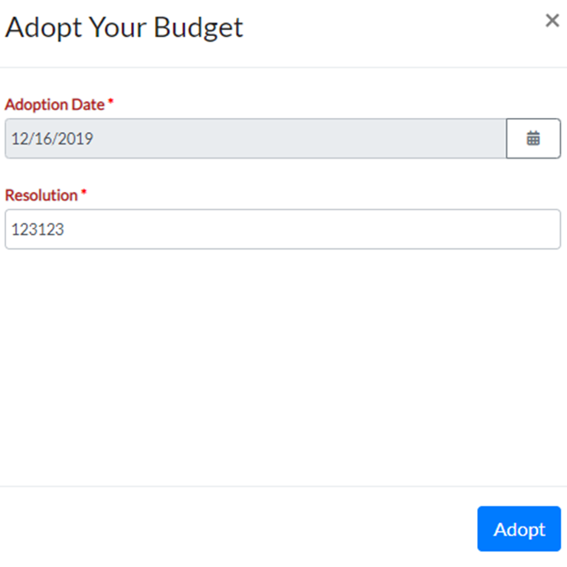
Adopt the Budget
If no revisions are needed, you just click “Adopt” to proceed with the budget as currently presented. Enter your Adoption date and resolution number and click “Adopt”.

Slide 97
Budget Documents Filed with Auditor
File the following documents with the county auditor:
Proof of Publication for Proposed Tax Notice
Proof of Publication for Regular Budget Notice
Signed Adopted budget and supplementary pages (also recommend filing the budget resolution)

Slide 98
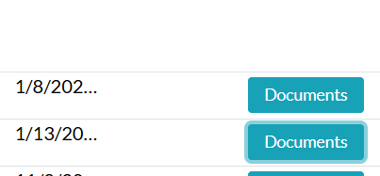
Budget Documents Filed with Auditor
We will also offer an option to upload your signed budget and proof of publication via the online system for the county auditor to then download for their certification:

Slide 99
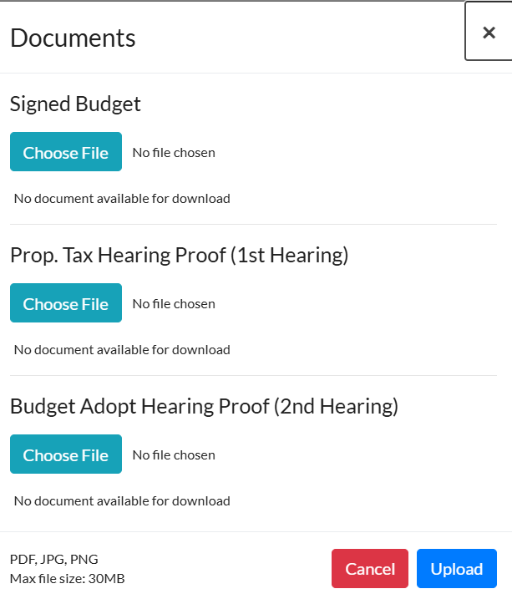
Budget Documents Filed with Auditor

Slide 100
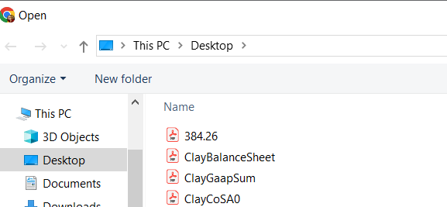
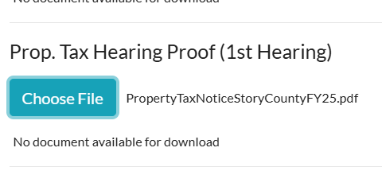

Slide 101


Once your documents are selected, click the Upload button.
If successful, you will see the following notification.
If you uploaded a document in error or need to replace the document previously uploaded, you can select Documents and Choose File again to overwrite the document previously uploaded.
If you use this option, your documents still must be uploaded by April 30.

Slide 102
Contact:
Iowa Department of Management
State Capitol
Des Moines, IA 50319
Carrie Johnson
carrie.johnson@dom.iowa.gov
515-281-5598

