Slide 1
Carrie Johnson
Fiscal & Policy Analyst Sr.
September 4, 2025

Slide 2
County AFR Basics and Updates

Slide 3
Agenda
AFR Timeline and Requirements
Overview of Reporting
New Debt Page in GAAP Report
Walk Through the Online Process

Slide 4
AFR Timelines and Requirements

Slide 5
County Annual Financial Report
The “Statement of Revenues, Expenditures, and Changes in Fund Balances – Actual and Budget” must be published in the prescribed format no later than December 1 in one or more newspapers that meet the requirements of Code of Iowa Section 618.14.
The county publishes the page from AFR that is the same format as how the county budgets. One purpose of the AFR is to compare the budget of the year versus the actual year ending. Most counties budget on a CASH basis and therefore complete and publish a CASH report.

Slide 6
County Annual Financial Report
All counties are required to complete a GAAP report by statute. If the county budgets on GAAP, that is the only report they complete.
One main difference between the CASH and GAAP report is the inclusion of the Balance Statement and the reporting method via modified accrual.
Another main difference, beginning with the FY25 GAAP report, is the inclusion of a debt page per the requirements of HF 718.

Slide 7
County Annual Financial Report
The Board of Supervisors is not required to act on the report. There is no public hearing on the AFR.
You make newspaper publication from the CASH report if you budget on a CASH basis. You make newspaper publication from the GAAP report if you budget on a GAAP basis.
Those that budget on a CASH basis “publish/post” the GAAP report by completing and “posting” it online.
Those that budget on a GAAP basis do not complete a CASH report.
AFRs can be amended as needed after submission.

Slide 8
County Annual Financial Report
PENALTY FOR LATE REPORTS
Code of Iowa Section 331.403, subsection 4 reads in part: “…report must be filed prior to the publication and adoption of the county budget under section 331.434 for the fiscal year beginning July 1 following the date such report(s) are due. If such report(s) are not filed pursuant to the requirements of this section, the department of management shall not certify the county’s taxes back to the county auditor under section 24.17.”

Slide 9
Overview of Reporting

Slide 10
REPORTING OF MENTAL HEALTH EXPENDITURES
In transition period away from regional MHDS.
Service Area 4 Expenditures
FY25 was the last year for Polk County to report Service Area 4 Expenditures.
For all other counties, certain services (Mental Health Advocate) provided for the MHDS region and county have a contract for the county employee to deliver MHDS services the county should:
-use a subfund of the General Fund
-a new function code was added to the Chart of Accounts under Service Area 9- 9040 Reimbursable MHDS Direct Expenses to track county revenue and expenditures
-when counties receive reimbursement from the region, the revenue code to use would be 2545 Payments from MHDS Fiscal Agent to MHDS Regional Members

Slide 11
AFR Pages and Tabs
“STATEMENT OF REVENUES, EXPENDITURES, AND CHANGES IN FUND BALANCE
– ACTUAL AND BUDGET”- PUBLISHSUMMARY”
The form must be published no later than December 1
FORM (“PUBLISHSUMMARY”) is almost entirely completed by the software using data entered on other forms.
The ONLY entries required by the county are in column “BUDGET TOTALS”. You will need to enter this data from the county’s budget for the fiscal year ended. Reflect any approved amendments. This must be prepared, published and filed on the same accounting basis as that for which the county budgets – otherwise there would not be a valid comparison of actual financial activity with budgeted amounts.

Slide 12
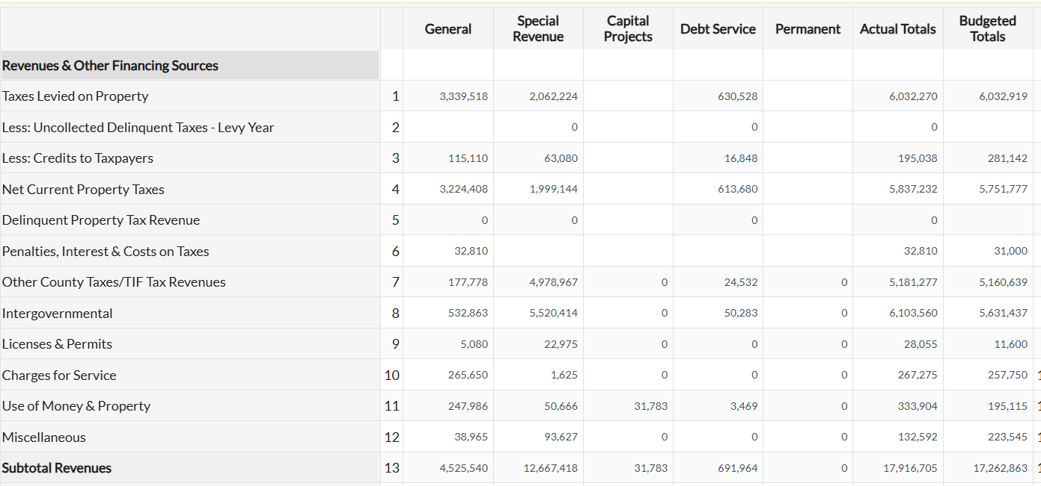

Slide 13
AFR Pages and Tabs-SUMMARY
“STATEMENT OF REVENUES, EXPENDITURES, AND CHANGES IN FUND BALANCE”
The form summarizes the supporting detail sheets and IS NOT PUBLISHED
Electronic Sheet Tab Name: “CASHSUMMARY” or “GAAPSUMMARY” if you budget GAAP
“CASHSUMMARY” or “GAAPSUMMARY” are completed by the software using data entered on other forms with the exception of the “GAAPSUMMARY” that allows entry of “NOTES TO THE FINANCIAL STATEMENT”

Slide 14
AFR Pages and Tabs-REVENUES
“REVENUES DETAIL”
The form allows entry of Revenue detail by Fund type.
Electronic Sheet Tab Name: “REVENUESDETAIL”
Additional sources for the Revenue Types to those listed are available in the “County Chart of Accounts”.
The most recent version of the Uniform Chart of Accounts is located at https://dom.iowa.gov/local-government/county-resources under “Forms & Templates”.

Slide 15
AFR Pages and Tabs-REVENUES
PROPERTY TAXES:
“Taxes Levied on Property” The first four lines deal with Year Ending property taxes and credits against those levied taxes. Taxes Levied on Property (line 1) probably will not equal the tax certification amounts from the Department of Management. Any adjustments to the taxable valuations, and the simple rounding of taxes due, will produce different levied amounts. The spreadsheet produces Taxes Levied on Property by adding the sum of Net Current Property Taxes, plus Credits to Taxpayers, plus the Uncollected Delinquent Levy-Year Taxes. (Line 1) is the sum of lines 2, 3, & 4. The software produces “Taxes Levied on Property” (Line 1) by summing the “Uncollected Delinquent Levy-Year Taxes”, “Credits to Taxpayers”, and “Net Current Property Taxes” (Lines 2, 3 & 4 respectively).
“Uncollected Delinquent Levy-Year Taxes” (Line 2) represents the amount of taxes due but not paid during the actual year.
“Credits to Taxpayers” (Line 3) represents the full amount of credits given to the taxpayers and will almost certainly be greater, sometimes equal to but NOT LESS THAN (Line 14), “State Replacements Against Levied Taxes”
“Net Current Property Taxes” (Line 4) represents the total property taxes collected/paid during actual levy year
“Delinquent Property Taxes” (Line 5) represents taxes collected for prior years.

Slide 16
AFR Pages and Tabs-REVENUES
Note with respect to Uncollected Delinquent Taxes – Levy Year:
Some counties have reported negative uncollected levy-year delinquent taxes It is not possible to have negative taxes. DO NOT force taxes levied on property to match the amounts shown on the Department of Management’s tax certification sheet.
Most counties will actually levy a greater or lesser amount of taxes than what the certification indicates. Any changes to valuations – “Certificate of Adjustment” items such as Board of Review changes or PAAB changes, erroneous assessments, omitted assessments, court ordered changes, incorrect application of levies can all drive the differences. Rounding of taxes due to the nearest $2.00 also has an impact.

Slide 17
AFR Pages and Tabs-REVENUES
Note on Accrued Property Taxes Collected in July and August: Accrued property taxes collected in July and August could include collections for the immediate prior year and/or delinquent taxes for all years prior to the actual year just ended. July and August collections for the immediately preceding fiscal year are accrued back to “Taxes Levied on Property” and “Net Current Property Taxes”. July and August collections for years prior to the fiscal year just ended are accrued back to “Delinquent Property Tax Revenue”.
“Penalties, Interest, and Costs on Taxes” (Line 6) represents penalties, interest, and costs on collected taxes. The loss on credits funded by the State is not shown on the annual report.

Slide 18
AFR Pages and Tabs-REVENUES
Most of the revenue lines should be included in the AFR per your local software reporting and using the Uniform Chart of Accounts.
A new lines to note:
“Beginning Fund Balance” (Line 34)
The balance at the beginning of the fiscal year by fund is entered on (Line 34)
“Total Resources” (line 35)
Total Resources are produced by the software adding Line 33 (Total Revenues) and Line 34 (Beginning Fund Balance). Total Resources must equal Total Requirements on (Service Area 0 page), for each fund and in total. The electronic system makes this a forced balance

Slide 19
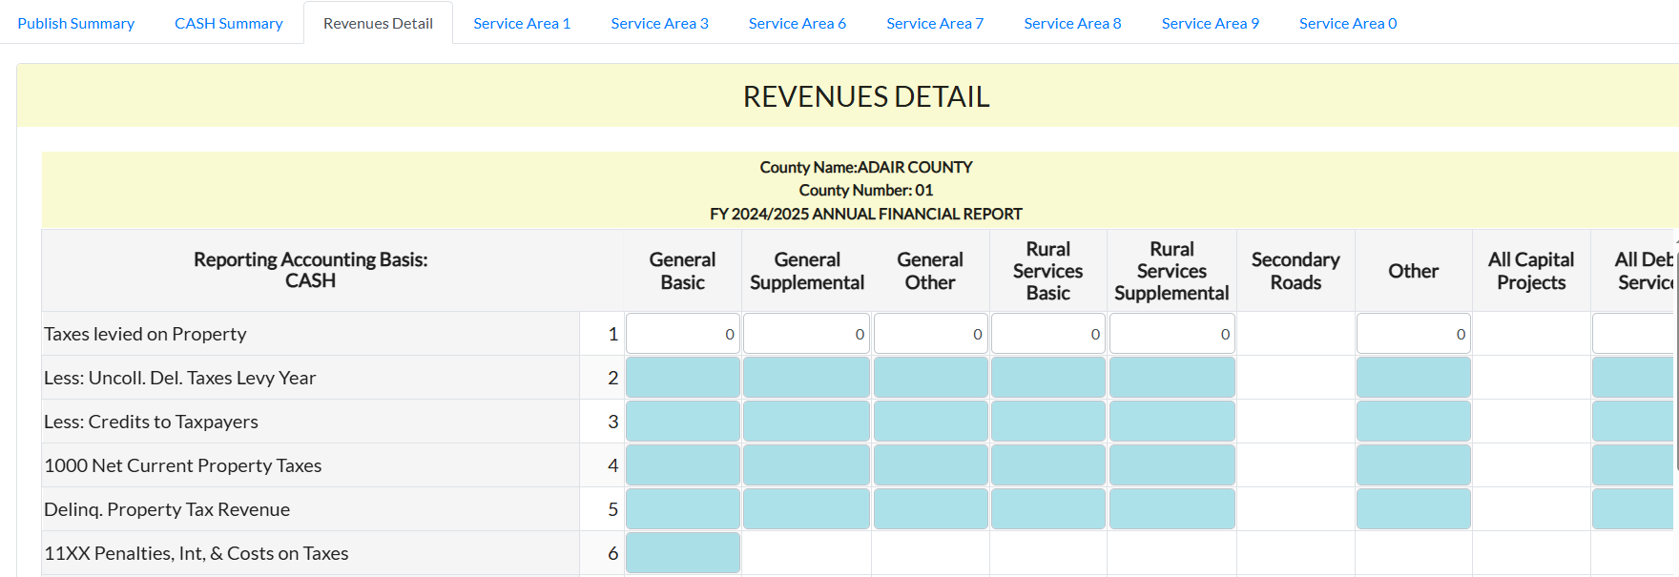
AFR Pages and Tabs-REVENUES

Slide 20
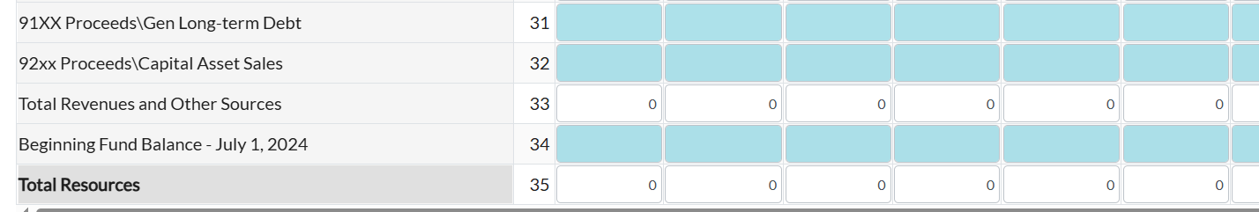
AFR Pages and Tabs-REVENUES

Slide 21
AFR Pages and Tabs-Expenditures
Expenditures are reported by Service Area (program area) and Fund in the AFR per your local software reporting and using the Uniform Chart of Accounts.
Expenditure programs are located on the forms listed. Each program has associated activities/detail listed on each page. The County Chart of Accounts provides additional detail regarding expenditures under a specific program.
The software subtotals and totals each page.
The page totals are then carried forward to the appropriate line of the expenditure summary on “SERVICE AREA 0”

Slide 22
AFR Pages and Tabs-SERVICE AREA 0
EXPENDITURES SUMMARY
The totals for each class of the ten classes of expenditures are automatically fed here and then totaled on line 23. The totals are then carried forward to the Summary.
OPERATING TRANSFERS OUT
Lines 24 through 27 are for Transfers Out to budgetary funds.
If a Transfer Out was recorded to a non-budgetary fund, this is not a correct classification and you should re-classify the Transfer Out as an expenditure within one of the ten expenditure classes.
Transfers Out to budgetary funds are totaled on line 28.

Slide 23
AFR Pages and Tabs-SERVICE AREA 0
REFUNDED DEBT/PAYMENTS TO ESCROW
Line 29 is for transactions related to the refunding of long-term debt.
INCREASE (DECREASE) IN RESERVES
Line 30 Increase/Decrease in Reserves

Slide 24
Fund Balance Types
The implementation of GASB 54 shifted the focus of fund balance reporting to “the extent to which the government is bound to honor constraints on the specific purposes for which amounts in those funds can be spent” (GASB Statement No. 54, paragraph 5).
There are 5 components of fund balance:
-Nonspendable
-Restricted
-Committed
-Assigned
-Unassigned
Not all components will always be used.

Slide 25
Fund Balance Types
FUND BALANCE – NONSPENDABLE-Line 31
Represents fund balance that cannot ever be spent, such as inventories or prepaid items, or that cannot currently be spent, such as nonfinancial assets held for resale. This also includes funds legally or contractually required to remain intact, such as the principal of an endowment or revolving loan fund.
FUND BALANCE – RESTRICTED-Line 32
Represents fund balance that is subject to externally enforceable legal restrictions. This includes those funds with restrictions imposed by creditors, or laws or regulations of other governments.
FUND BALANCE – COMMITTED-Line 33
Represents fund balance whose use is constrained by limitations that the government imposes upon itself. The commitment is imposed at the government’s highest level and is binding unless the commitment is removed in the same manner as it was imposed. Action to commit must be taken by the end of the reporting period (i.e., action to commit FY25 funds must have taken place by the end of the FY25 fiscal year.)
FUND BALANCE – ASSIGNED-Line 34
Represents fund balance that is intended to be used for a purpose. The purpose is assigned by the governing body or a person or body to whom the governing body delegates the authority to assign. The amount is never in excess of total fund balance less its nonspendable, restricted and committed components.

Slide 26
AFR Pages and Tabs-SERVICE AREA 0
FUND BALANCE – UNASSIGNED-Line 35
Represents fund balances which are not restricted, committed or assigned. (In the software, all fund balance defaults to this designation, unless amounts are entered as one of the other types on Service Area 0.) The fund balance on line 35 defaults to line 36 if an entry is not made on lines 31-34. Entries in lines 31-34 are subtracted from line 36. Special revenue funds, the capital projects fund and the debt service fund may have deficit unassigned balances.
ENDING FUND BALANCE- Line 36
The June 30 ending balance is produced (forced) on line 36. It is the product of Total Requirements, minus Expenditures, minus Operating Transfers Out, plus the change in Reserves.
TOTAL REQUIREMENTS-Line 37
Line 37 should be the total of lines 23 + 28 + 29 – 30 + 36. Total Requirements are programmed to equal Total Resources for each fund and in total.

Slide 27
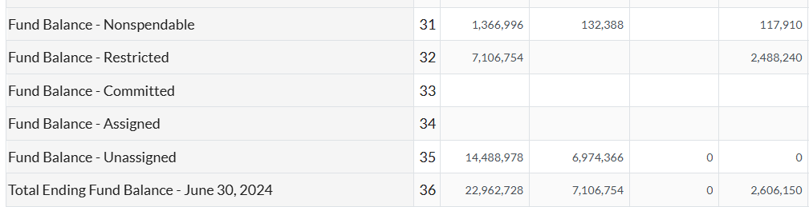
AFR Pages and Tabs-SERVICE AREA 0
FUND BALANCE CALCULATION

Slide 28
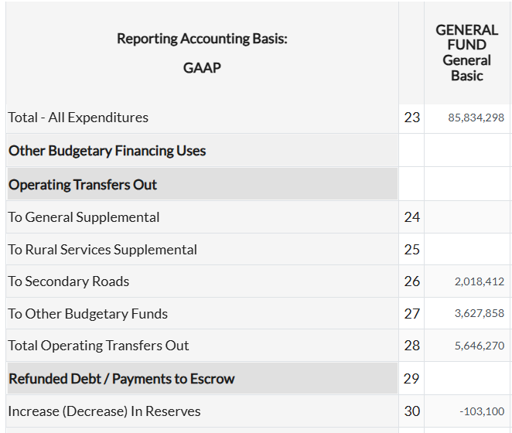

Line 37 should be the total of lines 23 + 28 + 29 – 30 + 36.

Slide 29
AFR Pages and Tabs-BALANCESHEET
USED ONLY ON THE GAAP REPORTING FORMS TO REPORT “ASSETS”(cash & pooled investments, receivables (net where applicable), “LIABILITIES”, accounts payable, salaries & benefits, & contract payable, due to other funds, trusts payable, etc, “FUND EQUITY”, fund balances.
As provided in Code of Iowa Section 331.403, the annual financial report must be prepared and filed in conformity with Generally Accepted Accounting Principles (GAAP) and pursuant to instructions prescribed by the Department of Management.
The annual financial report should include all budgetary funds. Some non-budgetary funds, such as drainage districts, would not be included on the CASH basis report, but should be included in the GAAP report.

Slide 30
AFR Pages and Tabs-BALANCESHEET
PLEASE NOTE: The application will require your Balance Sheet Fund Equity totals to match your GAAPSUMMARY Fund Balances by total and fund designation.
If they do not, the application will note the Error and you will not be able to finalize your report and post it to the web site. ((COMMON ERROR))

Slide 31
AFR Pages and Tabs-BALANCESHEET
CASH AND POOLED INVESTMENTS:
For recording cash on hand as of June 30
“County Treasurer”
The auditor’s cash fund balance as of June 30 plus any unrecorded interest (interest received on or before June 30, but not recorded until after June 30)
“Other”
The cash value of other liquid assets

Slide 32
AFR Pages and Tabs-BALANCESHEET
RECEIVABLES (Net where applicable):
Assets due to the county on or before June 30, generally, the amount not collected during July and August of the new fiscal year is deferred. However, certain exceptions apply to the “Deferral Rule”. For example, “GASB Section 1600.115”: “Accrual When Receipt Is Delayed” “Some revenues, even though not susceptible to accrual, should be recorded prior to actual receipt. Generally, material revenues otherwise not recorded until received should be accrued if receipt is delayed beyond the normal time of receipt.” Accrued interest received is another exception to the “Deferral Rule”. All amounts of accrued interest receivable should be accrued – no amount should be deferred.
Deferred amounts are not shown on the operating statements. The “Net Where Applicable” allows for any uncollectible accounts. In most counties, there will not be uncollectible receivables calculated.

Slide 33
AFR Pages and Tabs-BALANCESHEET
“Accounts”
Is for amounts due for goods and services furnished (but not including amounts due from other funds, other governments, or the items listed immediately below)
“Property Taxes”
Is for all property taxes collectible including the related penalty and interest
“Property Taxes-Succeeding Year”
Is for taxes certified by the Board of Supervisors to be collected in the next fiscal year set out in the budget for the next fiscal year
“Accrued Interest”
Is for interest earned on accounts and investments as of June 30 but not received

Slide 34
AFR Pages and Tabs-BALANCESHEET
“Drainage Assessments”
Is for drainage assessments assessed but not collected
“Other”
This line may be used for other miscellaneous receivables such as special assessments or others that may not fit in another category
“Due From Other Funds”
Represents receivables from other funds maintained by the county, including but not limited to county officials. Keep in mind “due from other funds” should balance in total to “due to other funds”, but there are circumstances when they may not be in balance

Slide 35
AFR Pages and Tabs-BALANCESHEET
“Due From Other Governments”
Represents receivables from other governmental entities, such as the federal and state governments, and other local government subdivisions that are due the county on or before June 30 but become available after June 30. As mentioned earlier, generally amounts not collected during July and August are deferred
“Inventories (at cost)”
Inventories may include secondary road materials, county farm produce, or any other amounts for goods used in operations
“Other Assets”
Represents all other types of assets and may include such items as prepaid expenses
“Total Assets”
Are the total of all assets. Keep in mind that Total Assets must equal Total Liabilities and Fund Equity for each fund and in total

Slide 36
AFR Pages and Tabs-BALANCESHEET
LIABILITIES:
“Accounts Payable”
Are the amounts due for goods and services received on or before June 30 (but not including due to other funds, other governments, or items listed below.)
“Salaries & Benefits Payable”
The amount of salaries and benefits owed to employees at the end of the fiscal year.
“Contracts Payable”
The amount owed at the end of the fiscal year on contracts for work already completed
“Due To Other Funds”
The amount owed to other funds maintained by the county. Keep in mind “due to other funds” should balance in total to “due from other funds” but there are circumstances when they may not be in balance.

Slide 37
AFR Pages and Tabs-BALANCESHEET
“Due To Other Governments”
The amount owed by the county at the fiscal year end to other governmental entities
“Trusts Payable”
The amount held in trust for others at the fiscal year end
“Deferred Inflows of Resources-Succeeding Year Property Taxes”
The offset for succeeding year property tax receivables
“Deferred Inflows of Resources-Other Unavailable Revenue”
Amount due to the county at the end of the fiscal year that is not received during the revenue recognition period – generally July and August of the new fiscal year. Also, include any revenues received before they are earned, such as any amounts of grant moneys received in the fiscal year but not earned or used by fiscal year end

Slide 38
AFR Pages and Tabs-BALANCESHEET
“Other Liabilities”
All other types of liabilities
“Total Liabilities”
The total of all liabilities
“Fund Balance – Nonspendable”
“Fund Balance – Restricted”
“Fund Balance – Committed”
“Fund Balance – Assigned”
“Fund Balance – Unassigned”
“Total Fund Equity”
Total of all fund equity
“Total Liabilities and Fund Equity”
Total of all liabilities and all fund equity.
Keep in mind that Total Liabilities and Fund Equity
must equal Total Assets by fund and in total

Slide 39
New Debt Page in GAAP Report

Slide 40
House File 718
County & City Bond Issuance Report - COI 8.5(16)
    The use of each bond issuance procedure
      General corporate purpose
        Voted
        Non-voted
      Essential corporate purpose
    Amount of each type of debt issued
    DOM is to file a report with the General Assembly annually by January 15

Slide 41
House File 718
Requirement to increase the amount of debt reporting on city & county AFRs
  Beginning with FY 2024-2025:
    List of all outstanding “bonds, notes, or other obligations”
    Amount of issue
    Purpose of the issuance
    Method of approval
    Ties to other debts

Slide 42
Implementation
New page added to the AFR
COUNTY DEBT DETAIL
  Similar to the Long-Term Debt pages of the budget form
  Requires a few extra pieces of debt information
    Rate range
    Principal outstanding as of beginning of FY
    Method of approval – Voted
    Tied to other debt?
    Purpose of the debt issue – what was it used for?

Slide 43
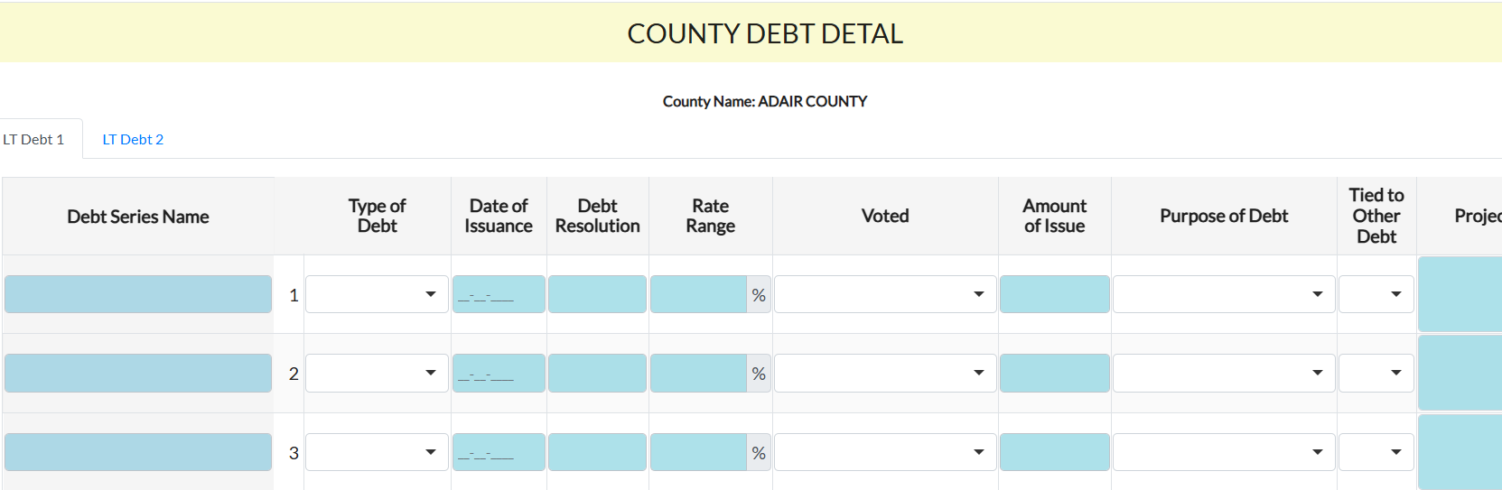
County Debt Detail

Slide 44
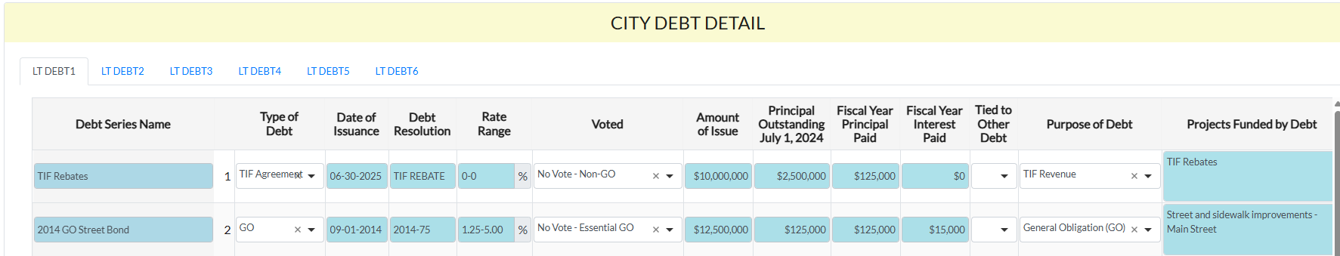
County Debt Detail
Debt Series Name
  Enter the year of issuance, authorized repayment source, and purpose of debt as the name
Type of Debt
  Select the authorized repayment source of the debt

Slide 45
County Debt Detail
Date of Issuance & Debt Resolution
  Enter the number of the resolution which approved the issuance of the debt and the date that the resolution was passed
Rate Range
  Enter the lowest and highest interest rate being
  charged on this debt

Slide 46
County Debt Detail
Voted
  Select the approval method which was required under Code of Iowa 331 for the type of debt issued from the dropdown
    Voted: Debt was required to be approved by a vote of the citizens
    No Vote – Essential GO: GO debt was approved by as an essential corporate purpose, which does not have a debt requirement.
    No Vote – Below Threshold: GO debt was below threshold of principal issued over which a citizen vote would be required
    No Vote – Non-GO: Debt is not a general obligation

Slide 47
County Debt Detail
Amount of Issue
  Enter the amount of principal originally borrowed with the approval of this debt
Principal Outstanding July 1, 20XX
  Enter the amount of principal remaining to be paid as of the beginning of the FY being reported
  ALSO INCLUDE ANY DEBT ISSUED DURING FY25

Slide 48
County Debt Detail
Tied to Other Debt
  If multiple debts funded the same project(s), use the dropdown to show that these debt lines are connected in purpose.
Purpose of Debt
  Select the purpose for which the debt was issued from the list in the dropdown.
  If a GO debt was used for more than one purpose, select GO or break it into separate debt lines

Slide 49
County Debt Detail
Projects Funded by Debt
  Enter the project(s) funded by the debt
  A character limit of 150 characters applies to each cell
    Spaces and punctuation count as a character

Slide 50
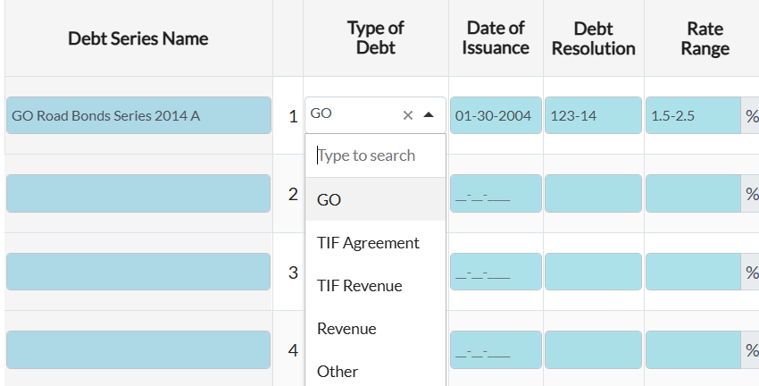
County Debt Detail

Slide 51
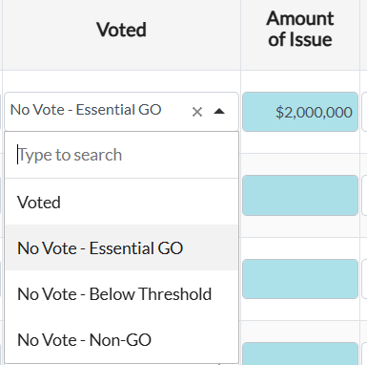
County Debt Detail

Slide 52
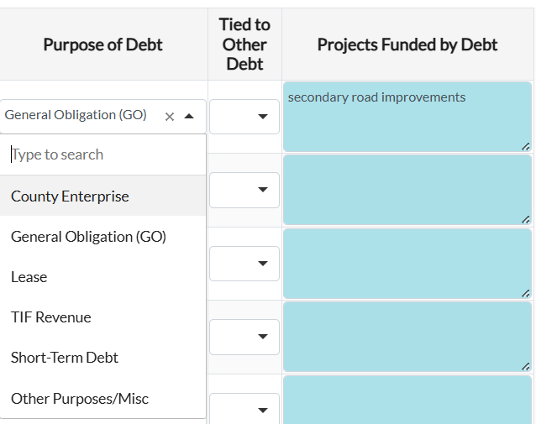
County Debt Detail

Slide 53
Reminders
TIF rebates / agreements
  Aggregate totals onto one line
  Amount of issue is the total of the original not to exceed amounts
  Principal outstanding is the not to exceed minus amount paid to beginning of the fiscal year being reported
150 characters for “Purpose” cell – be concise

Slide 54
ONLINE COMPLETION OF AFR

Slide 55
Online System for AFRs
County Auditor role has access to AFRS. Valuation, county budget and certification of all budgets.
A&A users can also be given access only to the AFR, if staff members do not need other capabilities
Access should transfer forward
Email me if a new county staff member needs access to the system.

Slide 56
Online System for AFRs
If you use the tab key during data entry, it will move between the cells in which you can enter data. You can also use the arrow keys side to side and up and down.
Ending fund balances are produced by subtracting the sum of all expenditures from the sum of beginning balances and revenues.

Slide 57
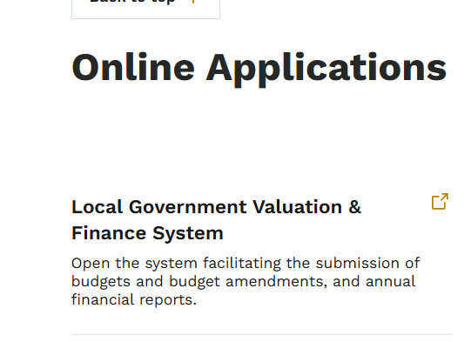
https://dom.iowa.gov/local-government/county-resources

Slide 58
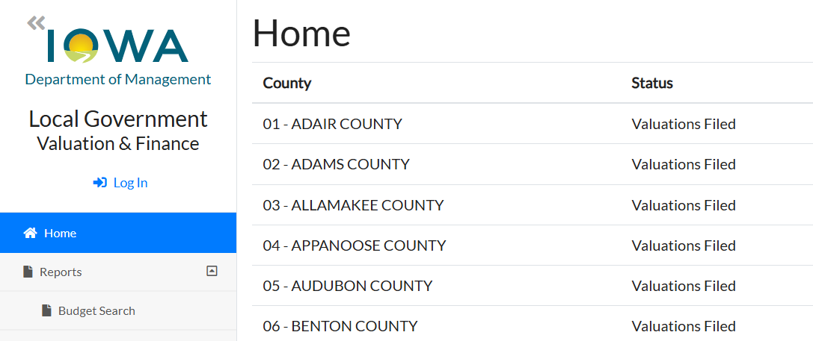

Slide 59
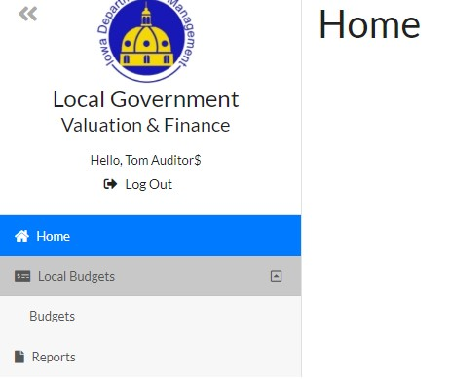
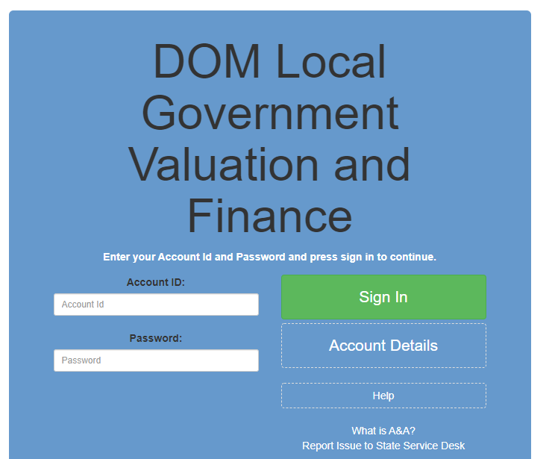
To begin your AFR:
Login using your Enterprise A&A an Account ID and password.

Slide 60
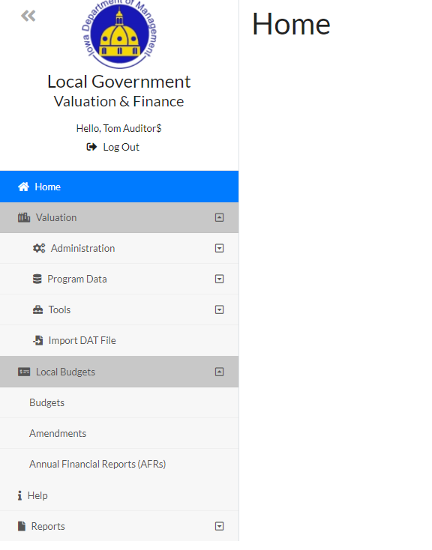
To begin your AFR:

Slide 61
AFR Screen
The new FY25 AFRs as well as past AFRs created in the system will be displayed.
Click the “Edit” icon to enter an AFR to view, enter data and print.
You can view and amend the AFR also from this screen.

Slide 62
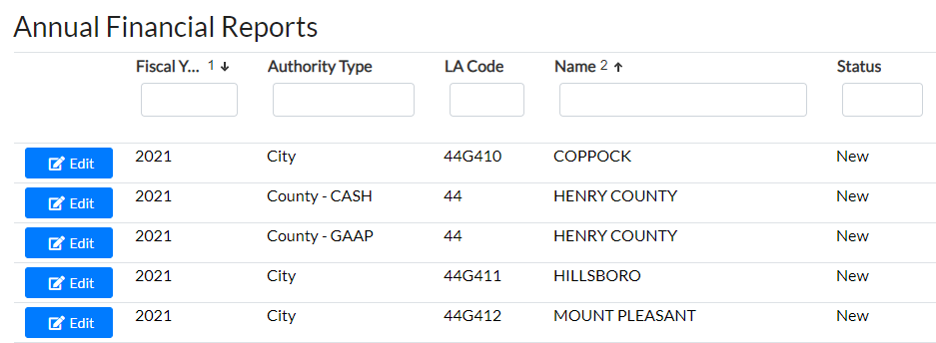
AFR Screen
Cities also complete their AFR in this online system, so cities in your county are listed along with the county ones.
However, obviously, you need to only be concerned with the county AFRs displayed at the top (CASH, then GAAP).

Slide 63
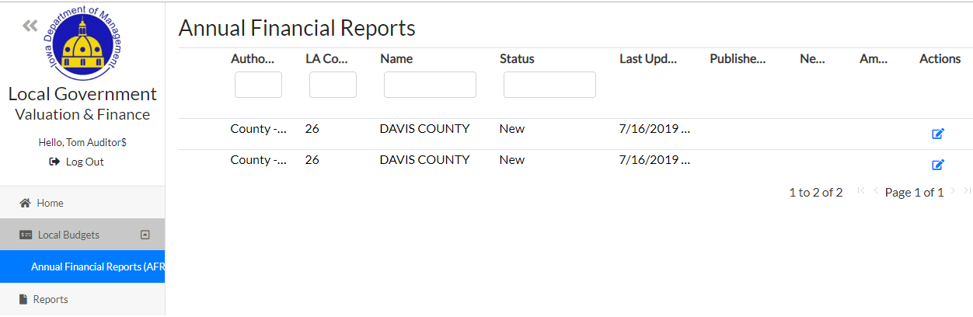
AFR Screen
If you are only a submitter for the County AFR (not a county auditor role) you will only see the Annual Financial Report option on the left and the two county reports displayed.

Slide 64
To begin your AFR:
To open a report and start working in it, select the check box or “Edit” under Actions.

Slide 65
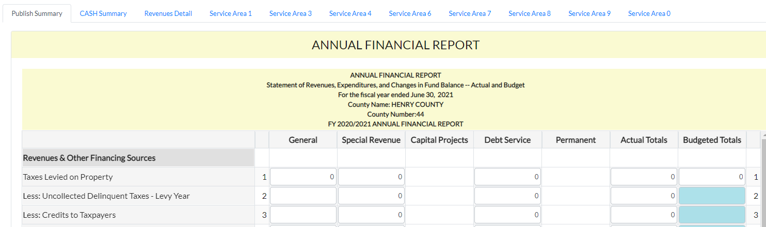
AFR Tabs and Pages
The online system has tabs that mirror the pages of the prior AFRs. Click on the tabs to
enter that page and start working

Slide 66
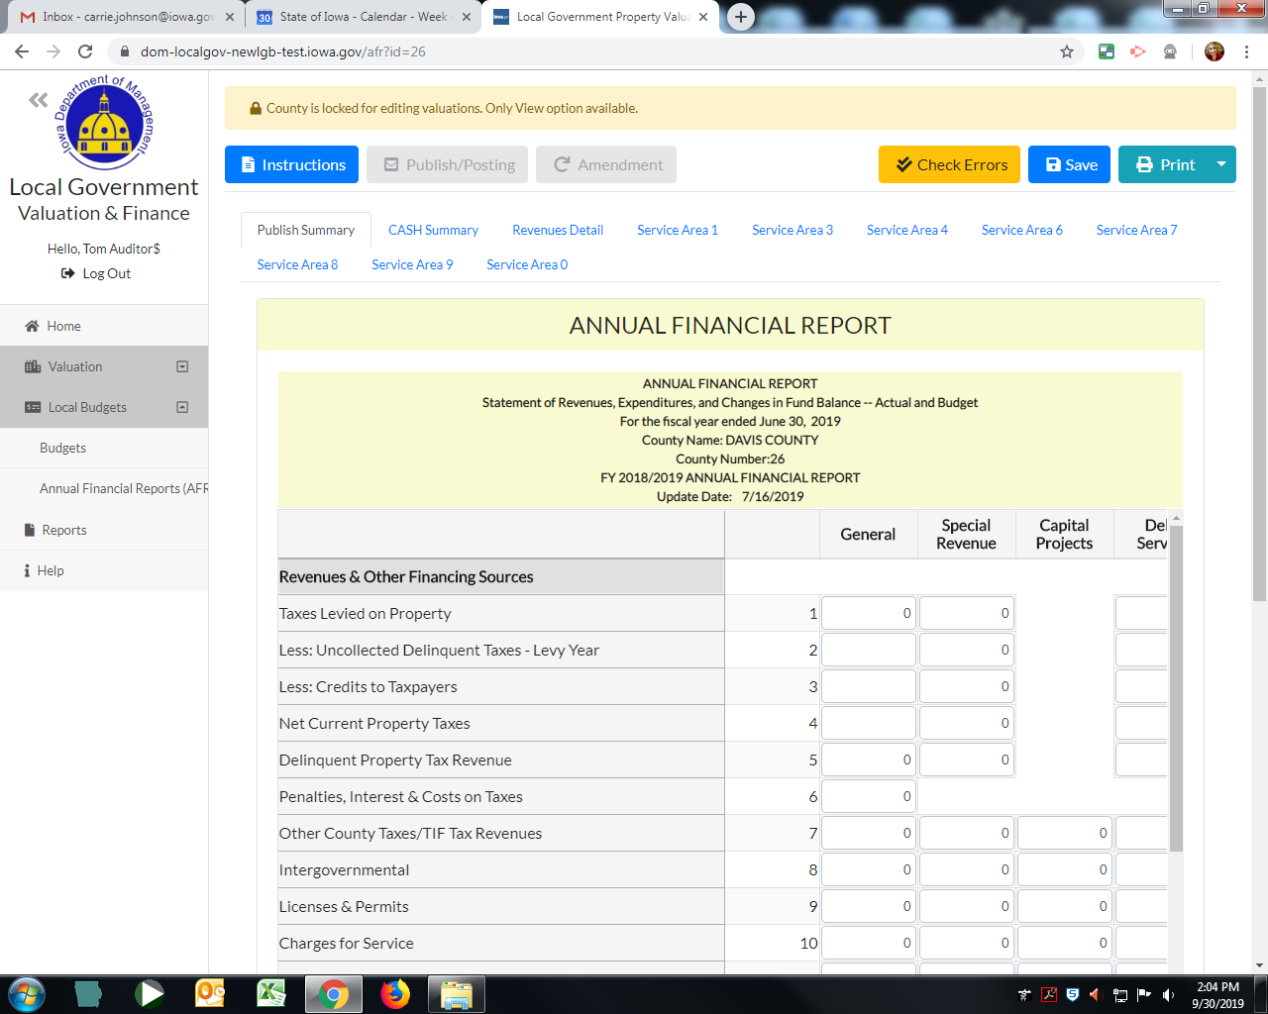
AFR Tabs or Pages
Click on “Instructions” to pull up a PDF of the Instruction document

Slide 67
AFR Tabs or Pages
As you are working in the system, be sure to click “Save” often
and at least before leaving a tab.

Slide 68
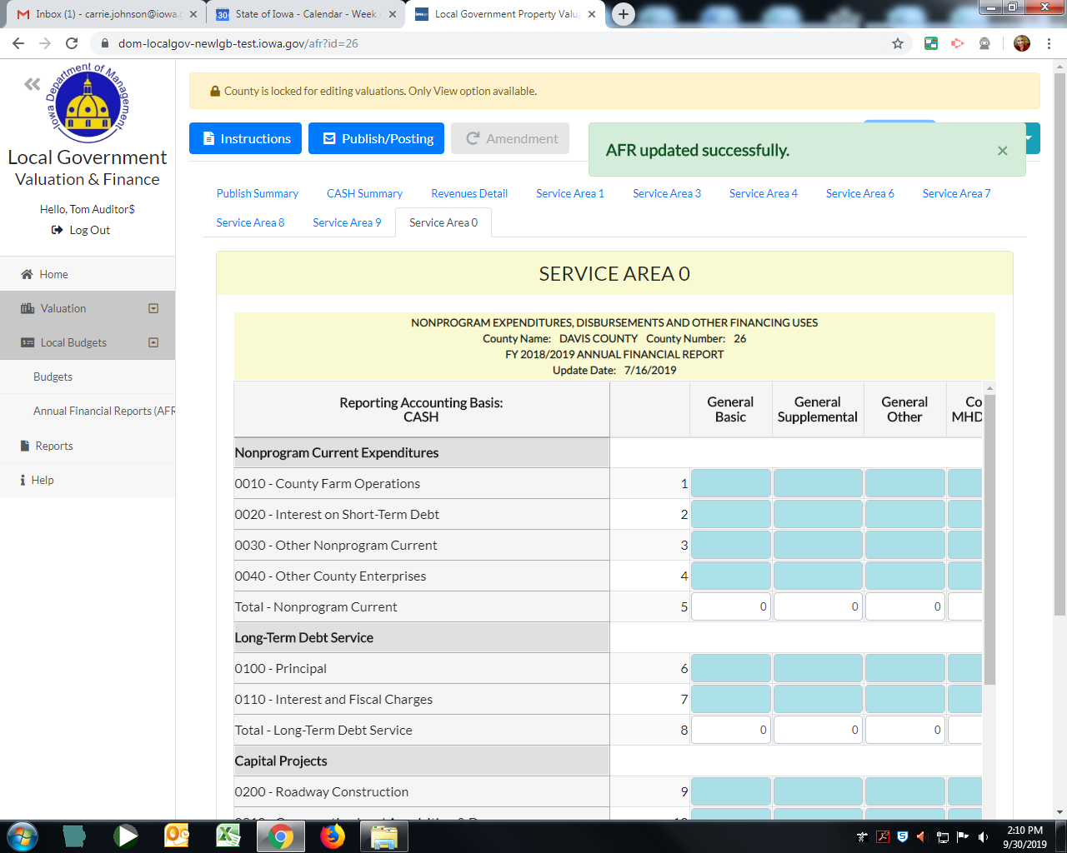
AFR Tabs or Pages
You will see a green box indicating your successful save.

Slide 69
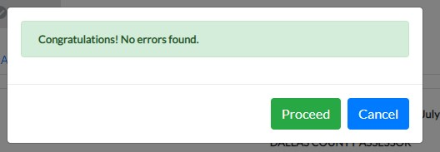
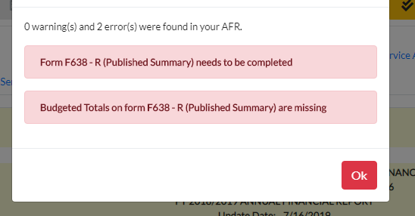
Check Errors
If you have errors, they will be displayed in red. You cannot publish your AFR with errors.
You may see “Warnings” in yellow. They do not prevent you from publishing, they are simply items to check.

Slide 70
Publish/Posting AFR
When you are ready to Publish your AFR, Select “Publish/Posting”

Slide 71
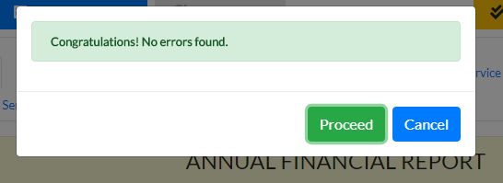
Publish/Posting AFR
The application will do its own errors check to make sure you are error free.
If you are, it will tell you “No errors found”.
Select “Proceed” or Cancel if you do not want to publish at this time.

Slide 72
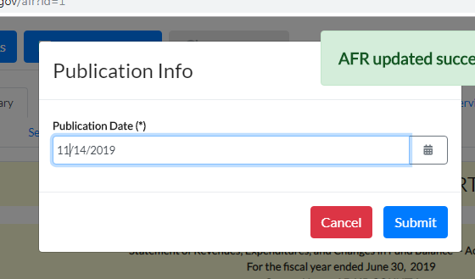
Publish/Posting AFR
The system will require you to enter the date the AFR will be published in a newspaper.
Enter your date in the format indicated DD/MM/YEAR and select “Submit”

Slide 73
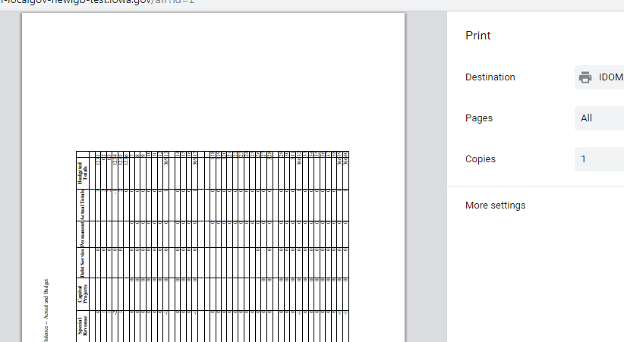
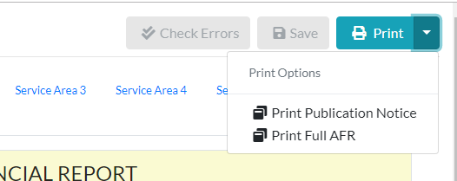
The application will generate a one page PDF that you can then submit to the newspaper.
You can print either the Publication Notice or the full AFR (in a PDF format) by select “Print” on the far right.
You can also print only the current page.

Slide 74
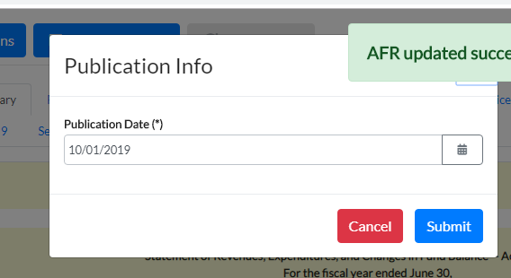
Publish/Posting AFR
CASH basis counties completing a GAAP report do not publish the GAAP report, but still select the Publish/Post option. Simply enter the date of posting to the web site
(typically this would be that date you click the button, as you feel you are finished with the report and are submitting it.)
DOM will note this as your submittal date.

Slide 75
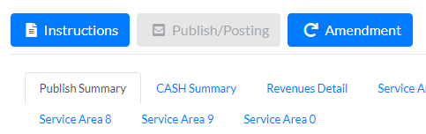
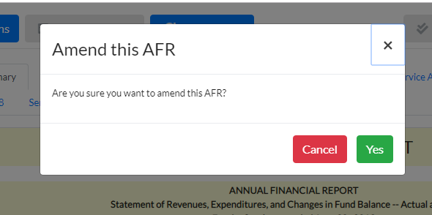
Amending AFRs
If you find you need to Amend either report, click the “Amendment” option.
This will not become available to you (it will be grayed out) until you have clicked “Publish/Post” at least once.
When you click “Amendment” it will ask if you are sure.

Slide 76
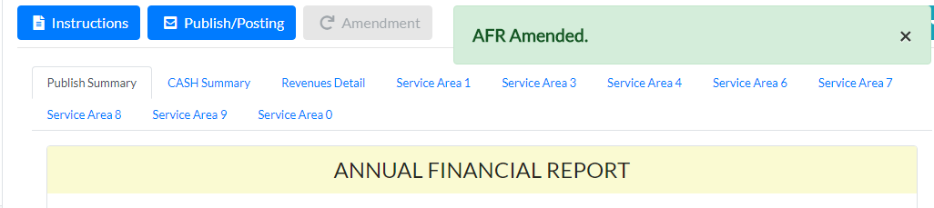
Amending AFRs
Selecting “Yes” will indicate the “AFR Amended” and will open up the report for changes.
Be sure to save often as you make any changes.

Slide 77
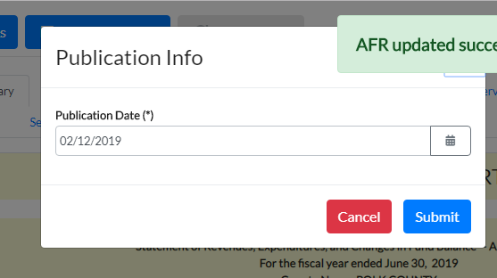
Amending AFRs
When you are finished with your amendment, select “Publish/Post” again to finalize your changes.
It will give you the option to enter a new publication date.
Unless the amendment is such that you are republishing, you do not need to change the date, just select “Submit”.
It will generate a new PDF, but you do not need to save it unless you are publishing again.

Slide 78
Contact:
Iowa Department of Management
State Capitol
Des Moines, IA 50319
Carrie Johnson
carrie.johnson@dom.iowa.gov
515-281-5598

