Slide 1
Carrie Johnson, Ted Nellesen, John Parker
State and Local Budgets Division
March 7, 2024

Slide 2
FY25 Budget Certification

Slide 3
General Timeframe
1.All local government budgets (except EMA) are due April 30.
2.County Auditors certify budgets
3.DOM sends out individual budget certifications
4.DOM then certifies consolidated tax rates by taxing district to county auditor
5.County auditor provides tax list to county treasurer by June 30

Slide 4
Budget Extensions
Cities and counties can request a budget extension from DOM in writing
“for circumstances beyond their control”

Slide 5
Budget Extensions
If an extension is granted, a letter with a new due date is sent to the city/county and the county auditor receives a copy.
No other levy authority has the option to request a budget extension

Slide 6
Late Budgets
Cities, counties and townships that certify their budget late are held to the last year’s certified taxes.
DOM will assist with applying the penalty.

Slide 7
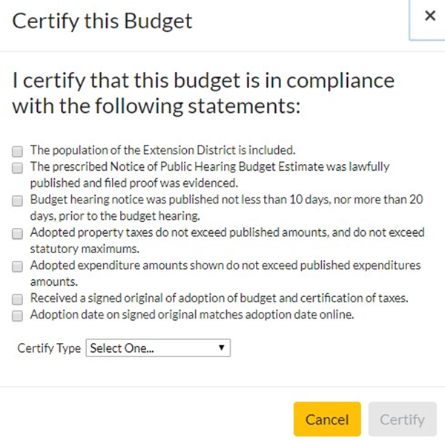
County Auditor’s Role
County auditor certifies all local budgets, including the county budget

Slide 8
Documents Filed with County Auditors
One (1) proof of publication or affidavit of posting (cities 200 and under).
Verify that publication requirements are met.
–The proof of publication can be a legible copy of what was published in the newspaper.
–The affidavit from the newspaper attests to the version published.
–If the proof of publication is not legible, request a new copy or have the levy authority request an original version.

Slide 9
Documents Filed with County Auditors
•One (1) copy of the Adopted Budget Summary
•One (1) SIGNED copy of the Adoption of Budget and Taxes (Property Tax Tab).
•One (1) copy of the detailed budget forms for the budget year.
•Long Term Debt Schedule for the Budget Year.
•New schedules or updated long term debt schedules if the payment amounts for the fiscal year have changed.
•Pre-Levy resolutions and Surplus Levy Resolutions if applicable.

Slide 10
Documents Filed with County Auditors
For COUNTIES, CITIES AND SCHOOLS ONLY-In addition to regular budget adoption proof, you will also need a proof of publication or affidavit of posting (cities 200 and under in pop.) for Proposed Property Tax Levy Notice per HF 718.
Do not send any paper documents to DOM-County Auditors keep and file these forms

Slide 11
Documents Filed with County Auditors
•Compare proof of publication with adopted budget:
–Budget hearing notice and budget estimates were published or posted within required timelines before budget hearing.
–Budget hearing notice and budget estimate was lawfully published in the official newspaper or posted as required.
–Adopted property taxes do not exceed published amount.
–Adopted expenditures do not exceed published amount.
–**Additional checks will be required for cities, schools and counties due to HF 718

Slide 12
Documents Filed with County Auditors
•Any errors in the above areas should be returned to the levy authority for correction. DOM can assist.
•Be sure to use the proof of publication for verification.
•Iowa Code allows expenditures and property tax dollars to be less than published but never more.

Slide 13
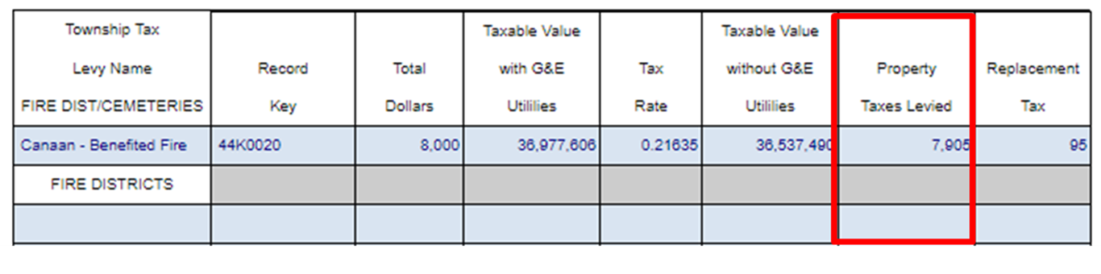
Levy authorities are held to the same tax dollars as what they published, not the same tax rate.

Slide 14
Documents Filed with County Auditors
Verify that the signed Adoption of Budget and Certification of Taxes matches the same form on the online system

Slide 15
Publication Timeline
Levy authorities have the requirement to publish/post notice not less than 10 and no more than 20 days before the date of the public hearing. The date of the hearing is not included.
For example, for a budget hearing on February 22, the hearing notice must be published on February 2 through February 12

Slide 16
HF718 Requirements
HF718 passed and requires an additional public hearing (for cities, schools and counties only) prior to the regular budget process. Replaces Max Levy process for cities and counties.
–Cities, schools and counties must file the following additional document with the county auditor per this new law:
For COUNTIES, CITIES AND SCHOOLS ONLY-One (1) proof of publication or affidavit of posting (cities 200 and under in pop.) for Proposed Property Tax Levy Notice per HF 718.

Slide 17
HF718 Requirements
Cities, schools and counties are also required to post notice on website and social media if applicable.
–Cities, counties, and schools will attest that they posted online as required (if applicable) when they adopt their budget.

Slide 18
HF718 Requirements
•County auditors need to verify all the regular budget documents and process as before.
•Due to the HF 718 requirements they also need to verify:
–Publication requirements were met for the additional notice.
–When the full budget is later adopted, the city, county, and schools did not exceed the total property tax asking published in the Proposed Tax Levy Notice.

Slide 19
Check Tax Rates
All tax rates must be authorized by statute.
–If a rate requires an election, be sure to have documentation of the election
–Make sure rates meet any other statutory parameters (for example, if a rate can only be used if another rate is at its maximum, be certain that requirement is being met)

Slide 20
Check Tax Rates
DOM budget software is designed to help control potential errors, but please ensure these are correct through the certification process.
DOM will annually provide a “Summary of Tax Rate Limitations” document

Slide 21
Check Debt Service
Check to ensure that any debt service levy is properly authorized (that you have a copy of the bond resolution)
Ensure that debt service taxes are being collected as required to meet a levy authority’s debt obligations
Verify that debt service levy is for general obligation debt, not revenue debt
If a bond resolution is filed after the budget deadline be sure to let DOM know.

Slide 22

Certifying Budgets Online
Once a budget is Adopted and the levy authority has given you their required budget documents, you log back into the online system to certify that budget.
Go to the applicable budget and select the
Edit Icon

Slide 23
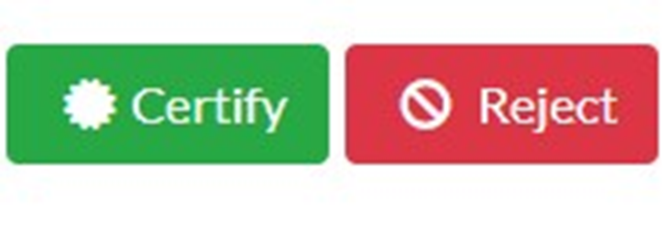
Certifying Budgets Online
Select the Certify button at the top.

Slide 24
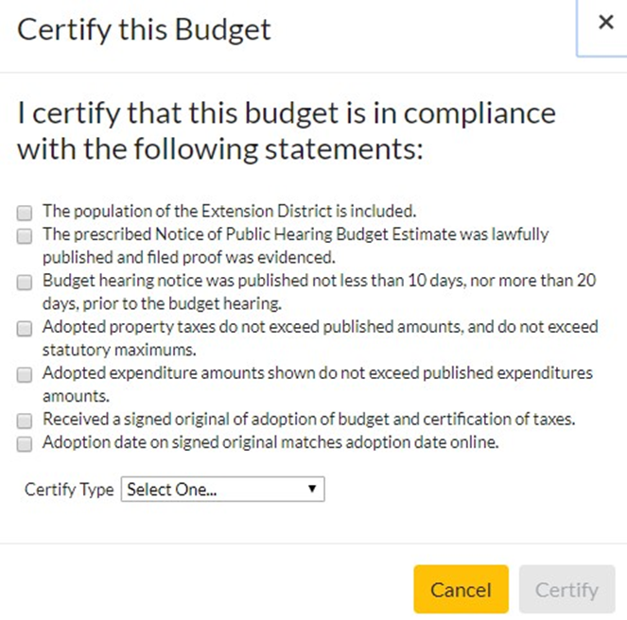
Certifying Budgets Online
A check box will appear specific to that budget type. All boxes must be checked to certify the budget.

Slide 25
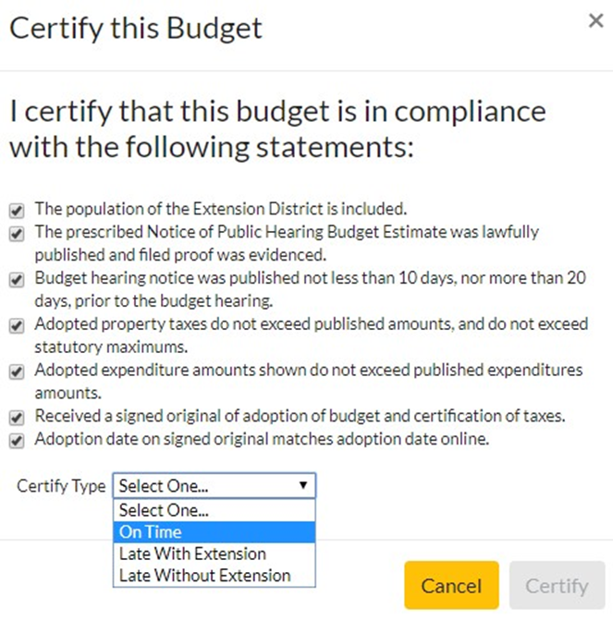
Certifying Budgets Online
You will indicate if a budget is certified on time, late or late with extension.

Slide 26
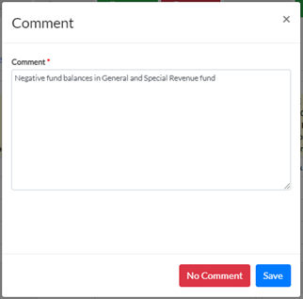
Certification Comments
After clicking on certify, an comment box will appear where any information pertinent to the certification of the budget can be entered and saved. If no comment is necessary, bypass this by clicking “No Comment”.

Slide 27

Certifying Budgets Online
The system will provide a notification at the top once budget is properly certified.

Slide 28

Certifying Budgets Online
If a budget is unable to be certified due to errors, it must be Rejected.
You would select the button at the
top of the screen.

Slide 29
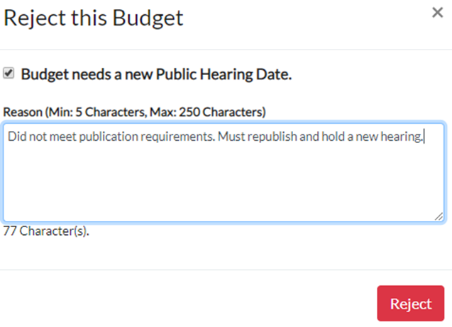
Certifying Budgets Online
You will need to enter a brief explanation if you are rejecting a budget. You also must indicate if the budget needs a new hearing (due to publication error, etc.)

Slide 30
Certifying Budgets Online
The budget will be rejected and returned to draft status so the levy authority can make required changes, propose again and create a new publication page.
If you are rejecting a budget for any reason, be sure to inform the impacted levy authority as well as DOM. We can assist with this process.

Slide 31
Budget Protests
•Protesting a local government budget is covered under Code of Iowa Section 24.27. Persons affected by the proposed budget, expenditure or tax levy, or by any item thereof, may appeal the budget by filing a petition and appeal with the county auditor of the county in which the local government is located. Deadline is May 10.
•Protests to county budgets require at least 100 signatures
•County Auditor forwards protest document to State Appeal Board

Slide 32
Budget Protests
State Appeal Board-
–Three member board comprised of the Auditor of State, Treasurer of State, and Director of the Department of Management.
–State Appeal Board schedules a local hearing on the budget. It is the intent that the conduct of hearings and appeals shall be simple and informal, subject only to rules prescribed by the State Appeal Board. The State Appeal Board may designate deputies to attend the local hearing.

Slide 33
Budget Protests
Following the hearing, the State Appeal Board will render a decision in writing within 45 days of the appeal hearing.
–State Appeal Board can reduce (but not increase) tax asking and expenditures within the protested budget.
–State Appeal Board works with the County Auditor to implement any required changes to the budget under protest prior to finalization of tax rate.
Prior decisions found on DOM web site.

Slide 34
DOM Finalization of Budgets
Once budgets for a levy authority are certified locally, DOM finalizes and issues tax certification forms
–DOM will alert local governments and county auditors when online system budgets are finalized. County auditors will log into the budget system and will access the finalized budgets. They would then print/save the certification page as a separate document.
–Expectation is certification is reviewed as soon as possible by both the county auditor and the local levy authority.
Discrepancies need to be reported immediately.

Slide 35
Tax Certificates
DOM will notify you once a levy authority type is finalized.
•Log into the online budget system
•“Edit” the individual budget to enter it
•Print the applicable certification page at your convenience.

Slide 36
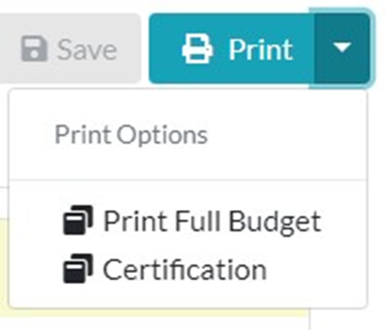
Tax Certificates

Slide 37
Tax Certificates
To access budget certifications for levy authorities for which your county is NOT the control county:
•DO NOT Log in to the online budget system
•Use the Budget Search option on the left to pull up the budget you need.
•Select the Cert button to the left of the budget to view their certification document. You can also select the View button to see the entire budget. Print the applicable certification page at your convenience.

Slide 38
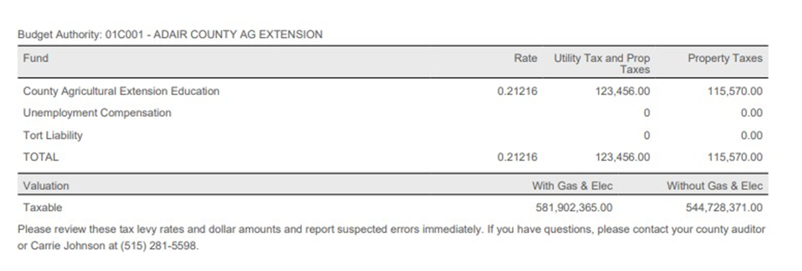
Tax Certificate Example

Slide 39
Consolidated Tax Rates
DOM certifies the final total property tax levies by tax district to county auditor-consolidated rates list
–Double check the total rates per tax district add to your total rates
–Notify DOM as soon as possible with any discrepancies.

Slide 40
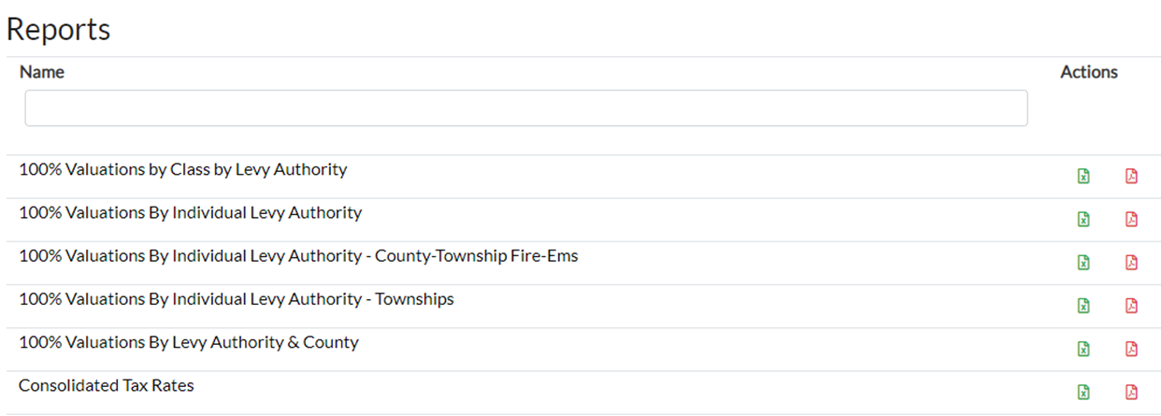
Consolidated Tax Rates
Go to https://dom-localgov.iowa.gov/home and “Reports” and find “Consolidated Tax Rates”

Slide 41
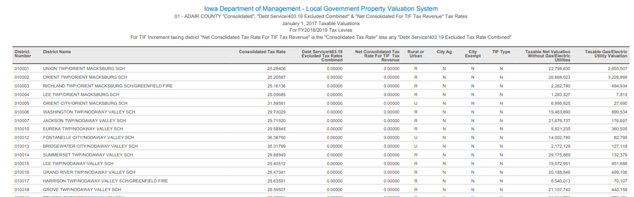
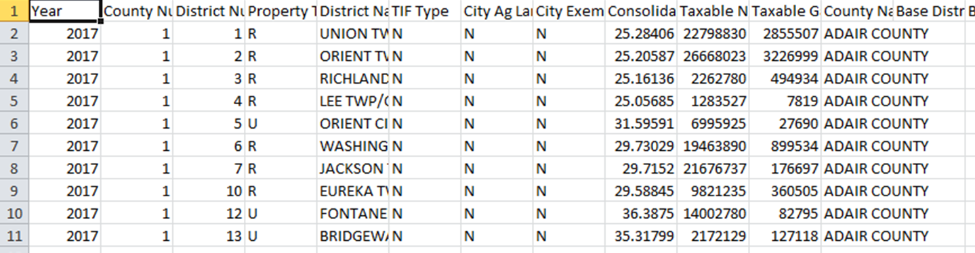

Slide 42
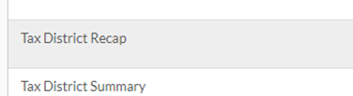
Consolidated Tax Rates
Can also view the component pieces of the consolidated rate by tax district with the Tax District Recap Report-also in PDF or CSV

Slide 43
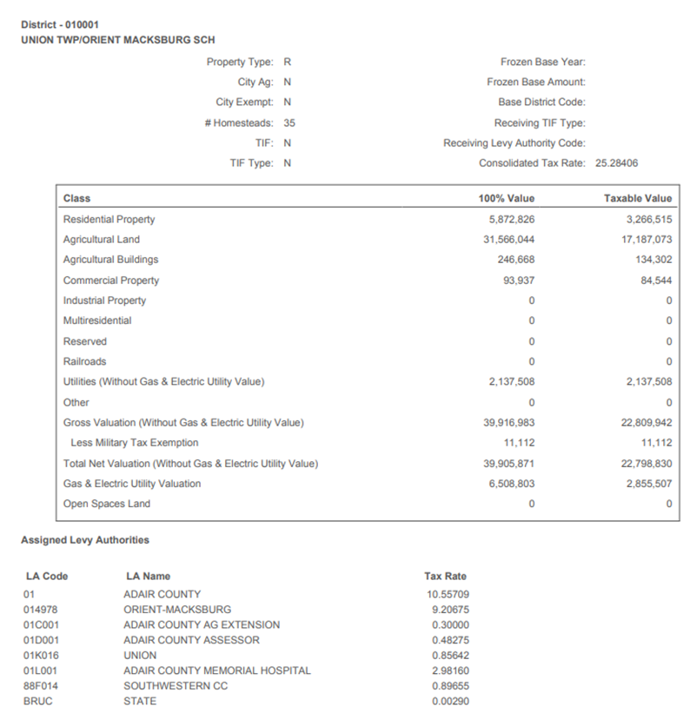
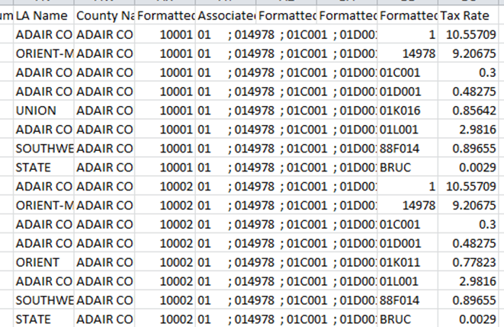

Slide 44
Schools Budget Certification

Slide 45
Proof of Publication/Affidavit
1.) The proof of publication/affidavit from the newspaper was filed in the county auditor’s office for the Proposed Tax Notice (first hearing notice)
2.) The proof of publication/affidavit from the newspaper was filed in the county auditor's office for the Budget Adoption Notice (second hearing notice)

Slide 46
Proof of Publication/Affidavit
3.) Proposed Tax Notice (first hearing notice) was published not less than 10 days, nor more than 20 days, prior to the budget hearing.
4.) Budget Adoption (second hearing notice) was published not less than 10 days, nor more than 20 days, prior to the budget hearing.

Slide 47
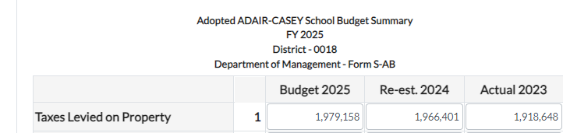
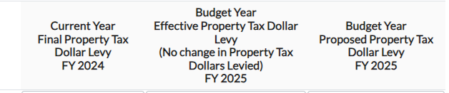
Adopted Taxes Levied on Property
5.) Adopted Taxes Levied on Property (Line 1) of the Adopted Budget Summary for the Budgeted Fiscal Year do not exceed:
Published amounts on the Proposed Tax Notice (First Notice) for the Grand Total Property Taxes

Slide 48
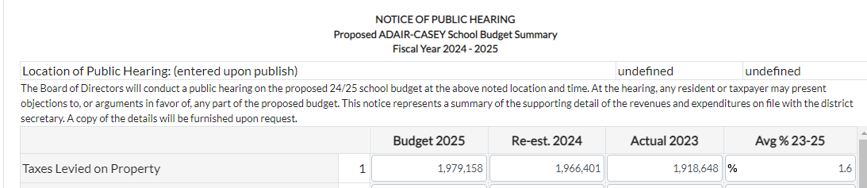
Adopted Taxes Levied on Property
6.) Adopted Taxes Levied on Property (Line 1) of the Adopted Budget Summary for the Budgeted Fiscal Year do not exceed:
Published amounts on the Budget Adoption Notice (Second Notice) for the Taxes Levied on Property (Line 1):

Slide 49
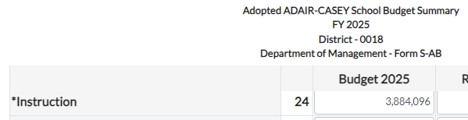
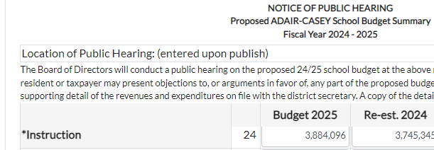
Adopted Expenditures
Instruction line 24
7.) Adopted expenditures do not exceed published in each of the four individual expenditure categories:

Slide 50
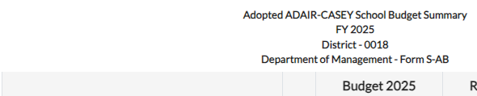

Adopted Expenditures
2.) Total Support Services (line 31A)
7.) Adopted expenditures do not exceed published in each of the four individual expenditure categories:

Slide 51
Adopted Expenditures
3.) Noninstructional Programs (line 32)
7.) Adopted expenditures do not exceed published in each of the four individual expenditure categories:

Slide 52

Adopted Expenditures
4.) Total Other Expenditures (line 35A)
7.) Adopted expenditures do not exceed published in each of the four individual expenditure categories:

Slide 53
Debt Service needs are met
8.) Adopted property taxes meet the debt service and loan agreement needs identified on the Long Term Debt Schedule.
There are four sections to the School Long Term Debt Schedule each for a different purpose:
Voted GO Bonds - Bonds approved by 60% of the Voters - Property Taxes Can be Levied to Service the Bonds
Advanced Surplus Levy - Additional Property Tax Levy for current GO bonds to pay off the GO debt sooner
Voted PPEL Loan - Loans against the VPPEL - To ensure levy will pay principal and interest of loan
Sales Tax Revenue Bonds - To complete reporting of bonds against SAVE dollars

Slide 54
Debt Service needs are met
8.) Adopted property taxes meet the debt service and loan agreement needs identified on the Long Term Debt Schedule.
The County Auditor is Responsible for Verifying the first two sections:
Voted GO Bonds - Bonds approved by 60% of the Voters - Property Taxes Can be Levied to Service the Bonds
Advanced Surplus Levy - Additional Property Tax Levy for current GO bonds to pay off the GO debt sooner

Slide 55
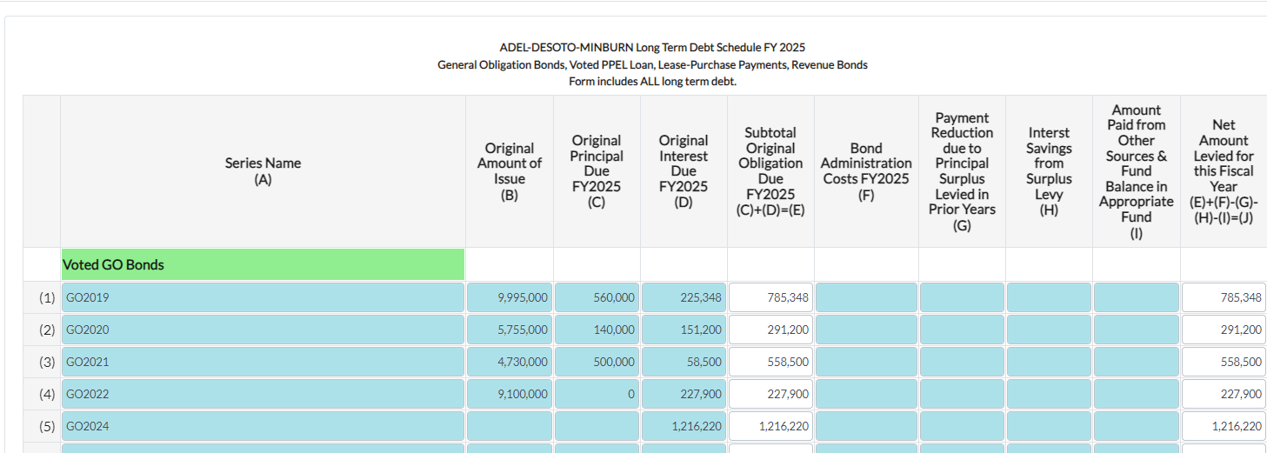
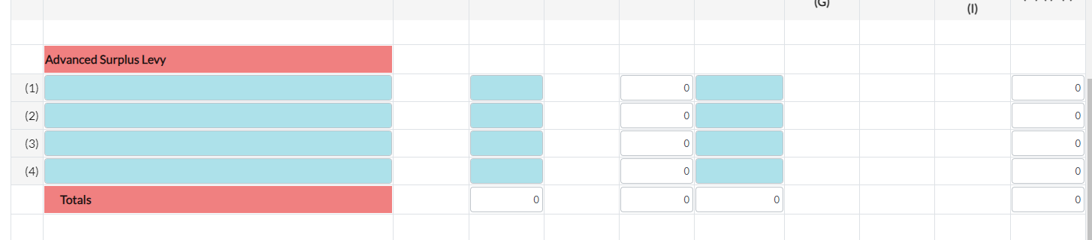
Debt Service needs are met
8.) Adopted property taxes meet the debt service and loan agreement needs identified on the Long Term Debt Schedule.

Slide 56
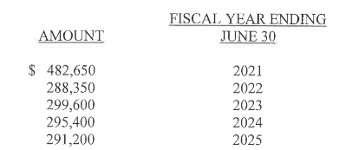
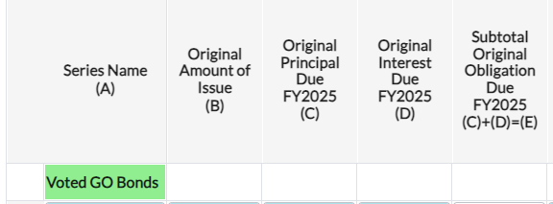
Debt Service needs are met -
Voted GO Bonds
8.) Adopted property taxes meet the debt service and loan agreement needs identified on the Long Term Debt Schedule.

Slide 57
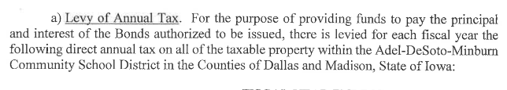
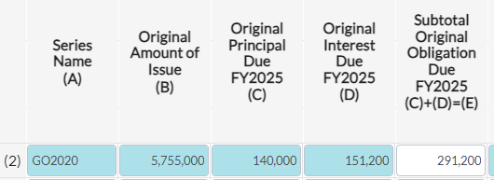
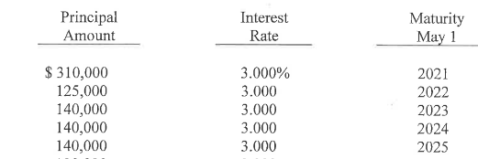
Debt Service needs are met -
Voted GO Bonds
8.) Adopted property taxes meet the debt service and loan agreement needs identified on the Long Term Debt Schedule.

Slide 58
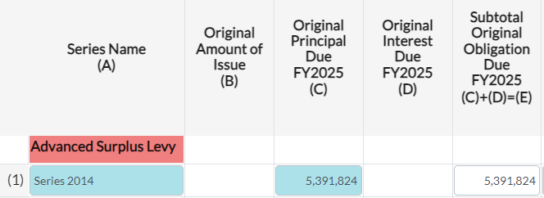
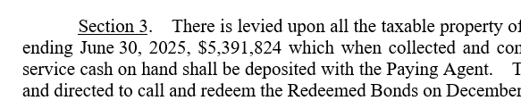
Debt Service needs are met -
Voted GO Bonds
8.) Adopted property taxes meet the debt service and loan agreement needs identified on the Long Term Debt Schedule.

Slide 59
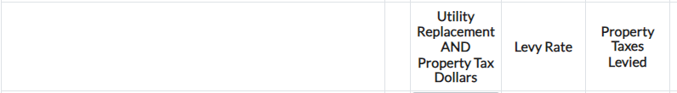
Voted Physical Plant & Equipment Levy Verified
9.) Voted Physical Plant & Equipment Levy (VPPEL), if used, is currently in force (verified with Abstract of Election).

Slide 60
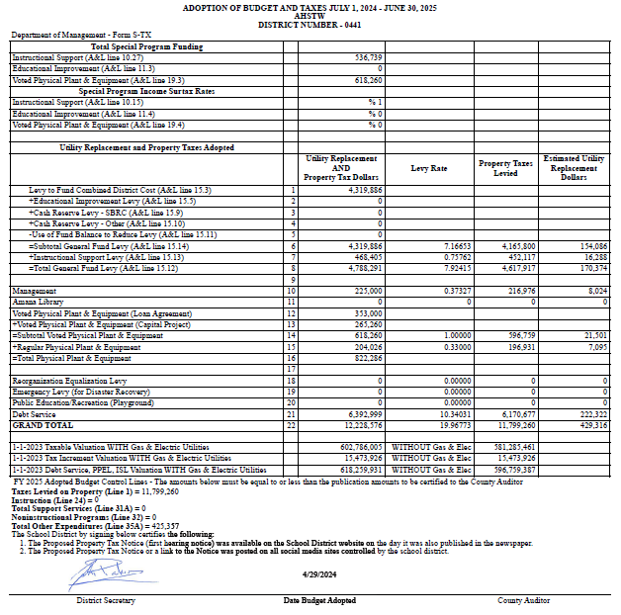
Signed Adoption of Budget and Taxes
10.) Received a signed original of adoption of budget and certification of taxes.

Slide 61
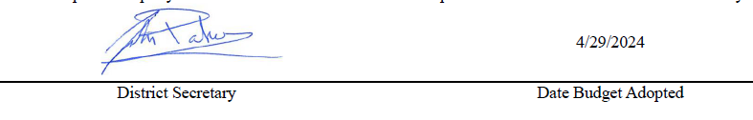
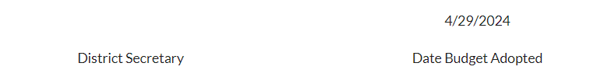
Adoption Date Matches
11.) Adoption date on signed original matches adoption date online.
Signed Original Submitted to County Auditor:
Budget System Online version of “Property Tax” Tab:

Slide 62
Ted Nellesen; ted.nellesen@iowa.gov; 515-281-3705
•Cities
•Townships
•Miscellaneous Districts including:
–Regional Transit Districts
–Soil and Water Conservation
–Land Use
–Benefited Water, Fire, Street Lighting, Law Enforcement, Recreational Lake
–Emergency Medical Services
–Rural Improvement Zones
–Sanitary Districts
–Other Miscellaneous Taxing Districts
John Parker; john.parker@iowa.gov ; 515-281-8485
•School Districts
•Community Colleges
•Emergency Management Agencies
•911 Service Boards
Carrie Johnson; carrie.johnson@iowa.gov; 515-281-5598
•Property Valuations
•Utility Replacement Excise Tax
•Counties
•Hospitals
•Agricultural Ext
•Assessors

