Slide 1
Carrie Johnson
Fiscal & Policy Analyst Senior
State and Local Budgets Division
February 28, 2024

Slide 2
HF 718
Proposed Property Tax Mailing

Slide 3
First: A Few Reminders…
BY MARCH 5 (NO LATER THAN MARCH 15 BY CODE)
Cities, Counties and Schools enter Proposed Property Tax Notice Hearing (1st hearing) information in DOM Online Budget System. This information is used for the Proposed Property Tax notice hearing statement mailed by County Auditors to taxpayers.
ON MARCH 20
County Auditors mail Proposed Property Tax notice statements to taxpayers in their county.
PLEASE NO EARLIER THAN MARCH 25
Cities/Counties/Schools hold their 1st hearing, this one on the Proposed Property Tax levy (in addition to the mailing, notice must have been published/posted no later than 10/no more than 20 days prior to the date of hearing)
BY APRIL 30
Cities/Counties/Schools hold 2nd hearing, this one is the regular hearing on the full budget (notice must have been published/posted no later than 10/no more than 20 days prior to the date of hearing)

Slide 4
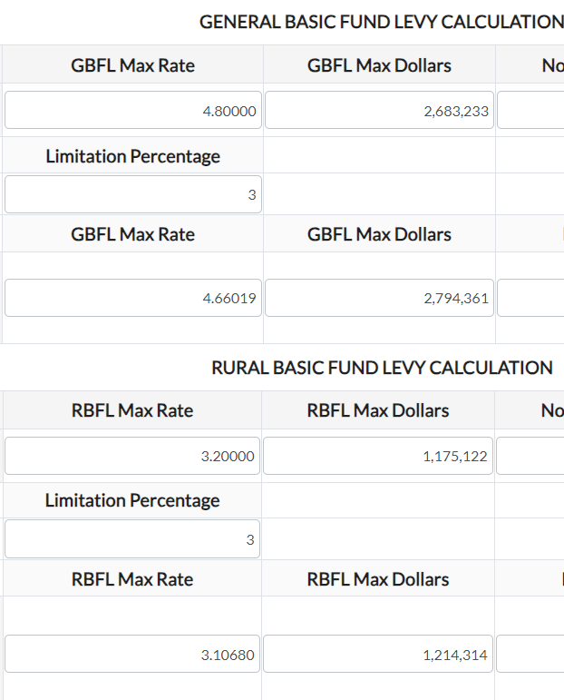
First: A Few Reminders…
You CANNOT
exceed
YOUR COUNTY’S
listed maximum
rates/levies

Slide 5
First: A Few Reminders…
The statutory language and concept behind the General Supplemental is that you can ONLY use it when you determine your tax capacity in the General Basic is not enough. While the General Supplemental is not rate limited, it can only be used for those items listed in Code of Iowa 331.424. Again, you must be at your county's maximum in order to use the General Supplemental.
If you choose to use the General Supplemental on top of the General Basic in FY25 and you are decreasing the countywide tax asking, you would reduce that from the General Supplemental asking first, as it is an optional, add-on levy used only when you have determined the General Basic alone is not enough for you.

Slide 6
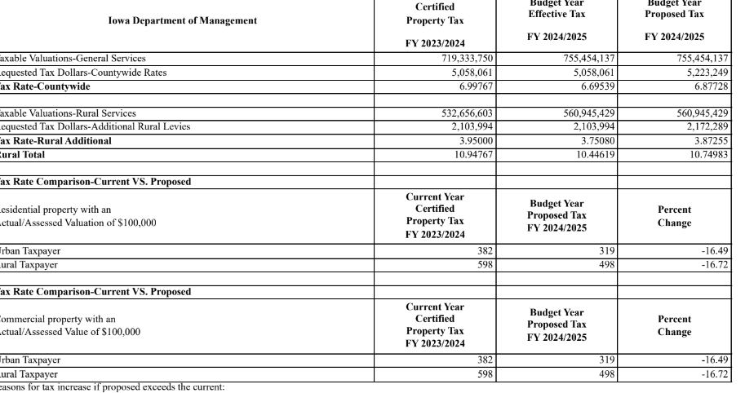
And an explanation…

Slide 7
And an explanation…
FY24
100,000 * 54.6501= 54,650 (same for both commercial and residential examples since the first 150,000 of commercial gets the residential rollback)
(54,650/1000) *6.99767=382
(54,650/1000) *10.94767=598
FY25
100,000 * residential rollback of 46.3428 = 46,343 (same for both commercial and residential examples since the first 150,000 of commercial gets the residential rollback)
(46,343/1000)*6.87728=319
(46,343/1000)*10.94767=498
Percent change
382-319=63 63/382= -16.49%
598-498=100 100/598= -16.72%
So the assessed value staying at 100,000 for both years, coupled with the big drop in the residential rollback in FY25 is going to make most examples negative.

Slide 8
HF 718 Mailing to Taxpayers
No more MAX LEVY for cities and counties
Requires cities, counties and schools submit the following information via DOM system
-Time, Date and Place of hearing
-Proposed Budget Year Tax Rate and Dollars
-If there is an increase, an explanation of the reasons for the increase, detailing specific purposes or programs

Slide 9
HF 718 Mailing to Taxpayers
Total Current Year Tax Rate and Dollars (DOM Provides)
An example of the tax impact on a residential and commercial property (DOM Provides)
Percentage of current year property tax rate in relation to other levy authorities (DOM Provides)

Slide 10
HF718 Proposed Tax Notice
Requires notice be published of this public hearing in the same manner as the regular budget notice (for counties, all official newspapers)
Requires it be placed on local government’s web page and social media

Slide 11
HF718 Proposed Tax Hearing
Public Hearing is separate from any other meeting and no other business shall be conducted at the hearing
No action required after the hearing.
The local government may decrease but NOT increase the property tax adopted in the final budget.

Slide 12
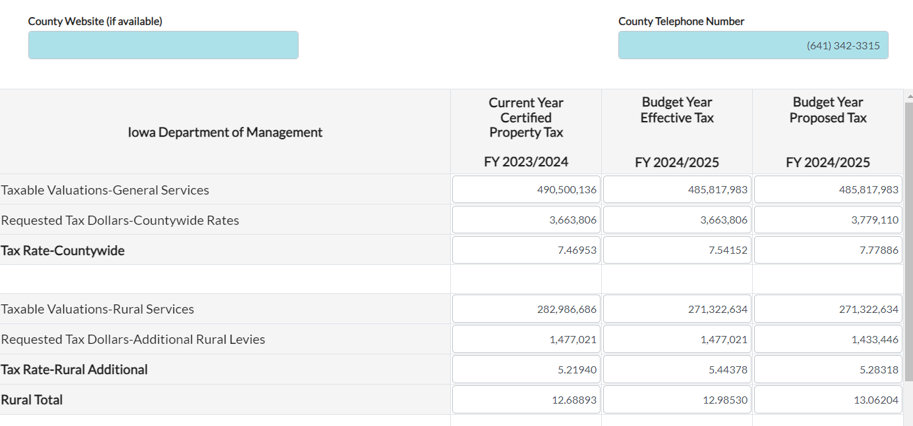

Slide 14
HF 718 Mailing to Taxpayers
BY MARCH 5 (NO LATER THAN MARCH 15 BY CODE)
Cities, Counties and Schools enter Proposed Property Tax Notice Hearing (1st hearing) information in DOM Online Budget System.
DOM INSTRUCTION TO CITIES, COUNTIES and SCHOOLS WILL STATE INFORMATION NEEDS TO BE ENTERED BY MARCH 15th at 4:00 PM TO BE INCLUDED IN MAILING
MARCH 20
County auditor to mail the budget statements to taxpayers

Slide 15
Document to be Mailed
DOM created the form to be mailed and supplied it to software providers as well as mailing companies as requested.
One page document-2 sided

Slide 16
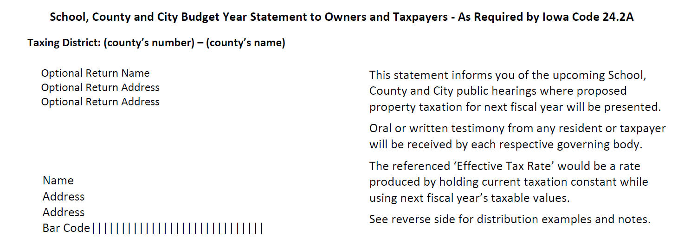
Document to be Mailed

Slide 17
Document to be Mailed

Slide 18
Document to be Mailed

Slide 19
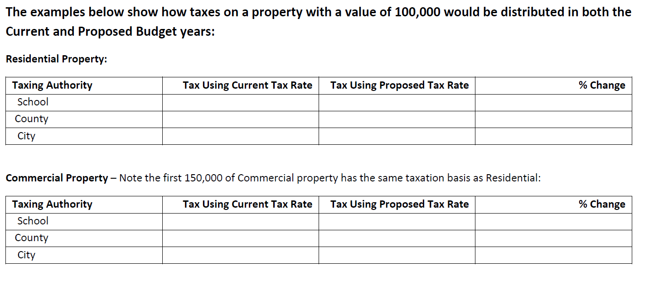
Document to be Mailed

Slide 20
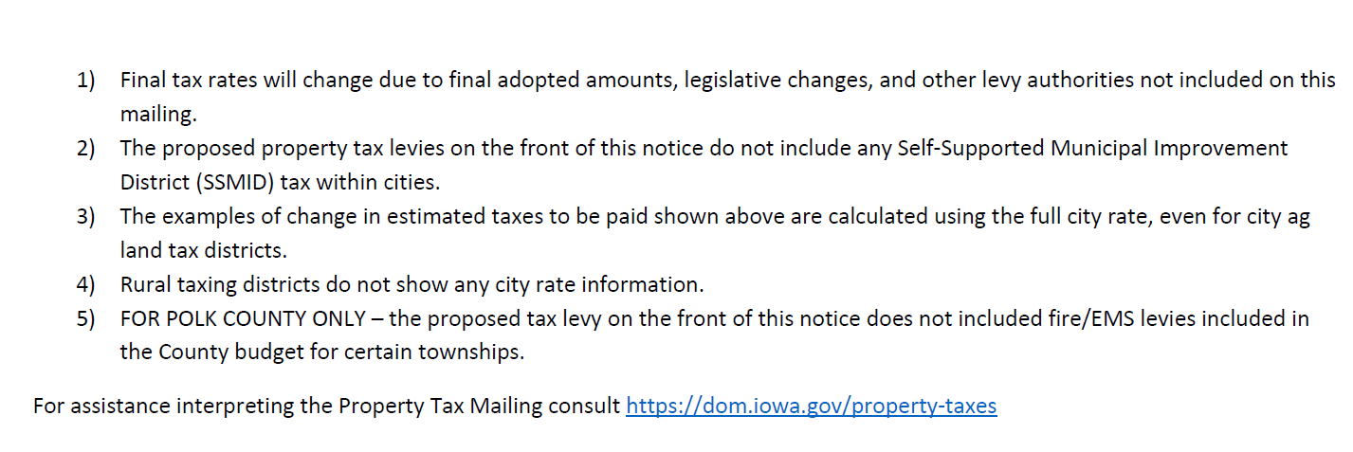
Document to be Mailed

Slide 21
Data for the Document to be Mailed
Source data for the mailing:
-DOM system when cities, counties and schools enter their information for their hearing notice
-Current year distribution is DOM calculated fields from current year data.

Slide 22
Data for the Document to be Mailed
County auditor logs into DOM system
Option on left hand navigation for County Auditor Property Tax Mailing

Slide 23
Data for the Document to be Mailed

Slide 24
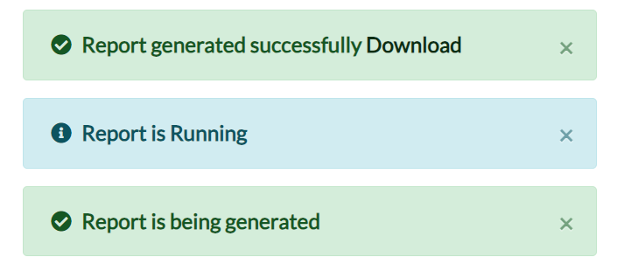
Data for the Document to be Mailed

Slide 25
Data for the Document to be Mailed

Slide 26
Data for the Document to be Mailed

Slide 27
Data for the Document to be Mailed

Slide 28
Document to be Mailed
DOM data is by DOM tax district number
County software has parcels by DOM tax district number
County software will merge the downloaded CSV file with budget statement template so mailing to parcels (property tax payers) can occur.

Slide 29
Two weeks out to mailing…
Please touch base with small cities to help keep them in the loop.
Be ready to assist with questions regarding the mailing. You can direct folks to our website for general explanation.
**Failure of a taxpayer to receive the mailing does not invalidate the process.

