Slide 1

New Pharmacy/Manufacturer Settlements

Slide 2
RECAP: Where we have been in this litigation….
Starting in 2017 lawsuits targeted three groups:
Manufacturers
Distributors
Retail Chain Pharmacies

Slide 3
Manufacturers
Purdue (bankruptcy)
Janssen (settled)
Mallinckrodt (bankruptcy)
Actavis / Allergan / Teva (new proposed settlement)
Endo (Bankruptcy)
Insys (Bankruptcy)

Slide 4
The Distributors
McKesson Corporation (settled)
AmerisourceBergen Drug Corporation (settled)
Cardinal Health Inc. (settled)

Slide 5
The Pharmacies
Walmart (new proposed settlement)
Walgreens (new proposed settlement)
CVS (new proposed settlement)
Regional pharmacy chains (in negotiations)

Slide 6
New Settlements:
Allergan
Teva
CVS
Wal-Mart
Walgreens

Slide 7
Manufacturers
Allergan $2.37 billion to be paid over 6 years
Teva $4.25 billion to be paid over 13 years
TOTAL: $6.62 billion

Slide 8
Pharmacies
Walgreens $5.7 billion to be paid out over 15 years
CVS $5 billion to be paid out over 10 years
Wal-Mart $3.1 billion to be paid out over 5 years
TOTAL: $13.8 billion

Slide 9
Total Settlements
$26 billion (Distributors + J&J)
$6.62 billion (Allergan +Teva)
$13.8 billion (Walgreens, Walmart, CVS)
Nearly $50 Billion

Slide 10
Additional Non-Monetary Relief
Teva and Allergan have agreed to strict limitations on their marketing, promotion, sale, and distribution of opioids, including a ban on: (1) promotion and lobbying; (2) rewarding or disciplining employees based on volume of opioid sales; and (3) funding or grants to third parties;
Walmart, CVS, and Walgreens are required to implement changes in how they handle opioids, including requirements addressing their compliance structures, pharmacist judgment, diversion prevention, suspicious order monitoring, and reporting on red-flag processes, as well as blocked and potentially problematic prescribers.

Slide 11
Estimated Amounts to Iowa:
Defendant | IA
Allergan | $ 15,825,667.97
CVS | $ 35,138,251.76
Teva | $ 26,564,169.89
Walgreens | $ 38,209,169.06
Walmart | $ 19,898,247.84
Total | $ 135,635,506.53
IA Settlement |  |  | $135,635,506.53
State Share | IA Settlement |  | $135,635,506.53
 | State Share |  | $67,817,753.26
LG Share | LG Share | 50% | $67,817,753.26
Allocation in Iowa is Identical to First Settlements

Slide 12

Where does the information reside?
https://nationalopioidsettlement.com/

Slide 13
Current Settlements:
In late 2022, agreements were announced with three pharmacy chains—CVS, Walgreens, and Walmart—and two additional manufacturers—Allergan and Teva.
In January 2023, each of those pharmacy chains and manufacturers confirmed that a sufficient number of states had agreed to the settlements to move forward.
As with the 2021 National Settlements, states and local governments that want to participate in the 2022 National Settlements now will have the opportunity to “opt in.” The greater the level of subdivision participation, the more funds will ultimately be paid out for abatement.

Slide 14
Critical Mass
The NEW settlements are once again dependent on the participation of States and Local Governments!
We are currently in the Approval Phase- we will need to go through the Participation Process with each County to maximize participation throughout the entire country.
This was a major lift last time around and we hope to use the same process to make things move smoother & faster

Slide 15
What Do You Need to Do?
Get Board Approval and Sign Your Participation Agreements and Addendum to the MOA before April 18, 2023.
Documents in Iowa have already been sent to your registered contact person
Let us know if your county has NOT received this!

Slide 17
Recap: Action Items
Execute the Participation Agreements that come to your County!!!
Before April 18, 2022.
As of today – We have received 33 of the executed forms back…. KEEP THEM COMING!!!!

Slide 18
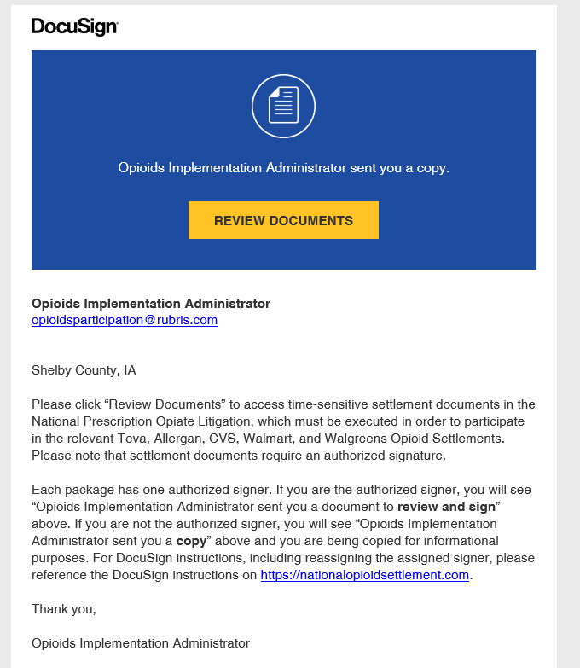

Slide 19
Bankruptcies

Slide 20
Noat Information:
https://www.nationalopioidabatementtrust.com/

Slide 21
Mallinckrodt Bankruptcy:
$1.725 Billion Bankruptcy Settlement approved in US Bankruptcy Court on February 3, 2022
$1.275 Billion of the total will be used to establish the Opioid MDT II Trust
The FUNDS are already being DISTRIBUTED
REPORTING REQUIREMENTS WILL SOON GO INTO EFFECT!
The Trust will post reports required by the governing documents after the Reporting Deadline.
First Deadline – Should be 2024 – Unless FUNDS were Already Received?

Slide 22
Purdue Bankruptcy:
Waiting on 2nd Circuit Decision – but Practical Reality is Bankruptcy OVER
$6 Billion in Funds

Slide 23
ENDO Bankruptcy:
Will Move Quickly and Will Follow Lead of Mallinckrodt
Less than $1billion in Funds

Slide 24
Bankruptcies
Approximately $8 Billion in Additional Funds for Governments
All FUNDS must be used for approved purposes
No FUNDS dispensed to Counties can be used for Attorney Fees
There are small Attorney Fee Funds – which will primarily be used to pay our Excellent MDL Bankruptcy Counsel
We anticipate receiving No Attorney Fees from these Bankruptcies

Slide 25

What remains?

Slide 26
Clean Up: What Remains
Approximately 100 Defendants Remain
Judge Polster is Still Presiding over MDL
Most of the remaining defendants are regional (some of significant but most are nominal)
PEC is Considering Size and Value of Proceeding and Will Soon Make Dismissal Recommendations to Counties
We plan that Additional Settlements will be Reached with the larger Entities such as Kroger, Publix, Albertsons.

Slide 27

Questions?

