Slide 1
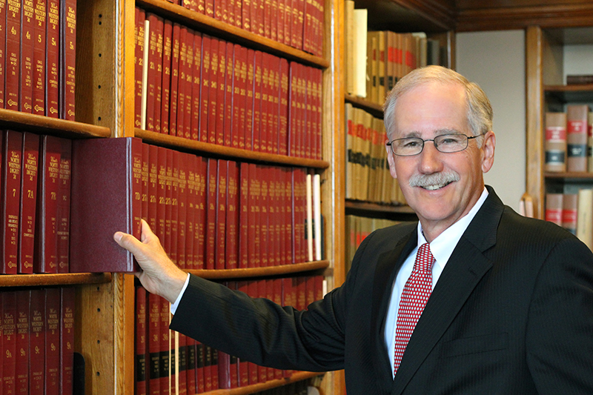
ALL ABOUT YOUR ASSOCIATIONS
Presented by
Bill Peterson
ISAC Executive Director
January 18, 2023

Slide 2
IOWA STATE ASSOCIATION OF COUNTIES (ISAC)
VISION
TO BE THE PRINCIPAL, AUTHORITATIVE SOURCE OF REPRESENTATION, INFORMATION, AND SERVICES FOR AND ABOUT COUNTY GOVERNMENT IN IOWA.
MISSION
TO PROMOTE EFFECTIVE AND RESPONSIBLE COUNTY GOVERNMENT FOR THE PEOPLE OF IOWA.
WWW.IOWACOUNTIES.ORG

Slide 3
The Iowa State Association of Counties (ISAC) serves approximately 600 elected officials, 1000 appointed county officials, and 15,000 county employees in the state of Iowa. Incorporated in 1964, ISAC’s purpose is to:
Represent the interests of counties and their citizens at both the state and federal level through advocacy of member adopted policies.
Provide a forum for the exchange of information, ideas, and experiences about local government services.
Assist county officials with the development of efficient and standardized administrative practices in order to reduce the cost of operations.
Develop and promote county official education to maximize their ability to efficiently serve their citizens.
Perform all other things necessary, proper, and fitting to provide appropriate services to member counties.

Slide 4
ISAC is governed by a 21-member board of directors elected or appointed to represent each of ISAC’s 16 affiliate organizations. There are six elected affiliates and 10 appointed affiliates, all representing county offices or departments.
Elected Affiliates – Auditors, Treasurers, Recorders, Sheriffs, County Attorneys, Supervisors
Appointed Affiliates – Assessors, Community Services, Conservation, Emergency Management, Engineers, Environmental Health, Information Technology, Planning and Zoning, Public Health, Veterans Affairs

Slide 5
NATIONAL ASSOCIATION OF COUNTIES (NACo)
VISION
HEALTHY, SAFE AND VIBRANT COUNTIES ACROSS AMERICA
MISSION
STRENGTHEN AMERICA’S COUNTIES
The National Association of Counties (NACo) strengthens America’s counties, serving nearly 40,000 county elected officials and 3.6 million county employees. Founded in 1935, NACo unites county officials to:
• Advocate county priorities in federal policymaking
• Promote exemplary county policies and practices
• Nurture leadership skills and expand knowledge networks
• Optimize county and taxpayer resources and cost savings • Enrich the public’s understanding of county government
WWW.NACO.ORG

Slide 6
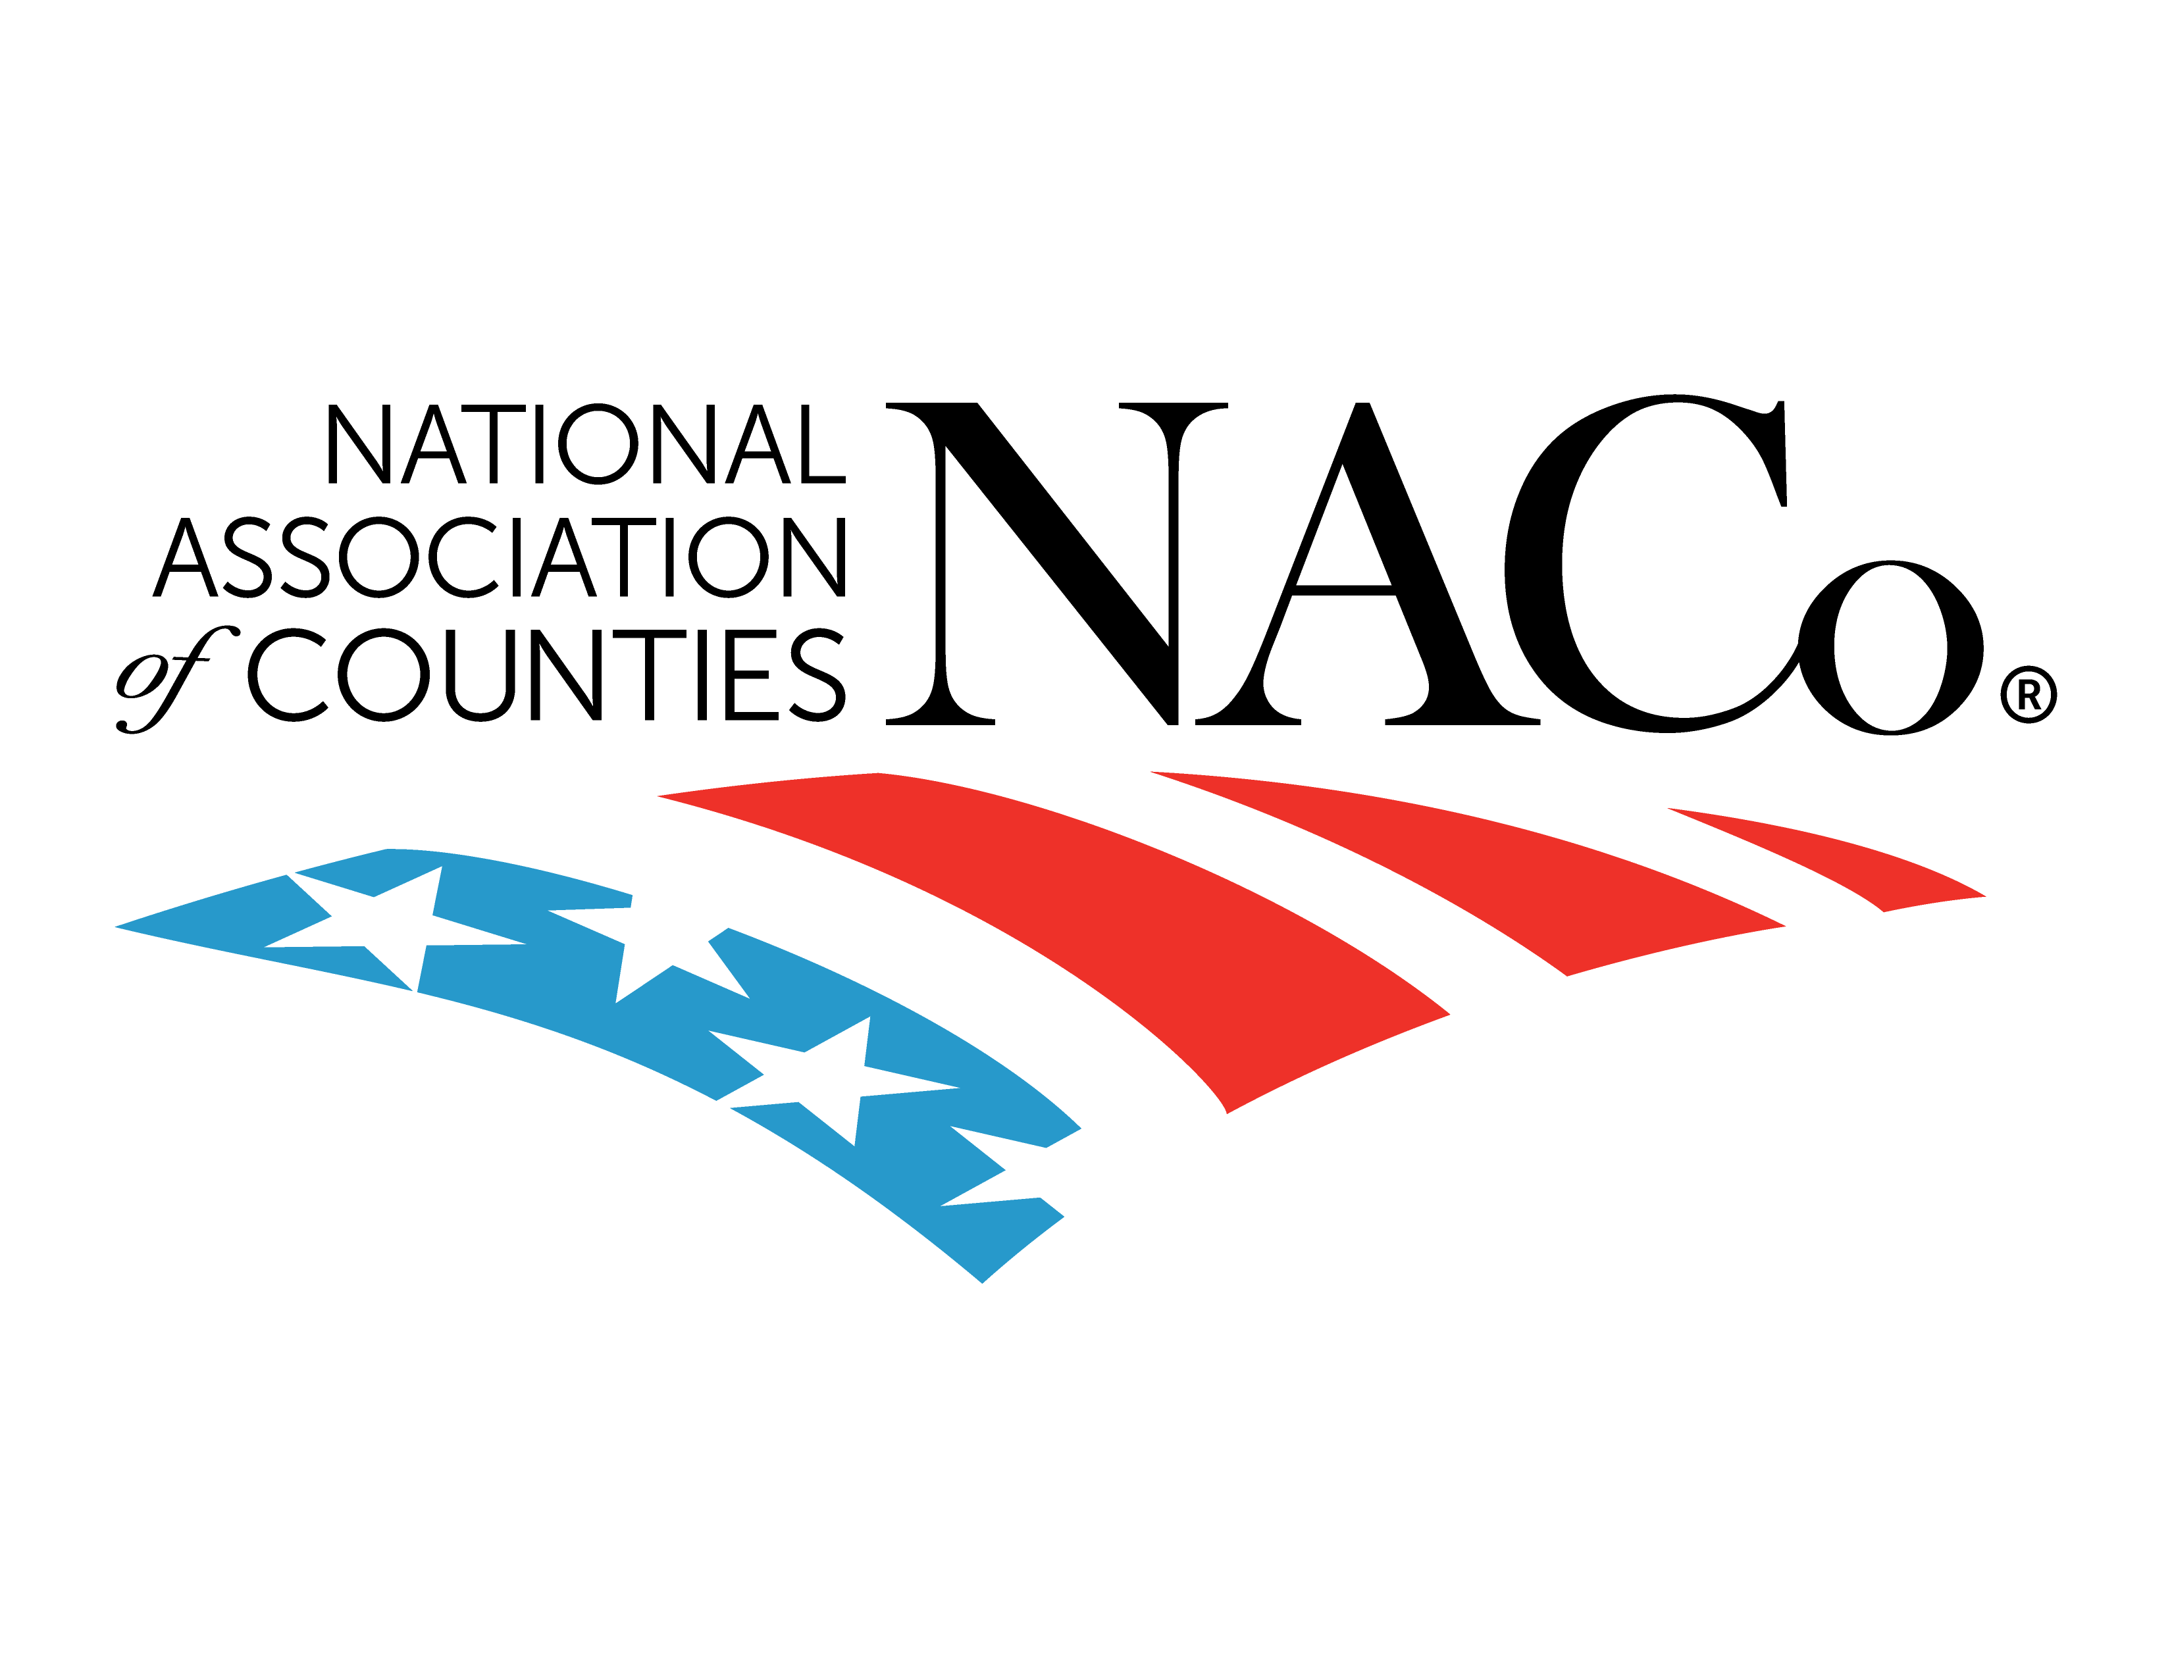
Five greatest benefits to active members of ISAC and NACo
Membership Community and Networking Opportunities
Resources Providing Knowledge and Information Sharing
Conferences and Workshops Providing Professional and Leadership Development Opportunities - Both in-Person and Virtual
Membership Programs and Services that Provide Cost Savings
Advocacy of the Public’s Interest

