Slide 1
County Budgeting 2023 New County Officer’s School

Slide 2
Agenda
Budget Timelines and Everyone’s Role
Funds and Expenditure Classes
Property Tax Levies and Rates
Budget: A financial plan for a specified period of time (fiscal year) that matches all planned revenues and expenditures with various County services.

Slide 3
Budget Process and General Timelines

Slide 4
Timelines
The fall is a good time to review established spending policies and labor negotiations for tentative budget proposals
Typically in November or December the Auditor (or Budget Director) will furnish budget worksheets to elected officials and department heads to prepare proposed revenues and expenditures for the next fiscal year.
County Compensation Board will meet to recommend salary changes for elected officials.
County auditors certifies valuations to DOM and all levy authorities by January 1
County departments submit proposed expenditures and revenue by January 15.
The board files the proposed budget with the auditor, allowing enough time for the budget to be lawfully published and certified (by January 20).
The notice of proposed tax asking (SF 634 notice or Max Levy) is published and posted on applicable county social media “not less than 10 nor more than 20 days” before the hearing.
The hearing is held for taxpayers and residents of the county to present to the board their objections to, or arguments in favor of, the county tax asking.
The board adopts the tax asking by resolution. If the tax asking increases from the current year by more than 2%, a 2/3 vote is required to pass the resolution. Resolution is posted on county web site if applicable.

Slide 5
Timelines
The regular notice of public hearing and proposed budget summary is published “not less than 10 nor more than 20 days” before the hearing.
The hearing is held for taxpayers and residents of the county to present to the board their objections to, or arguments in favor of, any part of the budget.
The board adopts the budget by resolution.
The board directs the auditor to properly certify and file by March 31.
Citizens have until April 10 to file a budget protest.
County auditors certify county budget (and other local government budgets.)
DOM certifies property tax rates to county auditors by June 15.
County auditor provides tax list to county treasurer by June 30
The Board of Supervisors appropriate, by resolution, the amounts necessary for each county officer and department during the ensuing fiscal year.

Slide 6
Department of Management’s Role
DOM provides the forms (including web-based), instructions, technical assistance for all local government budgets
https://dom.iowa.gov/counties

Slide 7
County Department Roles
Department Estimates
By January 15 , each elective or appointive officer or board, having charge of a county office or department, shall prepare and submit to the auditor or other official designated by the board an estimate, itemized in the detail required by the board and consistent with existing county accounts, showing all of the following:
a. The proposed expenditures of the office or department for the next fiscal year.
b. An estimate of the revenues, except property taxes, to be collected for the county by the office during the next fiscal year.

Slide 8
County Auditor’s Role
By January 20, the auditor or other designated official shall compile the various office and department estimates and submit them to the board.

Slide 9
County Supervisors’ Role
Consults with any officer or department concerning the estimates and requests and may adjust the requests for any county office or department.
Prepares and files the budget with the county auditor.
Sets hearing dates.
Approves or amends elected official salaries recommended by compensation board.
Approves Max Levy and full budget by resolution.
Appropriates by resolution.

Slide 10
Walk Through the Budget Process Timelines

Slide 11
SF 634 passed in 2019 Session
Attempt to further notify public about property tax increases
Only impacts city and county budgets
Requires and additional public notice, public hearing, and resolution
Must have separate 10-20 day notice period
Requires that certain pieces of information be shown on notice and in resolution
Requires notice also be posted to County social media & websites
Requires resolution to be posted to County web site

Slide 12
PROPERTY TAX NOTIFICATION – SF634
County Impacted Levies
General Basic
General Supplemental
Rural Basic
Rural Supplemental

Slide 13
SF 634 – Public Notice
Required information on hearing notice
(3 columns of data):
Column 1-Certified tax rate & requested tax dollars for certain specified levy rates for current year
Column 2-Rate and requested dollars as they would be for the budget year, if the requested tax dollars were not increased from what they are in the current year
Column 3-Proposed budget year property tax rate and requested dollars

Slide 14
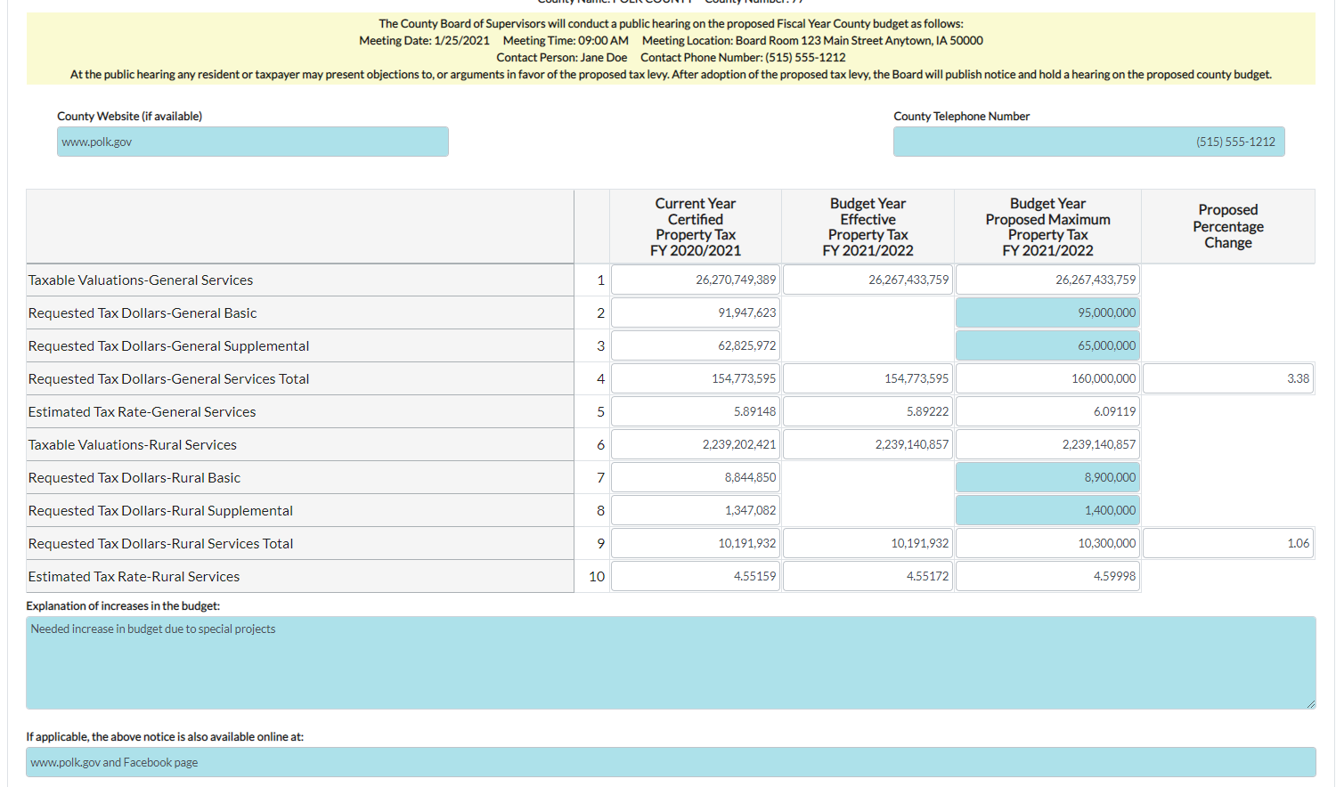

Slide 15
SF634 – Required Resolution
After the hearing, a resolution must be adopted approving the maximum tax dollars that may be assessed for the specified levies during the next fiscal year
If this amount is more than 102% than current year, the resolution must be passed by 2/3 vote of the governing body.
39 Counties have 5 supervisors
The adopted resolution must be posted on the county website and social media accounts if they have them.

Slide 16
SF634 – Required Resolution
Resolution should include the following:
Statement indicating the publication/posting requirements of the bill were met
Statement indicating the date of the public hearing
A not to exceed statement for both General and Rural County Services Maximum Property Tax Dollars
An indication if the dollars requested results in a greater than 102% increase request for either General or Rural County Services
An ability to indicate the vote of each member. This is needed to ensure compliance with the requirement of a 2/3 vote when the percentage increase is greater than 102%.
We recommend consulting with your county attorney on any specifics related to your particular county.

Slide 17
Approval of FY___ Maximum Property Tax Dollars
WHEREAS, the ____________ Board of Supervisors have considered the proposed FY_____ county maximum property tax dollars for both General County Services and Rural County Services, and
WHEREAS, a notice concerning the proposed county maximum property tax dollars was published as required and posted on county web site and/or social media accounts if applicable,
WHEREAS, a public hearing concerning the proposed county maximum property tax dollars was held on _______,
NOW THEREFORE BE IT RESOLVED by the Board of Supervisors of ___________________ that the maximum property tax dollars for General County Services and Rural County Services for FY____ shall not exceed the following:
General County Services-_______________________________
Rural County Services-__________________________________
The Maximum Property Tax dollars requested in either General County Services or Rural County Services for FY____ represents/does not represent an increase of 102% from the Maximum Property Tax dollars requested for FY ____.
Roll Call Vote:
_______________-
_______________-
_______________-
_______________-
_______________-

Slide 18
PROPERTY TAX NOTIFICATION-SF 634
At that point, the county proceeds with the budget process as always (public hearing, with a notice published/posted not less than 10 no more than 20 days from the hearing date.)
Requires the regular public hearing notice for the budget to include a statement regarding the process to protest a county budget-DOM has included this in the forms.

Slide 19
PROPERTY TAX NOTIFICATION-SF 634 REMINDERS
You must complete the SF 634 Notice, Public Hearing and Resolution adoption prior to setting the date for your regular budget public hearing.
You can approve less property tax dollars in your Max Levy Resolution than published in the Max Levy notice but not more.
In the adopted budget, you can ask for less property tax dollars than approved via the Max Levy Resolution but not more.

Slide 20
Public Hearing Notice
Notice of public hearing published in all county newspapers selected under Code of Iowa Chapter 349.
Must be published not less than 10 nor more than 20 days before the hearing.
Budgeted expenditures and levies may be reduced as a result of the public hearing, but may not be increased without another publication and another hearing as required by law.

Slide 21
Public Hearing
Your opportunity to communicate to your public the overview of the proposed budget
Budget Summary
Explains any change in the countywide levy rate
Impact to property owner taxes
Any changes which result in increased cost to the county for services
Any changes in Treasurer’s interest earnings
Overall wage and benefit changes or limits
Graphs and Charts will be helpful in explaining comparisons to prior years

Slide 22
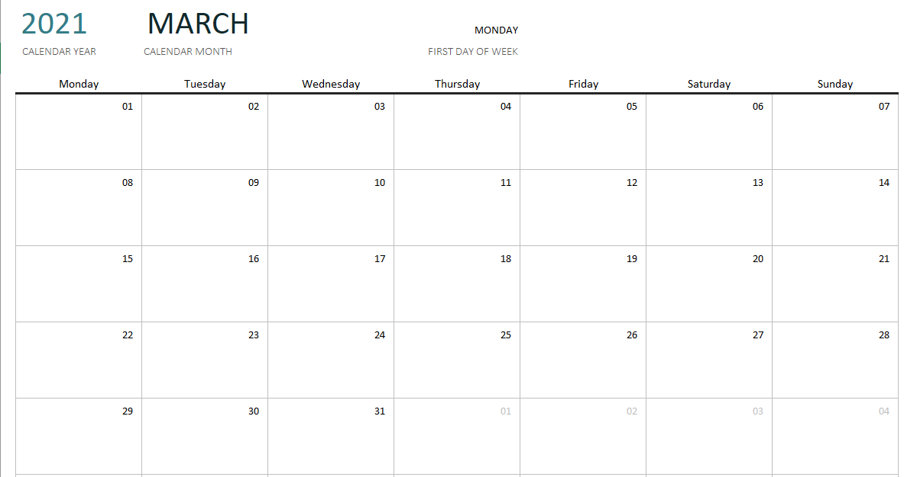
Budget Adoption and Deadline
After the public hearing, the Board adopts the budget by resolution and the county auditor files the budget.
Budget submission deadline for cities and counties is March 31.

Slide 23
Late Budgets
Taxes levied by a county whose budget is certified after March 31 shall be limited to the prior year’s budget amount.
The penalty may be waived by the director of the DOM if the county demonstrates to the satisfaction of the director that the deadline was missed because of circumstances beyond the control of the county.

Slide 24
County Auditor’s Role
County auditor certifies all local budgets, including the county budget

Slide 25
Budget Protests
Budget Protest deadline is April 10 to accommodate later budget deadline.
Budget hearing notice must include information on protesting the budget (DOM added language to the hearing notice.)

Slide 26
Budget Protests
Protesting a local government budget is covered under Code of Iowa Section 24.27. Persons affected by the proposed budget, expenditure or tax levy, or by any item thereof, may appeal the budget by filing a petition and appeal with the county auditor of the county in which the local government is located.
Protests to county budgets require at least 100 signatures
County Auditor forwards protest document to State Appeal Board

Slide 27
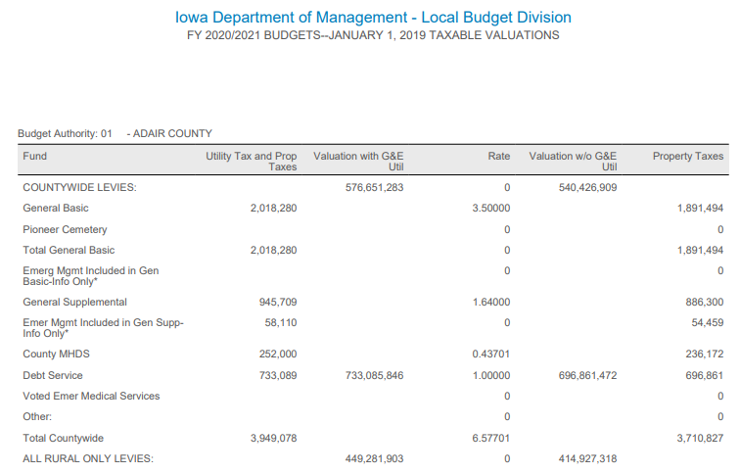
Department of Management’s Role
DOM certifies the final property tax levies by tax district to county auditor by June 15, as well as consolidated rates
Tax rates and amounts are within statutory limits

Slide 28
Budget Amendment
A budget amendment is required for any increase in the totals for any one of the 10 major classes of expenditures listed on the adopted budget summary. The amendment must be effective before the expenditure amounts are exceeded.
Budget amendments require the same notice and hearing procedures as required for the adoption of the original budget.
Budget amendments are subject to protest. An amendment of a budget after May 31, which is properly protested but without adequate time for hearing and decision on the protest by June 30, is void.

Slide 29
Appropriations
The board must appropriate, by resolution, the amounts deemed necessary for each of the different county officers and departments during the ensuing fiscal year.
Without an appropriation, expenditures are not authorized. Appropriations need not be made in any specific level of detail.
It is unlawful for a county official to authorize an expenditure larger than the amount, which has been appropriated by the board of supervisors (Code of Iowa Section 331.437).

Slide 30
Changing Departmental Appropriations
Increases or decreases in departmental appropriations do not require a budget amendment, as long as none of the 9 major classes of expenditures are to be increased. Instead, changes in departmental appropriations may be provided by resolution at any regular meeting of the board. Obviously, any increases in departmental appropriations will have to be offset by decreases in other departmental appropriations, so individual expenditure class amounts are not exceeded.

Slide 31
Changing Departmental Appropriations
Decreases in appropriations for an office or department of more than 10 percent or $5,000, whichever is greater, are not effective until the board holds a public hearing on the proposed decrease, and publishes notice of the hearing not less than 10 nor more than 20 days prior to the hearing, in all of the county newspapers selected under Code of Iowa Chapter 349 (Code of Iowa Section 331.434(6)).

Slide 32
Funds and Expenditure Classification

Slide 33
Governmental Funds
The accounts of the County are organized on the basis of funds, each of which is considered a separate accounting entity.
The operations of each fund are accounted for by a separate set of self-balancing accounts that comprise its assets, deferred outflows of resources, liabilities, deferred inflows of resources, fund balances, revenues, and expenditures.

Slide 34
Types of Funds
Governmental (Budgetary)
General
Special Revenue
Capital Projects
Debt Service
Permanent
Governmental Activities
(for government-wide reporting)

Slide 35
Types of Funds, cont.
Nonbudgetary
Fiduciary
Agency
Proprietary
Enterprise
Internal Service

Slide 36
Governmental Funds
GENERAL FUND - The General Fund is the chief operating fund of the County. All general tax revenues and other receipts that are not allocated by law or contractual agreement to some other fund are accounted for in this fund. From this fund are paid the general operating expenses, the fixed charges, and the capital improvement costs that are not paid from other funds.
SPECIAL REVENUE FUNDS - Account for proceeds from specific sources (other than those accounted for within capital projects funds) which are usually required by law or regulation to be accounted for in separate funds and debt service or are restricted or committed to expenditure for specific purposes. Expendable trusts should be reported here.

Slide 37
Governmental Funds
CAPITAL PROJECTS FUNDS - Optionally account for resources used in the acquisition or construction of major capital facilities and capital assets. (Even if a capital projects fund is used, not all capital acquisition need be accounted for in the fund. For example, the routine purchases of capitalizable items (e.g., police vehicles, copy equipment) are typically budgeted and reported in the general fund.)
DEBT SERVICE FUNDS - Account for the payment of interest and principal on the County's general long-term debt, except when authorized or required to be paid from other funds.

Slide 38
Governmental Funds
PERMANENT FUNDS – account for resources that are legally restricted to the extent that only the earnings, and not principal, may be used for purposes that support the reporting of government’s programs (i.e., for the benefit of the government or its citizenry).
GOVERNMENTAL ACTIVITIES – (Government wide financial reporting). Account for balances related to governmental funds that are only reported in the government-wide statement of net position.

Slide 39
Governmental Funds-Non Budgetary
AGENCY FUNDS – Account for those assets held solely in a custodial capacity by a governmental unit as an agent for individuals, private organizations, other governmental units, and/or other funds. Also include any 28E entities for which the county is fiscal agent.
ENTERPRISE FUNDS-May be used to report any activity for which a fee is charged to external users for goods or services. Activities are required to be reported as enterprise funds if any one of the following criteria is met. Governments should apply each of these criteria in the context of the activity’s principal revenue sources.
INTERNAL SERVICE FUNDS-May be used to report any activity that provides goods or services to other funds, departments, or agencies of the primary government and its component units, or to other governments, on a cost-reimbursement basis. Internal service funds should be used only if the reporting government is the predominant participant in the activity. Otherwise, the activity should be reported as an enterprise fund.
The major use of internal service funds by Iowa county governments is for self-insurance.

Slide 40
Special Revenue Funds
Rural Basic Fund
The operating fund for county services benefiting property not within incorporated areas of the county.
Rural Services Supplemental
If the Rural Basic levy is insufficient to meet the county’s needs, the supplemental levy can be used to pay charges for:
FICA, IPERS, and unemployment premiums associated with salaries in Rural Basic
County contribution to an aviation authority

Slide 41
Special Revenue Funds
Secondary Roads Fund:
The operation fund for maintenance and repair of secondary roads, construction and maintenance of county bridges and bridges in cities having a population of 8,000 or less, and all or part cost of construction of roads which are located in cities of less than 4,000 and lead to state parks.
Revenues from federal, state, and county
Road Use Tax - Farm-to-Market – Transfers from General Basic and Rural Basic funds

Slide 42
Classification by Function
Budget summary requires reporting of expenditures by 12 expenditure classes or functions (9 currently in use)
The 10 classes are categorized into 7 functions
Functions are comprised of programs
Programs are composed of activities

Slide 43
Classes of Expenditures
Personnel Services
Salaries
Benefits
Operations
Physical purchases
Services
Capital Outlay
Capital Asset Acquisitions
Debt Service
Other
Transfers
Tip: Understand how the budget is developed by fund. General Fund will hold most salary and benefits plus other expenditures, while Mental Health Fund or Capital Fund will hold purchased services and capital outlay.
Understanding the type of expenditures will help in understanding how flexible changes may be made.

Slide 44
Service Area Detail
Public Safety & Legal
Law Enforcement
Legal Services and Courts
Emergency Services
Physical Health & Social Services
Physical Health Services
Services to Poor Programs
Services to Military Veterans
Children’s & Family Services

Slide 45
Service Area Detail
County Environment & Education
Conservation & Recreation Services
Animal Control
Planning & Development
Educational Services
Administration
Policy & Administration
Central Services
Risk Management

Slide 46
Service Area Detail
Roads & Transportation
Secondary Roads
Roadway Maintenance
Mass Transit
Government Services to Residents
Elections
Motor Vehicles
Recording of Public Documents

Slide 47
Service Area Detail
Long Term Debt
General Obligations Bonds
Revenue Bonds
Loans
Lease-Purchase Payments
Capital Projects
Buildings or Improvements
Roads and Bridges
Equipment or Technology Acquisitions

Slide 48
Tax Rates and Levies

Slide 49
How Valuations Tie to Budgets
Valuation/1000 X Rate = Taxes Levied
Valuation is set by the County Assessor and the Department of Revenue
Rates are set by local governments to generate the desired levy

Slide 50
County Property Tax Levy
331.301 General powers and limitations.
7. A county shall not levy a tax unless specifically authorized by a state statute

Slide 51
Categories of Property Tax Levies
General county services
Rural county services
Debt service
Other taxes specifically provided by law
Examples:
Unified Law
Voted Emergency Medical Services

Slide 52
Basic Property Tax Levies
Maximum Basic Levies
$3.50 per $1,000 of taxable valuation for general county services
Services which are primarily intended to benefit all residents of a county, including secondary road services, but excluding services finance by other statutory funds
$3.95 per $1,000 of taxable valuation for rural county services
Services which are primarily intended to benefit those persons residing in the county outside of incorporated city areas, including secondary road services, but excluding services financed by other statutory funds

Slide 53
Exceeding Basic Property Tax Levies
Only for reasons set forth in 331.426
Unusual increase in population
Natural disaster or other emergency
Unusual problems relating to major functions required by state law
Unusual staffing problems
Unusual need for additional moneys to permit continuance of a program which provides substantial benefit to county residents
Reduced or usually low growth rate in the property tax base of the county

Slide 54
Exceeding Basic Property Tax Levies
Special levy election
By including additional information with the notice of public hearing on the county budget.
331.425 and 331.426 provide process
Suggest consulting county attorney prior to pursuing

Slide 55
Supplemental Property Tax Levies
Limited in purpose, not amount
331.424 (1) for general county services
Examples include elections, FICA, IPERS, health insurance, etc.
331.424 (2) for rural county services
General or Rural Basic levy must be at limit before using the applicable supplemental levy

Slide 56
Debt Service Levy
Debt Service Levy to pay
Certain judgments
Interest and Principal on General Obligation debt
Certain payments under a lease or lease purchase agreement
Lease cost of a joint city/county building

Slide 57
Cemetery Levy
Levy limit of $0.0675 per $1,000 of taxable valuation to repair and maintain cemeteries under the jurisdiction of the Board of Supervisors (includes Pioneer Cemeteries)
Levied and accounted for within General Fund
Around 20 counties use this levy

Slide 58
Emergency Services Levy
If county provides fire protection to a township under 331.385, the county shall establish an emergency services fund and may certify taxes in the township not to exceed levy limits in 359.43
Currently only applicable in Polk County

Slide 59
Emergency Medical Services – 422D
New Levy across the state.
60% +1 to pass levy recommendation to make Emergency Medical Services an essential Service.
Levy is for up to 10 years before recertification
Could be property or income tax.

Slide 60
Unified Law Enforcement Levy
Unified law enforcement levy under Code of Iowa Chapter 28E.
The county levy is only on property outside of incorporated areas and is limited to $1.50 per thousand dollars of taxable valuation.
A vote of the people is required to establish this levy (Code of Iowa Section 28E.22).

Slide 61
Flood and Erosion Control Levy
A flood and erosion control purposes levy, to be levied only against agricultural lands valuations.
Limited to $0.06750 per thousand dollars of taxable valuation (Code of Iowa Section 161E.9).

Slide 62
BUDGET OPTIONS & TIPS –From a Budget Director
Set a calendar for January and February with all needed publication and hearing dates
Establish salary and wage changes for department heads and hourly employees taking into consideration any union negotiations.
Consider fund balance levels
Look to prior fiscal year ending fund cash balances
Departmental budgets can help to indicate cash flow needs
Request capital improvement plans and capital asset purchasing plans from officials and departments
Understand the revenue and expenditures streams and the types that are within your control and those that are not –
Property Tax dependence vs intergovernmental.
Consider difference between raising taxes collected OR not raising the tax rate
Salary and Benefits vs Capital; One time use of funds
New Revenues to consider: ARPA, Local Government Consistency Allocation; Opioid settlement funding

Slide 63
Elected Officials & Boards
Attorney §331.751
Auditor §331.501
Board of Supervisors §331.201
Recorder §331.601
Sheriff §331.651
Treasurer §331.551
Conservation Board §350
Board of Health §137
Veteran Affairs Commission §35(B)

Slide 64
County Departments
Civil Service
Community Services
Engineer
Human Resources
Information Technology
Facilities/Maintenance
Medical Examiner
Planning & Zoning/Code Enforcement
Other

Slide 65
Non-County associated governments
Assessor
District Court Administration
Juvenile Court Services
E911
Emergency Management
Human Services Administration
Solid Waste Management
Entities may qualify as separate government, state agency, component unit government – not directly budgeted for, but may impact costs otherwise.

Slide 67
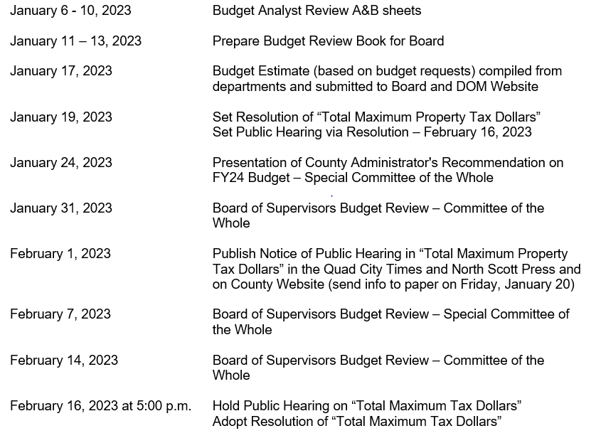
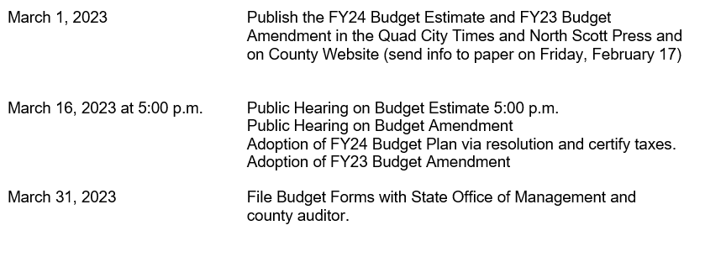

Slide 68
Other Communications and Strategies
Budget Goals
Strategic Plans
Capital Improvement Planning
Townhall
Tax Levy Rates
Budget Amendments
Before May 31
All County Official newspapers
Long Range Forecasting
Change in Services
Impacts to homeowners / businesses
Overall Health
Published not less than 10 nor more than 20 days
Increases in any of 10 major classes of expenditures
Annual Reports
Audited Financial Statements
State Annual Financial Report
Published by December 1
Single Audit
Other - Treasurer’s Annual Statement, REAP, Secondary Roads, Self Insurance
Tools
Budget Goals
Historical Analysis
Budgeting Methodology
Organizational charts
Notes:
Budget Goals – Official document is not the only means to communicate your objectives:
Strategic Plans by the count board
Long range forecasting such as contract negotiations debt issuances.
Capital Improvement Planning – Fleet studies or building studies. Long range capital and debt costs.
Board meeting could also discuss the impacts to your citizens:
Tax Levy Rates among all Iowa Counties. There is numerous information available from the Iowa Department of revenue website and Iowa DOM.
Changes in Services – Communicating changing services lines such as Public Safety or Mental Health Services.
Impacts to homeowners / businesses – Real Estate tax Impacts, customer service impacts. Road improvements,
Overall Health of your local government.
Budget Amendments
Necessary if increasing the expenditures in any of the 10 major classes of expenditures. Transfers of budgeted funds may be increased without am amendment but must be approved by the BOS. Recommended before May 31 to prevent voiding after proper protest and hearing. Submit to DOM after amending.
Change within the departments does not require amendment, as log as none of 10 major classes are increased.
Annual reports: Additional reporting on the back end – Annual Financial Reports – State Auditors’ office or other Independent auditor.- State Report Published in Newspaper by 12/1. Could be subject to single audit if expending over $500,000 in federal funds within fiscal year.
Other reports Treasurer's annual statement, REAP Report, Secondary Roads Report, and Self Insurance Report.

Slide 69
Contacts:
Carol Robertson
Mills County Auditor
712-527-3146
crobertson@millscountuyiowa.gov
David Farmer, CPA, MPA
Director of Budget and Administrative Services
Scott County
Phone (563) 326-8651
david.farmer@scottcountyiowa.gov

