Slide 1
Emotional Intelligence
Ronee Andersen, MBA, SPHR, CTAC
August 24, 2022
Notes:
Every have a bad boss?
Every had a toxic boss?
Co-worker?
Customer?
Nick

Slide 2
Emotions can lead to our worst decisions or our best ones: The difference is Emotional Intelligence
Notes:
NEW Vehicle

Slide 4
Overview
What is Emotional Intelligence (EQ)
Business Cases for EQ
EQ Behaviors
Five Pillars of EQ
Call to Action

Slide 5
Emotional Intelligence (EQ) Defined
Recognize, understand and manage our own emotions and the emotions others.
Emotional intelligence (EQ) is the ability to use emotions effectively.
Notes:
Better communication, better relationships,

Slide 6
EQ versus IQ
EQ is the #1 predictor of success in personal and professional life.
90% of top performers are high in EQ.
60% of performance in all types of jobs is accounted for by EQ.
Notes:
Paul

Slide 7
Benefits of Having a High EQ
Happier and more optimistic in life
Overcome challenges easier
More assertive and expressive of their personal needs.
More empathetic and understanding of others.
Capable of saying “no” to others and setting healthy limits.
Less impulsive and trend to make better decisions.
Capable of tolerating stress better.
Notes:
Cyndi – 1st Class
Dylan

Slide 8
Business Case for EQ
Pepsi found that executives with high EQs generated 10% more productivity, had 87% less turnover, brought $3.75M more value to the company, and increased ROI by 1000%.
High EQ salespeople at L’Oreal brought in $2.5 million more in sales.
An EQ initiative at Sheraton helped increase market share 24%.
Harvard Business Review has stated EQ is Twice as important as IQ.

Slide 9
Five Pillars of Emotional Intelligence
Self-Awareness
Self-Regulation
Self- Motivation
Empathy
Social Skills

Slide 10
Self-Awareness
Hallmarks:
Self-confident
Realistic self-assessment
Sense of humor about their weaknesses or mistakes
Notes:
We find the people who make the most progress in improving their emotional intelligence are usually the ones who ask the most questions. Bradberry, Dr. Travis; Greaves, Dr. Jean. The Emotional Intelligence Quick Book: Everything You Need to Know to Put Your EQ to Work (p. 66). Atria Books. Kindle Edition.
Do you think the bad bosses or co-workers were self-aware?
Laugh at yourself or your mistakes! STORY:

Slide 11
Self-Regulation
Hallmarks:
Self-control
Trustworthiness and Integrity
Adaptability/Open to Change
Innovation
Comfort with Uncertainty
Notes:
Paul - Throw check away
Conscientious –know right from wrong.

Slide 12
Self-Motivation
Hallmark:
Achievement Driven
Commitment
Initiative
Optimism, even in the face of failure
“It’s not that I’m so smart,
I just stayed with the problem longer.”
Albert Einstein

Slide 13
Empathy
Hallmark:
Cross-cultural sensitivity
Service to Clients and Customers

Slide 14
Social Skills
Hallmarks:
Effectiveness in Leading Change
Persuasiveness
Expertise in building and leading teams
Notes:
Persuasiveness

Slide 15
EQ Behaviors
High EQ
Low EQ
Resilient
Listening
Empathic
Courageous
Flexible
Inclusive
Blaming
Unforgiving
Defensive
Stonewalling
Judgmental
Exclusive

Slide 16
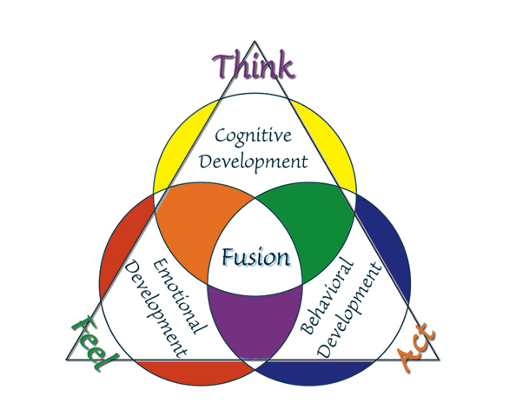
EQ is the consciously choosing thoughts, feelings and action to create optimal relationships with yourself and others!

Slide 17
EQ Fusion
We are most powerful when our emotions and thoughts work together.

Slide 18
Emotional Triggers
Words
Behaviors
Nonverbals

Slide 19
5 Skill to Develop EQ
EQ Skill 1: Rapidly reduce stress
EQ Skill 2: Emotional Awareness
EQ Skill 3: Nonverbal Communication
EQ Skill 4: Use humor and play to dual with challenges
EQ Skill 5: Reduce Conflict positively
Notes:
Nonverbal communication – Being able to read others nonverbal communication to respond appropriately.

Slide 21
The Challenge
Will you commit to increasing your EQ?
The EQ Initiative in
Iowa Counties
Notes:
Look around – Who has their hands up?

Slide 22
Resources to Complete the Challenge:
EQ Mastermind
Book Club
Accountability Partner
Podcasts
TalentSmart.com –
Assessments for $49
Blog

Slide 23
Summary
What is Emotional Intelligence (EQ)
Business Cases for EQ
EQ Behaviors
Five Pillars of EQ
Call to Action
Notes:
EQ – Use your emotions effectively.
Self-Awareness, Self-Regulation, Self-Motivation, Empathy and Social Skills

Slide 24
Thank You!
Ronee Andersen, MBA, SPHR, CTACC
www.consultingbyronee.com
ronee@consultingbyronee.com
515-971-6478

