Slide 1
The Ten Habits of Highly Effective Counties
Iowa State Association of Counties
Spring Conference
Des Moines, IA March 10, 2022
Patrick Callahan, Municipal Consultant
Callahan Municipal Consultants, LLC

Slide 2
Reason for this topic
After 48 years in City Government – 23 years as city manager and 25 years as a municipal consultant…
Why are some counties so successful?
Why do some counties struggle and fight?
Observation of “cycles of success and failure” in cities

Slide 3
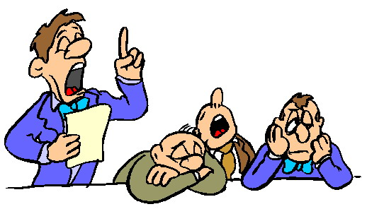
Disclaimer and Comments
Not every successful city adopts all ten habits
General rule….Adopt these habits and the probability of success will increase
Added bonus – Your job may be more enjoyable

Slide 4
Quotes to Ponder
“If you don’t know where you want to go, any road will get you there.” – Lewis Carroll, English Author – “Alice in Wonderland”
If you don’t know what you want to be, then you have no control over what you will end up becoming.” Author Unknown – Perhaps Earl Nightingale (1921-1989)

Slide 5
General Overview of Session
Review Ten Habits – 5 minutes each
Offer your suggestions – Name your county
Ask your questions
Send us your examples or model documents

Slide 6
1. Start with the Basics
Brief and concise mission statement
Develop a vision statement for the County’s future
Develop long range goals and objectives
New Board Member’s Orientation
Mission Statement
Vision Statement
Goals and objectives

Slide 7

2. Understand the Elements of Teamwork
Board – Collection of diverse people
Only Power – Act as one entity
Working together to accomplish a specific purpose
Key – trust, openness and mutual respect

Slide 8
3. Master small group decision making
Ability to work with others
Knowledge to do the job
Ability to deal with issues rationally
Remember the “dignity of the office.”

Slide 9

4. Clearly define roles and relationships
Board Member and Staff roles
Know the functions – specific responsibilities
Expected performance – behavior of the person in the role
Code of Conduct

Slide 10
5. Establish and Abide by a Good Board – Staff Partnership
Board – establish the vision, goals, policies and empowerment
Board – define the needs to be met and outcomes to be achieved
Staff – carryout directives, complete the tasks, and provide feedback
Key – trust, communication, and evaluation

Slide 11
6. Systematic Evaluation of Policy Implementation
Periodic feedback on policy results
Reports, staff memos, and newsletters
Policy amendments as needed
Work sessions to review results

Slide 12

7. Allocate Board time and energy appropriately
Goal setting – annual retreats
Study or work sessions – analysis of issues
Community relations – interaction with citizens and agencies
Prepare a capital improvements plan (CIP)

Slide 13
8. Set clear rules and procedure of board meetings
Conduct effective and productive meetings
Adopt rules and procedure
Conduct business – orderly, discipline and productive manner
Avoid political partisanship
Meetings are the board “image to the world”

Slide 14
9. Seek assessment of public concerns and evaluations of performance
Seed feedback – surveys, questionnaires, public hearings, etc.
Information on County website
Use of social media - carefully
Make adjustments, as needed

Slide 15
10. Practice continuous learning and development
Read the handbooks
Attend ISAC conference and workshops
Read the publications
Networking with other counties
Staff training and education too!

Slide 16
For copies of publications of the Iowa League of Cities that were references, Go to www.iowaleague.org
Go to Page marked – Resources
Go to the category - Administration

Slide 17
For copies of other publications or models referenced during this presentation – contact:
Patrick Callahan, Municipal Consultant
Callahan Municipal Consultants, LLC
callahan.cmc@gmail.com
563-599-3708
Note: Send your county’s “model documents” to the speaker to distribute

