Slide 1
HPAI Update
3/16/2022

Slide 2
What is HPAI?
Highly Pathogenic Avian Influenza –
An infection in poultry caused by any influenza A virus of the H5 and N7 subtypes.
HPAI are potentially zoonotic, though not easily transmitted to humans.
Wild bird reservoirs of LPAI is major potential sources of infection for domestic birds, especially free- and open-range poultry.
  Ducks and geese can carry and shed certain HPAI viruses without clinical signs.

Slide 3
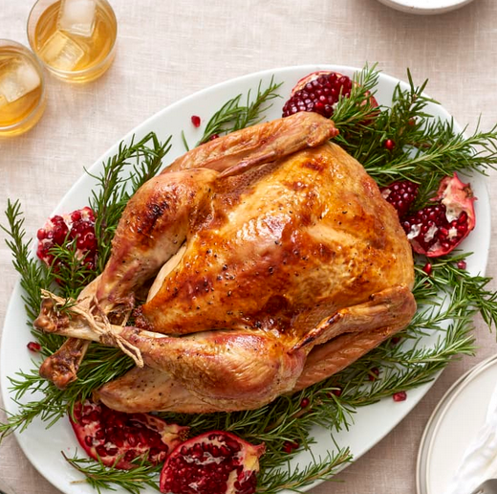

Iowa Poultry Production
Iowa leads the nation in egg production.
Iowa is 7th in the nation in turkey production.

Slide 4
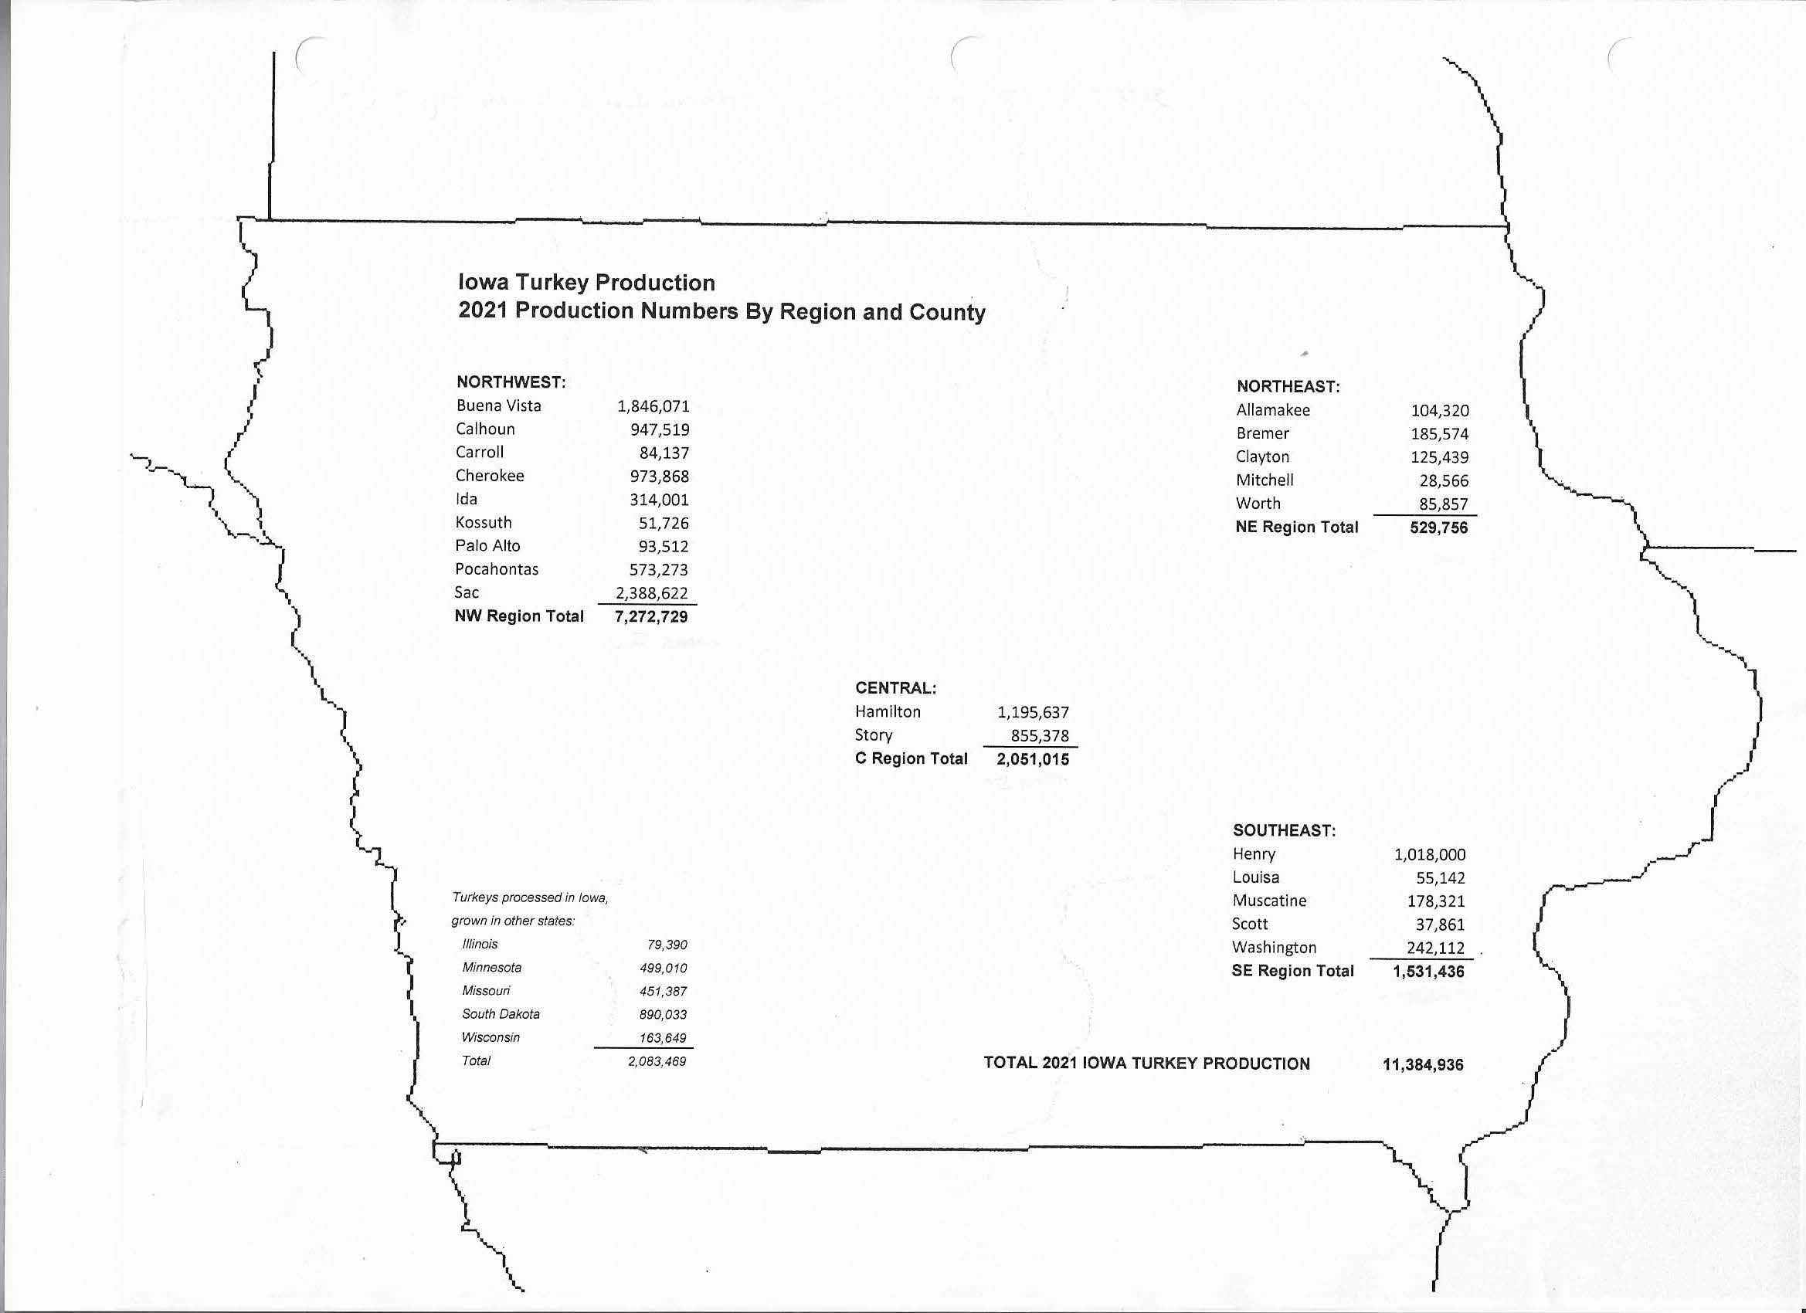

Slide 5
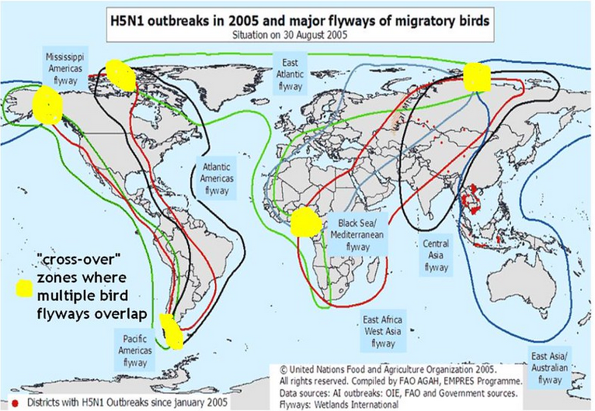

Slide 6
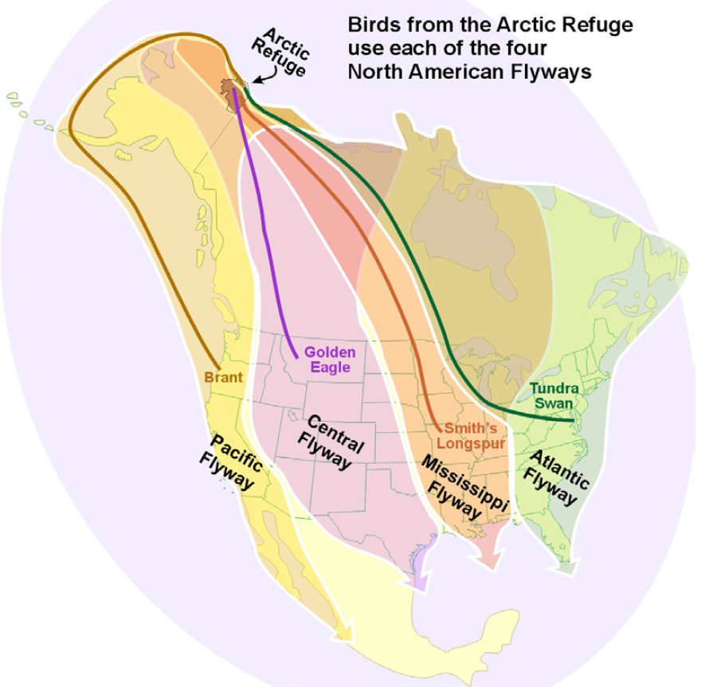

Slide 7
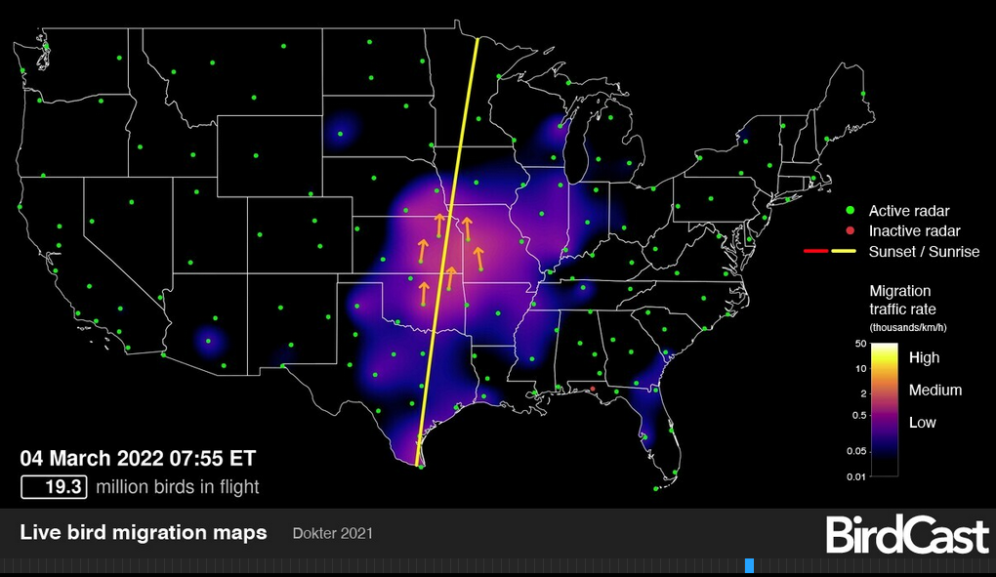

Slide 8
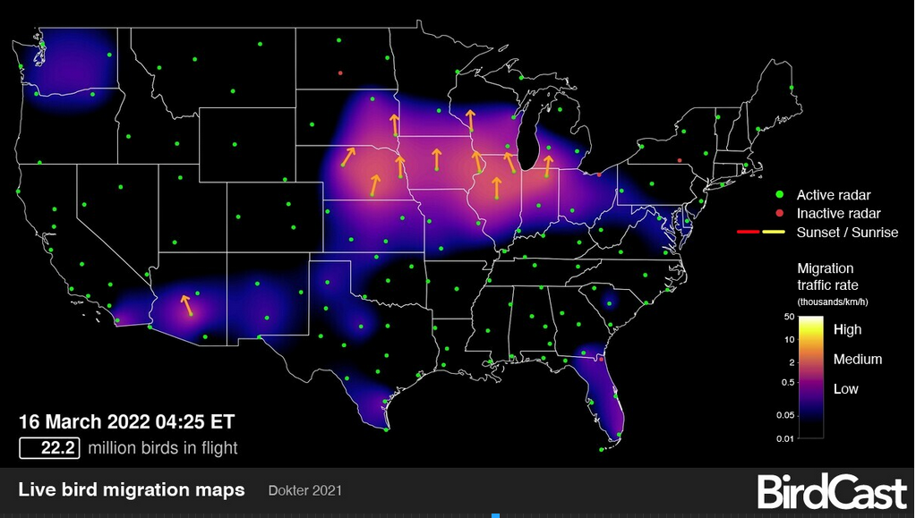

Slide 9
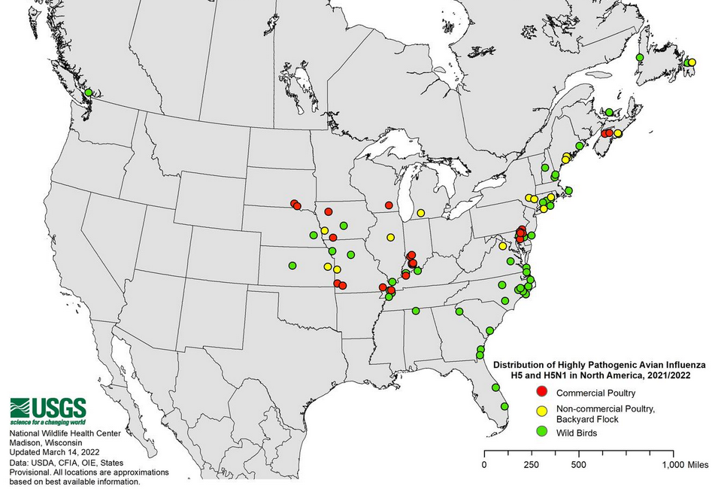

Slide 10
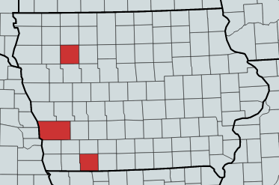
Current Iowa HPAI Status

Slide 11
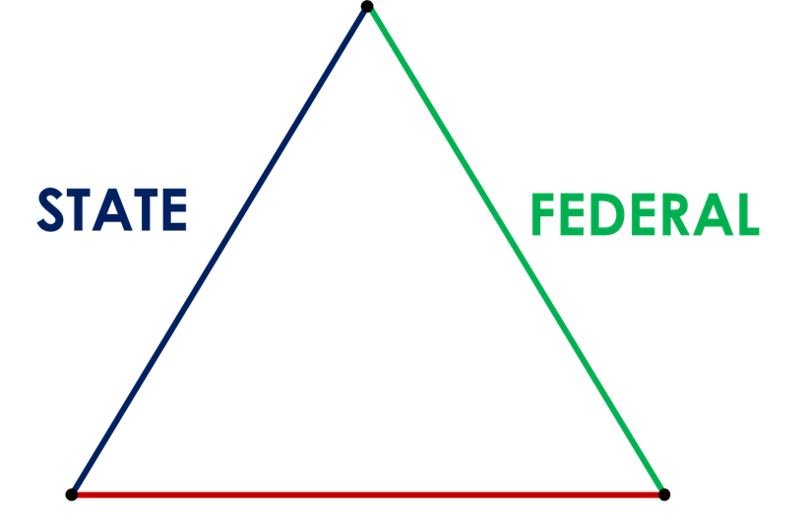
Triangle of Cooperation
PRODUCER / INDUSTRY

Slide 12








FAD Response Plan Steps
CONTAIN
Quarantine
Biocontainment
Epi info – trace in/trace out
CONTROL, ELIMINATE
Indemnity
Mass Depopulation
Disposal
Clean & Disinfect

Slide 13
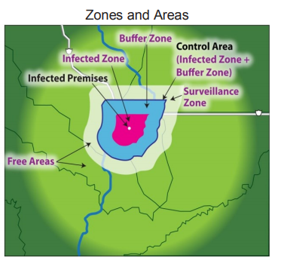

Contain & Control
Positive results
  Quarantine
  Control Area
  Surveillance Area

Slide 14
Movement by Permit Only
Farms not known to be infected but in a control area
Prevent disease spread
  Criteria to meet to determine movement is as safe as possible
Traceability ensures movement is safe
  Immediate
  Long-term

Slide 15
Goals
STAMP. IT. OUT.
CLEAN. IT. UP.
BACK. TO. BUSINESS.

Slide 16
HPAI Response in Iowa
Unified Command with USDA and IDALS.
  Each agency has duties and power that vary, though provide for a collaborative and coordinated response.
The IMT communicates HPAI confirmations to SEOC partners and specific County EMAs.
  The specific name/location of positive prems are CBI. E.g. Buena Vista 1, Taylor 1 . . .

Slide 17
Lessons Learned
Many lessons were learned in 2015, shaping response activities going forward:
No federal contractors; producers are more efficient and better caretakers of their own infrastructure.
Disposal will occur at the infected premise; no more trucking to landfills or incinerators.
  Eliminates the need for “clean” and “dirty” routing. & road signs.

Slide 18

Lessons Learned
Biosecurity at each poultry premise is the best defense against HPAI.
  Eliminates the need road signs.

Slide 19
Lessons Learned
Prioritization of epi trace-forward and trace-back of dangerous contacts.
  Epidemiology is the study and analysis of the distribution, patterns and determinants of health and disease conditions in defined populations. It is a cornerstone of public health; shapes policy decisions and evidence-based practice by identifying risk factors for disease and targets for preventive healthcare.

Slide 20

Key Actions to Defeating HPAI
◆ Biosecurity!
Assume HPAI is everywhere! The poultry producer’s best line of defenses is at their farm gate.
  Before it comes onto your premise, CLEAN IT.
  Eliminate contact with
  other poultry premises.
  Log all the entries and
  exits from your premise.

Slide 21
Key Actions to Defeating HPAI
❖ See something, say something!
The faster HPAI is diagnosed and stamped out, the less time the virus has to multiply and spread.
If any potential symptoms are present in a flock, or a wild bird mortality event is observed, contact IDALS ASAP at
  (515) 281-5305 during business hours,
  (515) 240-6632 after hours.
  And, the duty officer line is answered 24/7,
  (515) 242-0247.

Slide 22
Dr. Jeff Kaisand
Jeff.Kaisand@IowaAgriculture.gov
Robin Pruisner
Robin.Pruisner@IowaAgriculture.gov
iowaagriculture.gov/animal-industry-bureau/avian-influenza

