Slide 1
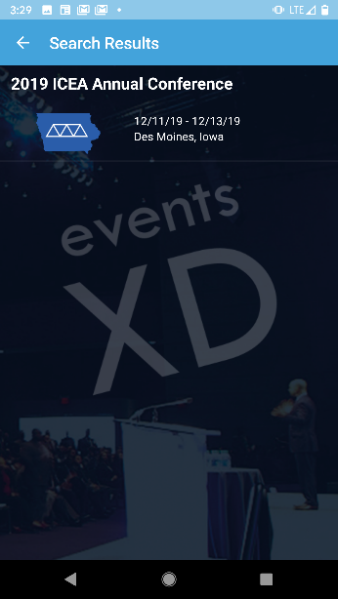
EventsXD
Steps to find and load conference app:
Open and Search for EventsXD from your app store. (Play Store)
Open Conference app
Click “SIGNUP” and create an account
Wait for email to complete setup
Login to app
Search for 2019 ICEA Annual Conference
Browse through on-screen icons for desired content.

Slide 2
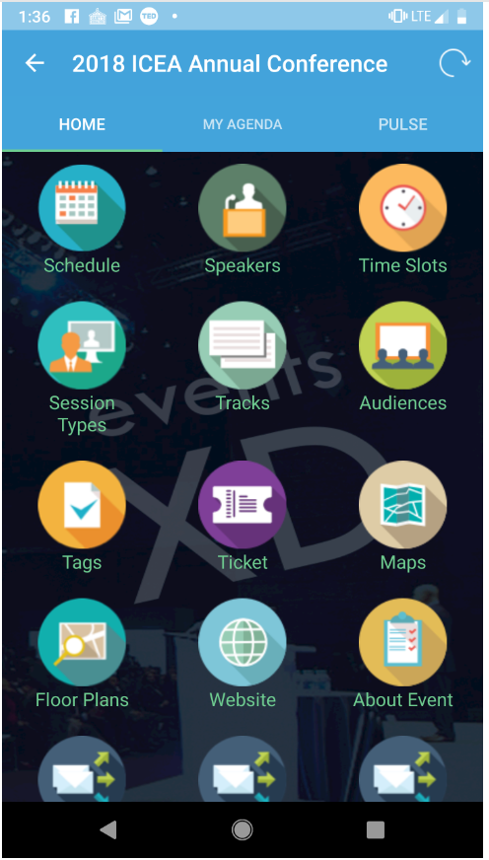
Home Screen
Using the app:
Schedule lists all sessions – click on session to list details
Select the star to add session to “My Agenda”
Colors identify specific session tracks
Speakers gives additional details
Time slots shows all the different times the sessions take place
Home Icons:
3 empty icons
Audiences
Tags
Tickets
My Agenda:
User defined
Pulse:
News Center
Updates pushed to users.

Slide 3
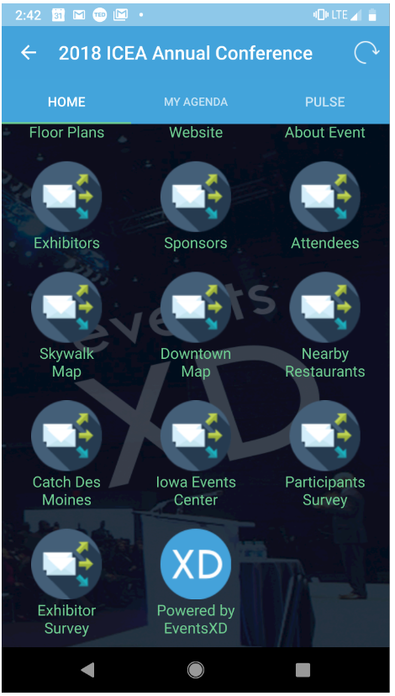
Home Screen - Continued
Bottom of screen
Floor Plans shows booth layout
List of Exhibitors
Sponsors
Attendees
Maps
Skywalk
Downtown
Restaurants
URL links
Catch Des Moines – Visitors Bureau
Iowa Events Center site
Conference Surveys:
Participants
Exhibitors
Hospitality Rooms

