Slide 1
Budgeting Transparency and Communications

Slide 2
Prologue
“There should be a place where only the things you want to happen, happen.”
-From Where the Wild Things Are

Slide 3
OUR STORY IS ABOUT A JOURNEY
We were unsure where we were headed…
We didn’t quite know how to get there (or know if we’d arrived)...
What we knew was simple – there are stories to be told and there is no better place to start than at the beginning!

Slide 4
Chapter One
“All shall be done,” said Aslan. “But it may be harder than you think.”
-From The Lion, the Witch, and the Wardrobe

Slide 5
AND SO ONCE UPON A TIME…
About eight years ago, in a county not so far away...

Slide 6
Chapter Two
“I am not afraid of storms, for I am learning how to sail my ship.”
-From Little Women

Slide 7

2012
Government Restructuring Committee and CPAT Report
2014
Adoption and Implementation of Communications Plans
2013
Strategic Plan

Slide 8
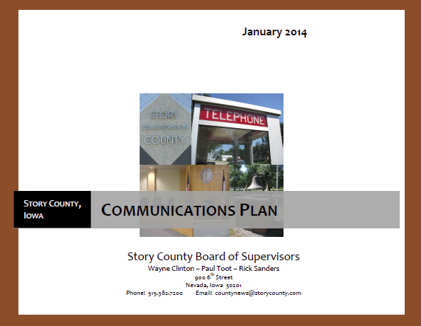





Slide 9
Chapter Three
“The moment you doubt you can fly, you cease forever to be able to do it.”
-From Peter Plan

Slide 10
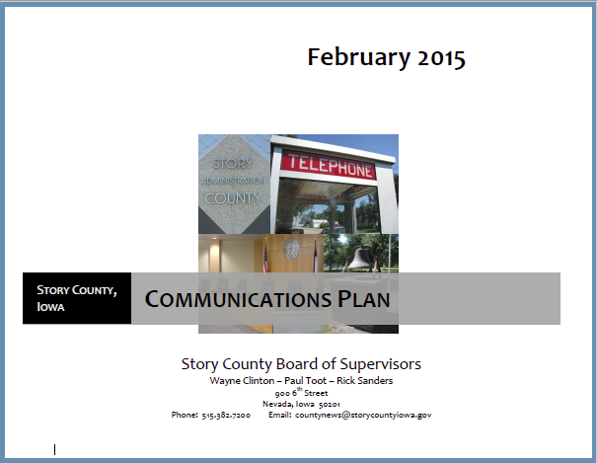


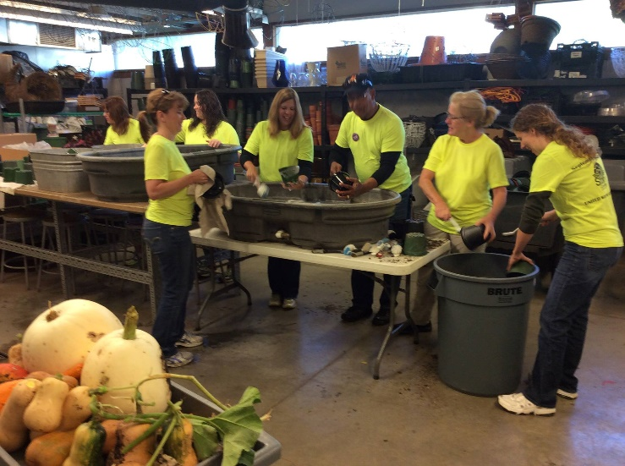
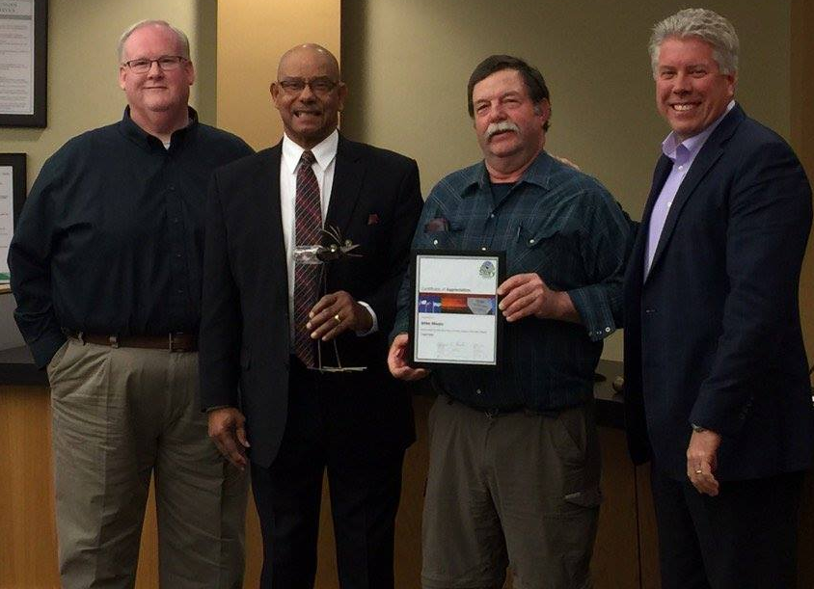
Communications Plan
Annual Reports
Citizen of the Year
NCGM
Capital Improvements Planning
Cornerstone to Capstone
Day of Caring
KHOI Radio Updates

Slide 11
Chapter Four
“You are never too old to set another goal or dream a new dream.”
-By C.S. Lewis

Slide 12
MARCHING FORWARD
Trying new things to tell Our Story
Using new tools (and sometimes tried and true techniques) to increase when, where, how, why, and to whom we deliver our messages
And, yes, even an “old dog can learn a few new tricks” because YouTube in an incredible teacher!

Slide 13

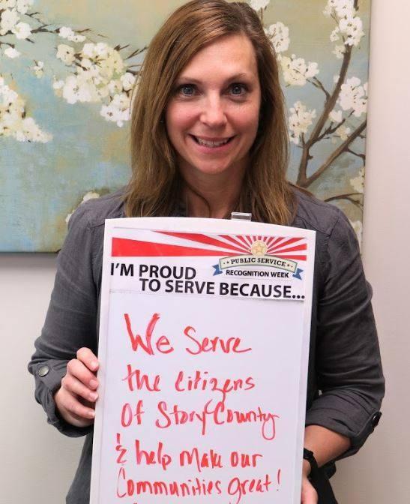

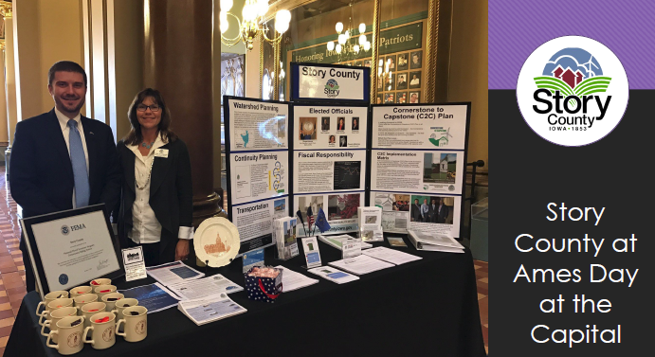
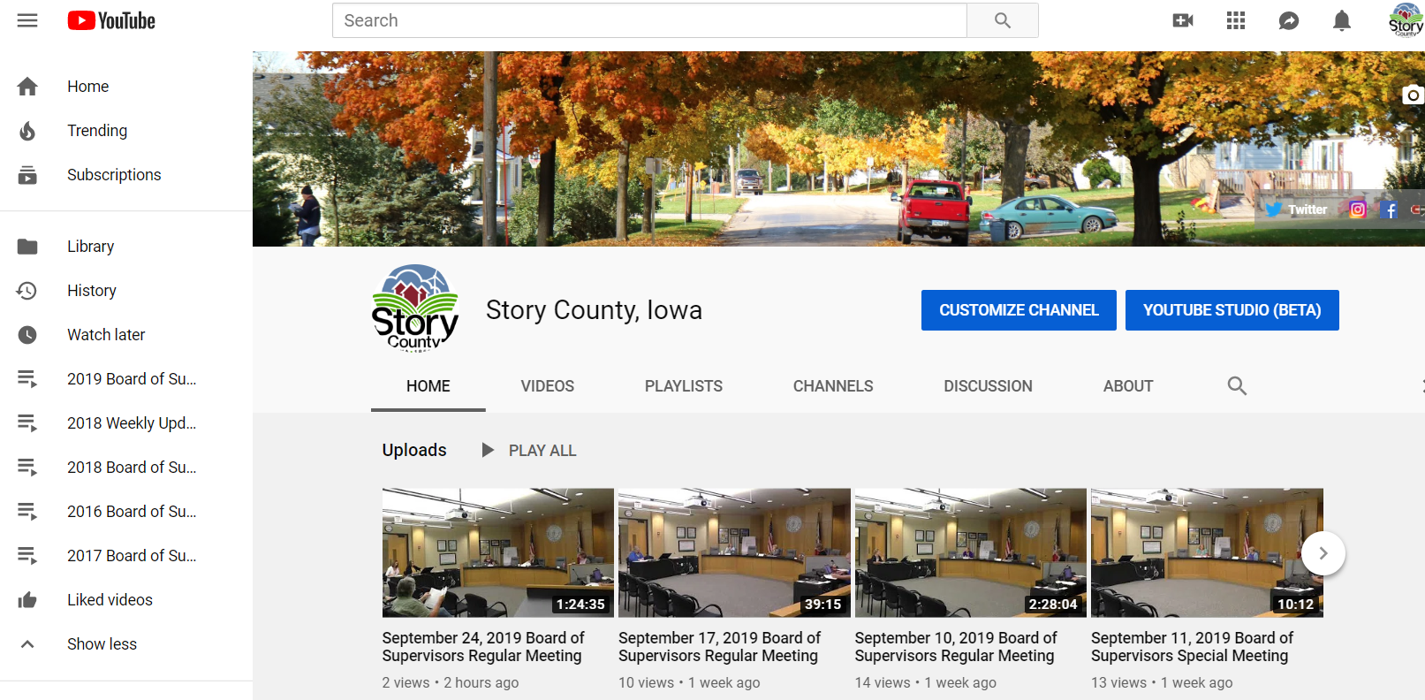


Slide 14
Chapter Five
“It’s not about what it is, it’s about what it can become.”
-By Dr. Seuss

Slide 15
AND THEN…
New faces and new strategies and ideas!
Keeping up with the “Social Media Joneses”
Looking at tools to make this easier
Creating engaging materials
Putting stuff in non-government speak – say what?
Staying current, relevant, and engaging
This is the song that never ends.
It goes on and on my friends.
Someone started singing it not knowing what it was,
And they’ll continue singing it forever just because…

Slide 16
Epilogue
“Talkin’ Bout the Things,
All the Woulda-Coulda-Shoulda Done.”
-By Shel Silverstein

Slide 17
Just keep swimming, just keep swimming!
Despite what comes our way…
People
Hazards
Money
umm – unfunded mandates and decisions from “other” elected bodies
We all believe in COUNTY GOVERNMENT and our challenge must be to share our stories and follow Dory’s advice to engage our citizens, encourage them to be involved and educate everyone what amazing services counties throughout the state of Iowa provide!

Slide 18
Contact Information
Leanne Lawrie Harter, AICP CFM
County Outreach and Special Projects Manager – Story County, Iowa
900 6th Street – Nevada, Iowa 50201
Email: lharter@storycountyiowa.gov Phone: 515-382-7247
Check Story County out online at www.storycountyiowa.gov or find us on Facebook, Twitter, Instagram and YouTube

Slide 19
Transparency
Gary Sawyer, October 2019

Slide 20
Introduction
Edited newspapers in Iowa, Oregon and Illinois during a 40-year career.
Currently, assistant teaching professor at Iowa State University’s Greenlee School of Journalism and Mass Communication.
Strong believer in the public’s right to know. The public usually makes reasonable decisions if given all the facts.

Slide 21
The knowledge gap
Many journalists don’t understand the property tax system.
Rely on ``experts’’ to tell the story.
Result: May not tell the complete story.
Most residents don’t understand the system:
Leads to misunderstandings and mistrust.
``Controversies’’ that really aren’t controversial.

Slide 22
Information they can understand
Explain the property tax system as simply as possible.
Make comparisons, (like percent of increase or decrease) a part of your budget documents.
Charts and graphs can help.
Make complete budget documents available, but consider condensed versions that are more accessible.

Slide 23
Different types of media
Newspapers:
May be looking for more in-depth information.
May want additional time to prepare the information.
Radio:
Not many true radio news departments.
May have interactive programs – talk shows – that can be beneficial.
TV:
A visual media.
Report will be short.

Slide 24
Different types of media
Online:
Various forms, from social media to blogs.
Need to be prepared to react as soon as possible.

Slide 25
Tell your story
Most journalists want to do a story that is fair and accurate.
What about the budget is important/outstanding.
Anticipate questions and concerns and consider getting out in front of them.
``Hiding’’ issues is risky.
Journalists don’t mind, and might even welcome, conversations about what’s important.
If something might be controversial, consider getting in front of it.

Slide 26
The importance of relationships
Get to know your local media
The reporter that covers you area.
The editor that assigns stories.
Know their deadlines, challenges, etc.
Complaints or suggestions:
If at all possible, start with the person closest to the issue (the reporter). If that doesn’t work, then go up the ladder.
It’s a professional relationship:
We can be friendly, but we most likely can’t be friends

Slide 27
Checklist for talking to journalists
Questions are a chance for you to explain the story.
Be accessible. It’s better to have dinner interrupted than an incorrect story.
Journalists may not recognize what you think is important. Tell them.
A good strategy might be to offer more information and fewer opinions.
Good journalists strive to tell all sides of a story. If you have critics, good journalists will be talking to them.

Slide 28
Checklist (cont.)
If you don’t know, tell them you will check and get back to them. Then, do that.
If you can’t say something, tell them why.
``No comment,’’ is a red flag.
Keep the lines of communication as open as possible.

