Slide 1


The Picture of Mental Health in Iowa

Slide 2

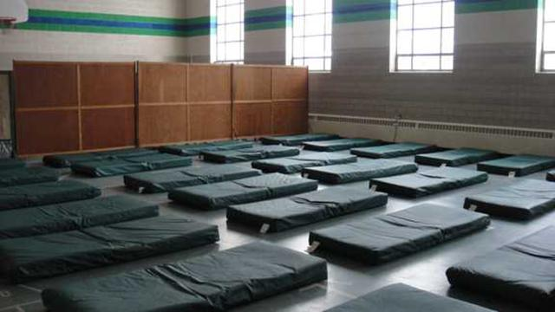
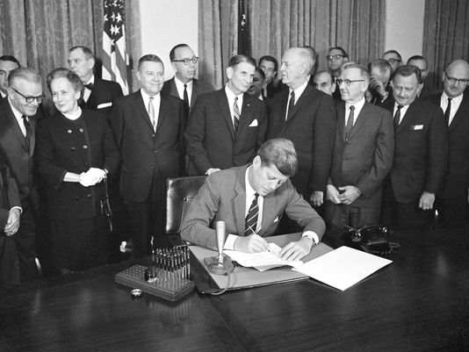

How did we get here?
Kennedy De-institutionalizes Mental Health
Decade of the Brain
Tough on Crime Era leads to increase in prisons and jails
90% of homeless population have serious mental illness, as do 50% of those incarcerated.

Slide 3
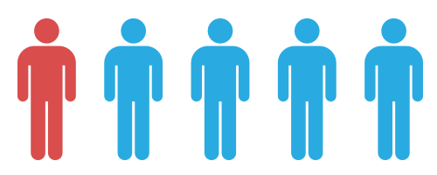
Top Mental Health Issues Facing Iowa Today
One in five people experience a mental illness annually
Approximately 130,000 Iowans live with a serious mental illness
Those with severe mental illness die an average of 28 years sooner than the general population

Slide 4
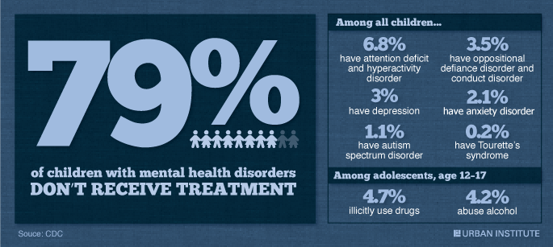
Children’s Mental Health

Slide 5
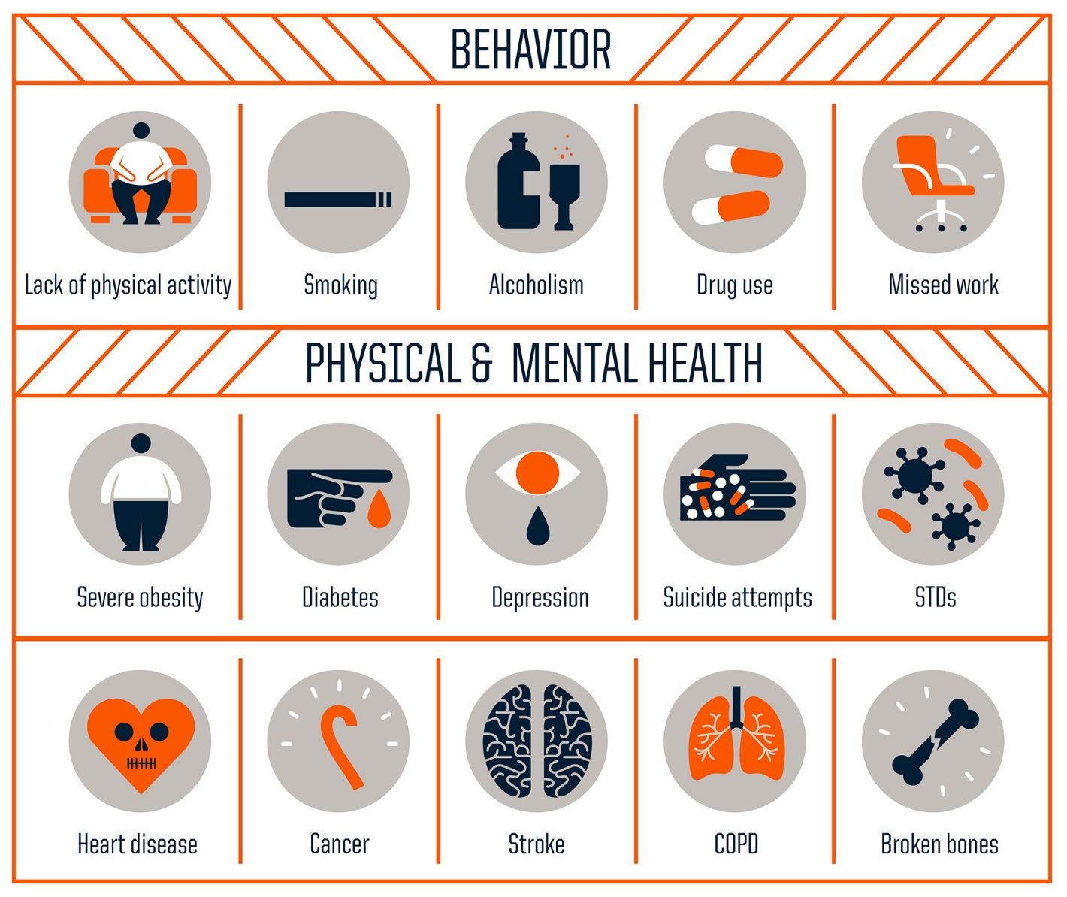
Children’s Mental Health, Continued
Half of all lifetime cases begin by age 14
There is no children’s mental health system in Iowa
Adverse Childhood Experiences Study (ACES) shows childhood trauma leads to lifetime consequences

Slide 6
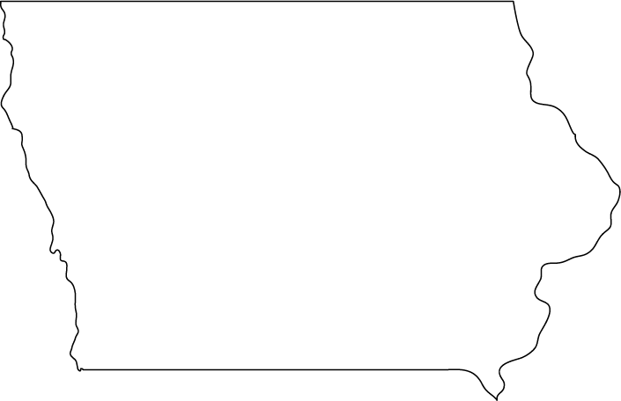
Suicide
450 Iowans commit suicide annually
Suicide is the leading cause of injury deaths
Over 90% of those who complete suicide have a mental disorder

Slide 7
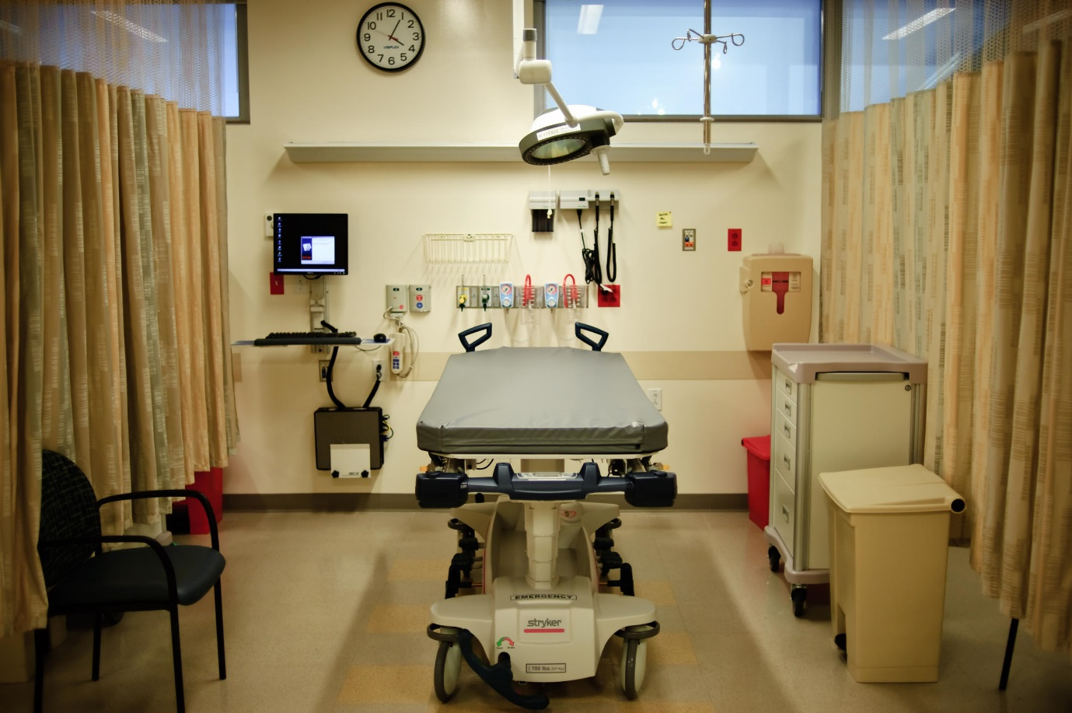
In-Patient Treatment
Iowa ranks 50th in the nation for state beds
Ranks 47th for overall number of beds

Slide 8
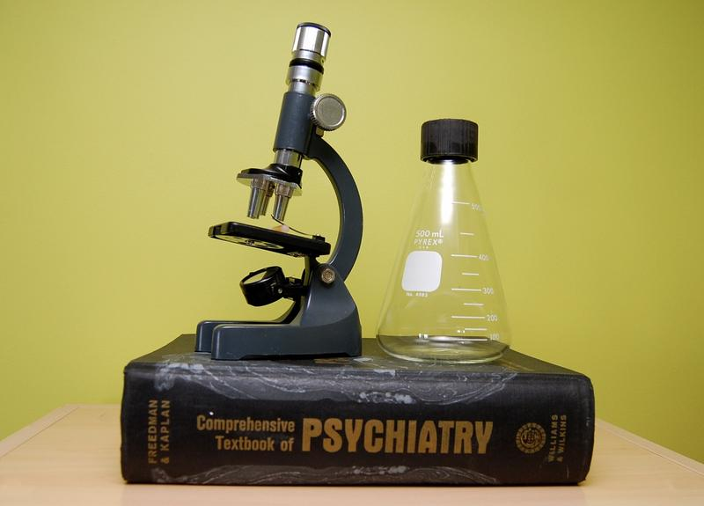
Lack of Providers
Iowa has only 121 psychiatrists in private practice
31 are child psychiatrists
Only 300 prescribers in the state. (Includes registered nurse practitioners and physician assistants.)

Slide 9
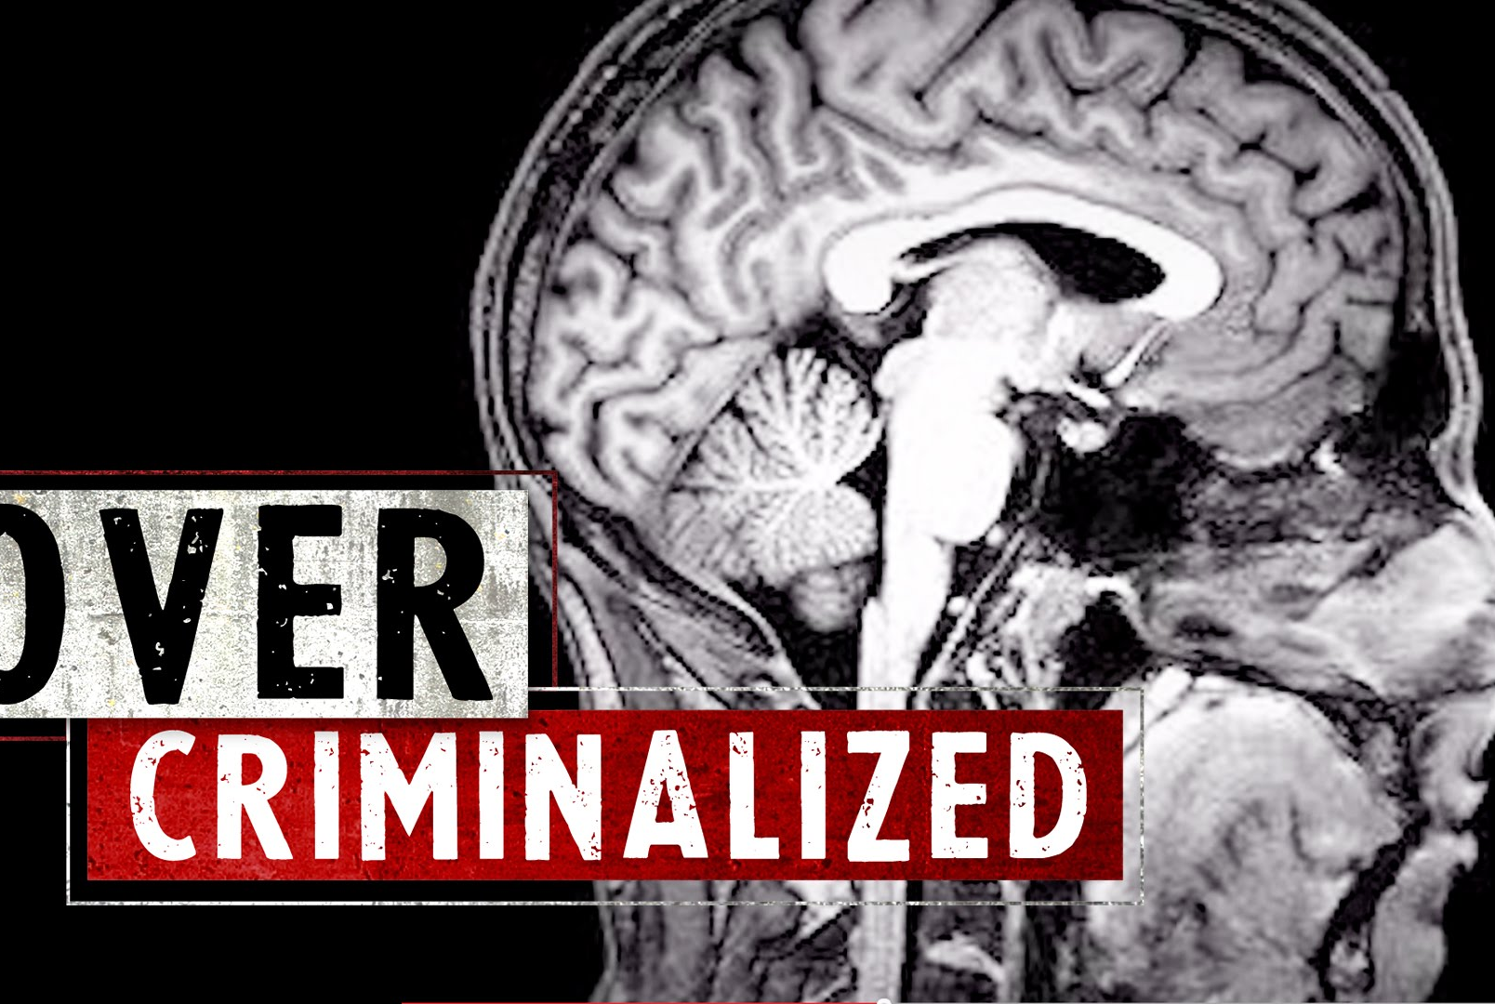
The Criminalization of Mental Illness
There are 10x more people with mental illness in jails and prisons than hospital beds

Slide 10

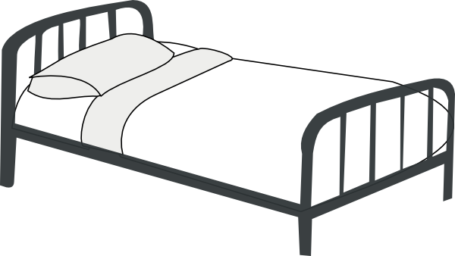
The Criminalization of Mental Illness
Number of Mental Health Beds
Number of Prison Beds
1950, Iowa had 5,000+
Today, we have 720
1950, Iowa had less than 2,000
Today, we have 8,000+

Slide 11



The Criminalization of Mental Illness
40% of male inmates in Iowa
have a serious mental illness diagnosis
60% of female inmates in Iowa
have a serious mental illness diagnosis
70% of all inmates in Iowa
have a substance use disorder

Slide 13

Who We Are
NAMI is the nation’s largest and oldest grassroots organization devoted to education, advocacy and support around mental health issues
National organization founded in 1979
Iowa chapter founded in 1988

Slide 14



NAMI National
In all 50 states
Over 600affiliates
10 signature programs
100,000 paid members

Slide 15





13 affiliates across the state

Slide 16
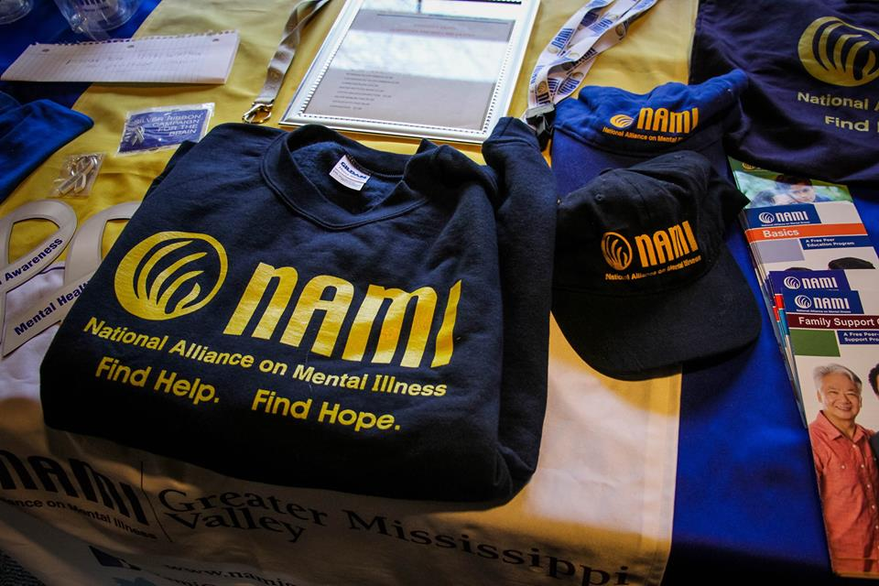
What We Do
Lobby for mental health reform
Train teachers and facilitators to lead classes and support groups
Provide assistance for affiliates
Promote statewide, systemic policy and program change

Slide 17
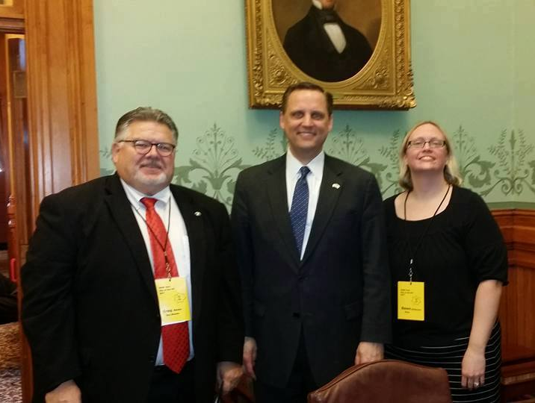
2017 Legislative Session
Legislative Victories
Day on the Hill
SF 504: Mental Health Levy Bill
HF233: Fail First Bill
HF 653: A Win for
Children’s Mental
Health
Over 100 advocates from across the state
A day of education, inspiration and talking to local legislators

Slide 18
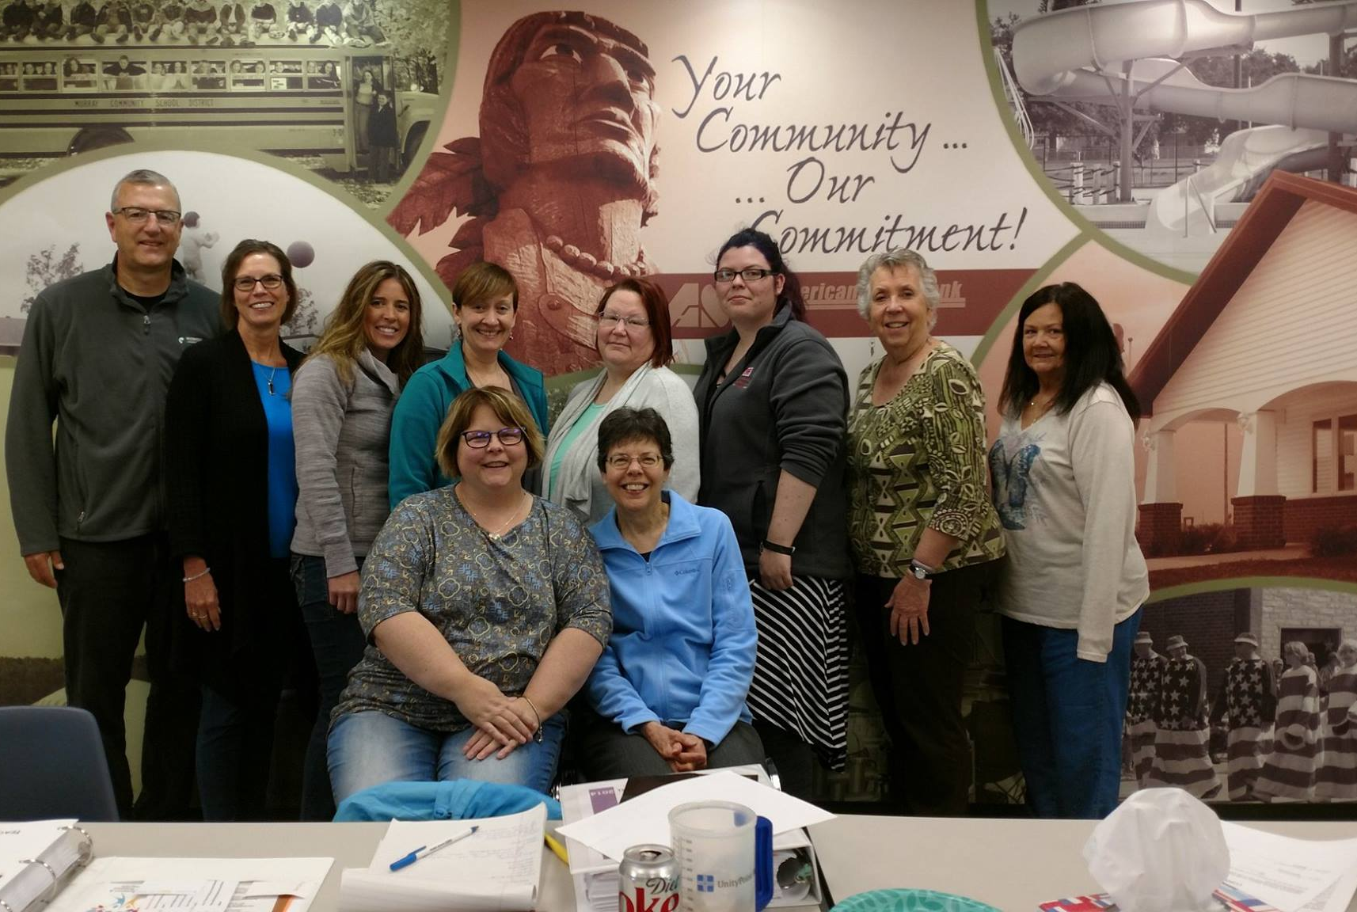
More Teachers, More Programs
6 teachers sent to National Train the Trainers to become State Trainers
8 new Family to Family teachers
6 NAMI Smarts Presenters
Plans for NAMI Basics and In Your Own Voice Training

Slide 19
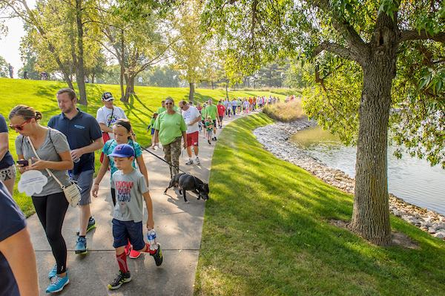
How to Get Involved
Become a member
Form a NAMI Walks team *September 30, 2017!
Beautiful Minds
*Attend or Host a Dinner
Donate
Volunteer

Slide 20

How to Get Involved
Sign up for our Advocacy Network and make your voice heard!
Attend our annual Day on the Hill
Attend local legislative forums and get to know your legislators
Help end the stigma
Follow us on Facebook and Twitter

Slide 21
Address: 3839 Merle Hay Road
Suite 229
Website: namiiowa.org
Email: info@namiiowa.org
Phone: 515-254-0417

