Slide 1
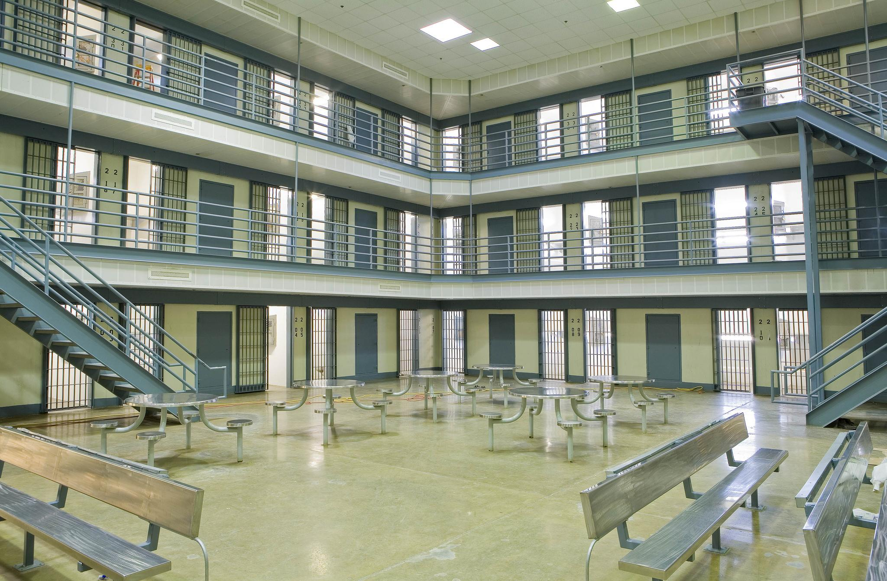
Every year,
11 million people cycle through 3,100 local jails, costing over $22B.
Notes:
Poor human outcomes

Slide 2
In local jails:
have a mental illness
have a substance use disorder
have chronic health problems
64%
68%
44%

Slide 3
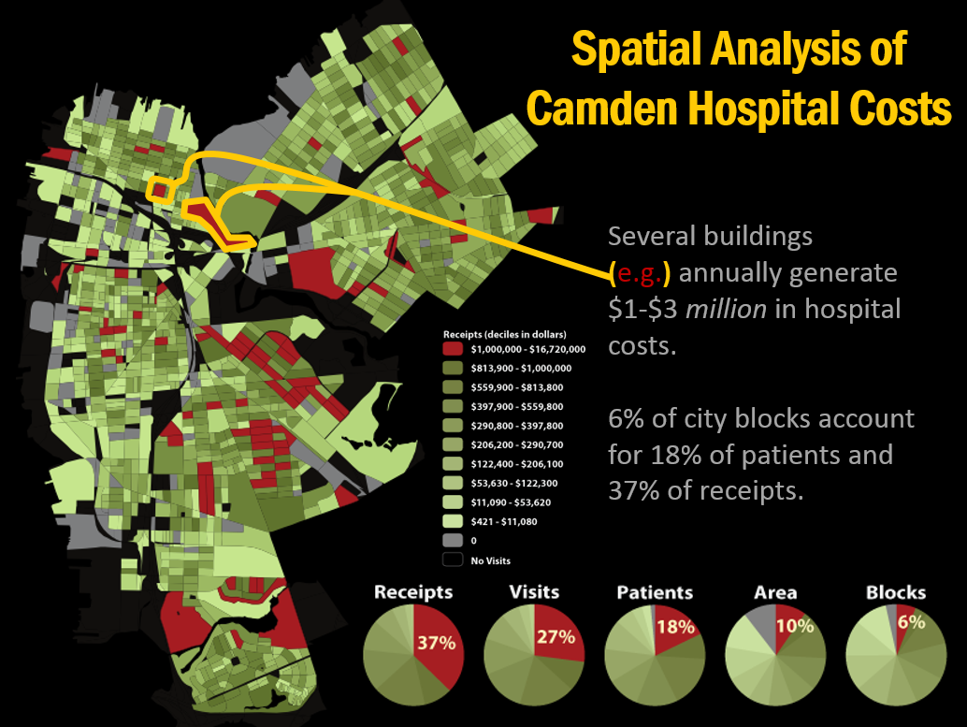
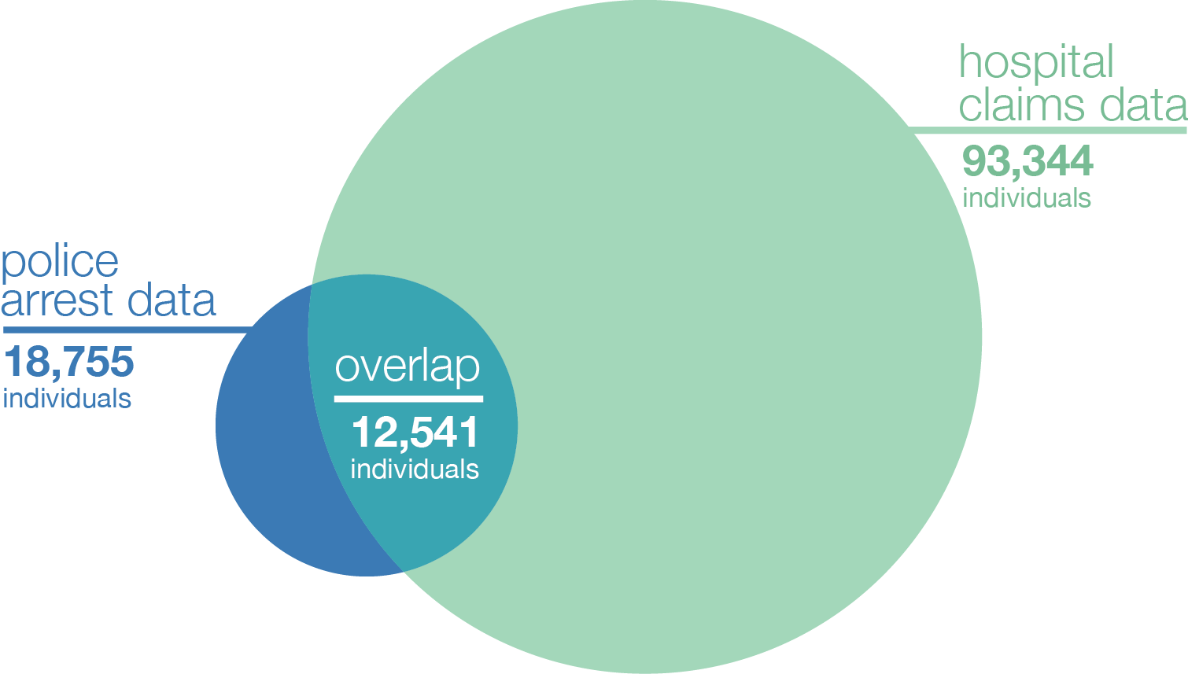
SCOUT & SCALE WHAT WORKS: REAL TIME USE OF DATA
Camden, NJ
Dual-System
High Utilizers
205 individuals were identified to be dual-system high utilizers (10+ ED visits & 6+ police encounters over five years).

Slide 4
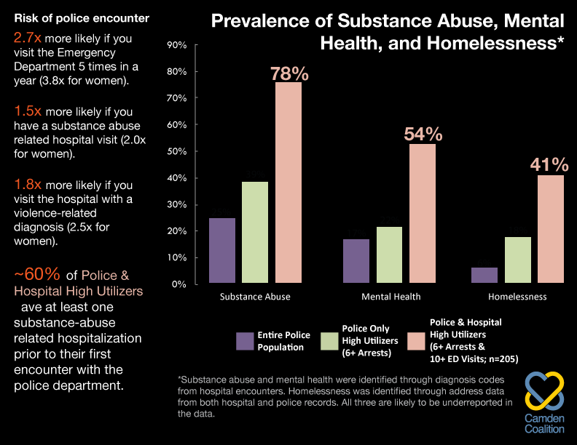
SCOUT & SCALE WHAT WORKS: REAL TIME USE OF DATA
Identify Unseen Opportunities to Intervene
h

Slide 5
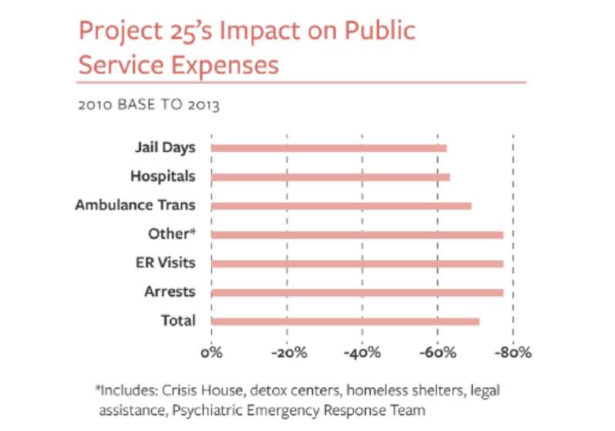
Project 25: Housing First, Health Home for Serious Mentally Ill and Chronically Homeless
SCOUT & SCALE WHAT WORKS: PROACTIVE INTERVENTION, REALIGN EXISTING SERVICES
San Diego, CA
In 2010, 28 people cost the community $3.5 million
Total Cost Savings = $3.7 million over 2 years (net ROI of 207% in 2012 and 262% in 2013)
All Project 25 individuals housed in their own apartments, have acquired health care insurance, and are receiving necessary supportive services and care on an ongoing basis.

Slide 6
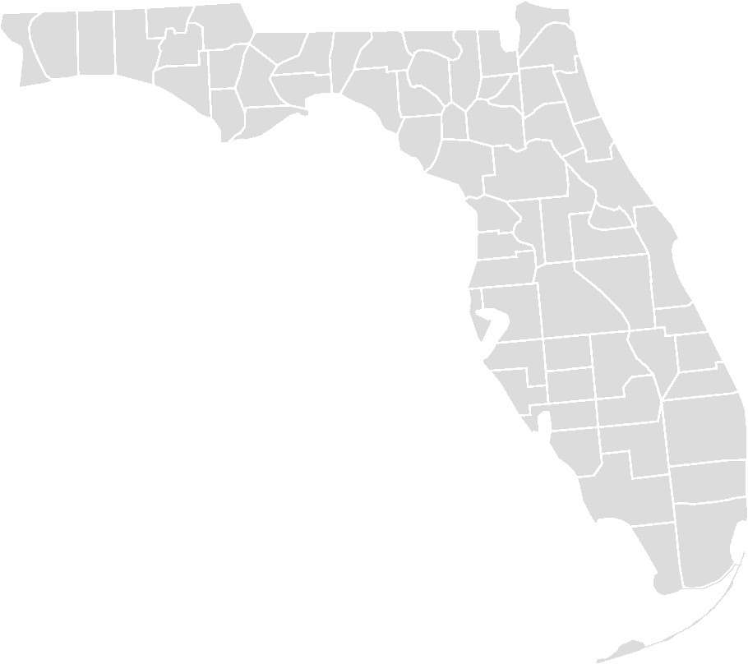
MIAMI-DADE, FLORIDA
97 PEOPLE $13.4M IN SERVICES
39,000 DAYS IN INSTITUTIONS WITH DE-ESCALATION TRAINING, RESPONDED TO 50,000 CALLS, ONLY MADE 109 ARRESTS, DIVERTED 10,000 PEOPLE JAIL POPULATION FELL FROM 7,000 TO 4,700 AND SAVED $12M A YEAR

Slide 7
(Some of the) Data Challenges
SILOED DATA
MANUAL ENTRY
PRIVACY
INTEGRATION
LEGACY SYSTEMS
A SCALABLE TECH SOLUITION

Slide 8
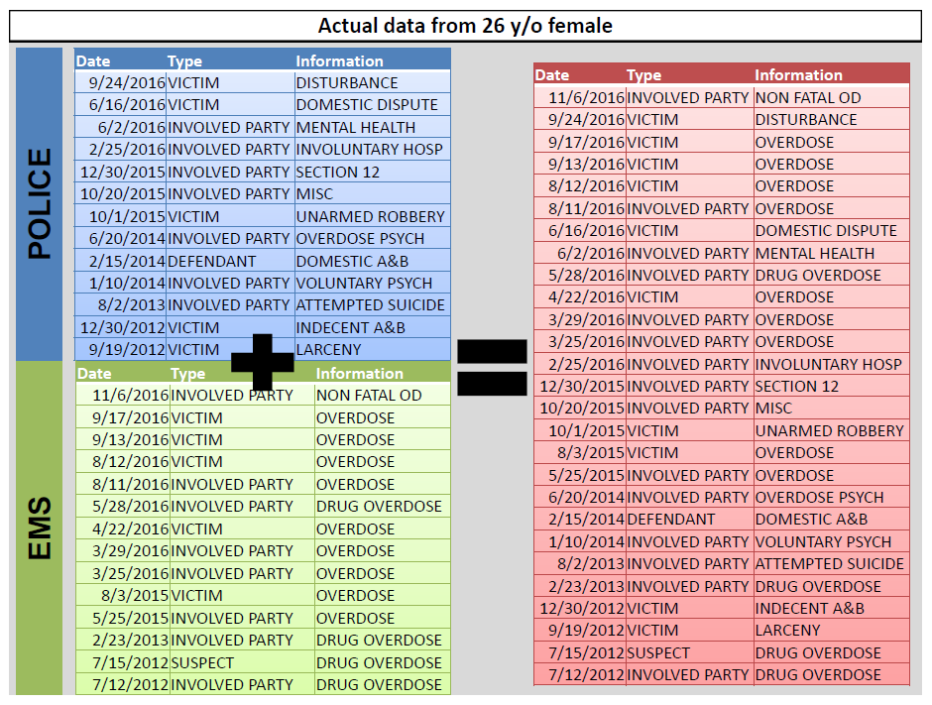
Image courtesy of Lieutenant Dan Wagner, Cambridge Police Department

Slide 10
Cross Sector Data Sharing

Slide 11
Four Local Johnson County Case Studies 2009 – June 2014 total costs of four individuals
*Legal Charges are a low estimate of the range provided for data collection.
Notes:
Collected an initial 26 individuals identified as frequent users of multiple systems – picked four to collect case data on.
*Legal and Law Enforcement figures are extremely low estimates. It was not possible to get data on the cost of individual court cases so we used the lowest average estimate for a general case that goes to court. Range was $1,000 - $50,000 for the type of legal cases these individuals incurred, and we used the $1,000 estimate for all of them.

Slide 12
Four Johnson County Case Studies Average annual costs for four individuals
Notes:
Average cost for each individual for one year. Typical program enroll requirement is $50K

Slide 13
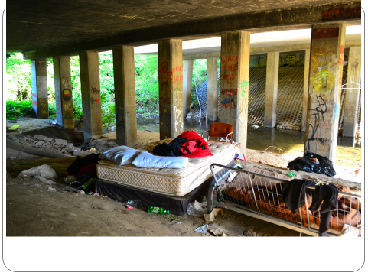

Slide 14
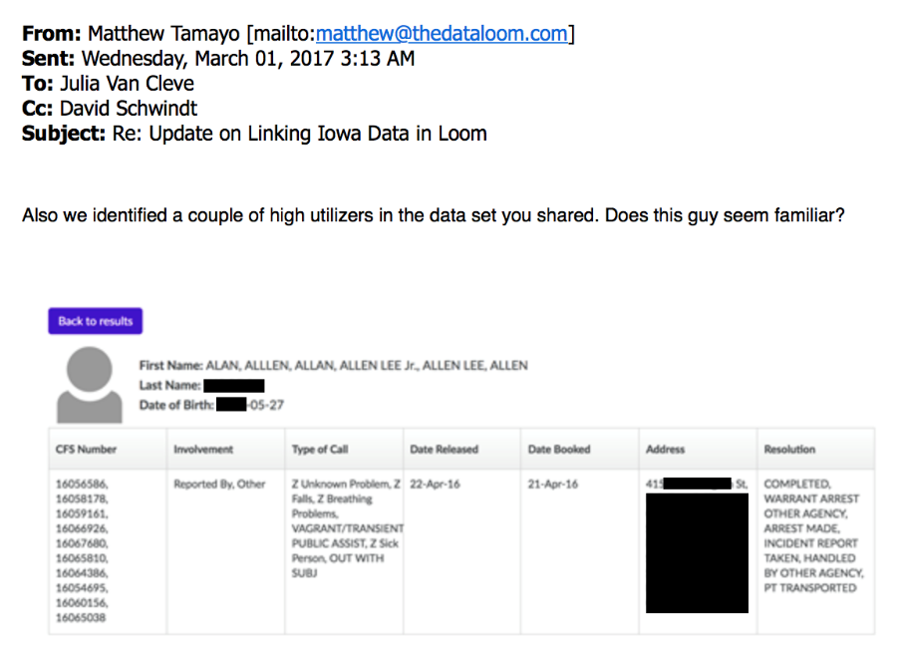
Progress in: Iowa City
Matthew,
Alan ####, the man you referenced below, is very familiar to us. Mr. #### is homeless, an alcoholic, and has a number of health issues. He isn’t very nice when he’s drunk, but he is great to talk to when sober. Here’s a picture of (sober) Alan and me having coffee in our downtown one morning. Ignore my double-chin. I’m working on my selfie skills.
Alan is one who causes us many, many issues. Unfortunately, we just don’t have a way to work with Alan…That’s why you don’t see him getting booked. We try to take him to our low barrier shelter when it is available, take him to get showered, but we rarely arrest him.
If there was something that worked to help Alan we would do it, we just don’t know what that is. So we respond to the 911 calls and do our best with what we have.
David Schwindt

Slide 15
