Slide 1
Welcome
    Information Security Office
    Services Available to Counties
    Security Operations Center
    Questions

Slide 2
Information Security Office (ISO) Background
Mission: Promote the secure use of information technology resources and effectively manage the associated risks.
Office of the Chief Information Officer (OCIO)
  Bob von Wolffradt, Chief Information Officer (CIO)
  Jeff Franklin, Chief Information Security Officer (CISO)
Information Security Office (ISO)
  Staff of 14 Employees
  Supported by all of OCIO Staff
  Open 7-5 Monday thru Friday
  Incident On-Call (24/7)
    Duty Manager
    Duty Officer
  Full Service Information Security Office

Slide 3
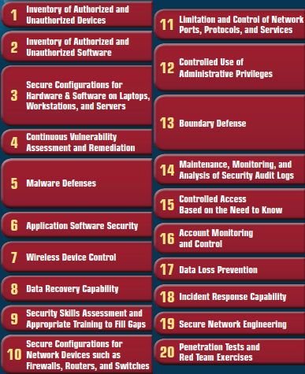
The CIS Critical Security Controls for Effective Cyber Defense

Slide 4





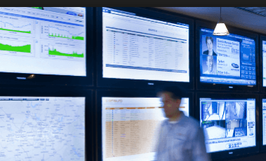
Services Available to Counties
Iowa Homeland Security Grant
Vulnerability Management
Patch Management
Intrusion Detection (IDS)
Anti-Malware
Security Operations Center
Notes:
Iowa Homeland Security Grant
Participating since 2010
Over $4M dollars awarded
40 counties participating
Do you want to talk about future services coming up – (Those in pilot)
SOC
Configuration Management

Slide 5
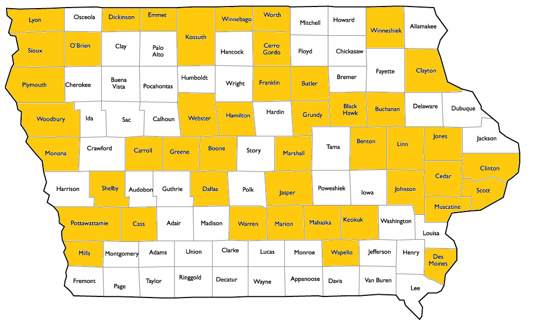
Vulnerability Management – CSC 4, 1, 2
IP360 Device Profiler
Scans for every device on your network
Lists vulnerabilities by importance
Vulnerability scores to help prioritize
Reduces Risk
Current Iowa County Participation Total: 46
Notes:
Vulnerability Management - The cyclical practice of identifying, classifying, remediating, and mitigating vulnerabilities", especially in software and firmware.

Slide 6
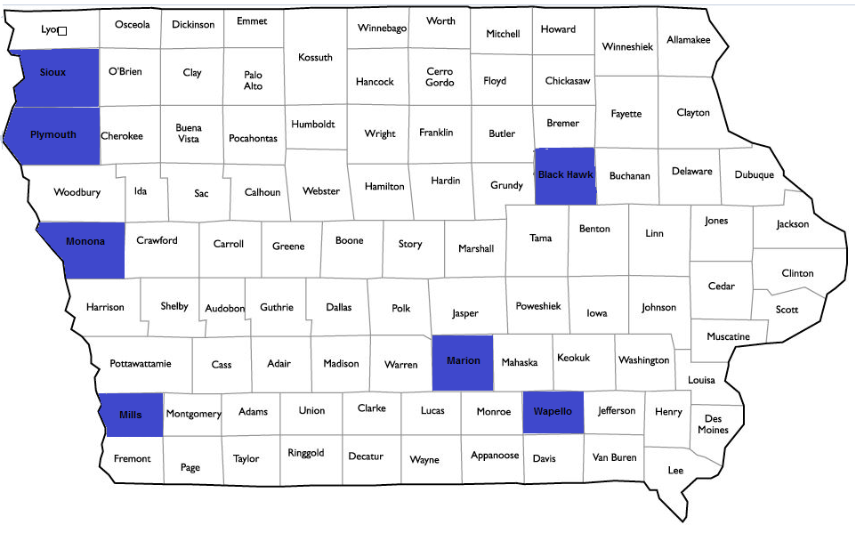
Patch Management – CSC 4
Asset Discovery
Third Party Patching
Auditing and Remediation
Helps Prioritize Your Risk
Current Iowa County Participation Total: 6
Notes:
Patch Management The cyclical practice of identifying, classifying, remediating, and mitigating vulnerabilities", especially in software and firmware.

Slide 7
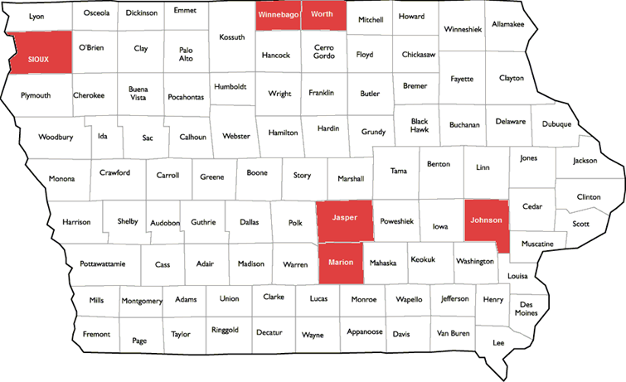
Malware Detection – CSC 8
Asset Discovery
Third Party Patching
Auditing and Remediation
Helps Prioritize Your Risk
Current Iowa County Participation Total: 6
Notes:
Malware Detection - FireEye HX ™ provides automated threat forensics and dynamic malware protection against advanced cyber threats
NX
Detect advanced threats
Analyzes over 80,000 events every second across a multitude of virtualized environments
FireEye NX ™ Multi-Vector Virtual Execution™ (MVX) engine, web traffic is analyzed in real time to identify the most sophisticated attacks
Stop known (signature-based), unknown (zero-day), multi-stage and multi-vector attacks that firewalls, AV software, IPS, and traditional sandboxes miss
HX
Enterprise Security Search: compromised endpoints can be isolated with a single click to identify known or unknown threats on other endpoints.
Data Acquisition: allows analysts to inspect compromised endpoints and analyze gathered information to create custom IOCs and address previously unknown threats.
Exploit Guard: detects and correlates exploits across multiple endpoints to improve overall visibility and protection

Slide 8

Intrusion Detection – CSC 12
New Service For Participating Counties
Open Source Solution
Talos Rule Set (SourceFire)
Initial Rollout to 13 Counties
Alert Monitoring and Reporting by ISO SOC
Notes:
Intrusion Detection - Systems that monitor for malicious activities, policy violations and suspicious traffic on a network.

Slide 9
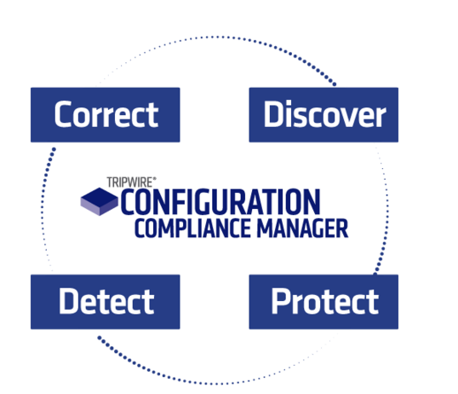
Configuration Management – CSC 3, 11
Discover and Audit Configurations.
Agentless
Scans Network for Compliance
Apply Compliance and security standards
Reduces Risk
Currently in Pilot
Notes:
Configuration Management -Tripwire CCM automates configuration auditing, change monitoring and configuration compliance processes, providing a clear picture of system configurations and the compliance impact of configuration changes.

Slide 10
Security Operations Center – CSC 19
Why a Security Operation Center?
Real Time Monitoring
Identifying Attacks (Alerting)
Respond Faster (Investigate)
Remediation
Recover
Notes:
ISO SOC Pilot
7 to 5 Monitoring
ISO Tools Set
Developing Alert Processes
Developing Communication
Developing Reporting
SOC Future
24 – 7 Monitoring
Staffed (Interns)
Additional Alerting
Additional Services

Slide 11






Information Security Office
Vulnerability Management- The cyclical practice of identifying, classifying, remediating, and mitigating vulnerabilities", especially in software and firmware.
Patch Management - Systems management that involves acquiring, testing, and installing multiple patches (code changes) to an administered computer system
FireEye – NX and HX provides automated threat forensics and dynamic malware protection against advanced cyber threats.
Intrusion Detection System – Systems that monitor for malicious activities, policy violations and suspicious traffic on a network.
Configuration Management – A process for establishing and maintaining consistency of a computer, server, mobile devices performance, functional, and physical attributes with its requirements, design, and operational information throughout its life.
Security Operation Center (SOC) - Provides situational awareness through the detection, containment, and remediation of IT threats. The SOC manages incidents for the enterprise, ensuring they are properly identified, analyzed, communicated, actioned/defended, investigated and reported. The SOC also monitors applications to identify a possible cyber-attack or intrusion (event) and determine if it is a real, malicious threat (incident), and if it could have a business impact.

Slide 12
Questions?
Contact: Jeff Franklin
Chief Information Security Officer
    (515) 281-4820
jeff.franklin@iowa.gov
Contact: Dan Powers
Manager, ISO
(515) 725-2906
dan.powers@iowa.gov

