Slide 11
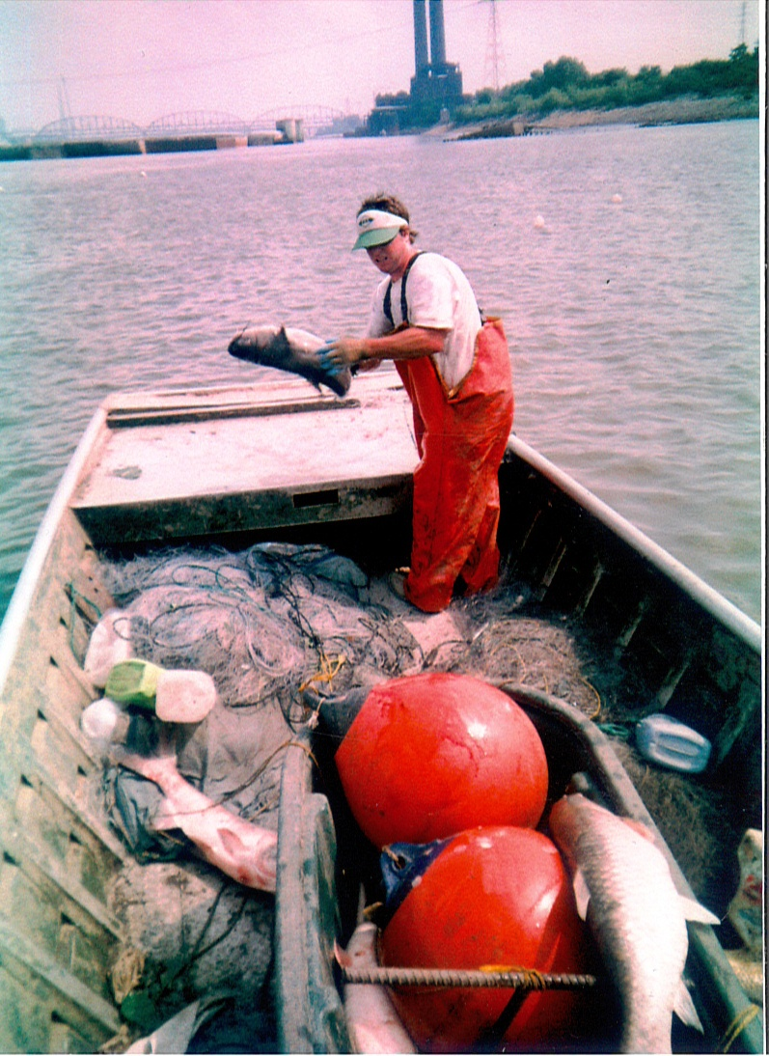
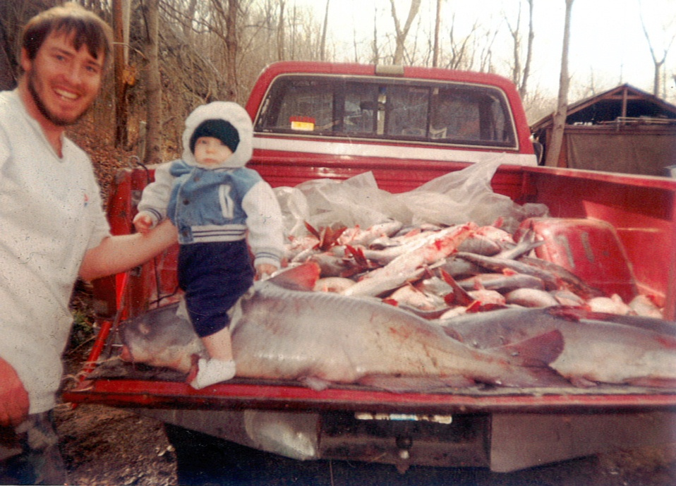
Notes:
‹#›

Slide 14
1997 CNN VIDEO
AMERICAN VOICES

Slide 16
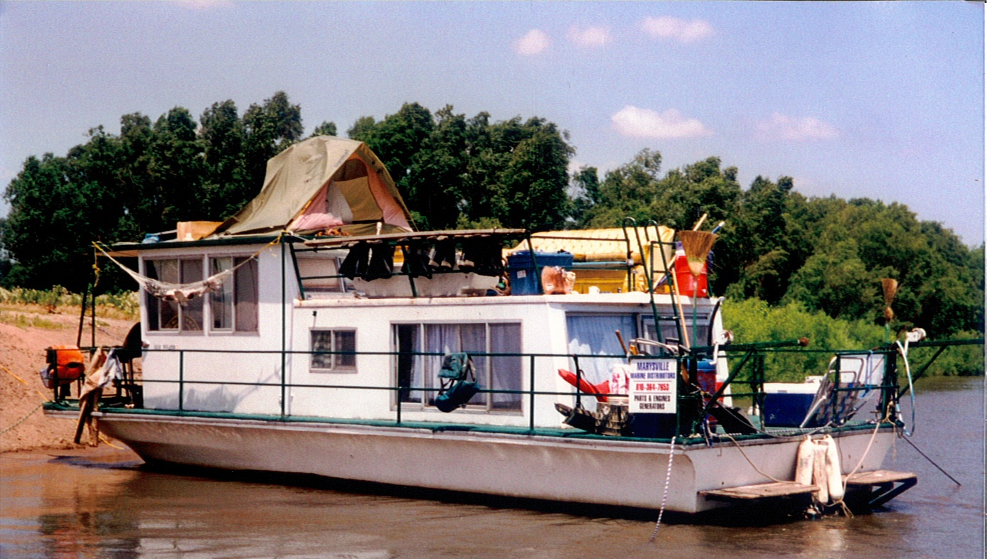

Slide 19
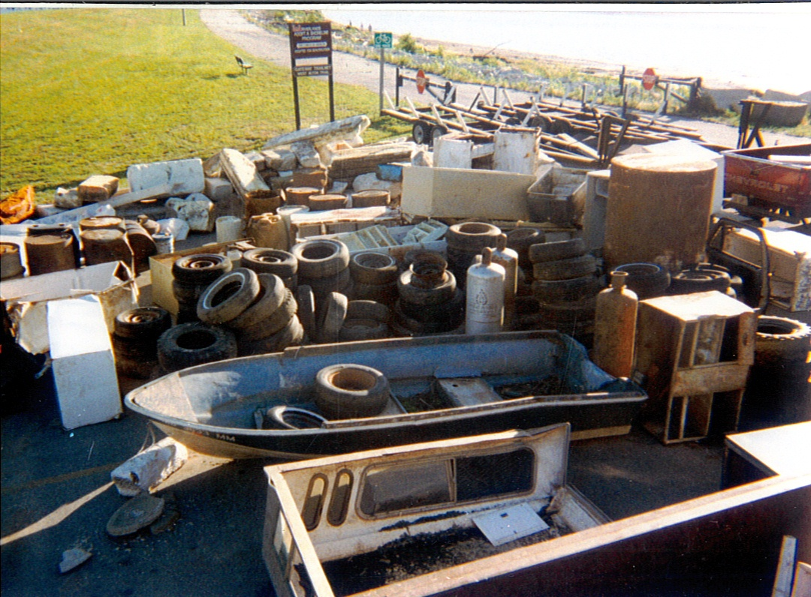

Slide 21
CBS SUNDAY MORNING VIDEO
2007

