Slide 1
Township Trustees and Clerks
10-7-2015

Slide 2
Since January 2014
Four ISUEO staff doing training – have conducted trainings in 59 counties
Trainings have been sponsored by:
County Board of Supervisors,
County Auditor’s Office
County Extension offices

Slide 3
Home rule
Allows us to do things differently but it should be within compliance with the Code
May need assistance from legal staff. If County has fewer than 25,000 use County Attorney

Slide 4
Township Trustee & Clerk Reference Manual
Manual for Township Trustees and Clerks hasn’t been updated for over 12 years by ISUEO
Manuals available for $20 at
https://store.extension.iastate.edu/Product/Township-Trustee-and-Clerk-Reference-Manual

Slide 5
Habits or law?
In many cases history has created habits that are now governed by law
Habits are hard to break – lack of information
Iowa Code requirements
-Budget | -Annual Report
-Fire Protection | -Fence Viewing
-Open Meeting/Open Records | -Cemetery

Slide 6
Iowa Code Chapter 21 & 22
Open meeting and open record changes in Code
Meeting places – publically accessible “and inviting”

Slide 7
Cemeteries
Large changes in state law in 2005
Internment Agreements
Cemetery Policies
No records
Some Counties want to translate fire districts and cemetery property to GIS
Perpetual Care Cemetery Reporting
County Supervisors taking over Pioneer Cemeteries – don’t double dip

Slide 8
Current Issues
Loosing Long Time Trustees
No transition – pick up traditions may be good or bad?
Not enough people willing to run for office
Questions of pay especially for fence viewing and clerks
Fire Department/EMS
Notes:
Asking for information to justify financial requests
Current 28E Agreements
Trustee ability to assume debt

Slide 9
Township Budgets & Annual Financial Reports
October 7, 2015

Slide 10
Township Budget Basics
Due March 15th
Must be approved by resolution of Trustees after a hearing
Notice of hearing must be posted not less than 10, no more than 20 days prior to the hearing
Signed copy of the budget must be submitted

Slide 11
Township Budget Basics
Late Submissions
Any submissions after March 15th are subject to penalty, no extensions allowed
Penalty is being held to previous year's property tax amount requested
Levies are to be put in place for townships even if they don't file a budget.
Taxes withheld until a budget is submitted in good form.

Slide 12
Township Budget Basics
Notice of Public Hearing
Township must give a copy of the posting notice to the County Auditor for posting
Posted at County Courthouse “in an area of the courthouse where notices to the public are commonly posted”
Not less than 10, no more than 20 days PRIOR to the date of hearing
Hearing and adoption can happen separately

Slide 13
Township Tax Levies
Township-wide levies
Owned Cemetery
Non-owned Cemetery
Township Hall
Township Hall Repairs
Library
Litigation
Tort Liability
District specific levies
Fire/Emergency Services

Slide 14
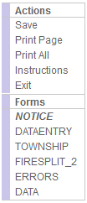
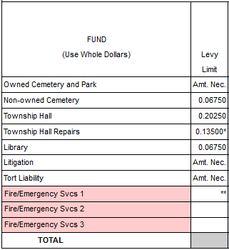
Township Tax Levies
Cemeteries
Owned
Unlimited levy
Township must own cemetery
Can accept cemetery as gift
Non-owned
$0.06750 Max
Payment to others for use of cemetery

Slide 15
Township Tax Levies
Township Hall
Hall Acquisition (360.1 & 360.2)
$0.2025 Max
For purchase, construction, or lease w/ purchase option
By election
Hall Repairs (360.8)
$0.13500 Max
Repair of owned or leased hall

Slide 16
Township Tax Levies
Library (256.69)
$0.0675 for support of a local library
Usually taxed for by the County, so this levy isn’t needed or used

Slide 17
Township Tax Levies
Litigation (359.19)
Unlimited
Allowed to cover the cost of hiring representation

Slide 18
Township Tax Levies
Tort Liability (359.19)
Unlimited
To pay for the cost of premiums of liability insurance

Slide 19
Township Tax Levies
Fire/EMS (359.43)
Base Maximum
$0.40500 base max (most Ctys.)
$0.54000 allowed if FD is paid & in a special charter city
$0.67000 if county pop is >300K

Slide 20
Township Tax Levies
Fire/EMS (359.43)
Additional support
$0.20250 extra can be levied if the base levy proves insufficient

Slide 21
Fire/Emergency Services
Fire rates can vary between districts
The other rates should remain the same from district to district
$0.30000 of each yearly levy can be reserved
Fire funds can be paid directly to the provider
Township
Fire Dist. 1

Slide 22
Fire/Emergency Services
Fire rates can vary between districts
Township fire districts can always levy up to maximum
Benefitted fire districts can only levy the amount that remains when benefitted fire rate is subtracted from max.
Township
Fire Dist. 1

Slide 23
Annual Financial Report
Due by September 30th
Need a full accounting of the receipts and disbursements by item
Need balances broken out into funds by purpose
Fire
Cemetery

Slide 24
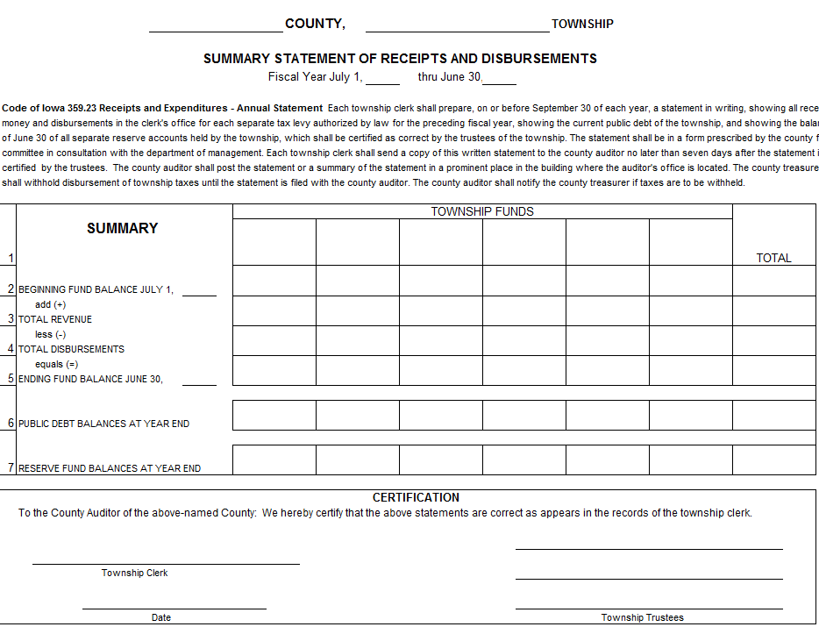
Annual Financial Report

Slide 25
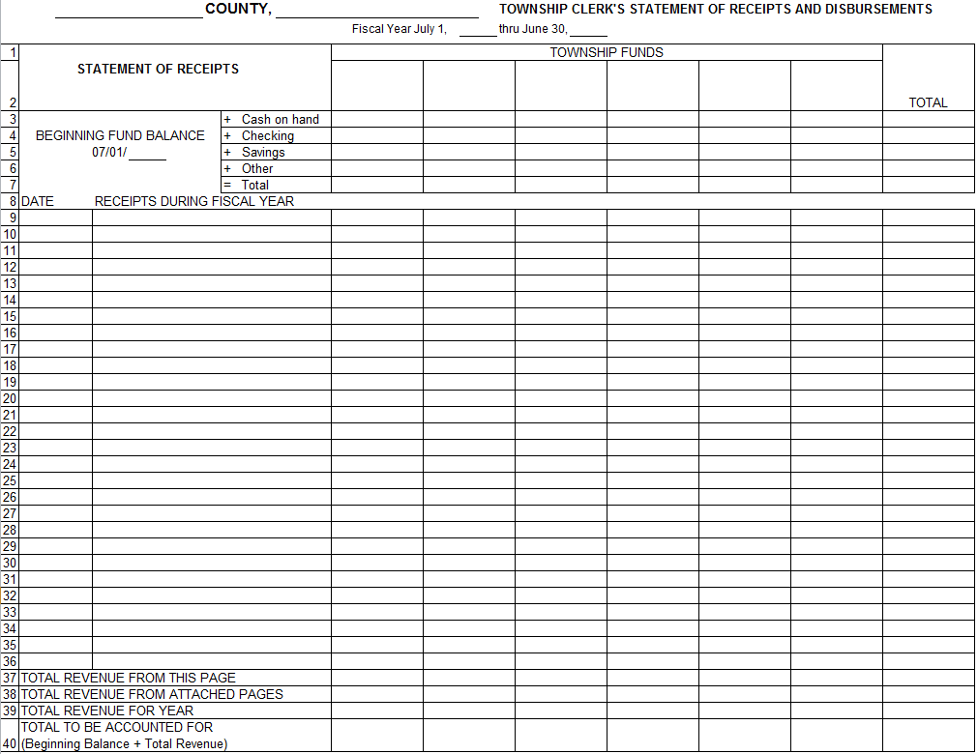
Annual Financial Report

Slide 26
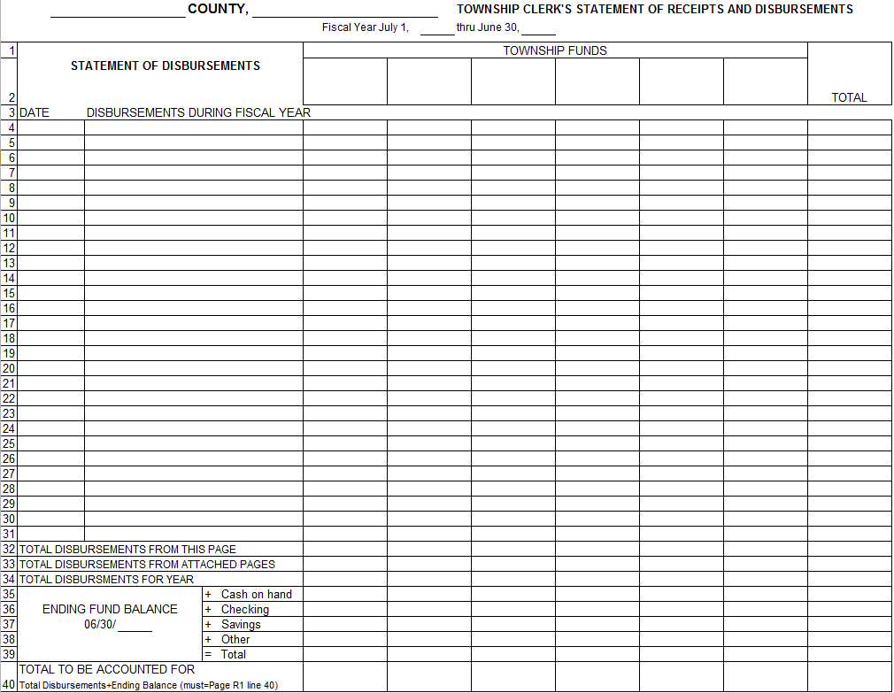
Annual Financial Report

Slide 27
Contact Information
Cindy Kendall, Extension Specialist
ISUEO, Office of State and Local Government Programs
ckendall@iastate.edu
515-294-1844
Ted Nellesen, Local Budgets
Department of Management, State of Iowa
ted.nellesen@iowa.gov
515-281-3705

