Slide 1
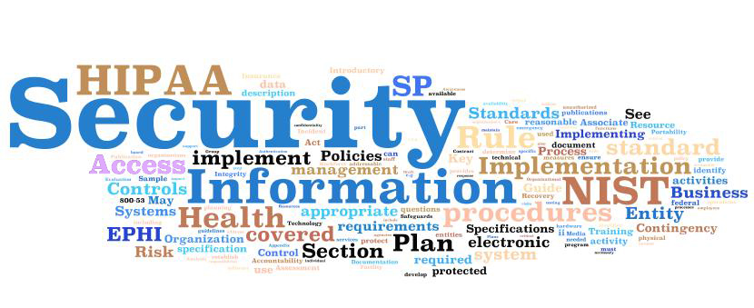

Slide 2
Topics
Rule Changes
Skagit County, WA
HIPAA Magic Bullet
HIPAA Culture of Compliance
Foundation to HIPAA Privacy and Security Compliance
Security Officer Responsibilities
HIPAA Security Rule Components

Slide 3
The Rules Have Changed
The recent HIPAA law changes started in 2009, when the American Recovery and Reinvestment Act included the Health Information Technology for Economic Clinical Health Act (“HITECH Act”). The HITECH Act impacted HIPAA covered entities and required revisions to the HIPAA regulations. On January 25, 2013, these new HIPAA regulations were published and made changes or additions to rules on breach notification, the marketing and sale of PHI, right to access of electronic copies of PHI, additional restrictions on disclosures, updates to the requirements for Notice of Privacy Practices, and changes to the applicability of HIPAA rules to business associates of covered entities.

Slide 4
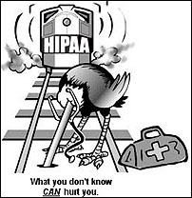

Slide 5
The Federal Government is conducting HIPAA audits and doling out penalties
In 2011, the Office of Civil Rights for the US Department of Health and Human Services began conducting HIPAA audits of covered entities.
This includes counties!
In 2014, OCR opened an investigation of Skagit County upon receiving a breach report that money receipts with electronic protected health information (ePHI) of seven individuals were accessed by unknown parties after the ePHI had been inadvertently moved to a publicly accessible server maintained by the County. OCR’s investigation revealed a broader exposure of protected health information involved in the incident, which included the ePHI of 1,581 individuals. Many of the accessible files involved sensitive information, including protected health information concerning the testing and treatment of infectious diseases. OCR’s investigation further uncovered general and widespread non-compliance by Skagit County with the HIPAA Privacy, Security, and Breach Notification Rules. Skagit County, Washington, has agreed to settle potential violations of the Health Insurance Portability and Accountability Act of 1996 (HIPAA) Privacy, Security, and Breach Notification Rules. Skagit County agreed to a $215,000 monetary settlement and to work closely with the Department of Health and Human Services (HHS) to correct deficiencies in its HIPAA compliance program.

Slide 6

HIPAA Compliance Magic Bullet
There is no magic bullet for HIPAA Compliance

Slide 7


Slide 8
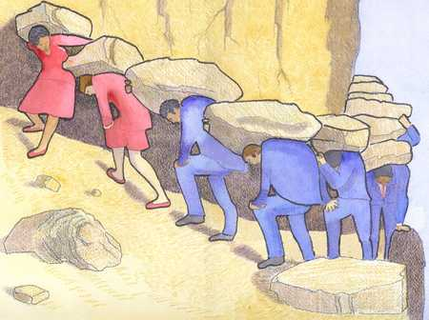
Myth: We’ve appointed people to our privacy and security officer positions. We’re going to be in compliance in no time.
The Truth: It takes a team. Assigning one or two people to do HIPAA Compliance is assigning failure.

Slide 9

Myth:
We’ve adopted the new policies and procedures. They look nice on the shelf. We’re compliant now!
The Truth:
If you’re not reviewing and updating your HIPAA policies and procedures on a regular basis, you’re not compliant.

Slide 10
HIPAA Culture of Compliance
A robust compliance program includes:
  Employee training
  Vigilant implementation of policies and procedures
  Regular audits
  Prompt Action Plan to respond to incidents

Slide 11


Slide 12


Slide 13
Foundation to HIPAA Privacy and Security Compliance
Step 1
Step 2
Step 3
Step 5
Step 4
- Form a HIPAA Compliance Committee
- Perform a thorough Risk Assessment (Baseline your compliance).
- Identify High Risk Areas and Mitigation Plan.
- Implement Mitigation Plan
- Implement HIPAA Policies and Procedures
“HIPAA Compliance Program”.
- Train Staff and Validate That it Works
- Conduct Annual Reviews and Updates
Notes:
Find those old policies on your shelf and take a look at them.
Take a look at the new sample policies on ISAC’s website.
Figure out who is (or who should be) your county’s HIPAA compliance officer(s).
Put together a HIPAA compliance committee.
Work on update old policies or adopting new policies.
Work on hybrid entity designation.
Work on a risk assessment.
Make sure you have updated business associate agreements with all necessary parties.
Train staff.
Need help? Have detailed questions? Consider joining ISAC’s HIPAA Program!

Slide 14
Security Officer responsibilities
Develop and revise HIPAA Security Policies and Procedures.
Answer all questions from employees concerning EPHI.
Prepare cost benefits analyses of appropriate EPHI safeguards and make recommendations regarding the adoption of safeguards.
Budget annually for EPHI security.
Meet regularly with committee to discuss EPHI security issues, policies and planning.
Monitor compliance with security laws and among the county and third parties.
Maintain records of access authorizations
Develop appropriate security training program.
Prepare and periodically assess County’s security response procedures, disaster recovery plan and business continuity plan for systems and devices containing EPHI.
Perform security audits and risk assessments of ongoing systems.
Investigate EPHI system security breaches.
Facilitate a process for Individuals to file a compliant regarding Security Policies.

Slide 15
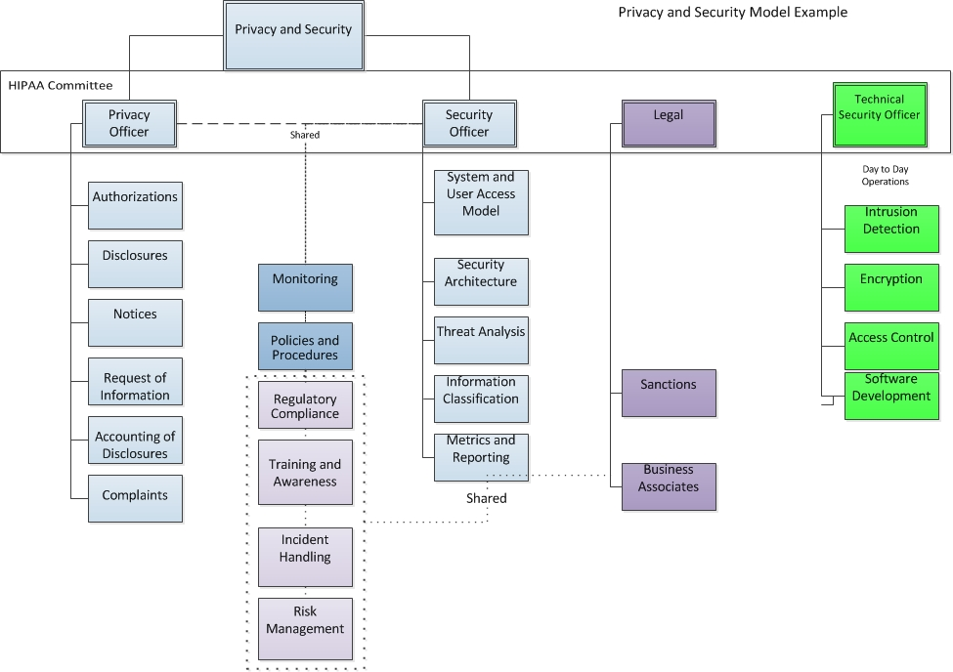
HIPAA Committee Example Organization

Slide 16
HIPAA Security Rule Components
Administrative Safeguards
Security Management Process
Assigned Security Responsibility
Physical Safeguards
Facility Access Control
Workstation Use
Technical Safeguards
Access Control
Workforce Security
Information Access Management
Security Awareness and Training
Contingency Plan
Evaluation
Business Associate Agreements
Workstation Security
Device and Media Control
Audit Control
Integrity
Personal or Entity Authentication
Transmission Security

Slide 17
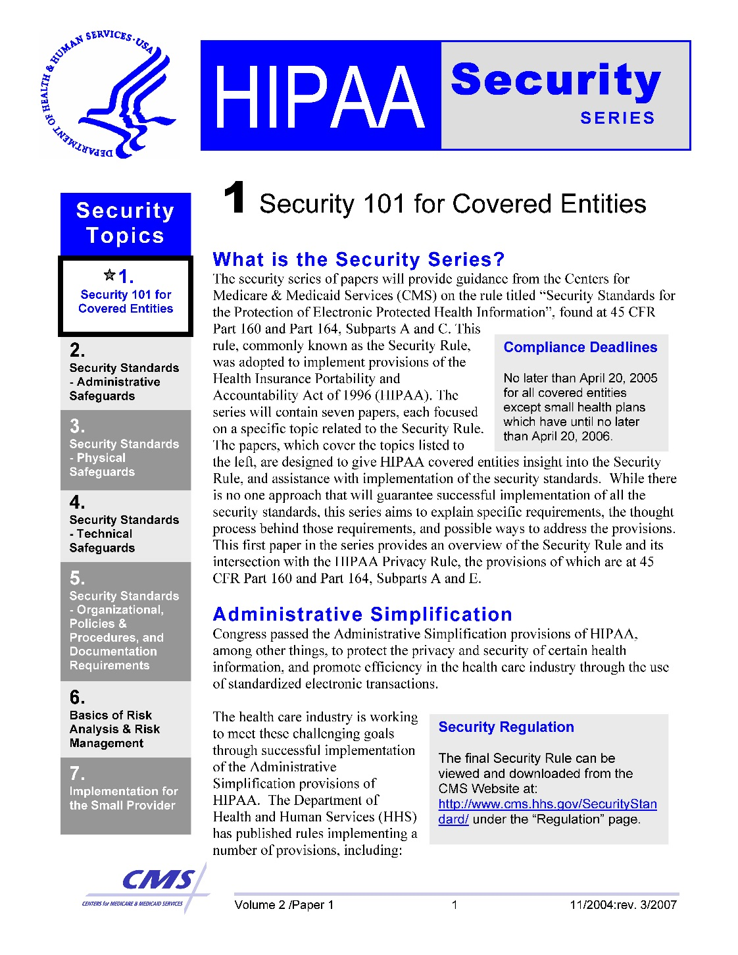

Slide 18
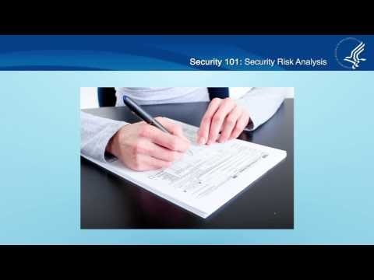

Slide 19
Important Resources
Security Rule Booklet
  http://www.hhs.gov/ocr/privacy/hipaa/administrative/securityrule/securityruleguidance.html
Security Risk Assessment Tool (SRAT)
  http://www.healthit.gov/providers-professionals/security-risk-assessment
ISAC HIPAA Program
  http://www.iowacounties.org/member-resources/legal/hipaa-information-for-counties/

Slide 20
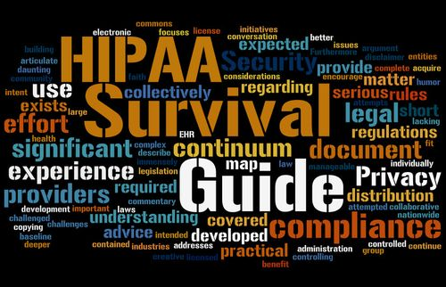

Slide 21


Slide 22
Discussion

Slide 23
ISAC-HIPAA-Program-summary-for-publication (3).docx
Iowa-Counties-and-Regions-HIPAA-Privacy-and-Security-Policies-Template-For-Counties-not-ISAC-2 (3).docx

