Slide 1
County finance & The property tax system
Lucas Beenken
Public Policy Specialist
Iowa State Association of Counties

Slide 2
Sources of County Revenue
Property Taxes
Intergovernmental
(state road use taxes, franchise taxes, state replacement of property tax credits, state and federal grants, and pass-through revenues)
Other County Taxes
(local option sales tax, hotel/motel tax, gambling tax revenue, tax increment financing revenue, and utility replacement excise taxes)
Charges For Service
Other Miscellaneous Revenue
(delinquent property taxes, licenses and permits, penalties and interest, use of money and property, long-term debt proceeds, and fixed asset sales)

Slide 3
Proportions of Revenue
Fiscal Year 2019
All Counties – Statewide Average
*Other includes long-term debt proceeds, penalties and interest, use of money, licenses and permits, and fixed asset sales

Slide 4
County Expenditures By Service Area
Public Safety & Legal Services
Physical Health & Social Services
Mental Health
County Environment & Education
Roads & Transportation
Government Services to Residents
(many state-mandated services, such as elections, motor vehicle registration, and the recording of public documents)
Administration
(some employee salaries and wages, as well as many insurance costs and general office expenses)
Nonprogram Expenditures
(short-term debt, corrections from previous years, debt service, and capital projects)

Slide 5
Allocation of Funds
Fiscal Year 2019
All Counties – Statewide Average
*Nonprogram expenditures include debt service and capital projects

Slide 6
Property Tax 101
Property taxes account for an average of 50.93% of county revenues statewide
Valuation x Tax Rate = Levy
(taxable value of (amount of tax per (property tax
real property) $1,000 of value) dollars generated)
*Note: Because valuation is determined independently, governing boards can control rate or levy but not both.

Slide 7
Property valuation
Property valuation is a key component of the property tax equation.
Property valuation set by assessor or Department of Revenue depending on property class.
Rate set by local governments to generate the desired levy amount
At the most basic level, the taxable value is multiplied by the tax rate to determine the dollars generated.

Slide 8
Property Tax Jurisdictions
Most local governmental entities tax property to generate revenue.
The county treasurer collects property taxes for all of the taxing entities.

Slide 9
Types of property subject to tax by local governments
Real Property
Land and any permanent improvements such as buildings or other structures
Personal Property
Everything subject to ownership that is not real property, for example a car or boat.
Iowa is among only a handful of states that exempt all personal property from property taxation.
Intangible Property
Includes intangible financial assets, such as investments in stocks and bonds.
Only a few states tax intangible personal property; Iowa is not among them.

Slide 10
Who determines property value in iowa?
County Assessor
Appointed by conference board comprised of the board of supervisors, mayors of each incorporated city, and school board members from each high school district.
City Assessor
Any city with a population of 10,000 or more may adopt an ordinance to establish the office of city assessor. Currently Iowa has 8 city assessors.
Appointed by conference board comprised of the board of supervisors, city council, and school board.
Department of Revenue
Central assessment of specific industries whose companies have property throughout the state.

Slide 11
Real property classifications in iowa
Assessor
Residential
Multi-residential
Commercial
Industrial
Agricultural
Department of Revenue
Gas
Electric
Railroad
Telecommunications
Property assessed every two years in odd-numbered years
Property assessed every year

Slide 12
PROPERTY CLASSES (continued)
Properties are divided into classes based on the primary use
Classification allows groups of property to be treated differently
Valuation method
Rollback
Tax credits
*Note: Property classification and zoning may be different.

Slide 13
Determining assessed values
Residential, multi-residential, commercial, and industrial properties assessed at market value.
Valuation Methods:
Sales Method
Compare to recent sales of similar properties in the vicinity
Cost Method
What would it cost to replace the property?
Income Method
Capitalize anticipated annual income for the useful life of the property

Slide 14
Assessment of ag property
Agricultural property is assessed based on productivity formula rather than market value.
The productivity formula is intended to measure the property’s capacity to generate farm income.
At basic level, net earning capacity is determined by 5 year rolling average of crop prices multiplied by yields minus expenses.
Productivity value per acre is multiplied by taxable acres to get the aggregate whole.
Ag buildings are assessed at their actual value and then multiplied by the ag factor (productivity value divided by market value)

Slide 15
ag property (continued)
Productivity value of the ag buildings is subtracted from the aggregate whole value of the ag land.
After taking out the ag buildings, the aggregate whole value is apportioned to land based on Corn Suitability Rating (CSR) and other factors.
Countywide aggregate value is limited, but not every acre will have the same value assigned.
The addition of ag buildings is a net zero for taxable valuation because of this formula.
In assessment year 2017, the productivity value as a percentage of market value was 26.3%.

Slide 16
Disputing assessed value
Informal Assessment Review
A dissatisfied property owner may request an informal assessment review by the assessor on one or more grounds for protest outlined in Iowa Code between April 2 and April 25.
Assessor may recommend the owner file a protest with the board of review and may make a recommendation to the board of review based on the informal review.
Assessor may also enter into a written agreement with the owner authorizing the assessor to correct or modify the assessment.

Slide 17
Disputing assessed value
Board of Review
Local board consisting of 3 or 5 members that evaluates assessment protests from property owners within the jurisdiction. Protests are submitted between April 2 and April 30, and the BOR meets between May 1 and May 31.
Property Assessment Appeal Board
State board consisting of 3 members that hears appeals to decisions by a local board of review. Appeals are submitted within 20 days of the BOR adjournment or by May 31, whichever is later.

Slide 18
equalization
In odd-numbered years the Department of Revenue conducts a statewide review of assessments in each class of property, and the assessor abstracts are compared to the Department’s sales assessment ratio study.
If the assessments in a given jurisdiction for a certain class are more than 5% above or below the sales assessment ratio, IDR “equalizes” the class in that jurisdiction by raising or lowering the assessment.
Equalization provides for consistency among the classes of property and across jurisdictions.

Slide 19
Assessed vs. taxable value
Assessed Value:
The actual value of property as determined by the assessor.
Approximates market value for all property except agricultural.
Taxable Value:
The value of property that is subject to tax after exemptions and rollback.

Slide 20
Property tax exemptions
Certain property may be wholly or partially exempt from property taxation because of the property itself, the owner, or the use.
Exemptions for military service, elderly/disabled individuals, conservation practices, wind energy conversion, and many other specific uses.
There is also property that is tax exempt because of the ownership such as property owned and used by the federal, state, or local government; non-profit organizations; churches or religious groups; educational institutions; public airports; and libraries.

Slide 21
Growth limitation
In response to rapidly rising residential values in the late 1970’s, the Iowa Legislature put in place the assessment growth limitation.
Originally just for residential and agricultural property, it soon applied to commercial and industrial property, and will include multiresidential.
Started off as cap of 6% annual statewide growth, reduced to 4% for AY1980, and reduced to 3% in SF295 for AY2013 and beyond.
Cap on annual statewide growth for particular class, not a limit on growth of individual property valuation.
Residential and ag property are “coupled” and limited to the lesser growth if less than the cap.

Slide 22
rollback
If the statewide increase in a class of property exceeds the growth limitation, the value is “rolled back” to equal the limitation amount.
While the growth limitation is on the entire class, the rollback is applied to each individual property.
Example (not accounting for new construction):
$75B taxable value last year + 3% growth = $77.25B
$80B actual assessed value (6.66% growth)
$77.25B / $80B = 96.56% rollback
Taxable value of $100,000 house would be $96,560
*As assessed value climbs and taxable value is limited, the rollback percentage continues to go down.

Slide 23
rollback
FY17 FY18 FY19
Agricultural 46.11% 47.50% 54.45%
Commercial 90% 90% 90%
Industrial 90% 90% 90%
Residential 55.63% 56.94% 55.62%
Multi-residential 86.25% 82.50% 78.75%
SF295 adjusted the Commercial and Industrial rollbacks to 95% in FY2015 and 90% thereafter.
The Commercial rollback applied to Multi-Res until FY17 when it became it’s own class. It will continue to decrease 3.75% per year until FY24 when it becomes coupled with Residential.

Slide 24
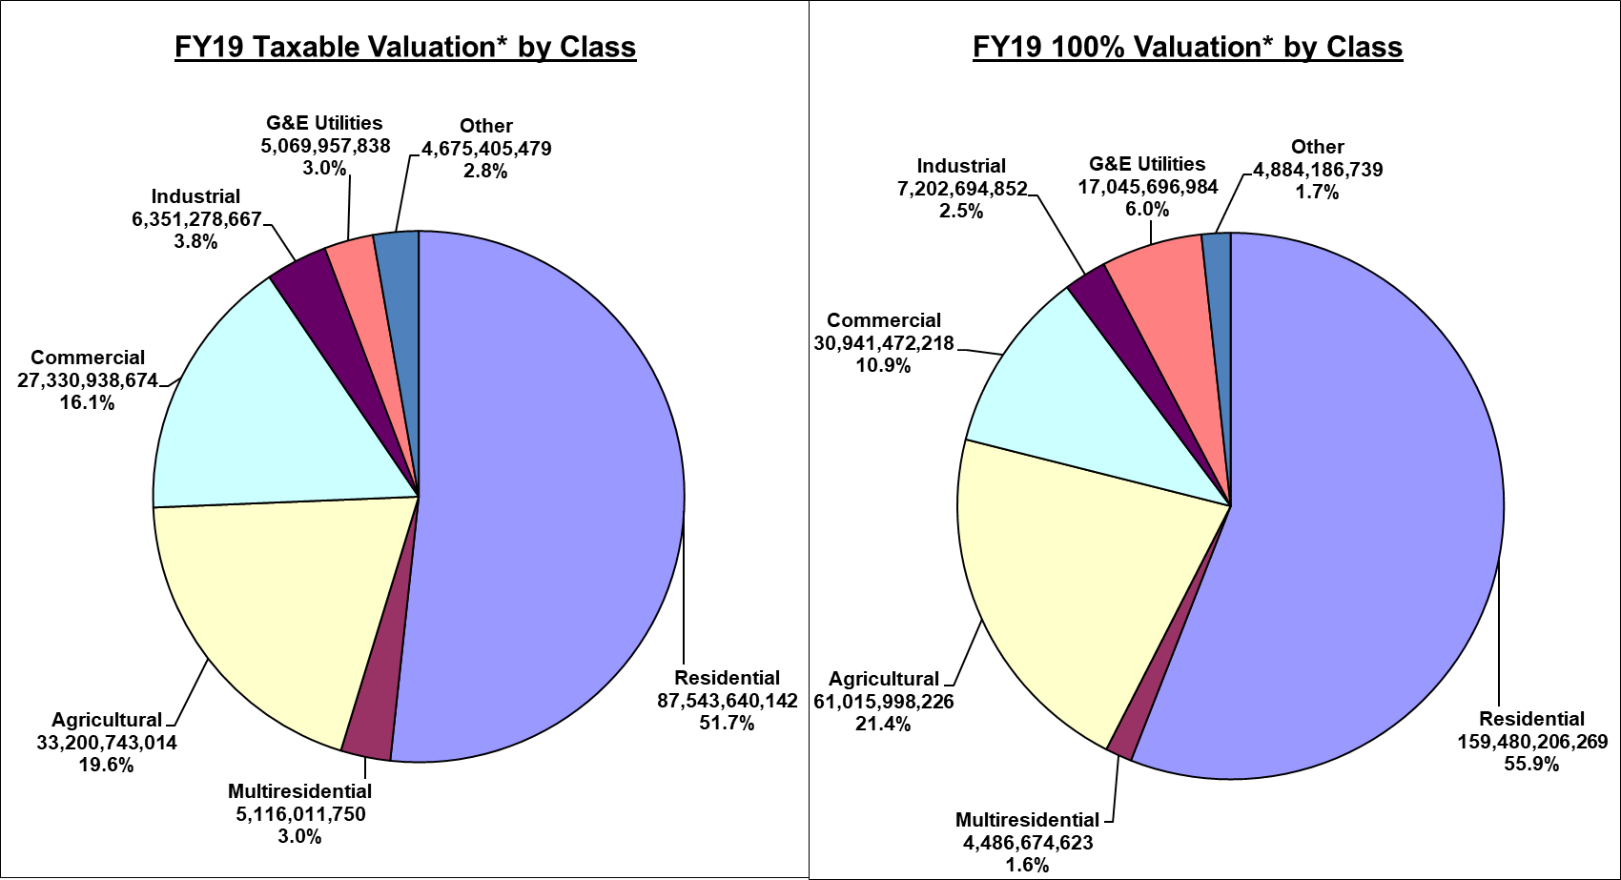
FY19 Taxable vs. Assessed Value
Total = $167.9 billion
Total = $285.1 billion

Slide 25
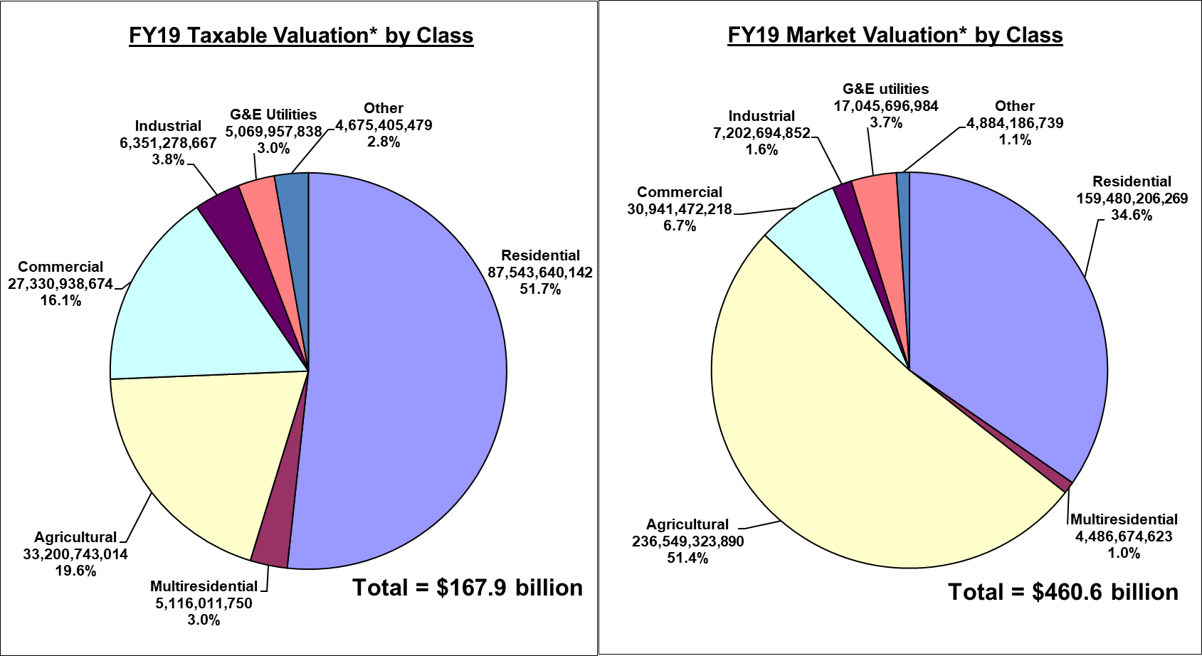
FY19 Taxable vs. market Value

Slide 26
Property tax Levies
General Fund
Taxes for the General Fund are levied against all taxable valuation in the county for general county services.
General Basic Fund
Levy rate limited to $3.50 per $1,000 of taxable value.
Limit can be exceeded in unusual circumstances outlined in Iowa Code such as unusual increase in population, natural disaster or other emergency, certain unusual problems or needs, and reduced or unusually low growth in property tax base.
In FY19, 67 counties were at the maximum, 27 counties exceeded the maximum, and 5 counties were below the maximum.

Slide 27
Property tax Levies
General Supplemental Fund
Levy rate not limited to a dollar amount.
Can only be used if General Basic is levied at maximum level ($3.50/$1,000)
Can only be used for purposes outlined in Iowa Code such as substance abuse costs, certain juvenile care services, elections and voter registration, salaries and certain benefits for general county services, insurance necessary for county operations, maintenance and operation of the courts, and other miscellaneous expenses allowed in code.
In FY19, 94 counties used the General Supplemental Levy.

Slide 28
Property tax Levies
Rural Fund
Taxes for the Rural Fund are levied against taxable valuation in the unincorporated area of the county for services primarily intended to benefit rural residents.
Rural Basic Fund
Levy rate limited to $3.95 per $1,000 of taxable value.
Limit can be exceeded for the same reasons outlined in Iowa Code for General Basic.
In FY19, 22 counties were at the maximum, 4 counties exceeded the maximum, and 73 counties were below the maximum.

Slide 29
Property tax Levies
Rural Supplemental Fund
Levy rate not limited to a dollar amount.
Can only be used if Rural Basic is levied at maximum level ($3.95/$1,000)
Can only be used for salaries and certain benefits for rural county services, and for contributions to an aviation authority as outlined in Iowa Code.
In FY19, 8 counties used the Rural Supplemental Levy.

Slide 30
Property tax Levies
County Mental Health and Disability Services Fund
Taxes for the County Services Fund are levied against all taxable valuation in the county for the purpose of providing mental health and disability services.
Levy rate not limited but dollar amount limited to a regional per capita rate multiplied by county population.
Each county contributes an amount necessary to meet financial obligations determined by regional service system management plan.
In FY19, 85 counties levied for MH/DS with the highest rate at $1.16/$1,000. Remaining counties were spending down fund balances.

Slide 31
Property tax Levies
Debt Service Fund
Taxes for the Debt Service Fund are levied against all taxable valuation (including valuation divided in TIF districts) in the county for the purpose of satisfying general obligation debt.
Levy rate not limited to a dollar amount, but the Iowa Constitution limits a county’s debt to 5% of its assessed valuation.
In FY19, 60 counties levied for Debt Service with the highest rate at $2.48/$1,000.

Slide 32
Property tax Levies
Other Levies
The countywide levy for pioneer cemeteries is limited to $0.0675 and is used in 20 counties.
The unincorporated area levy for unified law enforcement is limited to $1.50/$1,000 and is used in 1 county.
Levies for emergency medical services and flood & erosion control were not used by any county in FY19.

Slide 33
Property tax Levies
Countywide Levies (all property pays)
General Basic
General Supplemental
Mental Health and Disability Services
Debt Service
Pioneer Cemetery
Rural Services Levies (only unincorporated area pays)
Rural Basic
Rural Supplemental
Unified Law Enforcement

Slide 34
Timeline snapshot
January 1, 2019 – Assessment date
April 1, 2019 – Assessments complete, taxpayers notified
April 1 - 30, 2019 – Taxpayers may protest assessment
May 1 - 31, 2019 – Board of Review meets
July 1, 2019 – Assessment abstracts submitted to IDR
August 15, 2019 – IDR issues tentative equalization notices
October 1, 2019 – IDR issues final equalization notices
November 1, 2019 – IDR certifies assessment limitation percentages to county auditor

Slide 35
Timeline snapshot (continued)
December 2019 – February/March 2020 – Taxing entities set levy rates and adopt budgets based on valuations
July 1, 2020 – Beginning of fiscal year in which taxes are due and payable
September 30, 2020 – First half of property taxes are due to county treasurer
March 30, 2021 – Second half of property taxes are due to county treasurer

Slide 36
SF 295 Overview
Lucas Beenken
Public Policy Specialist
Iowa State Association of Counties

Slide 37
Property Tax Reform – SF 295
Business Property Tax Credit
Commercial/Industrial Rollback
Property Assessment Limitation
Telecommunications Property
Multi-residential Property

Slide 38
Property Tax Reform – SF 295
Business Property Tax Credit
$125 million state appropriation per year when fully implemented
Available for commercial, industrial, and railway property
With the credit in place, the first $241k (est.) of taxable value will pay the equivalent of the residential rate
Applies to property taxes due and payable in FY 2015 and after

Slide 39
Property Tax Reform – SF 295
Commercial/Industrial Rollback
Rollback of 95% for AY2013 and 90% for AY2014 and each year after for commercial, industrial, and railway property
Standing appropriation to backfill local governments for reduction in future revenue (commercial/industrial only)
Appropriation will fully fund the reduction in FY2015–FY2017, with future years capped at the FY2017 dollar amount (approx $152 million)

Slide 40
Property Tax Reform – SF 295
Property Assessment Limitation
Residential and Agricultural property remain coupled for purposes of property assessment limitation
Valuation growth for both classes limited to the lesser percentage growth of the two
Permissible allowable valuation growth percentage reduced from 4% to 3%
Retroactive to AY2013

Slide 41
Property Tax Reform – SF 295
Telecommunications Property
Property tax exemption based on value for telecommunications property
Full implementation by AY2014 with exemption equal to the sum of:
40% of value between $0 - $20 million
35% of value between $20 - $55 million
25% of value between $55 million - $500 million
20% of value over $500 million
No backfill to local governments for reduction in future revenue

Slide 42
Property Tax Reform – SF 295
Multi-residential Property
Creates new multi-residential classification that would include apartments, assisted living facilities, mobile home parks, etc.
10 year phase-in with 3.75% reduction in taxable value per year until AY2022 when it becomes coupled with the rollback of residential property
No backfill to local governments for reduction in future revenue
LSA estimated a loss of $374.1 million over 8 years among all taxing jurisdictions.

Slide 43
Impacts to County Government
Decrease in assessment growth limitation can drive down taxable value
No backfill for multi-residential rollback
No backfill for telecommunications exemption
No reimbursement for railway rollback
Total appropriation for rollback replacement claims(backfill) capped at FY2017 amount

Slide 44
Questions?
Lucas Beenken
Iowa State Association of Counties
lbeenken@iowacounties.org
(515) 369-7016

