Slide 1
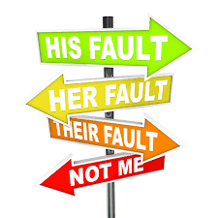
Power of Accountability
Driving Ownership Within Your County
Cindy Maher and Jamie Guite
Leading Edge Coaching & Development

Slide 2
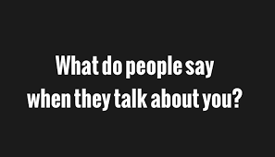
Buzz
Positive
Negative
Positive But Limiting

Slide 3
Responsibility v. Accountability
Extrinsic
Intrinsic

Slide 4
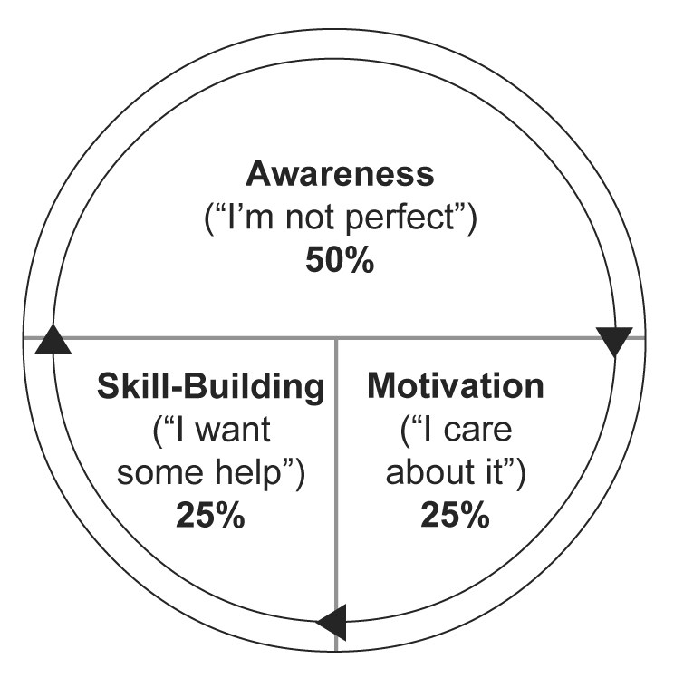
How People Develop* (and how these sessions are designed)

Slide 5
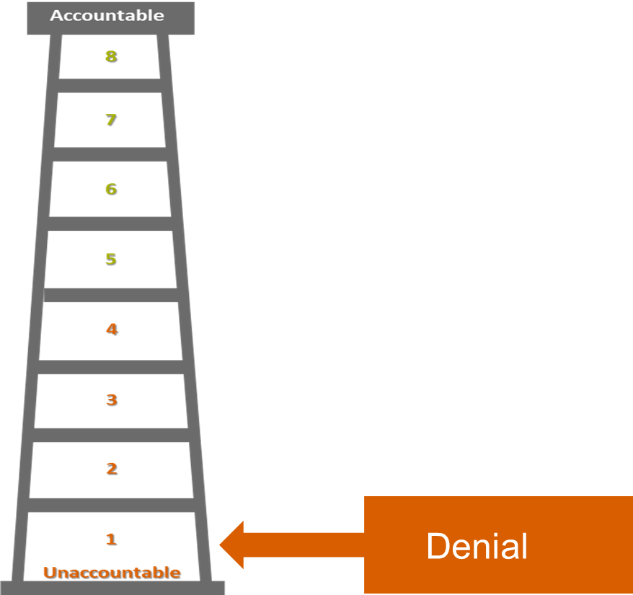
Ladder of Accountability: Level 1

Slide 6
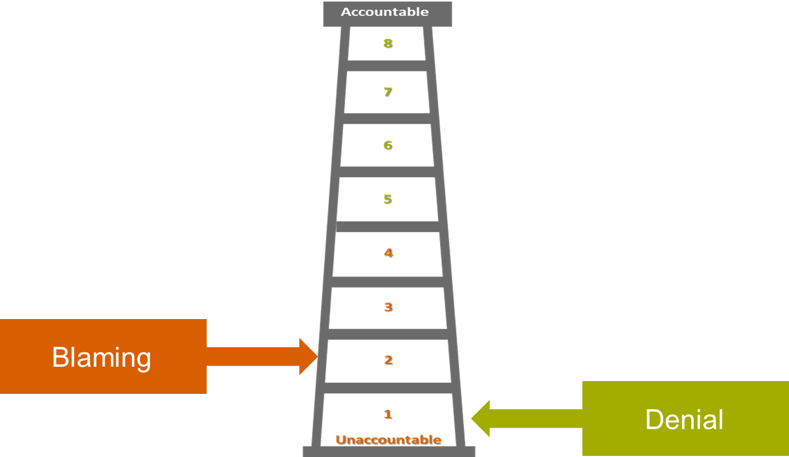
Ladder of Accountability: Level 2

Slide 7
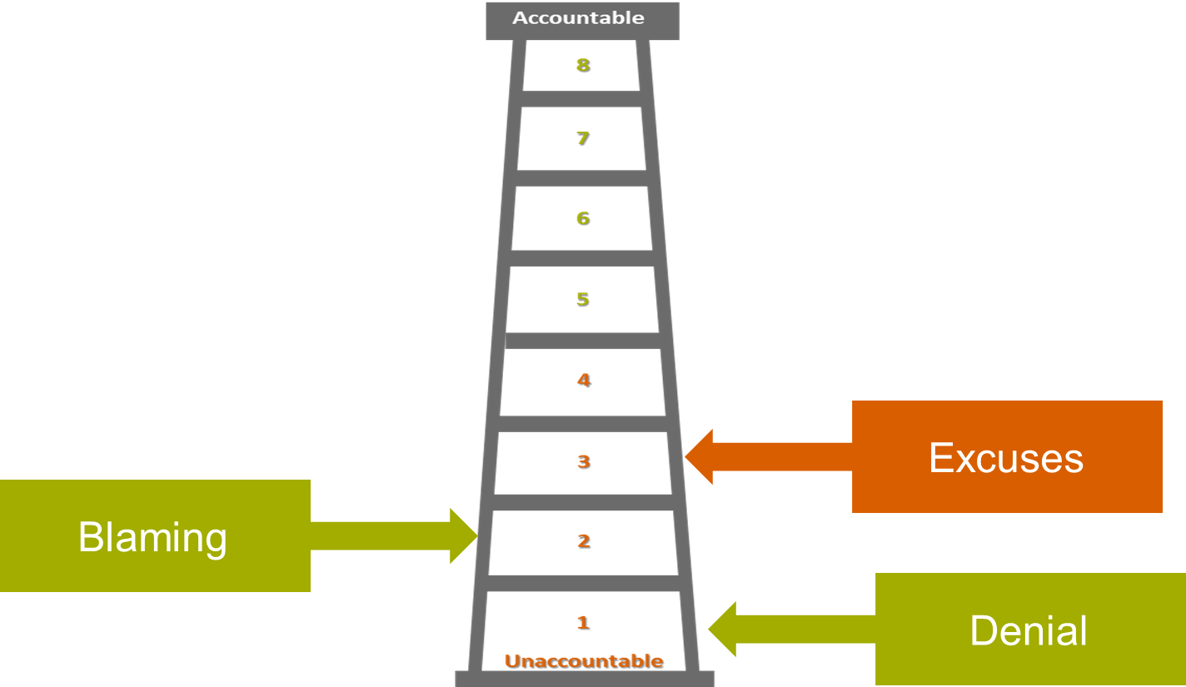
Ladder of Accountability: Level 3

Slide 8
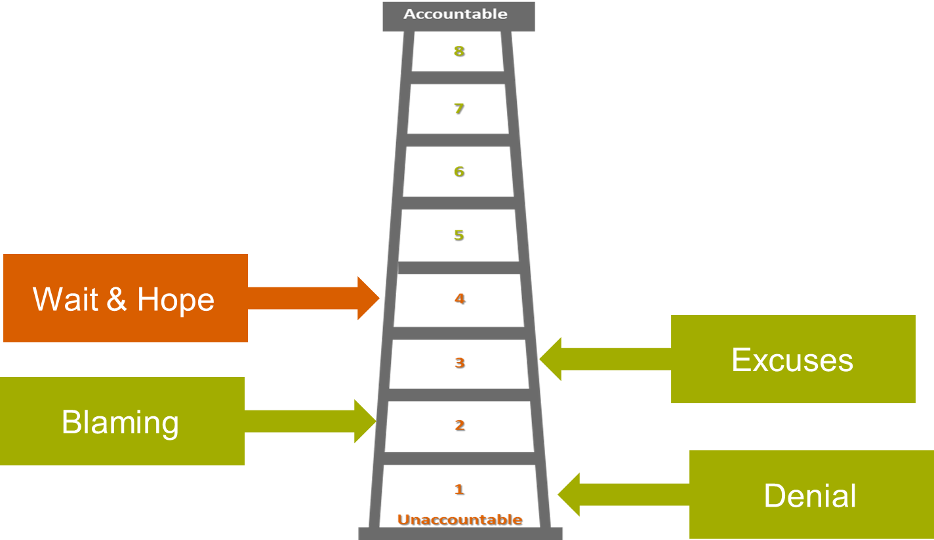
Ladder of Accountability: Level 4

Slide 9
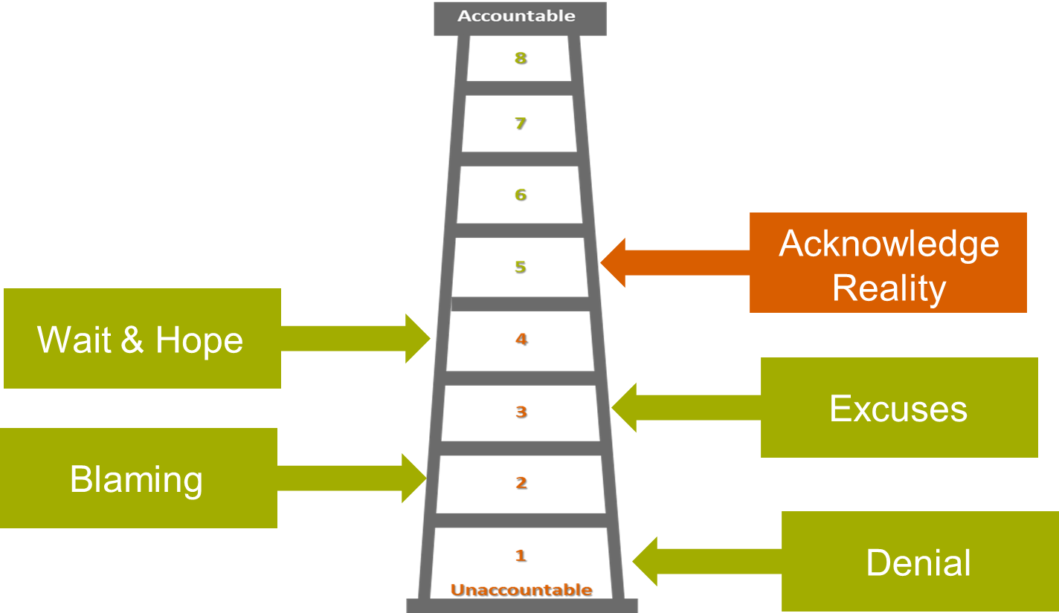
Ladder of Accountability: Level 5

Slide 10
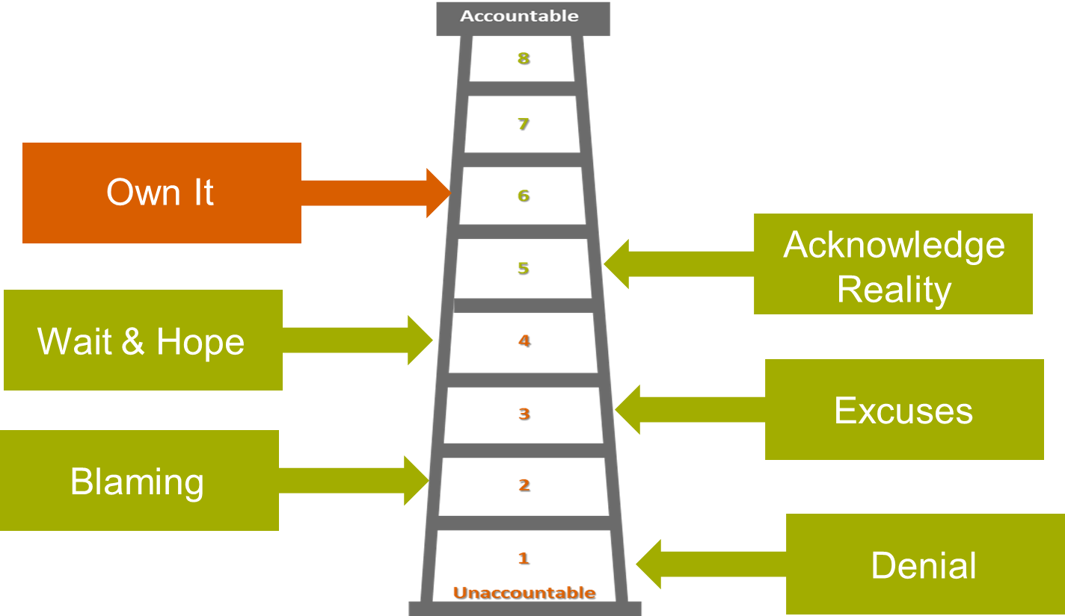
Ladder of Accountability: Level 6

Slide 11
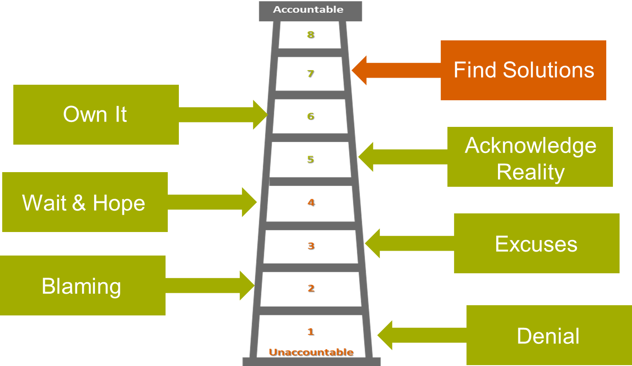
Ladder of Accountability: Level 7

Slide 12
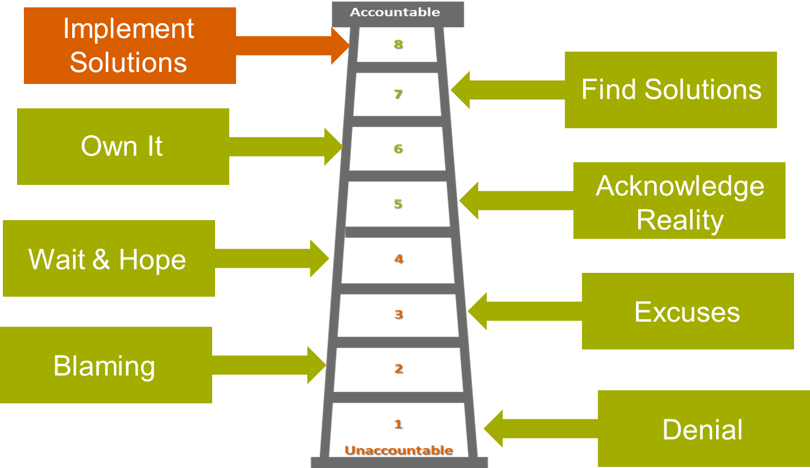
Ladder of Accountability: Level 8

Slide 13
Scenario 1: Which Rung on the Ladder is Sue?
Bob is following up with Sue because her report on #MentalHealthMatters is late. “The County Board of Supervisors is expecting our report this week. Why isn’t it ready?” Sue looks confused: “You should have told me it was a priority. How was I supposed to know that it was important?”

Slide 14
Scenario 2: Which Rung on the Ladder is Allison?
Allison is discussing an upcoming event for the 100th Anniversary in Woodbury County with a colleague. She takes a bite of her salad and shakes her head. I hope our Chairperson shows up for this. I left a message for him two weeks ago and he didn’t get back to me. But, if he doesn’t show, I have a Keith Radig mask that I wore last Halloween. I do a pretty good impression.

Slide 15
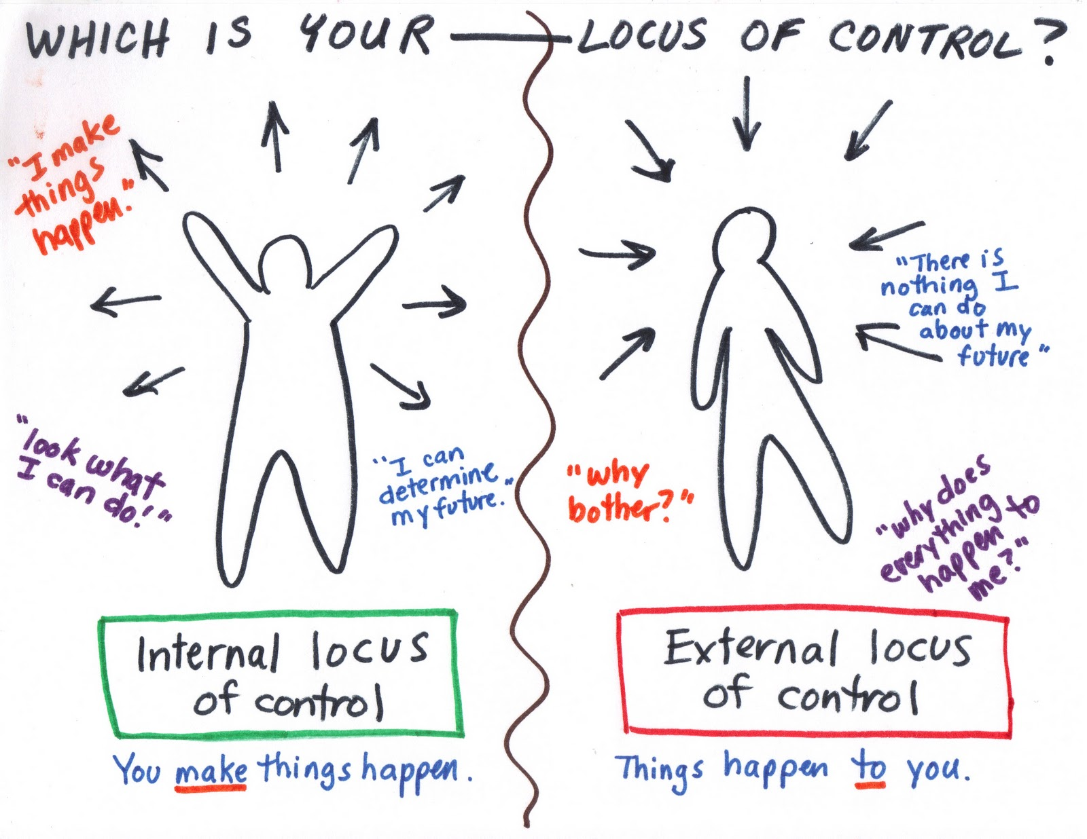
Locus of Control

Slide 16
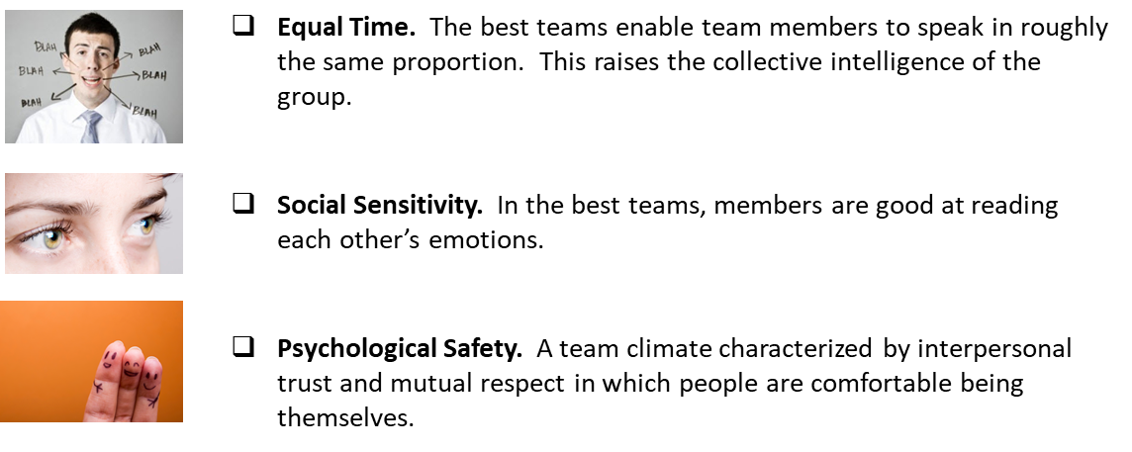
Project Aristotle*

Slide 17
Brene Brown on Blame

Slide 18
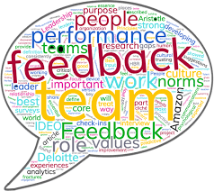
Feedback is a Gift
(But I’d Rather Get Chocolate)
Cindy Maher and Jamie Guite
Leading Edge Coaching & Development

Slide 19
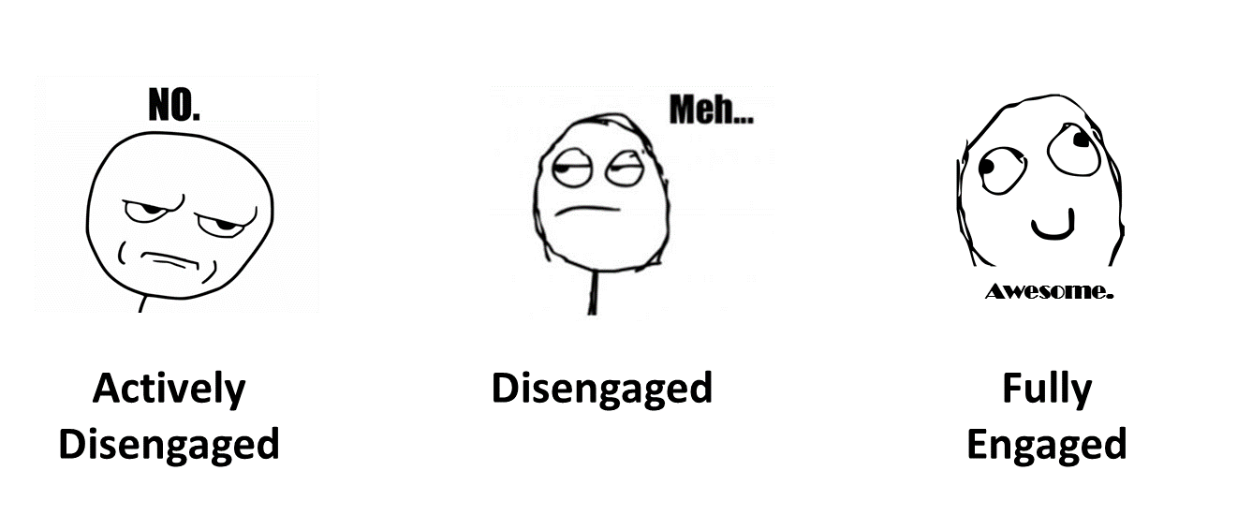
Engagement Drivers

Slide 20
Three Feedback Triggers*
Truth Trigger
Relationship Trigger
Identity Trigger

Slide 21
Listening & Curiosity
Level 1
Level 2
Level 3

Slide 22
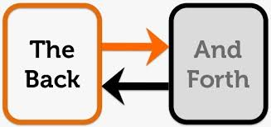
Defeating the Truth Trigger
Using Curiosity

Slide 23
Three Feedback Triggers*
Truth Trigger
Relationship Trigger
Identity Trigger

Slide 24
Two Things Trip Up the Relationship Trigger
What we think about …
How we feel treated by the …

Slide 25
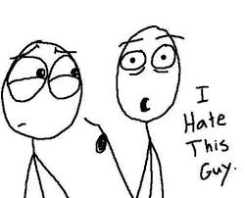
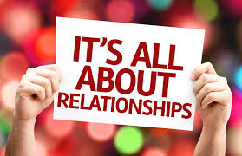
Defeating the Relationship Trigger
Identify the two topics and address them one at a time
Be open to “Surprise Players”
Build relationships

Slide 26
Deepen Trust with FORD

Slide 27
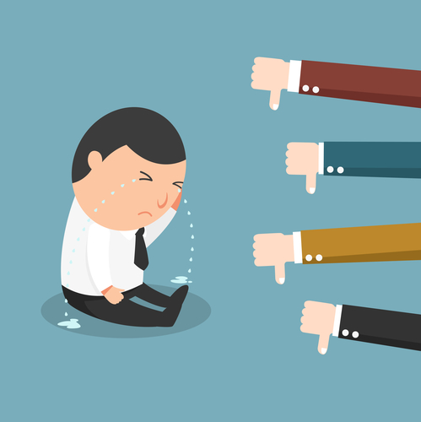
Three Feedback Triggers*
Truth Trigger
Relationship Trigger
Identity Trigger

Slide 28
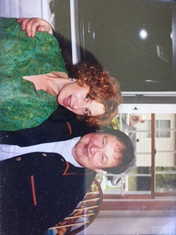
My Mom

Slide 29
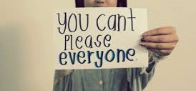
Defeating the Identity Trigger
Time
Specificity
People

Slide 30
4 Steps of Positive Feedback
Identify the situation
Describe observed behaviors
Describe the impact
Ask for the person’s perspective

Slide 31
Maximizing Energy
In a World That Sucks You Dry
Cindy Maher and Jamie Guite
Leading Edge Coaching & Development

Slide 32
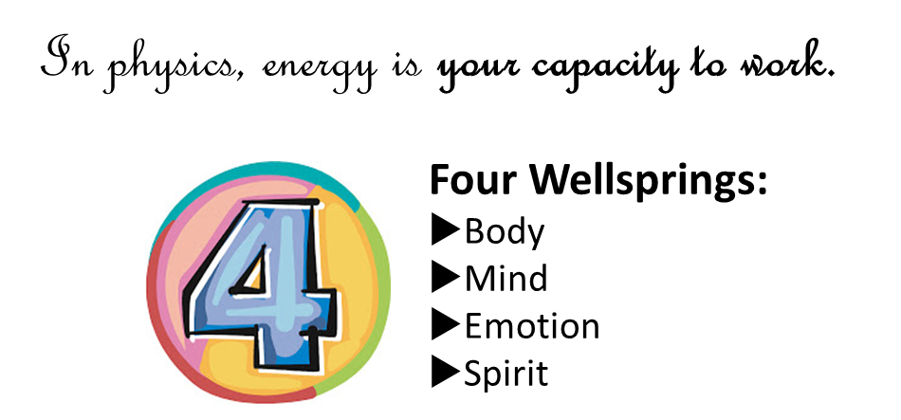
Four Wellsprings of Energy

Slide 33
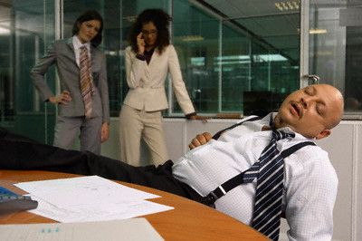
Body: The First Wellspring
Nutrition
Adequate sleep
Regular Exercise
Working a reasonable amount
Active breaks

Slide 34
Mind: The Second Wellspring
Manages the constant call of multi-tasking
Controls the interruptions of technology
Prioritizes and does the most important stuff first

Slide 35
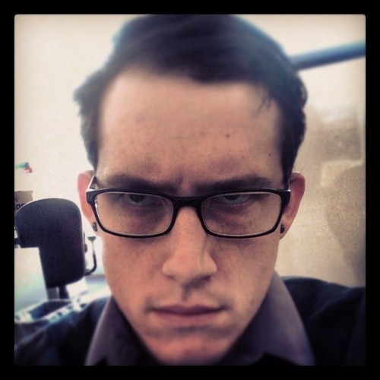
Emotion: The Third Wellspring
Control emotions
Heightened awareness of emotions
Cultivates a positive outlook
Regularly expresses appreciation

Slide 36
Spirit: The Fourth Wellspring
Able to connect your values to your work
Feel a sense of purpose in what you do
Do what you do best and enjoy most at work

Slide 37
Matt Cutts 30 Day Challenge

