Slide 1
Iowa State Association of Counties 2018 Spring Conference Public Building Security – Where We Have Been and Where We Are Going
Brian D. Gardner Linn County Sheriff

Slide 2
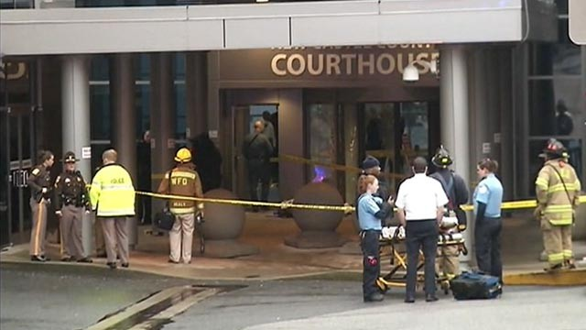
Courthouse & Public Building Violence
County courthouses & other governmental buildings
High profile criminal trials
Divorce & child custody hearings
Contentious public meetings
Anger with court & elected officials
Adverse employee actions
Notes:
This presentation will focus on Courthouse security issues. However, it can also be applicable to other public buildings as well, and to some extent, schools, churches, and other places where the public congregates. Violence in the workplace is becoming commonplace these days, more so than it has in the past. By virtue of the activities that are conducted within them, County Courthouses and other governmental buildings are a prime environment for hostility and anger. High profile criminal trials, contentious public meetings, divorce and child custody hearings, and adverse employee actions (to name just a few) all have the potential to lead to violence.

Slide 3
Courthouse & Public Building Violence Incidents
While some acts of violence committed in courthouses are emotional and reactionary, most are premeditated.
Motive & intent of perpetrator
Identity of intended target
Identify target venue
Identify a site that either has a lack of security or a recognized vulnerability, limitation, or deficiency that can be exploited
Attempt to circumvent or bypass security
Notes:
To commit a violent act in the courthouse, a person must, in addition to having motive and intent, be able to 1) identify the intended target; 2) determine the incident venue; 3) identify a site that either has a lack of security or a recognized vulnerability, limitation, or deficiency that can be readily exploited; and 4) attempt to circumvent or bypass security.

Slide 4
The Courthouse – County Responsibilities
Space for County functions to conduct business
Space for Court System to conduct business
Safeguard the public & employees
Liable for damages and/or injuries, specifically if found to be deliberately indifferent to potential threats
Notes:
Courthouses are owned and maintained by the County. They contain County offices and functions.
The County is also responsible for providing the court system with space in which to conduct the Court’s business.
In addition, the County has the responsibility to safeguard the public and the employees who work in their buildings. If they do not, they can be liable for damages and/or injuries, specifically if they are found to have been deliberately indifferent to potential threats.

Slide 5
Iowa Supreme Court
Supervisory Order on June 19, 2017
Authorized Chief Judge of each judicial district to develop additional policies & procedures
Prohibited all weapons from courtrooms, court-controlled spaces, and public areas of the courthouse and other justice centers occupied by the court system
Notes:
A Supervisory Order of the Iowa Supreme Court dated June 19, 2017, authorized the Chief Judge of each judicial district to work with county officials, as well as courthouse and public building security committees, to develop additional policies and procedures necessary to implement its Supervisory Order. In the advisory, the Iowa Supreme Court ordered that all weapons were prohibited from courtrooms, court-controlled spaces, and public areas of the courthouses, and other justice centers occupied by the court system.

Slide 6
Iowa Supreme Court
Supplemental Supervisory Order on December 19, 2017
Allowed the County Board of Supervisors to request that the Chief Judge modify the weapons prohibition by eliminating it in public areas on the floors not occupied by the court system.
Notes:
A supplemental Iowa Supreme Court Supervisory Order dated December 19, 2017, maintained the earlier weapons prohibition, however, it provided that the County Board of Supervisors could request that the Chief Judge modify the weapons prohibition by eliminating it in public areas on those floors of a courthouse not totally occupied by the court system. The court system would then relinquish to the BOS any authority over the regulation of weapons in the public areas on a floor of the courthouse not totally occupied by the court system.

Slide 7
Iowa Code §724.28
Prohibits political subdivisions (cities and counties) from enacting any ordinance
“regulating the ownership, possession, legal transfer, lawful transportation, registration, or licensing of firearms when the ownership, possession, transfer, or transportation is otherwise lawful.”
Statute States:
“An ordinance regulating firearms in violation of this section existing on or after April 5, 1990, is void.”
Notes:
Iowa Code §724.28 prohibits political subdivisions (cities and counties) from enacting any ordinance “regulating the ownership, possession, legal transfer, lawful transportation, registration, or licensing of firearms when the ownership, possession, transfer, or transportation is otherwise lawful.” The statue states, “An ordinance regulating firearms in violation of this section existing on or after April 5, 1990, is void.”

Slide 8
Iowa Code §724.28 (Amended)
July 1, 2017 (HF517)
Added that if a political subdivision enacts, or has enacted, an ordinance or other measure on any of these topics, then a person “adversely affected” may file suit for declaratory and injunctive relief or damages
Notes:
Iowa Code §724.28 was amended, effective July 1, 2017 (HF517). The amendment added that if a political subdivision enacts, or has enacted, an ordinance or other measure on any of these topics, then a person “adversely affected” may file suit for declaratory and injunctive relief or damages. However, the underlying preemption language in Iowa Code §724.28 has not been changed. I am unaware of this happening yet in the state. This may be difficult to due, especially in those courthouses where the public is prohibited from carrying weapons, airport-style security is provided, and armed deputies are present to maintain security and safety.

Slide 9
Iowa Attorney General Opinion
No. 03-4-1 issued on April 7, 2003
Preemption language in Iowa Code §724.28 does not prohibit cities and counties from regulating the possession of weapons in their facilities
To date, this has not ben rescinded, modified, or changed
Notes:
The Iowa Attorney General’s Office issued an Opinion dated April 7, 2003 wherein it concluded that the preemption language in Iowa Code §724.28 does not prohibit cities and counties from regulating the possession of weapons in their facilities. At the present time this opinion has not been rescinded, modified, or changed.

Slide 10
Right to Bear Arms vs. Regulation
District of Columbia v. Heller, 554 U.S. 570 (2008)
“[n]othing in our opinion should be taken to cast doubt on longstanding prohibitions on the possession of firearms by felons and the mentally ill, or laws forbidding the carrying of firearms in sensitive places such as schools and government buildings . . .” Heller, 554 U.S. at 726 (Scalia, J.)
Notes:
In the District of Columbia v. Heller, 554 U.S. 570 (2008), the United States Supreme Court recognized that the Second Amendment to the United States Constitution confers a right to bear arms. However, the majority opinion made clear that this right is not without reasonable limits: “[n]othing in our opinion should be taken to cast doubt on longstanding prohibitions on the possession of firearms by felons and the mentally ill, or laws forbidding the carrying of firearms in sensitive places such as schools and government buildings . . .” Heller, 554 U.S. at 726 (Scalia, J.)

Slide 11
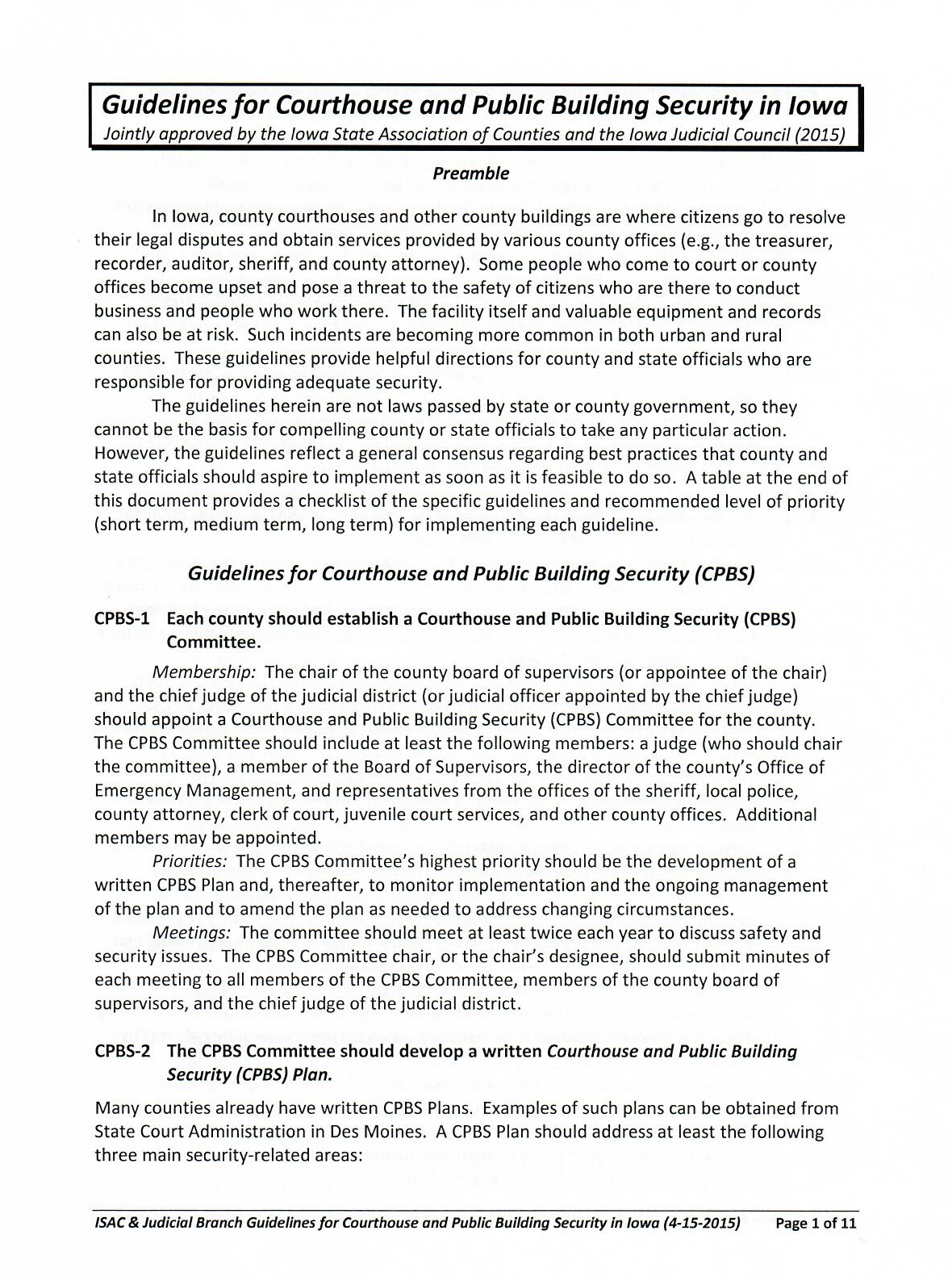
Courthouse & Public Building Security Guidelines
Guidelines jointly approved by ISAC and the Iowa Judicial Council in 2015
Guidelines provide general consensus on best practices for courthouse safety, but are not mandated
Notes:
Guidelines for Courthouse and Public Building Security in Iowa were jointly approved by the Iowa State Association for Counties and the Iowa Judicial Council in 2015. These guidelines provide helpful directions for county and state officials who are responsible for providing courthouse security. The guidelines reflect a general consensus regarding best practices that county and state officials should aspire to implement as soon as it is feasible to do so, but there is no mandate to do so.

Slide 12
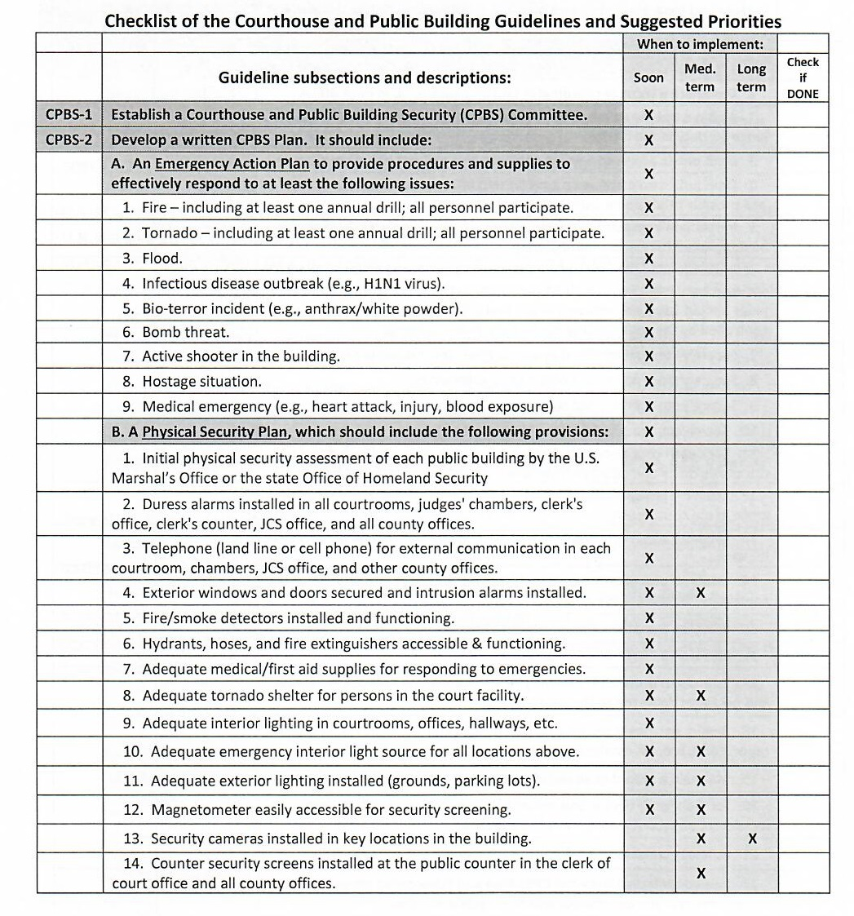
Courthouse & Public Building Security Guidelines
Also provided is a Checklist for the Courthouse and Public Building Guidelines and Suggested Priorities.
The checklist provides security guideline timeline implementation suggestions.
Notes:
The checklist provides timeline suggestions: soon, medium-term and long-term implementation.

Slide 13
Courthouse Security Committee
Chairperson of the Board of Supervisors and Chief Judge of the Judicial District should appoint a Courthouse and Public Building Security (CPBS) Committee, comprised of representatives from:
Judges
Board of Supervisors
Sheriff/Police
Court Administrator
Emergency Management
Clerk of Court
County Attorney
Juvenile Court Services
Custodial/Maintenance
Other Courthouse Users
Notes:
All counties are to have established court security committees and should have implemented, to varying degrees, the recommended best practices for court security. It is strongly suggested that all affected people be brought to the table for participation in the discussion.

Slide 14
Guidelines for Courthouse Security
The Courthouse and Public Building Security (CPBS) Committee should:
Develop a written CPBS Security Plan
Emergency Action Plan
Physical Security Equipment and Facilities Plan
Security Operations Plan
Notes:
Emergency Action Plan (9); Physical Security Equipment & Facilities Plan (18); and Security Operations Plan (22).

Slide 15
Guidelines for Courthouse Security – Cont. Emergency Action Plan (9 items)
Fire
Tornado
Flood
Infectious disease outbreak
Bio-terror incident
Bomb threat
Active shooter situation
Hostage situation
Medical emergency
Notes:
The next presenter, Clinton County Auditor Eric Van Lancker, will provide specific information on active shooter incidents. In Linn County, we have provided ALICE (Alert, Lockdown, Inform, Counter, and Evacuate) active shooter training to all courthouse employees, including several other county building employees (Juvenile Justice Center, Community Services Building, Health Department, etc.) and all school districts in the county, as well as many private employers in the county.

Slide 16
Guidelines for Courthouse Security – Cont. Physical Security Equipment and Facilities Plan (18 items)
Initial physical security assessment
Duress alarms
Telephone for external communications
Exterior doors & windows
Fire and smoke detectors
Hoses, hydrants & fire extinguishers
Adequate medical/first aid supplies
Adequate tornado shelter
Adequate interior lighting
Adequate emergency interior lighting
Adequate exterior lighting
Magnetometer
Security cameras
Security screens at business counters
Bullet-resistant material in front of judges’ benches
Advanced security screening equipment
Separate secure entrance for transporting inmates
Separate secure parking for
judges & elected officials
Notes:
Consideration should be given to the following… Building age and design may be limiting factors as to how much of this can be implemented.

Slide 17
Guidelines for Courthouse Security – Cont. Physical Operations Plan (22 items)
Designate a security coordinator
Assign a trained and armed peace officer to the court facility
Limit public access to the courthouse
Limit public access to each office
Immediately respond to duress alarms
Establish a weapons policy
Secure all admitted evidence when court is not in session
Securely store dangerous objects
Securely store prohibited weapons
Search courtrooms daily
Lock courtroom doors when not in use
Establish an inmate restraint policy
Establish a key control policy
Establish prisoner movement procedures
Segregate court and public movement
Establish a “high risk trial” plan
Establish a protocol for identifying and handling suspicious envelopes/packages
Report significant security threats
Maintain a record of security equipment and supplies
Semi-annually inspect security equipment/supplies
Annual fire & tornado drills
Distribute CPBS plans

Slide 18
Guidelines for Courthouse Security – Cont.
BOS should issue a written policy making CPBS plan and security video recordings confidential - Code of Iowa §22.7(50)
Adopt and implement a security training program for all courthouse and public building employees and judicial officers working in the facility
Training and emergency drills
Responsibility for coordinating training programs
CPBS Committee should submit reports on courthouse security annually
State & District Court Administrators
Board of Supervisors and other county elected officials
Notes:
Courthouse and Public Building Security (CPBS)

Slide 19
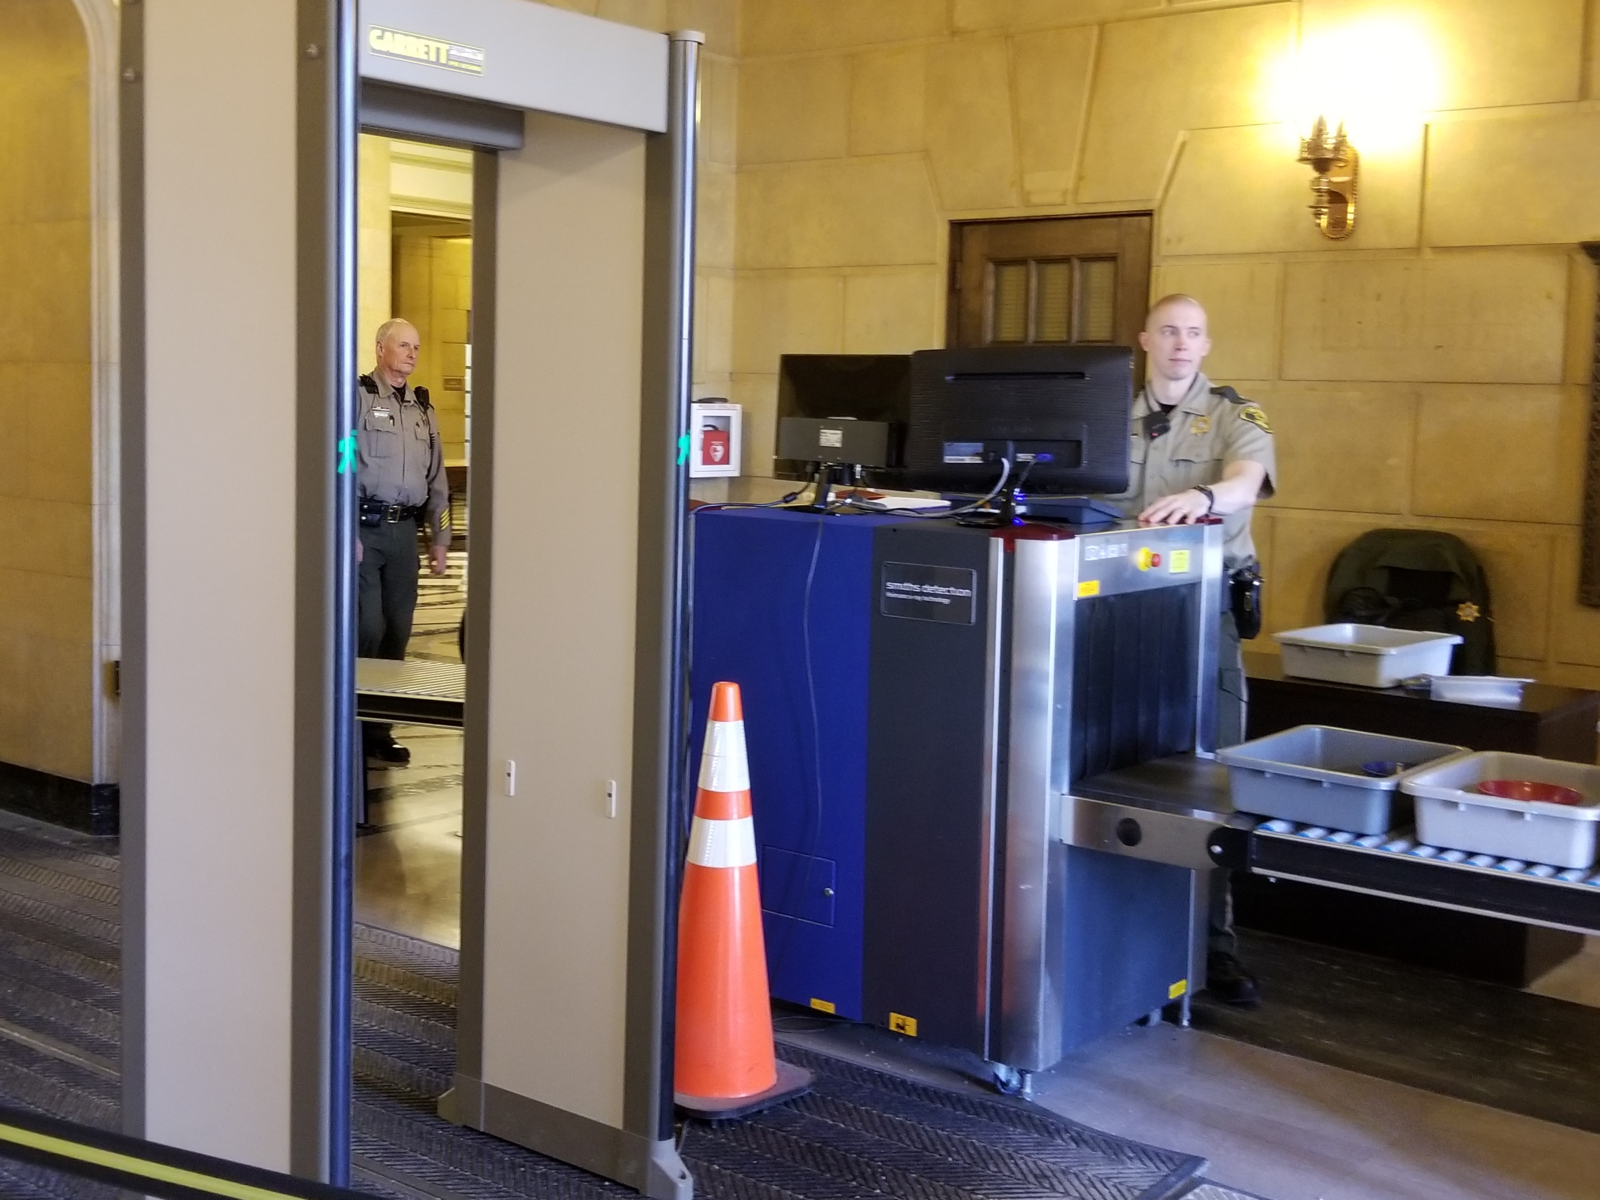
It Comes Down To: What Level of Security Is To Be Provided?
Deputy and/or security officer?
Roving patrol and/or…
Security checkpoint at entrance(s) or only in the courtrooms?
Is there room for the security equipment?
Notes:
Security can be as little as a deputy or security officer roving the courthouse or as much as locked down security with contraband scanners similar to those utilized in airports, staffed by sworn deputy sheriffs. Understand that although private security officers may be less costly than sworn deputy sheriffs, they come with limitations. They may or may not be armed, training verification issues, lack of arrest authority, etc. Do they intervene in security issues/threats or merely witness and standby for deputies to respond. Regardless, sworn personnel should be present to deal with law enforcement issues.

Slide 20
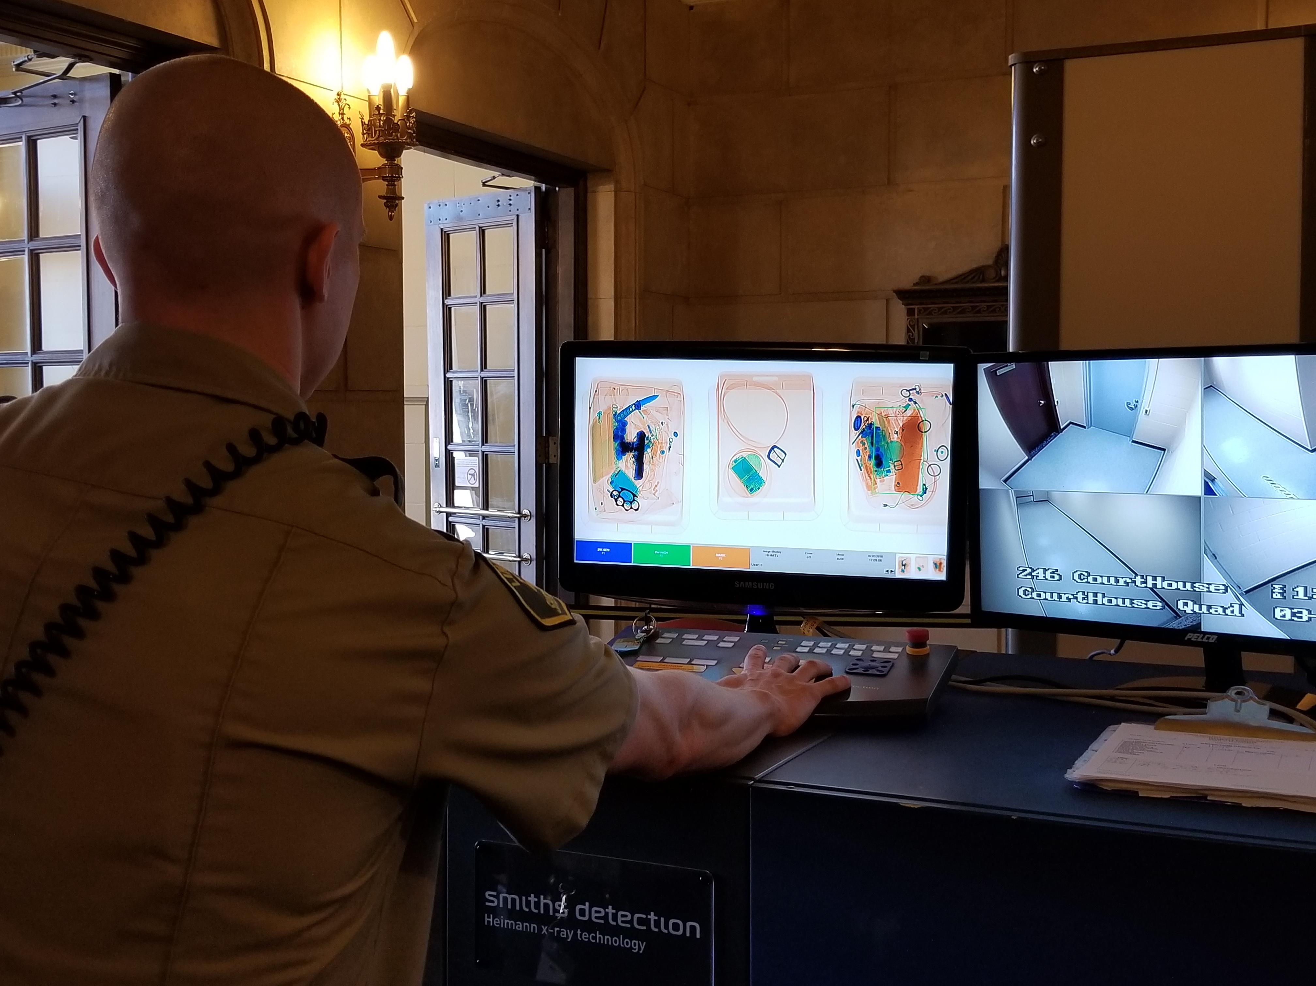
Security Equipment
Walk-through metal detectors
Baggage scanners
Hand wand metal detectors
Security cameras
Communication devices
Panic alarms
Notes:
Equipment to be considered for courthouse security can include walk-through metal detectors, baggage scanner, hand wand metal detectors, and security cameras. Communication amongst the courthouse security personnel and the communications center is essential, especially in the event of a security incident. Consideration should also be given to installing panic alarms in courtrooms, judge’s chambers, and windows at which business is conducted throughout the courthouse. These panic alarms should ring into a 24/7 staffed command or dispatch center.

Slide 21
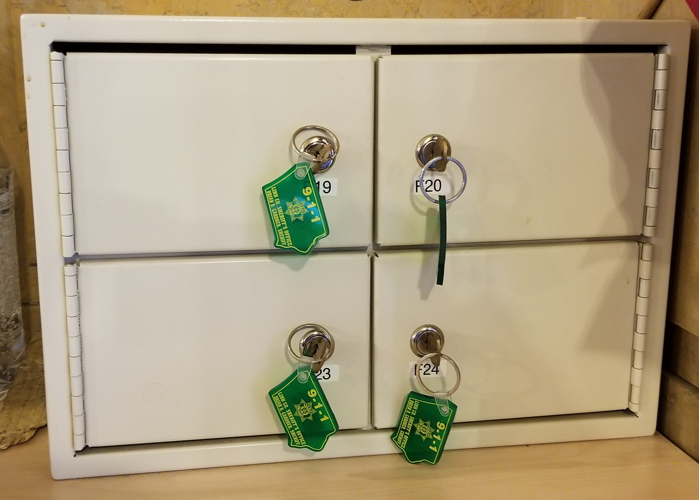
Other Security Considerations
Law enforcement weapons storage
Public weapons storage
Contraband disposal
Statistical data
Notes:
If weapons are banned from the courthouse, consideration will need to be made as to whether or not storage will be provided for law enforcement officers’ and the publics’ weapons. Also, what is the expectation if the public possesses contraband that is not otherwise illegal to possess? Safe keep it or turn them away.

Slide 22
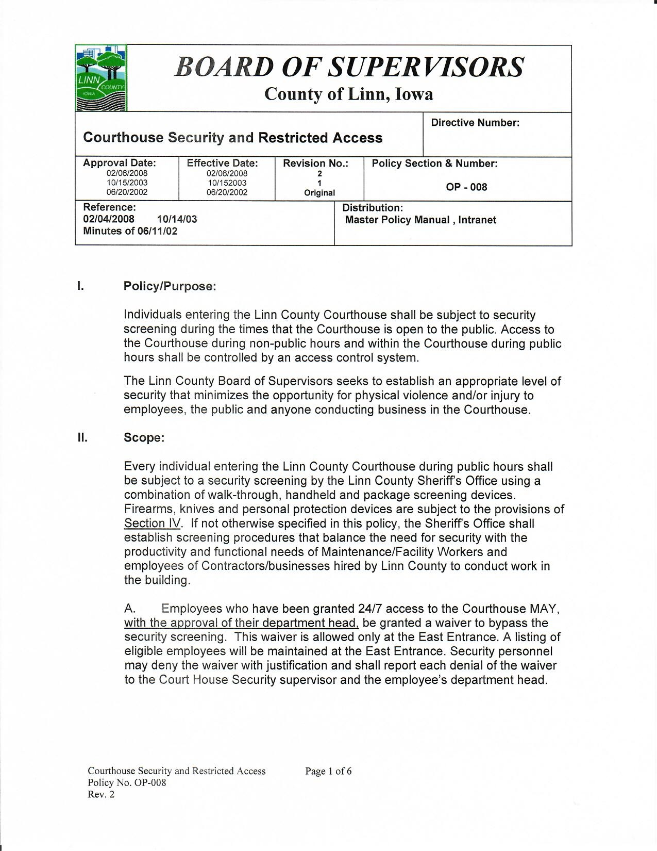
Establishing Courthouse Security
The Board of Supervisors should establish the level of security in County buildings and post that information to the public.
Notes:
The Board of Supervisors can establish the level of security in County buildings by ordinance, resolution, policy, or other means. Some counties have taken action to prohibit firearms and other weapons from their buildings (outside of the areas specifically utilized by the courts) while others have not.

Slide 23
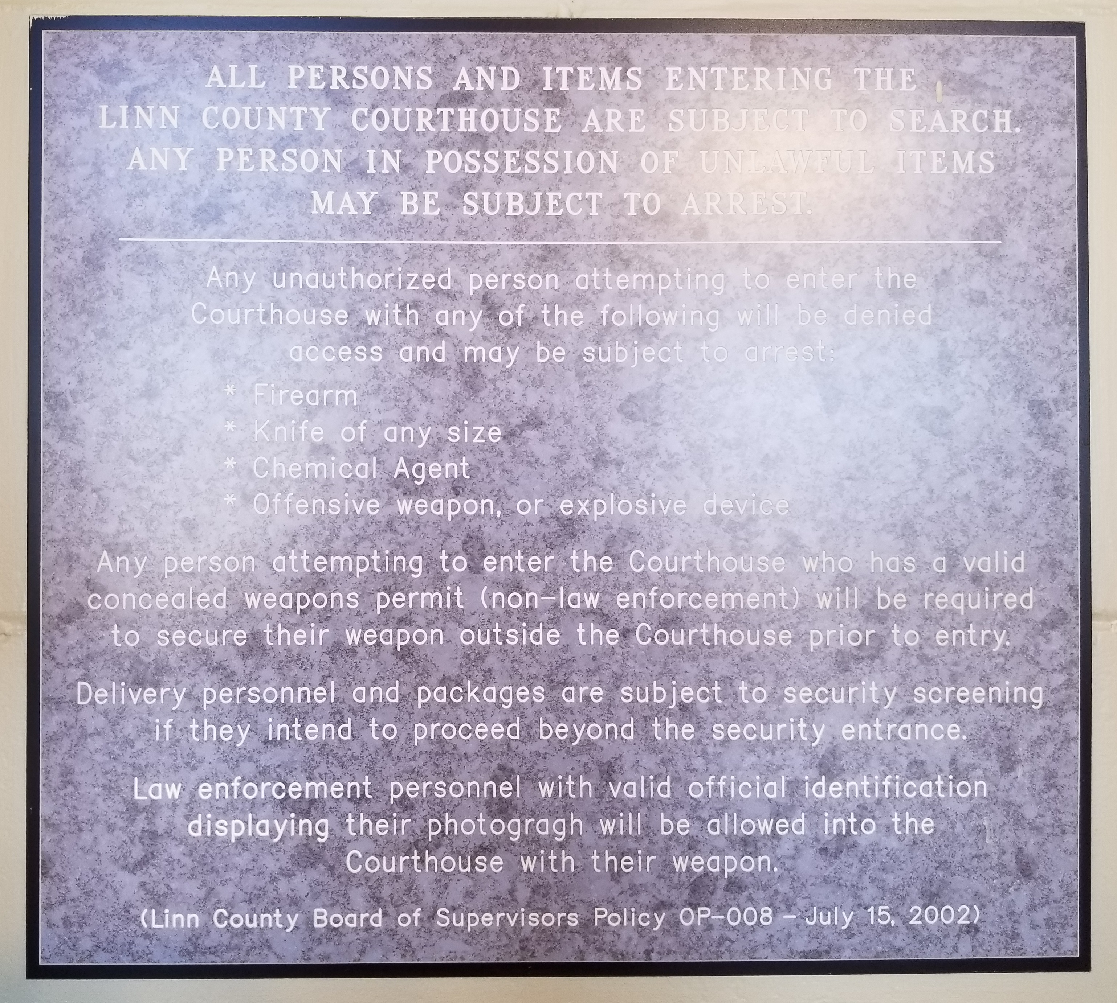
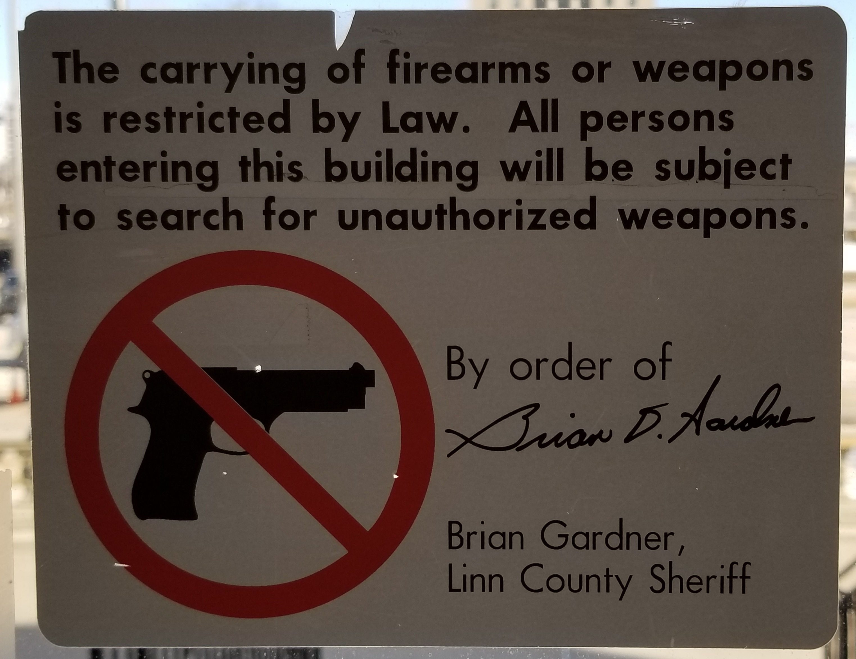
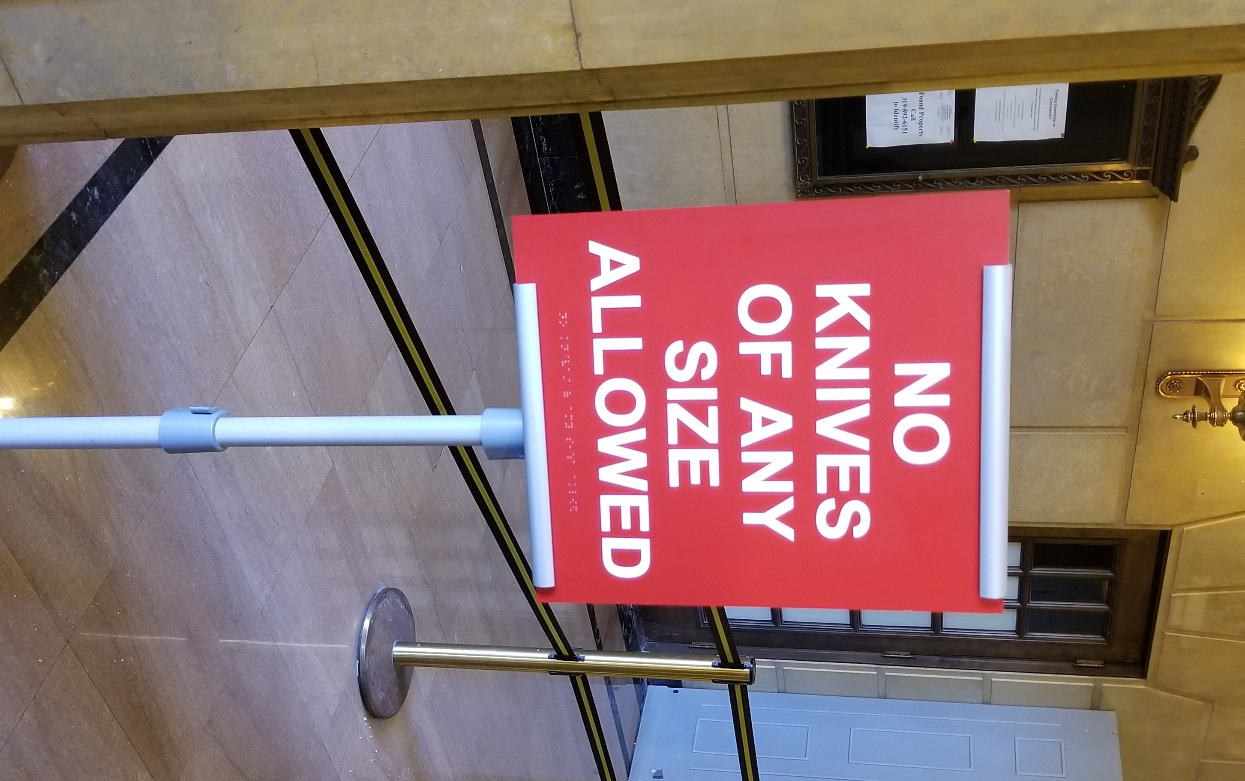
Public Notification
If the public is prohibited from carrying weapons in county-owned buildings, appropriate notice should be posted conspicuously at all public entrances.
Notes:
If the public is prohibited from carrying weapons in county-owned buildings, appropriate notice should be posted conspicuously at all public entrances. If the public refuses to comply and attempts to enter the building, as long as they are legally able to carry the weapon, there is no weapons offense. You are probably limited to criminal trespass.

Slide 24
72 Counties with a Ban on Weapons in the Courthouse as of 06/15/17
Notes:
According to the Iowa court system, as of 06/15/17, there were also 10 counties that had airport-style security screening at their courthouses (Dubuque, Black Hawk, Woodbury, Pottawattamie, Dallas, Polk, Johnson, Linn, Clinton, and Scott). Benton County will be adding airport-style courthouse security on April 2nd.

Slide 25
Courthouse Security Implementation Example - Linn County
October 1993 – Started out with 1 deputy providing roving patrol in the courthouse
January 2002 – Assistant Linn County Attorney Harold Denton was stabbed in the back by a homeless man (who was previously unknown to him) with a 4 inch knife as he was climbing the interior stairs in the courthouse. Denton received several stitches. His assailant was convicted of carrying weapons & assault while displaying a
dangerous weapon.
Notes:
While this helped prove the need for true courthouse security, the process was already underway at the time of the incident.

Slide 26
Courthouse Security Implementation Example - Linn County
June 2002 – Implemented the security program in the courthouse with 4 court security deputies and checkpoints at 2 entrances (12 courtrooms)
November 2011 – Added the security program in the new Juvenile Justice Center with 3 court security deputies and a checkpoint at 1 entrance (3 courtrooms)
Notes:
Linn County Courthouse opened in 1924. Originally had 5 entrances; 1 sealed due to flood mitigation; 2 closed; 2 security checkpoints maintained (1 main and 1 handicapped/employee).
Linn County Juvenile Justice Center built in 2011.
Security is only maintained while the courthouse is open for business. It is not maintained after hours.

Slide 27
Courthouse Security Costs Example - Linn County
$835,000 annual Courthouse Security Unit budget
7 deputies and 1 half-time sergeant (salary & benefits)
3 – Baggage scanners ($25,000 each)
2 at the Courthouse and 1 at the Juvenile Justice Center
3 – Walkthrough metal detectors ($5,500 each)
2 at the Courthouse and 1 at the Juvenile Justice Center
4 – Handheld metal detectors ($200 each)
3 at the Courthouse and 1 at the Juvenile Justice Center
Notes:
Security cameras: 32 at the Courthouse & 40 at the Juvenile Justice Center

Slide 28
Contraband Items Detected Example - Linn County
2016 Courthouse (2 security checkpoints)
131,583 items scanned/3,238 contraband items detected
2016 Juvenile Justice Center (1 security checkpoint)
31,1990 items scanned/665 contraband items detected
2017 Courthouse (2 security checkpoints)
135,495 items scanned/3,377 contraband items detected
2017 Juvenile Justice Center (1 security checkpoint)
32,486 items scanned/625 contraband items detected
Notes:
Contraband items seized include knives (#1), box cutters, scissors, multi-tools, razor blades, metal nail files, pepper prays, defensive tools, tools, stun guns, Tasers, firearms, forks, metal hair picks, horse blanket pins, corkscrews, and a torch.

Slide 29
Were you paying attention?

Slide 30
Brian D. Gardner Linn County Sheriff
brian.gardner@linncounty.org
(319) 892-6100

