Slide 1
Preparing for the Next Flood
John Benson
Moderator
Iowa Homeland Security & Emergency Management John.benson@iowa.gov
Bill Cappuccio
Panelist
Iowa Department of Natural Resources
Bill.cappuccio@dnr.iowa.gov
Aimee Bartlett
Panelist
Iowa Homeland Security & Emergency Management
Aimee-bartlett@iowa.gov
Les Beck
Panelist
Linn County Planning & Development
Les.beck@linncounty.org

Slide 2
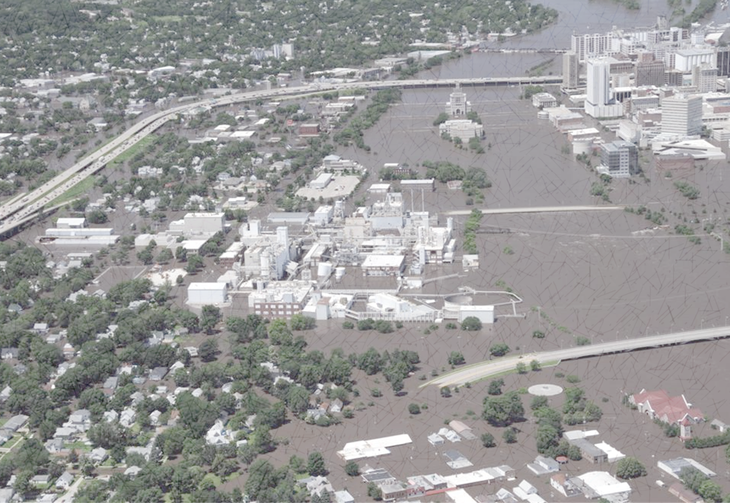
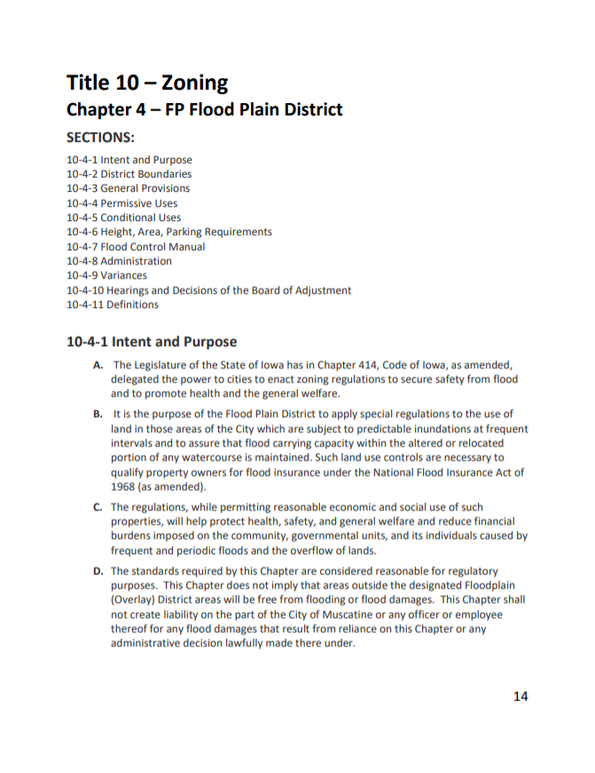
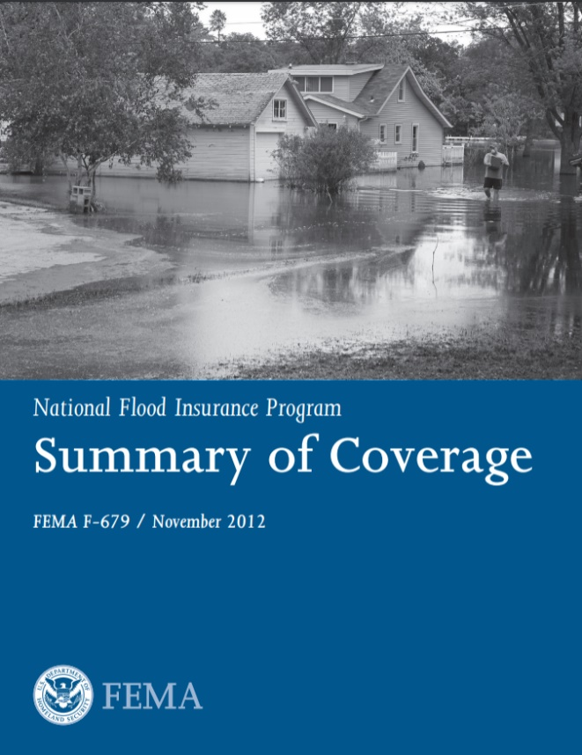
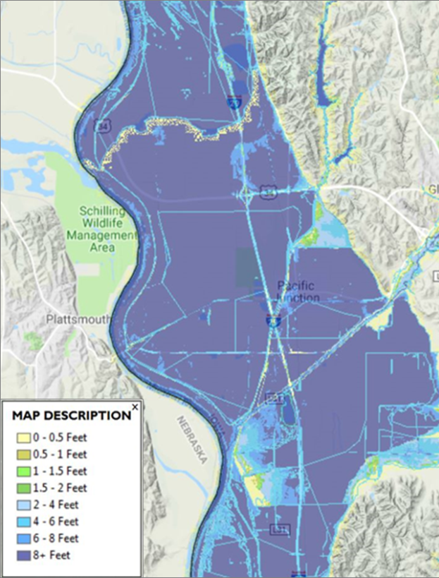
National Flood Insurance Program

Slide 3
Floodplain Regulation
681 Iowa communities currently participating in NFIP
Communities participating in NFIP must require permits for all development located in the SFHA
Development includes: construction of buildings, filling, grading, excavation, storage of materials, etc.
Also includes development by community: e.g., bridges, culverts, park structures
Regulation is mitigation
Protect development when constructed, not after it’s been damaged
Resist granting variances

Slide 4
Higher Regulatory Standards
Iowa floodplain development rules are more stringent than those of NFIP
Communities are encouraged to adopt higher standards
43 Iowa communities have adopted standards that exceed NIFP and DNR
Higher freeboard for buildings (i.e., >1 ft. above BFE)
Protect buildings from 500-year flood
Additional protection for critical facilities (e.g., water and wastewater treatment, etc.)
Restrictions on placement of fill
Cumulative Substantial Damage Definition
More restrictive flood map

Slide 5
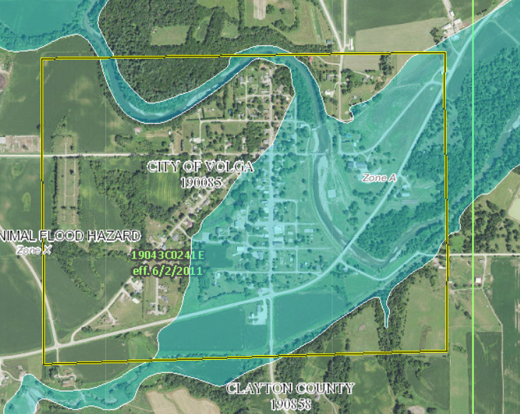
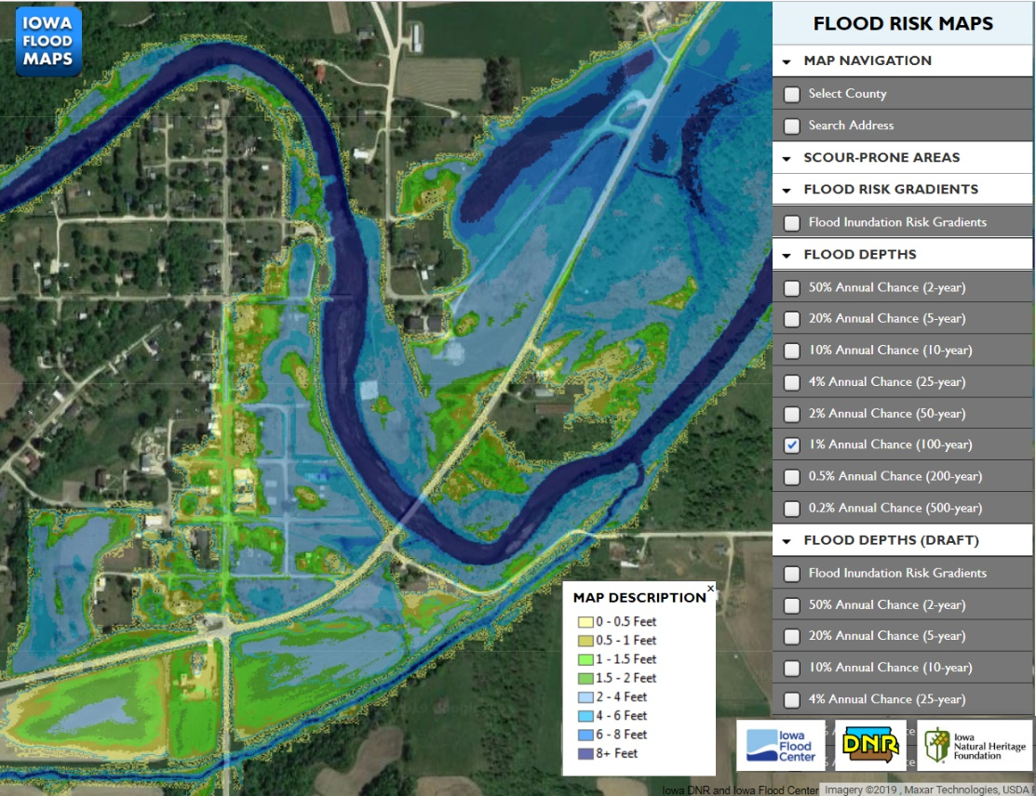
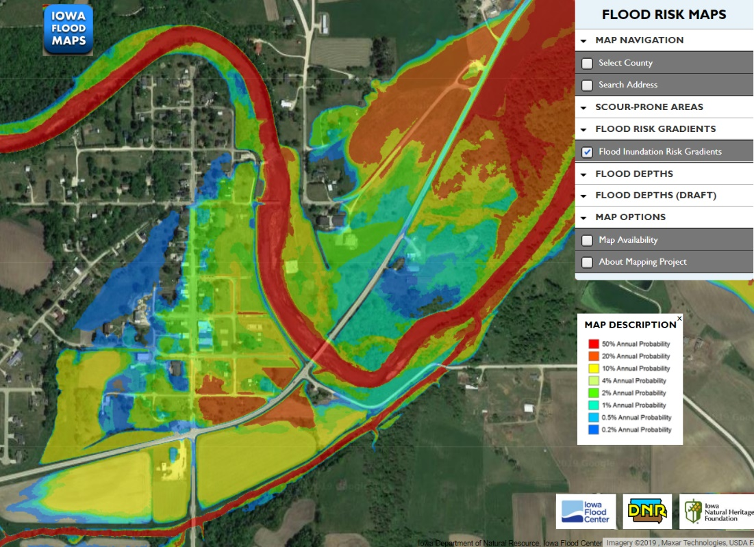
Floodplain Mapping
FEMA FIRM’s only show inundation area for base (i.e., 100-year) flood
Iowa mapping products include inundation areas for 8 flood frequencies (2-year thru 500-year)
Depth grids are also available for those frequencies
iowafloodmaps.org

Slide 6
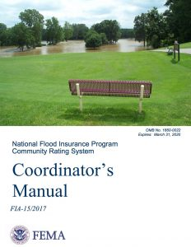
Community Rating System (CRS)
FEMA program that rewards communities for activities that exceed minimum NFIP standards
Earn points for activities
More points earned, the bigger the discount in premiums for all NFIP policies in the community
Currently 12 Iowa communities participating in CRS
Several more have expressed interest in joining
Community Name | Current Class | % Discount
Cedar Falls, City of | 5 | 25
Cedar Rapids, City of | 6 | 20
Charles City, City of | 9 | 5
Clive, City of | 5 | 25
Coralville, City of | 7 | 15
Davenport, City of | 8 | 10
Des Moines, City of | 7 | 15
Iowa City, City of | 6 | 20
Kalona, City of | 9 | 5
Linn County | 8 | 10
Pottawattamie County | 9 | 5
Story County | 7 | 15

Slide 7
NFIP Update
Current number of policies – 13,350
Private flood policies
Difficult to track
Reports from last year indicated ~$8 million in premiums
Rating 2.0 scheduled to start in October 2020
Legislation
NFIP needs to be reauthorized every 5 years
Last time was July 2012 (Biggert-Waters NFIP Reform Act of 2012)
Currently on 10th short-term extension (expires Sept 30th)
Currently no consensus between House and Senate
Competing priorities of program fiscal stability vs. premium affordability

Slide 8
Hazard Mitigation Assistance
Authorized by the Robert T. Stafford Disaster Relief and Emergency Assistance Act, Public Law 93-288, As Amended
Hazard Mitigation Grant Program (Sec. 404) assists with implementing long-term hazard mitigation planning and projects following a Presidential major disaster declaration
Pre-Disaster Mitigation (Sec. 203) provides funds for hazard mitigation planning and projects on an annual basis
Public Assistance Hazard Mitigation (Sec. 406) discretionary authority to fund mitigation measures in conjunction with the repair of the disaster-damaged facilities, so is limited to declared counties and eligible damaged facilities
Authorized by the National Flood Insurance Act of 1968, As Amended
Flood Mitigation Assistance (Sec. 1366) provides funds for planning and projects to reduce or eliminate risk of flood damage to buildings that re insured under the National Flood Insurance Program (NFIP) on an annual basis

Slide 9
Hazard Mitigation Assistance
FEMA is the authorizing federal agency
The Iowa Department of Homeland Security and Emergency Management as the pass-thru grantee entity developing applications and managing the overall federal award
Local jurisdictions, including cities, counties, school districts, and certain private non-profits, are eligible to apply for funding through the state agency
Public Assistance Section 406 mitigation will be written within a project worksheet immediately following a disaster and may become available between 6 and 18 months after the declared disaster
Hazard Mitigation Assistance Section 203, Section 404, and Section 1366 provide between 6 and 12 months for application development and an additional 6 to 12 months for state and federal review. Application development is dependent on available funding sources annually or immediately following a declared disaster.

Slide 10
Hazard Mitigation Assistance
Disaster Recovery Reform Act of 2018 as a part of the Federal Aviation Administration Reauthorization Act of 2018 and contains 50 provisions requiring changes to FEMA policy or regulation as they amend the Robert T. Stafford Disaster Relief and Emergency Assistance Act
National Public Infrastructure Pre-Disaster Hazard Mitigation (Sec. 1234) to be funded through the Disaster Relief Fund as a six percent set aside from the estimated disaster grant expenditures. This allows for a greater investment in mitigation before a disaster. This new program is named Building Resilient Infrastructure and Communities (BRIC).
Hazard Mitigation Grant Program for Resilience (Sec 1235a) ensures Hazard Mitigation Grant Program funding increase resilience to future damage, hardship, loss, or suffering
Public Assistance 406 Codes and Standards (Sec 1235b) authorizes FEMA to provide Public Assistance funding to replace and restore disaster damaged facilities to the latest published editions of relevant consensus-based codes and standards to ensure that facilities are restored in a manner that allows them to be resilient

Slide 11
Hazard Mitigation Assistance
Robert T. Stafford Act, as amended
https://www.fema.gov/robert-t-stafford-disaster-relief-and-emergency-assistance-act-public-law-93-288-amended
Disaster Recovery Reform Act of 2018
https://www.fema.gov/disaster-recovery-reform-act-2018
FEMA Hazard Mitigation Assistance
https://www.fema.gov/hazard-mitigation-assistance
Public Assistance Program and Policy Guide (PAPPG)
https://www.fema.gov/public-assistance-policy-and-guidance
44 Code of Federal Regulations (CFR)
https://www.ecfr.gov/cgi-bin/text-idx?SID=5e6b8be71598d48d948b162d19c0e85c&mc=true&tpl=/ecfrbrowse/Title44/44tab_02.tpl

Slide 12
Linn County Flood Damage Assessments
Flood Track
ISAC Annual Conference | August 21, 2019

Slide 13
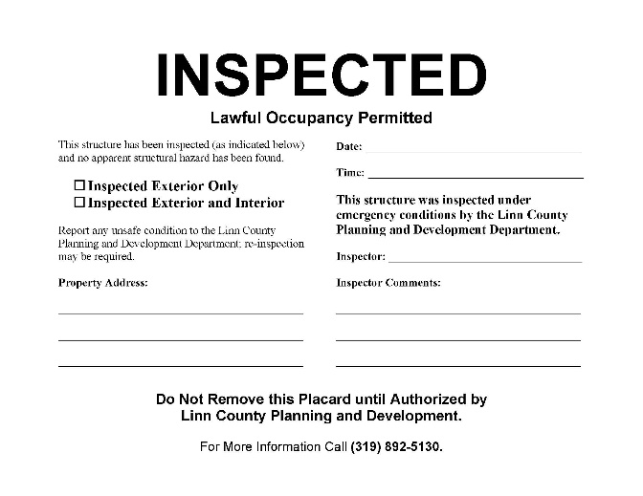
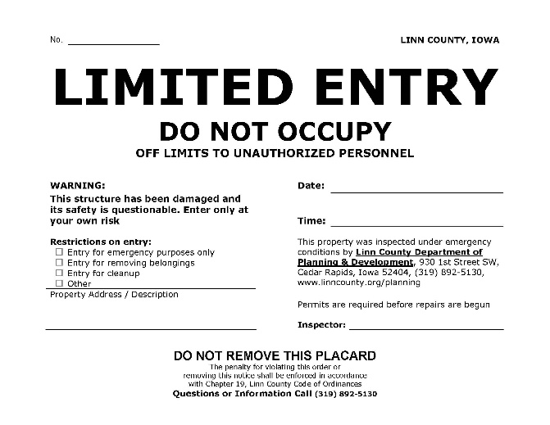
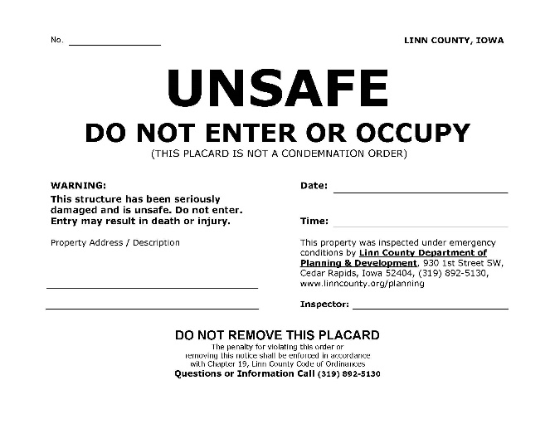
Initial Damage Assessment Placards
Green Placard
Yellow Placard
Red Placard

Slide 14
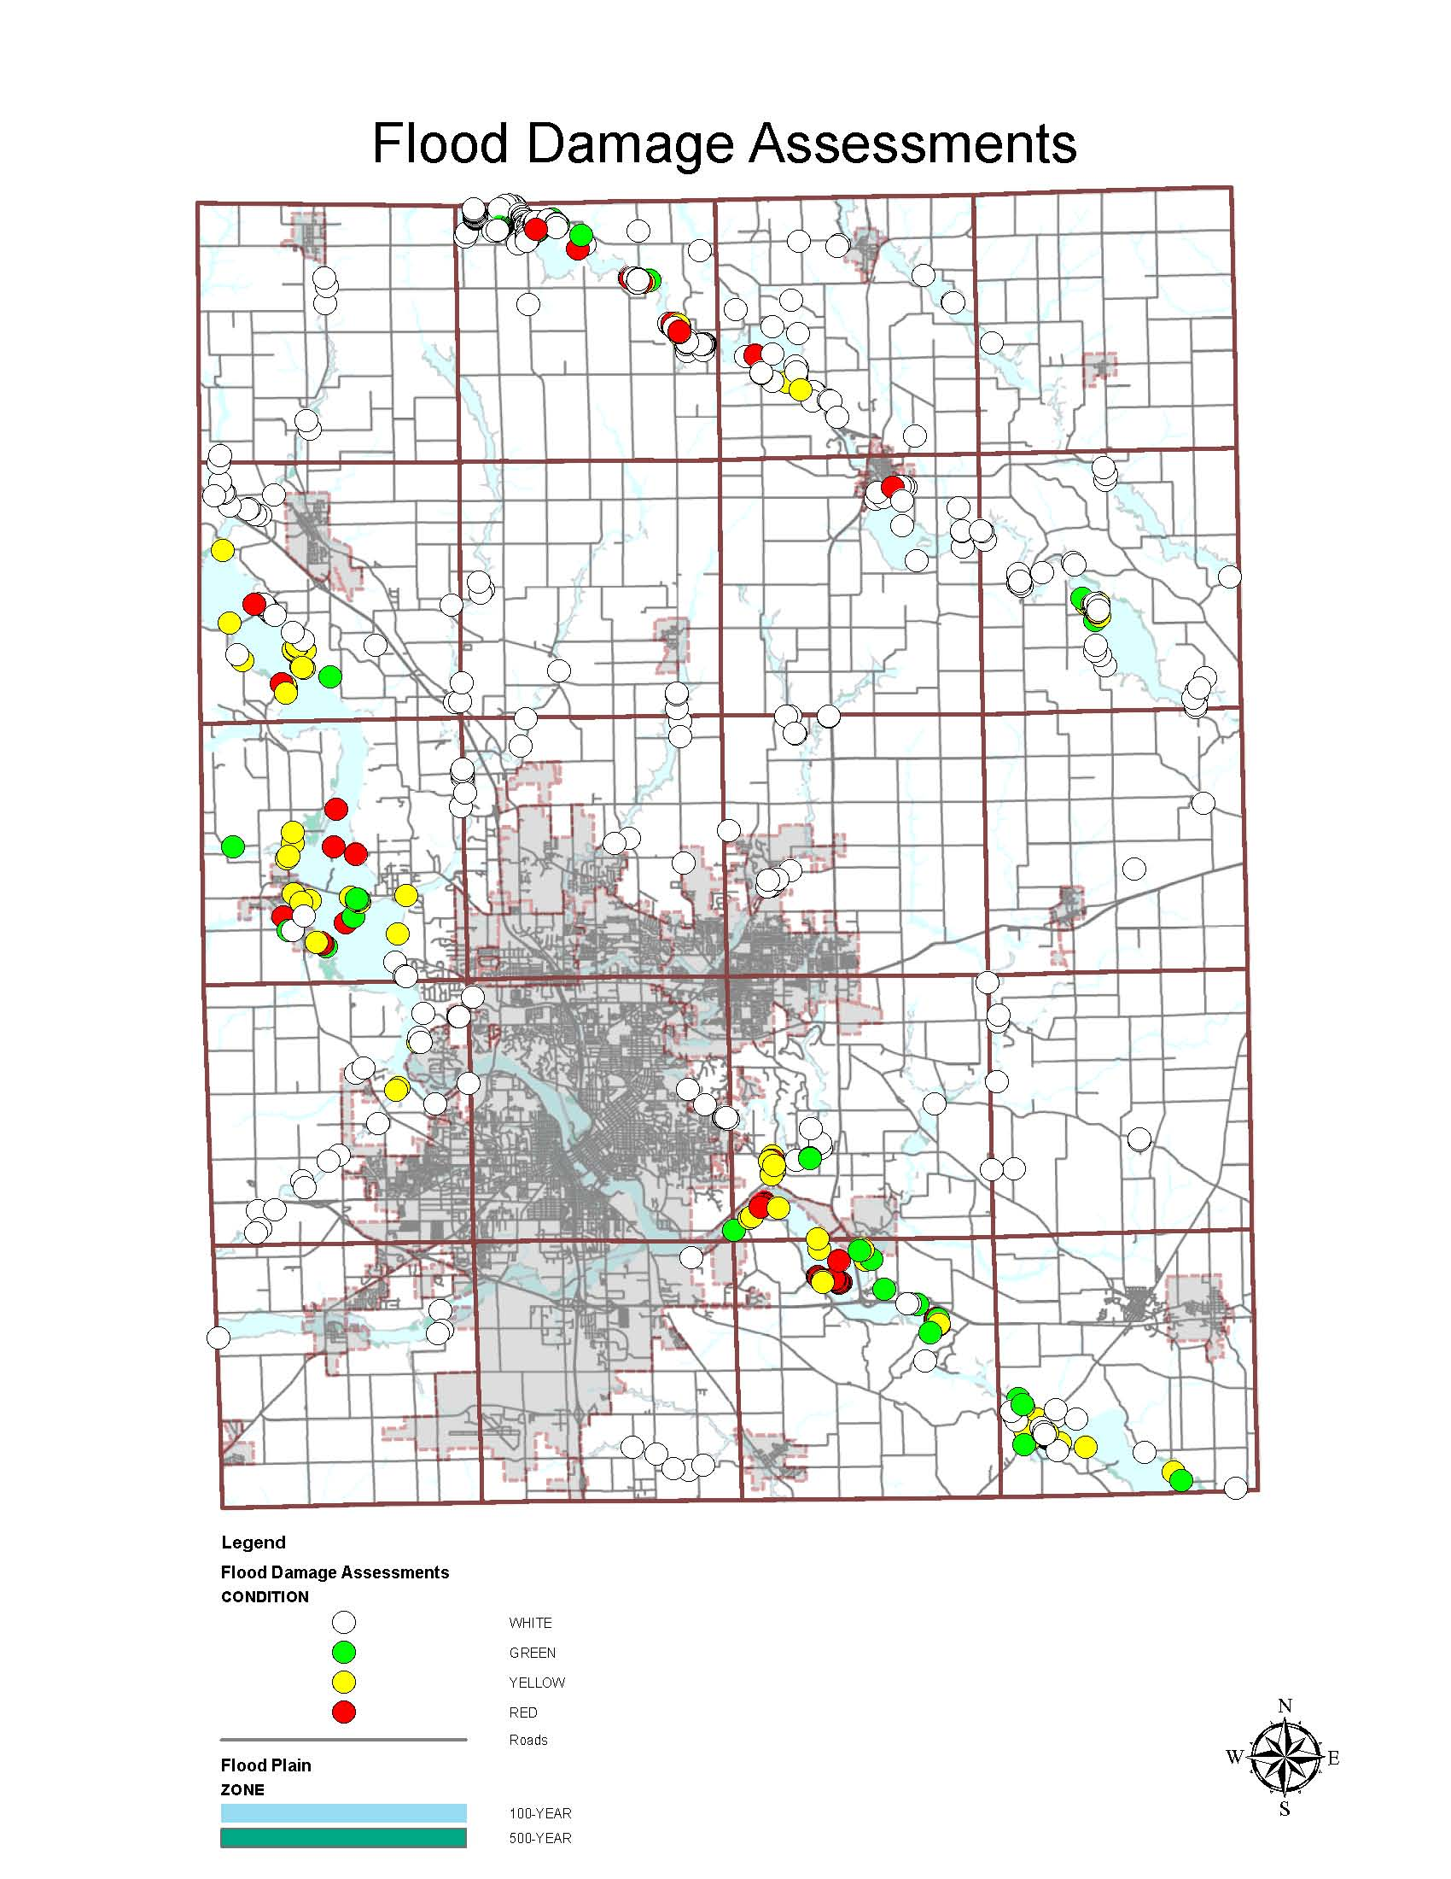
2008 Flood Event – Initial Damage Assessments

Slide 15
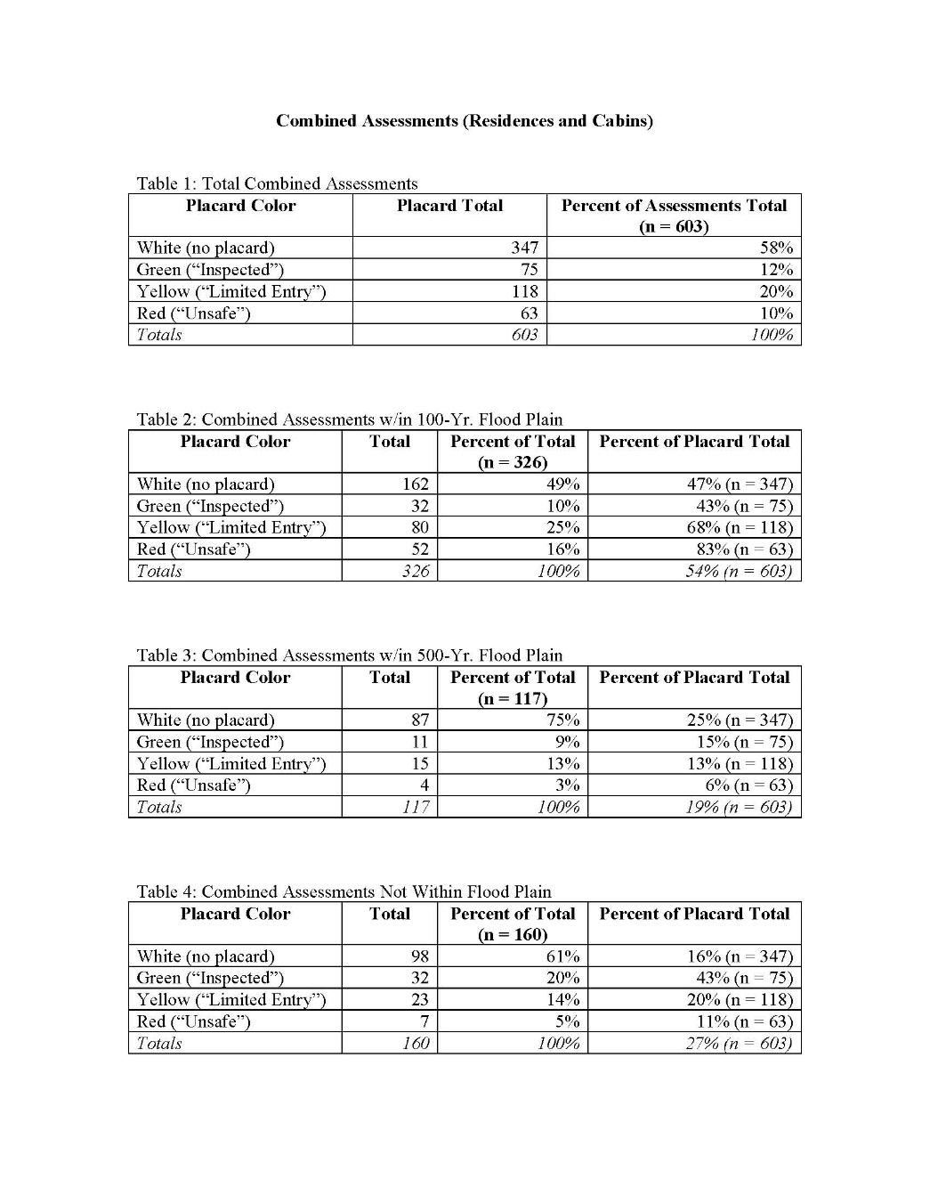
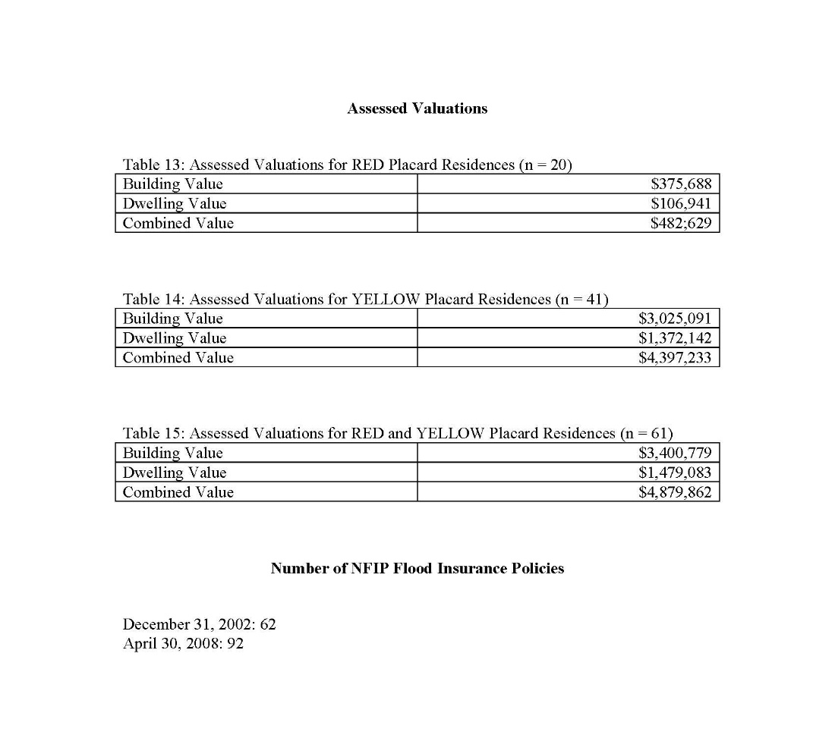
2008 Damage Assessment Data

Slide 16
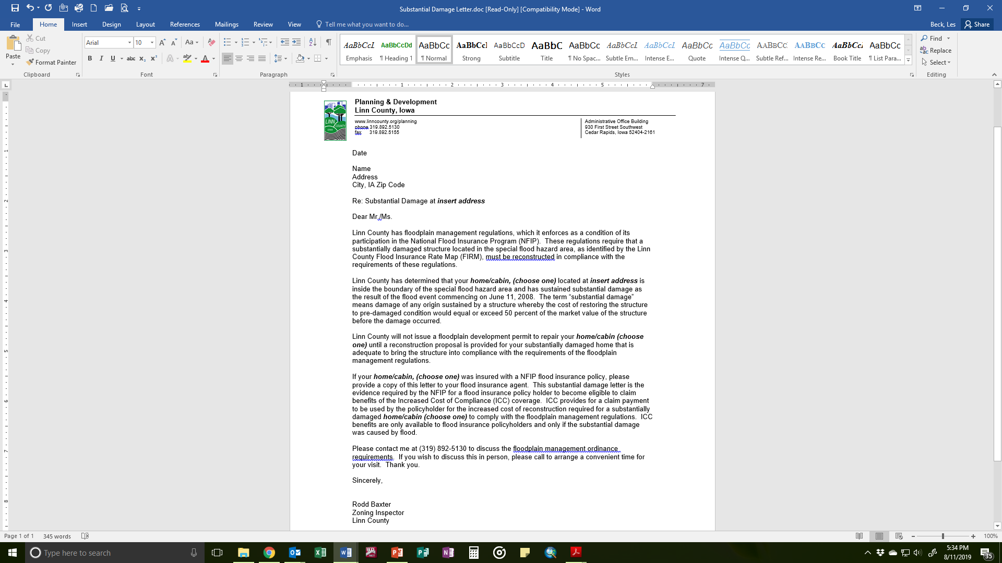

Slide 17
Damage Assessments ‘N More
City of Palo damage assessments + placarding: 427 structures; 3 days
Rural Linn County damage assessments + placarding: 603 structures; 2 weeks
28E Agreement with City of Palo for building inspection services
RSDE determinations: 179 structures; letters to owners; appeal process
24 appeals of RSDE determinations
NOI to IHSEMD for voluntary acquisition (Sec. 404) program; public info meetings
Attend flood disaster-related trainings
Review new DFIRM maps
Maintain “normal” business operations

Slide 18
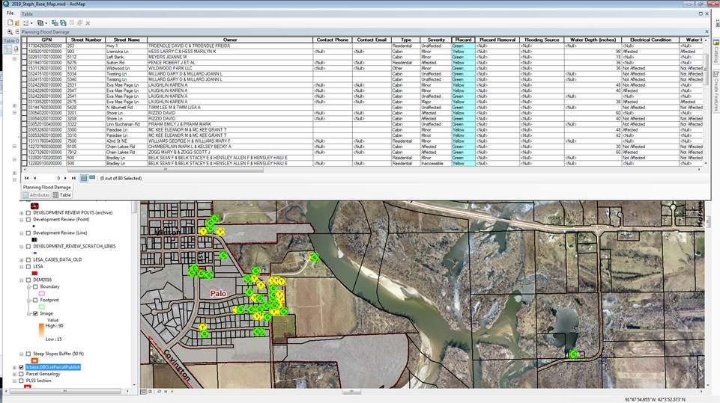
2016 Flood Event – Electronic Data Collection

Slide 19
Preparing for the Next Flood
John Benson
Moderator
Iowa Homeland Security & Emergency Management John.benson@iowa.gov
Bill Cappuccio
Panelist
Iowa Department of Natural Resources
Bill.cappuccio@dnr.iowa.gov
Aimee Bartlett
Panelist
Iowa Homeland Security & Emergency Management
Aimee-bartlett@iowa.gov
Les Beck
Panelist
Linn County Planning & Development
Les.beck@linncounty.org

