Slide 1
2019 ISAC Legislative Priorities
ISAC Legislative Team

Slide 2
Legislative Policy Committee (LPC)
Chaired by ISAC Second Vice President
Burlin Matthews, Clay County Supervisor
32 members (two from each affiliate)
Develop legislative objectives for ISAC’s legislative team to pursue for the upcoming session
Meet in August and September to develop legislative platform

Slide 3
Legislative Policy Committee (LPC)
Assessors: Pam Jensen and Tom Van Buer
Auditors: Heidi Burhans and Dennis Parrott
Community Services: Lori Elam and Shane Walter
Conservation: Dan Cohen and Matt Cosgrove
County Attorneys: Darin Raymond and Matt Wilbur
Emergency Management: Thomas Craighton and Lorie Glover
Engineers: Lyle Brehm and Dan Eckert
Environmental Health: Eric Bradley and Brian Hanft
Information Technology: Micah Cutler and Michelle Fields
Public Health: Chris Estel and Kevin Grieme
Recorders: Chad Airhart and Megan Clyman
Sheriffs and Deputies: Lonny Pulkrabek and Tony Thompson
Supervisors: Eugene Meiners and Henry Van Weelden
Treasurers: Sharon Gonzalez and Tracey Marshall
Veterans Affairs: Patty Hamann and Chris Oliver
Zoning: Joe Buffington and Josh Busard

Slide 4
ISAC Legislative Process
LPC develops policy statements and legislative objectives
Policy statements express long-term or continuing statements of principle importance for local control, local government authority, and efficient county operation. These statements are designed to guide the Association in responding to public policy issues affecting county government.
Legislative objectives provide specific problems and solutions for legislators to address. The ISAC policy team actively pursues bills for each legislative objective.
Top priorities are presented during meetings with legislative leadership prior to the session.

Slide 5
ISAC Legislative Process
September – LPC recommends priorities to ISAC membership
October – Voting tool link emailed to membership
November – ISAC Board ratifies legislative priorities and sets top priorities
December – Legislative webinar and rollout of top priorities
Legislators contacted
Meetings with leadership/governor

Slide 6
ISAC 2019 Top Priorities
Mental Health and Disability Services
Commercial and Industrial Property Tax Backfill
Water Quality, Natural Resources, and Outdoor Recreation

Slide 7
Mental Health and Disability Services
Eliminate the regional mental health levy caps that were established in SF 504 and allow for counties to levy what is necessary to meet their regional budgetary needs.
Remove the carry forward balance restrictions of 20% or 25% to provide counties/regions resources for new and existing programs without dramatic changes in property taxes.
If the above remedies are not advanced, an increase in the sales tax should be considered to fund MH/DS that must be constitutionally protected based on a distribution formula that is equitable for all counties in Iowa.

Slide 8
Commercial and Industrial Property Tax Backfill
The legislature should fully fund the commercial and industrial property tax backfill and should resist a rapid elimination of the backfill and legislation that affects local budgets that have been set or are in the process of being set.

Slide 9
Water Quality, Natural Resources, and Outdoor Recreation
Pass a statewide sales tax increase of at least 3/8s of a penny in support of the Natural Resources and Outdoor Recreation Trust Fund, or I-WILL, to which it is commonly referred.
Maintain the distribution formula found in Iowa Code Chapter 461, outlined by the Iowa Legislature in support of the 2010 vote by Iowans on the Constitutional Amendment.
Pass legislation that would support and encourage public sector entities, such as counties, to be directly involved in water mitigation projects that could involve county conservation boards, engineers, and supervisors.

Slide 10
Legislative Objectives
Absentee Ballot Commencement Date
Jamie Cashman (ISAC Lead)
County Infractions
Lucas Beenken (ISAC Lead)
Resource Enhancement and Protection (REAP) Program
Jamie Cashman (ISAC Lead)
Secondary Roads
Lucas Beenken (ISAC Lead)
Super Speeders
Jamie Cashman (ISAC Lead)
Weight Limits on Secondary Roads
Lucas Beenken (ISAC Lead)

Slide 11
Bill Tracking Tools

Slide 12
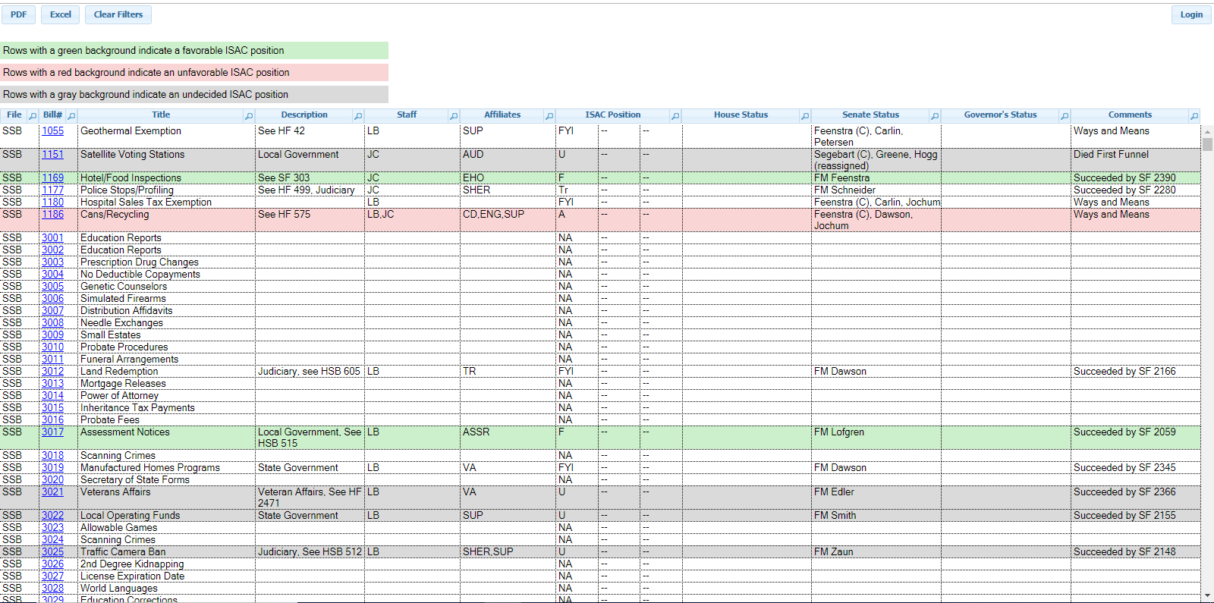
ISAC Legislative Bill Tracking Tool
http://affiliates.iowacounties.org/bills/

Slide 13
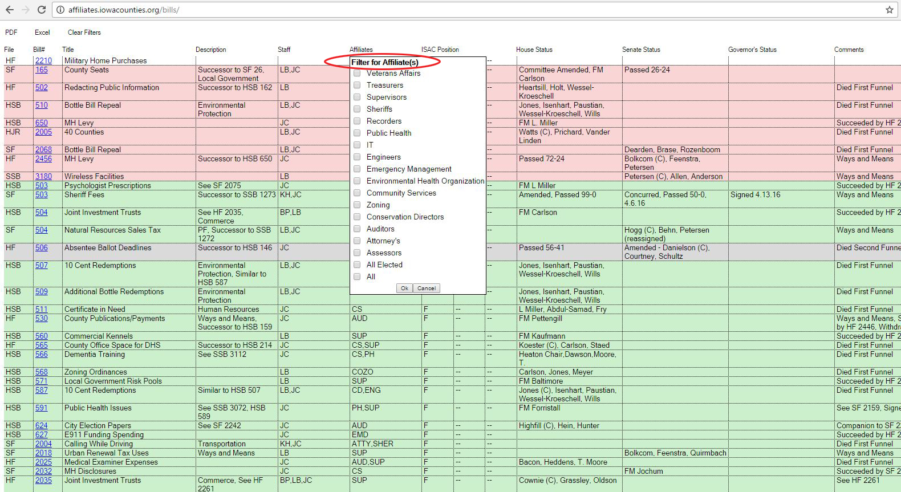

Slide 14
Get Involved!
Contacting your legislator
County Day at the Capitol – March 13, 2019
Phone calls
Email (clearly state your subject in the subject line)
Letters
Forums
Feedback
ISAC Update emailed on Friday’s during session
Use the Legislative Comment Form to provide feedback

Slide 15
Questions?
Jamie Cashman
ISAC Government Relations Manager
515.369.7017
jcashman@iowacounties.org
Lucas Beenken
ISAC Public Policy Specialist
515.369.7016
lbeenken@iowacounties.org

