Slide 1
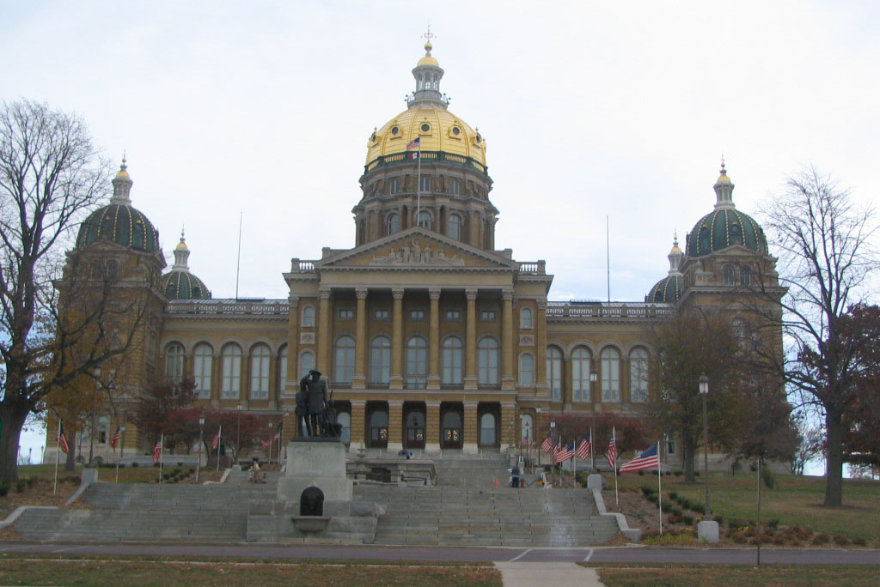
The Duties of the Iowa Assessor
(ISAC New County Officers School)
Wayne Schwickerath
Story County Assessor
January 17, 2019

Slide 2
Purpose of Presentation
(Iowa Code Chapter 441)
Assessment & Valuation of Property)
What are the Duties and Responsibilities of an Assessor?
How does the assessor interact with County Supervisors?
What is a Conference Board?
What issues are affecting how the Assessor does their job?
Importance of Building Bridges and Relationships

Slide 3
Iowa Assessor’s Position & Requirements
(Chapter 441.1)
Assessor is an appointed position created in 1948 (term of 6 years)
Iowa law requires every county to have an assessor
A City of greater than 10,000 in population may pass an ordinance to
have their own assessor (optional)
County Conference Board---(Mayors of each city, Board of Supervisors,
one member of each School Board district located in county)
City Conference Board---(Mayor-City Council, Board of Supervisors,
each School Board located within the city boundaries)
Duties of Conference Board---oversee the appointment of the
assessor and budget requirements

Slide 4
Iowa Assessor’s Position & Requirements (continued)
Primary Duty---assess or appraise all real estate located in the
jurisdiction (includes residential, agricultural, commercial,
(commercial dual class & multi-residential) & industrial properties)
Utilities are assessed by Iowa Department of Revenue.
Required to value all real estate every year. Required to revalue
every two years in the odd numbered year is reassessment year)
All classes are based upon market value (except agricultural class;
which is assessed on it’s productivity and net earning value)
Board of Review---independent review board appointed by the
conference board to hear Individual tax payer appeals (Meet in
May) (Chapter 441.31) (Appeal to District Court or PAAB)
State Equalization orders---are issued every 2 years in the odd
numbered year to ensure that each class of property in each
assessing jurisdiction is assessed at actual value as required by
law. (95% to 105% median ratio—assessment/sales price)

Slide 5
Iowa Assessor’s Appointment Requirements
To be appointed---pass an examination administered by the
Iowa Department of Revenue (exam covers appraisal theory &
practice & Iowa’s assessment laws)
Appraisal theory---covers sales, cost and income approaches
to market value
Assessment law---covers valuation standards, statutory
assessment procedures, tax credits & exemptions.
Pass Exam---name will appear on an Iowa Department of
Revenue Register of Candidates Eligible for Appointment as a
City or County Assessor
Name remains on list for period of 2 years; after 6 years of
experience as an assessor your name is on register list
forever

Slide 6
Functions of the Conference Board
( Assessor Appointment Requirements) continued
Regular certification---minimum two years of appraisal related experience
Temporary certification---lacking two years of appraisal experience
Temporary certification---needs eighteen month review and training by the Iowa Department of Revenue
Reappointed---required to have a minimum of 150 hrs. Continuing education of which 90 hrs. has to be tested. (Courses required to be approved of Iowa Department of Revenue)

Slide 7
Functions of the Conference Board
( Preliminary Education Requirements Prior to Test)
Prior to 2017 any individual could take the assessor or deputy exam
2017---HF 478 required Director of Revenue to prescribe by rule preliminary educational requirements before an individual is qualified to take the assessor or deputy exam.
2018---ARC 3725C (Administrative Rule Change) Assessor/deputy exam prerequisite educational requirements
Rule identified the Preliminary appraisal related tested courses to be taken before an individual is qualified to take the assessor or deputy exam
The required courses Must have been taken and exam passed in the past 5 years to be eligible to take assessor or deputy exam

Slide 8
Functions of the Conference Board
( 3-Preliminary Educational Options Prior to Exam)
Institute of Iowa Certified Assessors---Iowa Assessment & Taxation
Review Course (18.5 hrs.) (Working knowledge of IAAO 101, 102,
and Iowa Laws Course is strongly suggested)
Iowa Department of Revenue---Iowa laws Course (7.5 hrs.) and
A, B, or C Must have been taken in past 5 years
A. International Association of Assessing Officers—(IAAO)
Either Course 101(Fundamentals of Real Property Appraisal
or Course 300 (Fundamentals of Mass Appraisal)
(Each are a 30 hr. course)
B. Appraisal Institute---Basic Appraisal Principles and Basic Appraisal Procedures (Each are a 30 hr. course)
C. American Society of Farm Managers & Rural Appraisers---
Basic Appraisal Principles and Basic Appraisal Procedures
(Each are a 30 hr. course)

Slide 9
Functions of the Conference Board
( 3-Preliminary Educational Options (continued)
Current Appraisal Designations (Taken within the past 5 years)
A. ICA-Institute of Iowa Certified Assessors sponsored and Iowa Department of Revenue Iowa Laws course or Iowa Assessment & Taxation Review
B. CAE-International Association of Assessing Officers sponsored and Iowa Department of Revenue Iowa Laws course or Iowa Assessment & Taxation Review
C. RES-International Association of Assessing Officers sponsored and Iowa Department of Revenue Iowa Laws course or Iowa Assessment & Taxation Review)
D. MAI-Appraisal Institute sponsored and Iowa Department of Revenue Iowa Laws course or Iowa Assessment & Taxation Review)

Slide 10
Functions of the Conference Board
( 3-Preliminary Educational Options (continued)
Current Appraisal Designations (Taken within the past 5 years)
E. Accredited Rural Appraiser-American Society of Farm Managers & Rural Appraisers sponsored and Iowa Department of Revenue Iowa Laws course or Iowa Assessment & Taxation Review
Prior to this ADRC rule change; the assessor/deputy exam was given by the Iowa Department of Revenue in the spring and fall of each year in Des Moines, Iowa
Currently, the exam is taken on line at DMACC. Will be expanded to other area colleges in the future

Slide 11
Membership of the County & City Conference Board
County Assessor Conference Board (Iowa Code Chapter 441.2)
County Board of Supervisors (Supervisor is chairperson)
Mayor from each city within county
School Board representative from each school district within the county provided that individual is a resident of the county.
City Assessor Conference Board (Iowa Code Chapter 441.2)
Members of City Council (Mayor is chairperson)
County Board of Supervisors
The entire board directors of each school district having property located within the city
Assessor is clerk of each respective county or city conference board

Slide 12
Voting Procedures of Conference Board
Each of the three (3) units has one vote (total of 3 votes)
Two (2) members must be present from a unit to have a
quorum of that unit
Two (2) units of the three (3) units must have a quorum to hold
a meeting
Majority of votes of members of each unit determines vote of
that unit
Two (2) units must agree for a vote to pass

Slide 13
Functions of the Conference Board
(Examining Board and Assessor Appointment)
Examining Board---three person board (six year terms) representing each conference board unit (Iowa Code Chapter 441.3)
Must be a resident of jurisdiction
Request within seven days a registered list of potential candidates from the Iowa Department of Revenue
Advertise the vacant assessor position
Interview potential candidates for assessor vacancy
Make a report or recommendation to conference board within fifteen days of the interviews or their recommendation of findings
Conference Board makes final selection of assessor
Option: May request a local examination from IDR, if no appointment made
Notify Iowa Director of Revenue within ten days of appointment

Slide 14
Functions of the Conference Board
(Board of Review)
Tax payer may appeal their assessment to this board unit
May be three or five members (six year terms & shall be staggered)
Board Membership: (Iowa Code Chapter 441.31)
One licensed real estate broker or appraiser related occupation
One registered architect or person in construction field
One member must be a farmer (case of a county)
Not more than two members shall be of same occupation
Must be a resident of jurisdiction
Decisions may be appealed to District Court or PAAB

Slide 15
Functions of the Conference Board
(Budget Process---Iowa Code Chapter 441.16)
January 1 of each year assessor is to prepare a budget for the operating expenses necessary to operate the office
Separate Taxing Entity (Own tax/levy rate)
Regular Assessment Fund (Operating Expenses)
Salaries (FICA & IPERS)
Insurance-Benefits
Board of Review Expenses
Legal and Appraisal Services
Office Supplies/Equipment
Postage/Telephone/Publications
Mileage/Car Repairs
Appraisal & Administration Software & Hardware
Continuing Education & Training
GIS and Aerial Photography

Slide 16
Functions of the Conference Board
Budget Process (continued)
Regular Assessment Fund: (continued)
Reappraisal projects
Maintenance agreements
Maximum levy tax rate of 67.5 cents per thousand
May budget separately for FICA & IPERS if regular fund is maxed
out
Emergency Fund:
Petition State Appeal Board (Only if lack funds from Regular Assessment Fund)
Maximum levy tax rate of 27 cents per thousand

Slide 17
Functions of the Conference Board
Budget Process (continued)
Budget Timeline:
Hold budget meeting after January 1 for initial budget approval
Optional---preliminary meeting (Mini-board meeting)
Publication of proposed budget in at least one newspaper
Budget is to be adopted by March 15th
Published between 10 and 20 days prior to public hearing date
File adopted budget with county auditor
File adopted budget with Department of Management
Open meeting laws prevail (Iowa Code Chapter 21)

Slide 18
Issues Affecting the Assessor’s Job
Budget Restraints--- lack of adequate funding to perform duties of the assessor’s office. Lack of valuation or growth in value.
Legislation--- laws which are passed which are vague in meaning. Such as classification issues (what is ag, what is residential etc. ) or what do the rules actually mean. Rollback issues on various classes creates inequities in taxes. Directives from the Iowa Department of Revenue on what do the rules or regulations actually mean)
(2013---SF295 commercial legislation)
Public Opinion--- how does the public perceive what the assessor actually does concerning the assessment of property in the county.
Public Relations--- customer service may make or break your office operation. You may have the most accurate appraisals and valuations for your properties in your jurisdiction, but poor public relations will destroy your operation and create a negative opinion from the public. It’s all about building bridges, relationships and creating a “Positive Balance” to have “Truth in Taxation”.

Slide 19
In Summary, Review
What are the Duties & Responsibilities of the Assessor
Primary duty--- Administer and implement assessment laws pertaining to the valuation of all residential, agricultural, commercial & dual class, industrial, & multi-residential property within your respective jurisdiction using accepted real property appraisal methods and laws. (Market value & Productivity value)
Supervise, direct and coordinate--- the operations of the Assessor's office and staff in accordance with state and local laws governing real property appraisal methods, assessments, classifications, exemptions and credits, sales ratio studies, budgeting and other related reports. (Conference Board, Board of Review & equalization orders & Department of Revenue)
Perform public relations--- activities explaining the technical aspects of the appraisal theory, process, laws and regulations concerning the assessment of real estate.

Slide 20
“Who Is Our Public”?
Tax Payer, Property Owner, Renter
Assessor’s Staff//Other Assessors
Conference Board & Board of Supervisors
County or City Elected Officials//School Officials
Department of Revenue & Finance
Legislators
Attorneys & Tax Reps
Realtors & Appraisers, and Insurance Agents
Community & Business leaders, Civic groups
Local Media

Slide 21
What is the “Definition of Public Relations”
“Public Relations is the management function that identifies, establishes and maintains mutually beneficial relationships between an organization and the various publics on whom its success or failure depends.” Public relations is the key to how the public perceives (the organization), its programs, and its services.
Definition by the “Institute of Public Relations”
“Public Relations practice is the planned and sustained effort to establish and maintain goodwill and mutual understanding between an organization and its publics’.”

Slide 22
Understanding Public Relations
Public Relations affects almost everyone who has contact with other
human beings. All of us, in one way or another, practice public
relations daily.
Every phone call
Every letter written or received
Every email or web feedback
Every face to face encounter
Every action//Your attitude
Your words//Your reputation

Slide 23
Three Basic Components of Public Relations
Public Relations is comprised of the interactions between an individual
or an organization and the general public.
The interaction can be with the entire public, or with a select group,
or an individual.
The interaction, planned or unexpected, has an impact on the image,
success, or failure, and actions of the individual or organization that
communicates to the public.

Slide 24
Objectives of a Public Relations Program
Communicate a message---why does the assessor raise our taxes and
valuations? (School-County-City)
Improve and create an image---are we honest and trustworthy
Build awareness---make sure we have a presence
Persuade the Public you are acting in their best interest
Bolster one’s identity among your constituents and the public

Slide 25
Truth in Taxation
Accountability to the taxpayer---in form of public hearings & notices
Rollbacks & Property Tax Limitations
Property Tax Credits
Assessment, budgeting & Implementation
Notifications of assessments---directly to property owner
Right to be aware of valuation procedures
Right to Appeal assessments
All areas of government are affected by “Truth in Taxation”

Slide 26
Public Relation Tools & Techniques
Crisis management---a coordinated effort to handle the effects of
unfavorable publicity or of an unfavorable event.
(revaluations/equalization orders)
News papers---Local or statewide
News letters---County newsletter
Radio---Local or statewide
Television---Local or statewide
Speaking Engagements---Bar association/civic groups/Farm Bureau
Internet & World Wide Web---County web site & GIS web site

Slide 27
Methods of Data Availability
To the Public
Story County Assessor’s office is a paperless operation----majority of
reports are on demand. All credits/exemptions, DOV’s are scanned.
Telephone Support---answer courteous & be supportive in response
Counter traffic----staff helps answer questions; explain assessments
Public Monitor---CAMA data, Property Record Card, GIS , maps &
photography available, and print capability
Web Site--- Available 24/7 (CAMA data, Property Record Card,
GIS/Maps, Aerial photography available (no charge for data)
Email/FAX Support---send reports & data (costs associated)

Slide 28
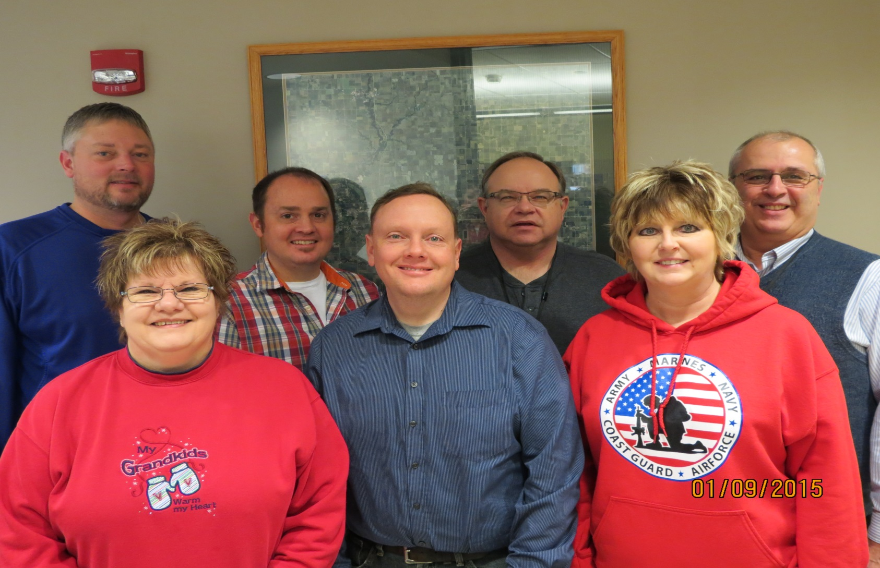
Story County Assessor’s Office Staff
(Relationships)

Slide 29
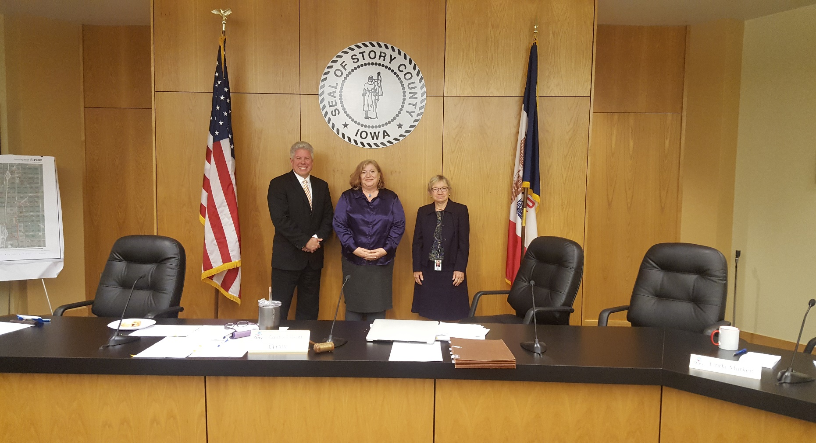
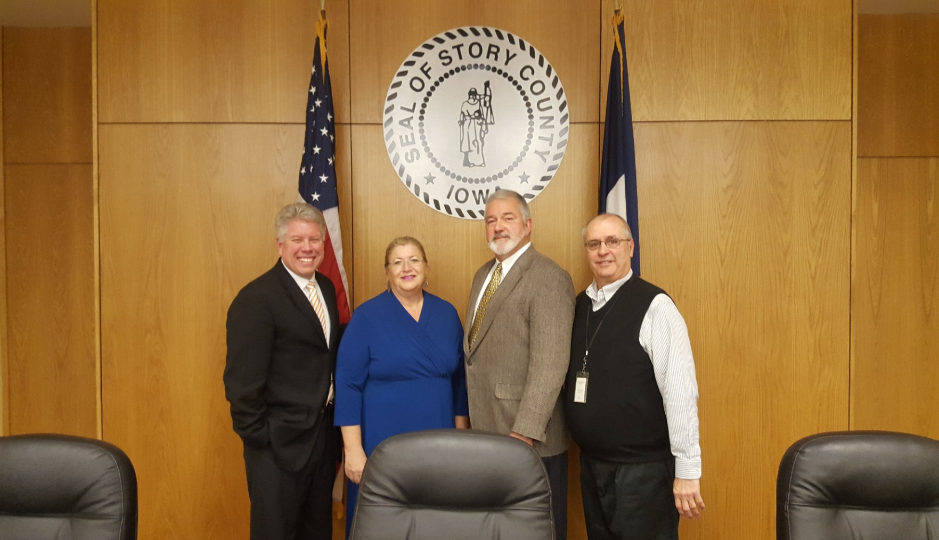
Story County Board of Supervisors
(Relationships)

Slide 30
Summary
One of the hardest things about handling public relations for any
organization, is judging the results. The people you work for usually do
not understand what you do. This includes the various government
agencies & the taxpayer.
Need to build bridges & enhance your relationships with the various
segments of your government counter-parts and the public.
Provide the public with accurate information and service in a prompt
and courteous manner. Need open lines of communication.
Operate your office in such a manner that all methods and procedures
are open to scrutiny and understood by the public. Convey you have
integrity.
Need communication & cooperation between agencies & individuals

Slide 31
Summary
(continued)
Compromise when appropriate. Show you have an open mind.
Use resources effectively & be efficient in daily operation.
A successful PR program is measured by PR.
Public Relations is measured by Public Response.
End result will be creditability & integrity with the operation of your
office.

Slide 32

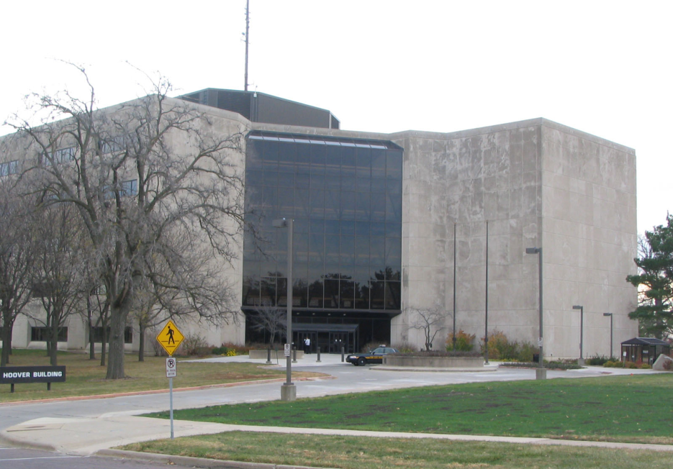
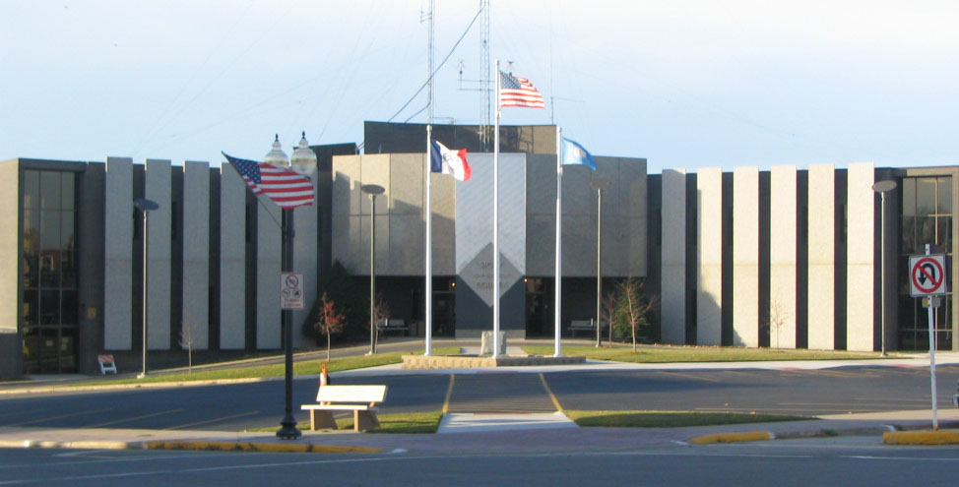
Building Bridges & Relationships Creates a
“Positive Balance” For Truth in Taxation
Legislators
Department of Revenue
Story County Supervisors

Slide 33
Thank-you for your time and consideration.
Questions
Wayne Schwickerath
Story County Assessor
900 6th Street, Nevada, Iowa 50201
515-382-7321
wschwickerath@storycountyiowa.gov

