Slide 1
“It Won’t Happen Here” is NOT a Plan. Preparing for Violence at Public Facilities
ISAC Conference, 01/20/2016
Presented by: Capt. Eric Dickinson, BS, NRAEMT
Dickinson Consulting L.L.C.

Slide 2
Objectives
During this presentation, the attendees will do the following;
Review historical examples and lessons learned from previous attacks and how they relate to county employees.
Learn basic points to assess preparedness of public facilities to limit any attack.
Understand common law enforcement and civilian response to terrorist attacks.
Understand likely injuries and basic emergency trauma care.
Articulate basic steps any citizen can take to respond to a violent attack.

Slide 3
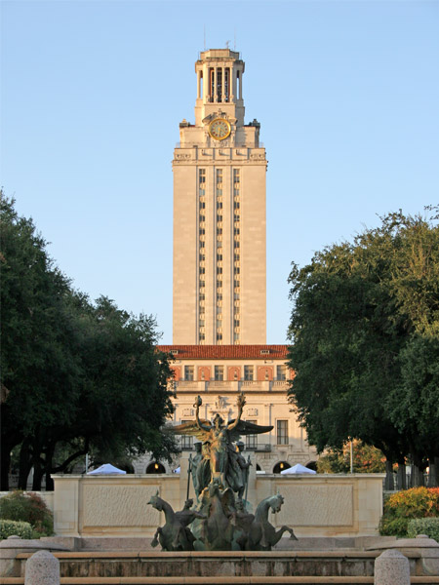
Notes:
Univ. of TX, Austin
Aug. 1, 1966
Charles Whitman
16 wounded
32 killed

Slide 4
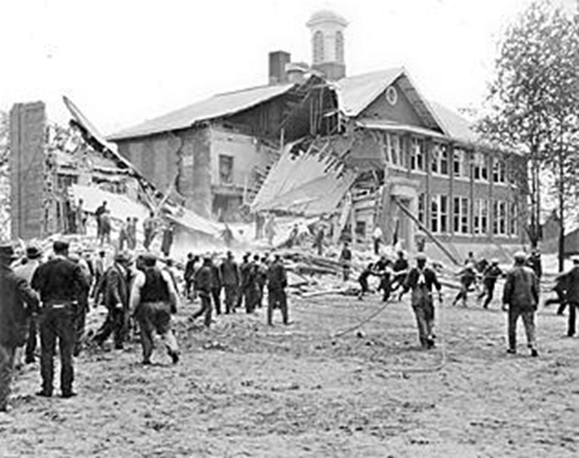
Notes:
May 18, 1927
Bath, Michigan
45 killed
58 wounded
There will always be a way for someone to attack your people/facility

Slide 5
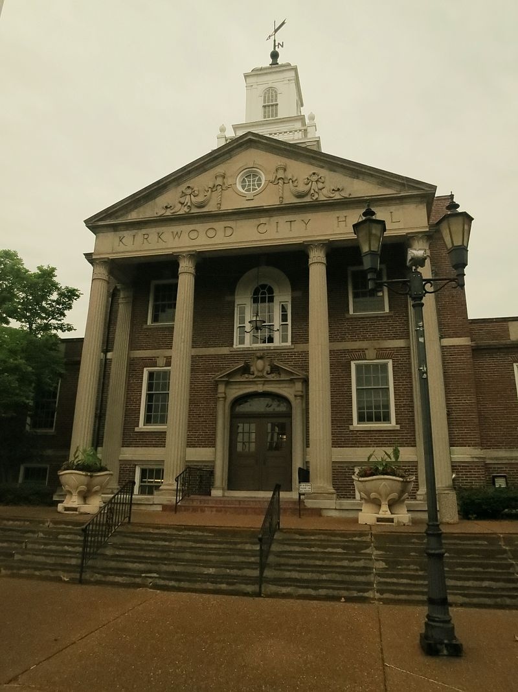
Notes:
Kirkwood (MO) City Hall shooting, 2/7/08, six killed (including 2 LEOs), 1 wounded, shooter killed by LEOs.
Ongoing dispute with council.

Slide 6
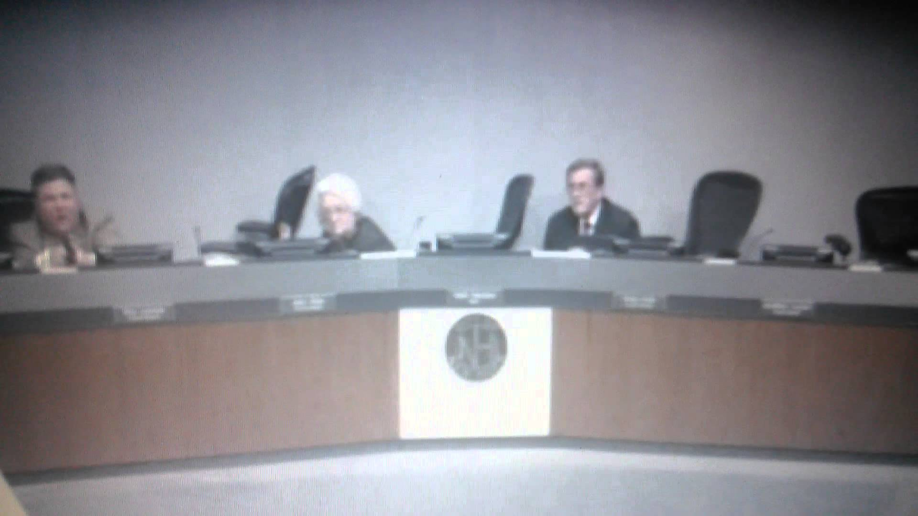
Notes:
New Hope, MN city council meeting
Jan. 26, 2015
2 LEOs wounded, gunman killed
Swearing-in ceremony had just occurred.

Slide 7
“It won’t happen here.”
Jackson Co. Courthouse, Supervisors Meeting, Sept. 9, 2014
Mount Pleasant City Council Meeting, Dec. 10, 1986
Marshall County Jail, lobby, Sept. 9, 1978
University of Iowa, November 1, 1991
Notes:
Jackson Co: shooter (property tax dispute) was only one killed when a Supervisor tackled him
Mount Pleasant: sewer dispute, mayor killed, two council members wounded
Marshall County: shooter guns down jailer in lobby
Univ. of Iowa: dispute over dissertation, killed 5, wounded 1 before suicide

Slide 8
“There are three kinds of lies; Lies, Damned Lies, and Statistics.” -attributed to Mark Twain
Reddit: over 374 mass shootings in 2015
FBI: 2013 study of active shooters, 160 active shooters 2000-2013
USA Today: 29 active shooters in 2015 as of 12/3/15
Notes:
2013 FBI study of Active Shooters
Only track shootings, not other types of attacks (vehicle, explosive, edged weapons, etc)
Cases like the D.C. Beltway Sniper attacks would be left out. Series of attacks over weeks.
Dependable research needed to base policy, training, and funding off of.

Slide 9
Conflicting Definitions
Active shooter incident
Mass shooting
Active killer incident
Rampage attack
Spree killer
Domestic Terrorism???
Notes:
Only track shootings, not other types of attacks (vehicle, explosive, edged weapons, etc)
Cases like the D.C. Beltway Sniper attacks would be left out. Series of attacks over weeks.
Current definitions used vary wildly.
Should define by motivations upon investigation, not weapon or number of casualties

Slide 10
MYTH
REALITY
Good guy = Invincible
Good guy = Expert marksman
Murderer = Expert marksman
Single bullet = Wave of destruction
Shot = Dead
Compliance = Survival
Anyone can be talked down
No lawsuits if handled correctly
Good people get hurt and/or die
We usually miss
Fetal position = Easy target
Bullets miss
Shot = Shot
Bad guy’s choice if you die
Rare in these incidents
We’re all getting sued by someone

Slide 11
Time Critical in Attacks When seconds count, help is minutes away.
Notes:
VTI: 7 minutes, 30 killed, 25 wounded
7.9 murder attempts per minute
Not counting shots that don’t hit.
Most over less than 5 min. Many over less than 2 min.

Slide 12
Its not the object, it’s the actor’s intent
Notes:
Too much focus on one weapon type.
Ink pen: manner of holding determines intent (something each of you have on your person now)
Car: vehicle rampage or impaired driving vs. normal driving
Pocket knife: we carried pocket knives at school (farms, Scouts, etc.) no problems
Firearm: a concealed or open carry pistol is vastly different than a someone brandishing a weapon

Slide 13
ATTACK PREVENTION
Notes:
Naïve people think we can PREVENT attacks.
Rarely possible if attacker is determined.
Gun free zones
Zero tolerance rules
Metal detectors
Security guards
Video cameras

Slide 14
Notes:
Can argue whether NOT having them prevents but having them clearly enables them. No one fighting back. Focuses on one WEAPON and ignores INTENT.
Courtroom judges who don’t allow LEOs to carry and hide behind law books under their bench

Slide 15
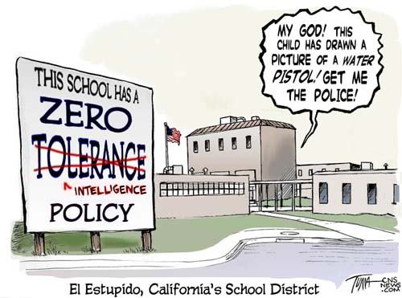
Notes:
Local org we did training for…during scenario safety check, they stated employees shouldn’t have any weapons. We were off site.
Its not the object…it’s the intent

Slide 16
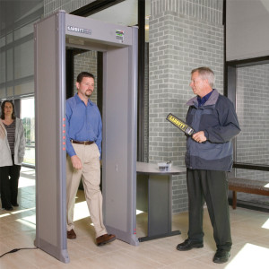
Notes:
Metal detectors: ignore improvised weapons, easily bypassed
Security guards: if not armed, they are just more targets

Slide 17
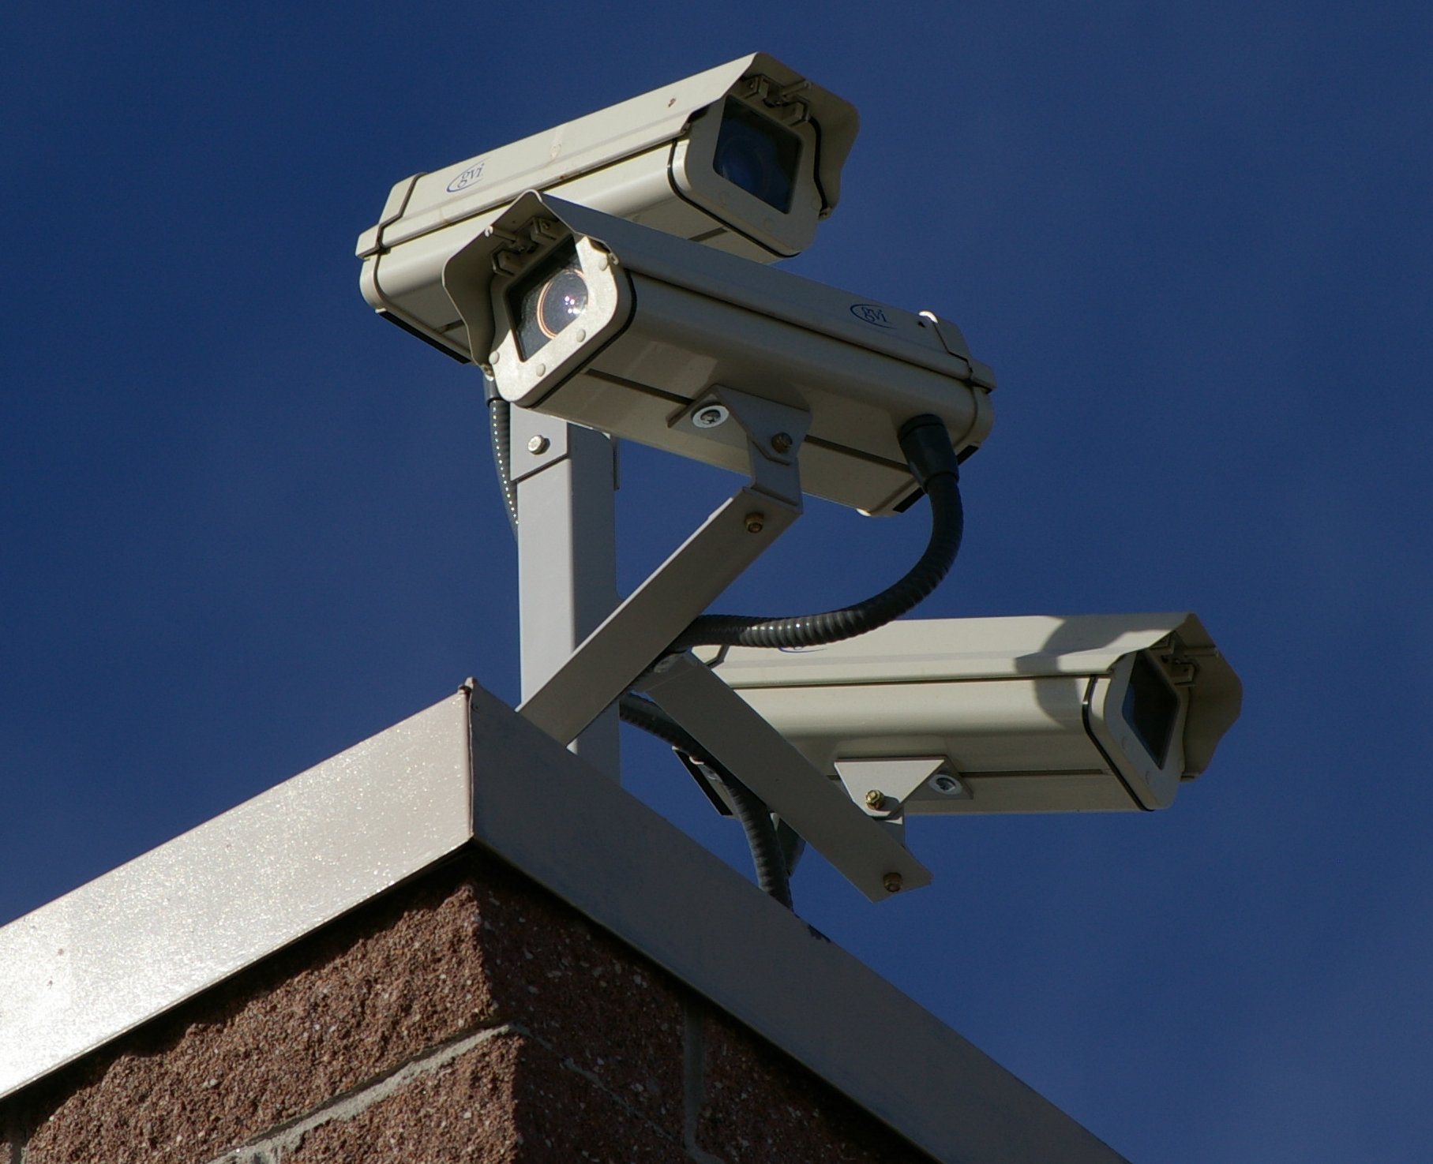
Notes:
If not monitored, only recording the crime.

Slide 18
Notes:
12/14/2010
Panama City (FL) School Board
None killed or wounded besides gunman (wounded then suicide)
Ginger Littleton later sold purse for charity, $13,000

Slide 19
ATTACK PREVENTION?
ATTACK MITIGATION
Notes:
Not preventing much.
Can’t eliminate risk.
Can only minimize it through proper mitigation.

Slide 20
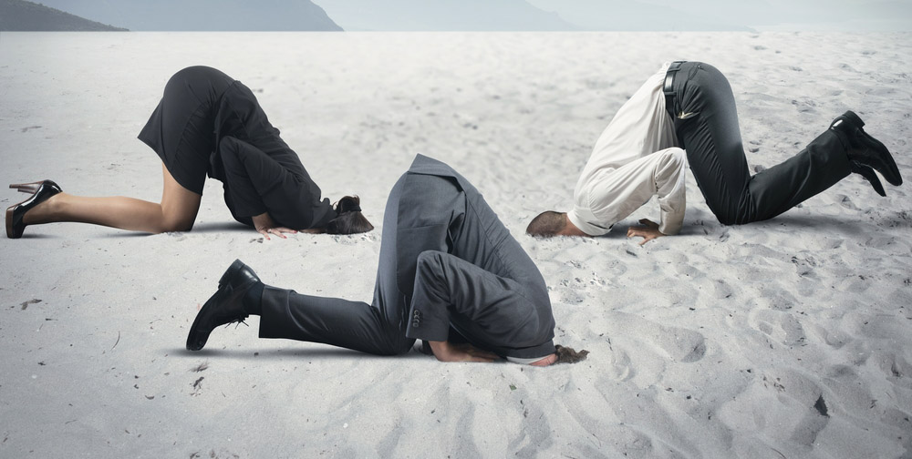
Notes:
Head out of the sand
Admit bad things happen “here”
Denial will not save anyone

Slide 21
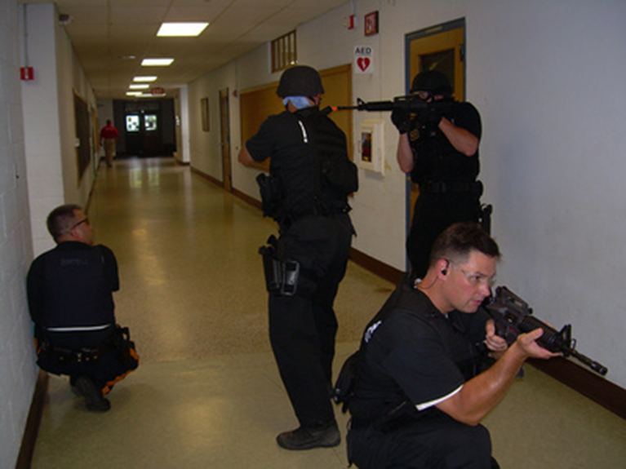
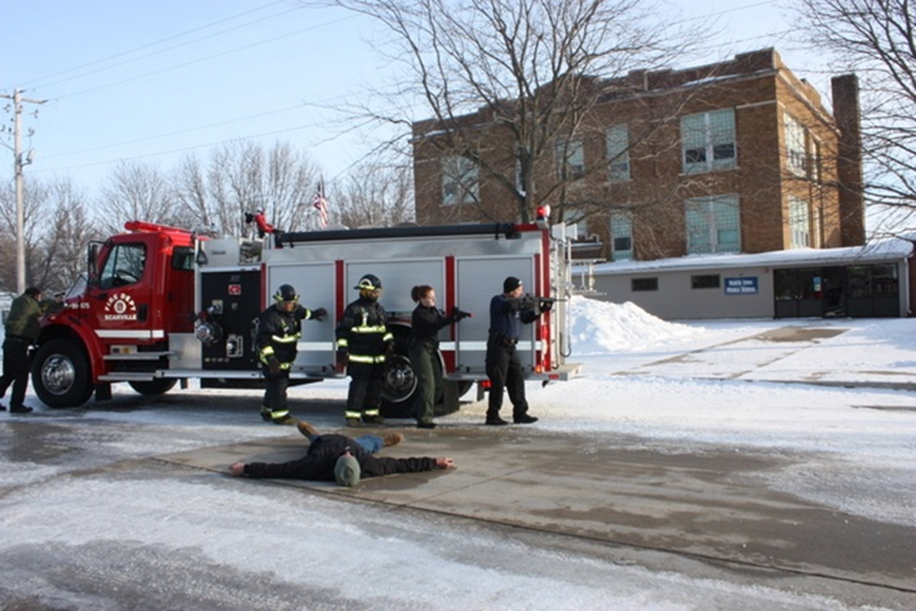
Public Safety Training
Notes:
PD, FD, EMS training for mass shootings, terrorism, etc.
Still have agencies/officers stuck in denial

Slide 22
Public Response Training Examples
Run, Hide, Fight
ALICE
Alert, Lockdown, Inform, Counter, Evacuate
Outs
Get Out, Lock Out, Take Out
Notes:
Why training before hard security measures? No matter what security measures you put in place you will still need these things.
This is where lives are actually saved.
Empower people to take action / save lives
Debate over instruction to students

Slide 23
Where will you run? Where/How will you hide? When are you willing to fight? Who will take action?

Slide 24
T.H.R.E.A.T.
Threat suppression
Hemorrhage control
Rapid Extrication to safety
Assessment by medical providers
Transport to definitive care
Notes:
Hartford Consensus

Slide 25
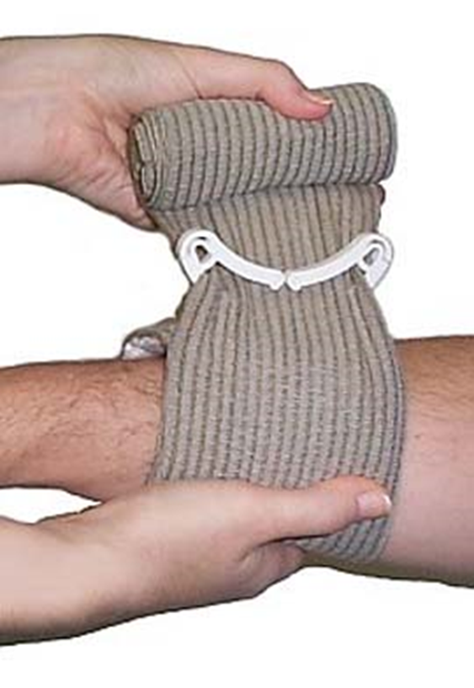
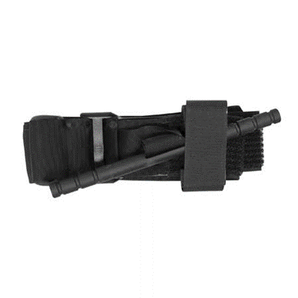
Hemorrhage Control
Notes:
Are you prepared to stop bleeding?
Basic first aid class won’t help much

Slide 26
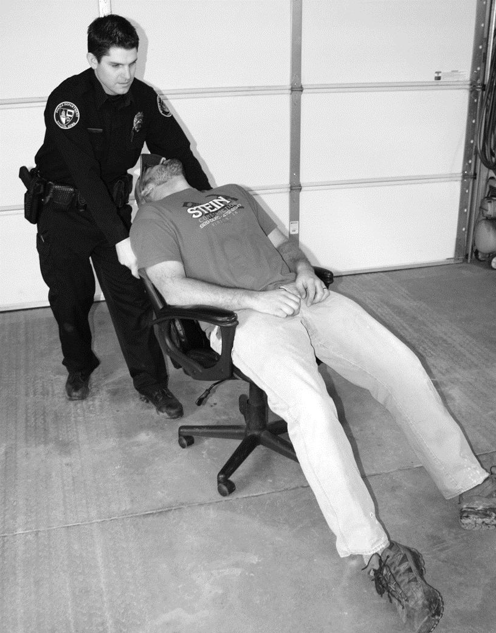
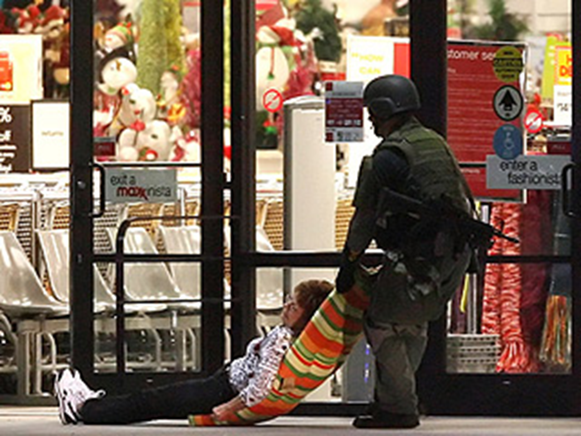
Rapid Extrication to Safety
Notes:
What do you have in the environment to move victims?

Slide 27
Notes:
How will your local govt. function?
Agency?
Who makes decisions if primary people are gone or dead?

Slide 28
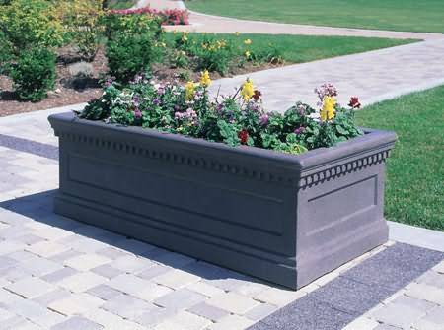
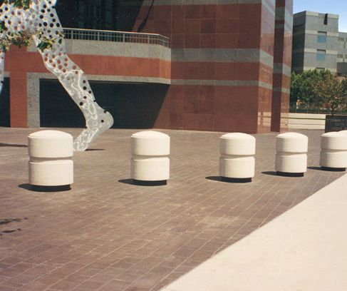
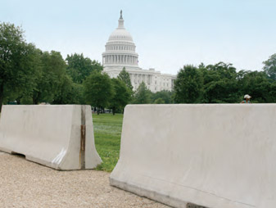
Facilities
Notes:
Security features are fine (video cameras, security guards, metal detectors)
Walls, barriers, planters (vehicle / IED protection)
Bullet resistant glass/doors

Slide 29
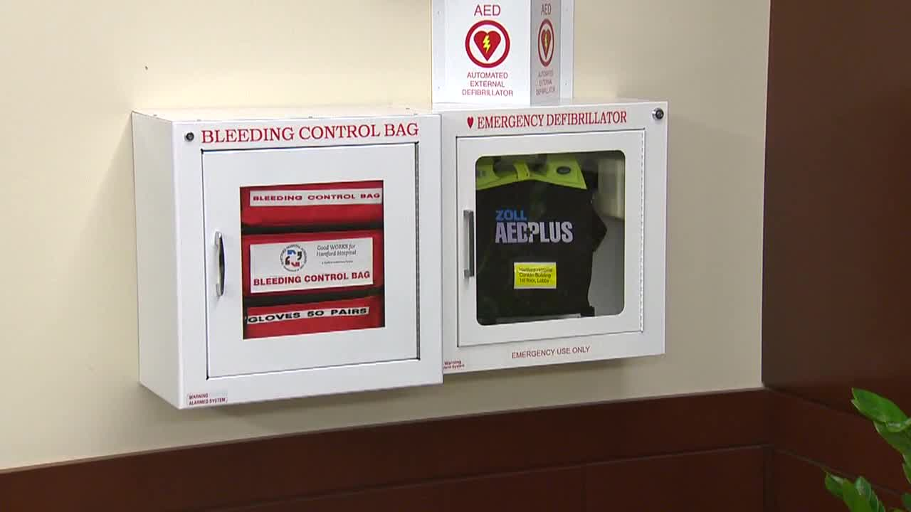
Notes:
Pre-positioned supplies (bleeding control, triage, patient movement)

Slide 30
“All that is necessary for the triumph of evil is that good men do nothing.” -Edmund Burke

Slide 31
Who is going to save you?
Notes:
Weapons. Controversial but necessary. (carried firearms, OC spray, knives, etc) (improvised weapons)
Return to idea of protecting ourselves AND others instead of waiting for someone to save us.

Slide 32
Contact: Eric Dickinson Dickinson Consulting L.L.C. edickinson49@hotmail.com

